Slide 1
The peer review process
(with particular focus on EPSRC)
Susie Douglas

Slide 2
What is a research proposal?
A document proposing a research project, requesting sponsorship for that research
Research proposals generally address several key points:
What research question(s) will be addressed, and how
How much time and expense will be required for the research
What prior research has been done on the topic
How the results of the research will be evaluated
How the research will benefit the sponsoring organisation and other parties

Slide 3
What makes a good research proposal?
Ideas should be:
Cutting edge science
Creative
Value for money
Adventurous
Have significant impact (that is relevant to the proposal)

Slide 4
Putting your team together
Make sure you have all the expertise needed to deliver the research project
If not, then involve collaborators:
from your own institution
from other UK universities
from overseas
from industry

Slide 5
A selection of funders of UK Mathematics research
Simons Foundation
STFC
MRC
IMA
AXA
Newton Fund
AHRC
EPSRC
EU
LMS
Wellcome Trust
Innovate UK
ESRC
NIH
Marie Skłodowska-Curie
NERC
BBSRC
Research England
Royal Society
James S. McDonnell Foundation
Leverhulme Trust
Royal Commission for the Exhibition on 1851

Slide 6
A selection of funders of UK Mathematics research
Lister Foundation
STFC
MRC
IMA
AXA
Newton Fund
AHRC
EPSRC
EU
LMS
Wellcome Trust
Innovate UK
ESRC
NIH
Marie Skłodowska-Curie
NERC
BBSRC
Research England
Royal Society
James S. McDonnell Foundation
Leverhulme Trust
Royal Commission for the Exhibition on 1851

Slide 7
The Engineering and Physical Sciences Research Council (EPSRC)
Government agency
Funder of training and fundamental research in engineering and physical sciences in the UK
Spend approximately £450 million a year for investment in training and research
Current Maths investment: £160M for 270 grants
£5M for 9 research grants at Bath
And SAMBa! (£8.8M for 2 grants)

Slide 8
EPSRC’s Strategic Plan 2015
Building Leadership
Accelerating Impact
Balancing Capability
Goals:
For UK to be positioned as international research leader, where discovery thrives and support generates highest quality research
For UK’s excellent research base & talented researchers to work with EPSRC to accelerate innovation for benefit of society and economy
http://www.epsrc.ac.uk/newsevents/pubs/strategic-plan-2015/

Slide 9
EPSRC funding
~10,000 students
CDT/DTP/ICASE
Research proposals
£5K travel grants
£10M Programme grants
Feasibility studies
Fellowships
Targeted areas (application, research)

Slide 10
EPSRC Portfolio
Notes:
For further information, refer to the “Our Porfolio” section of the EPSRC website – available from end of July 2011, for each theme and related research area a detailed analysis is given on these webpages.
You can also contact the relevant Theme Leader, Clive Hayter Associate Director Capability or Annette Bramley, Shaping Integrator.
In summary key messages:
EPSRC supports excellent, long term research and high quality postgraduate training in order to contribute to the economic competitiveness of the UK and the quality of life of its people. At any one time we are supporting a portfolio of research and training between £2-3billion.
In order to maintain the UK’s international research standing in the face of increasing competition EPSRC must take a strategic approach to managing our portfolio. For example, to ensure we have sufficient critical mass in the areas we invest.
In future, all our investment decisions will be based on the international excellence of the research and its national importance, while continuing to encourage the free generation of ideas and curiosity-based research.
Shaping Capability means being selective where necessary – making difficult choices.
The hard truth is that we can’t support everything. This has always been true, but in the past 10 years we have had a significant increase in investment in the science budget; this is not likely to continue so we have to be prepared to have to make some choices.
We need to invest so that UK retains key capability and resilience for the future and is internationally competitive in that areas that we do support.

Slide 11
An EPSRC proposal comprises
Application form (money, personnel, contact details)
Summary section
Objectives
Summary
Academic Beneficiaries
Impact
A case for support to include:
Track record of applicants (max 2 sides A4)
Description of proposed research (max 6 sides) including impact summary and national importance
Diagrammatic work plan (1 side A4)
Justification of resources (2 sides A4)
Pathways to Impact (2 sides A4)

Slide 12
An ITT proposal comprises
Application form (money, personnel, contact details)
Summary section
Objectives
Summary
Academic Beneficiaries
Impact
A case for support to include:
Track record of applicants (max 2 sides A4)
Description of proposed research (max 7 sides) including impact summary and national importance
Diagrammatic work plan (1 side A4)
Justification of resources (2 sides A4)
Pathways to Impact (2 sides A4)

Slide 13
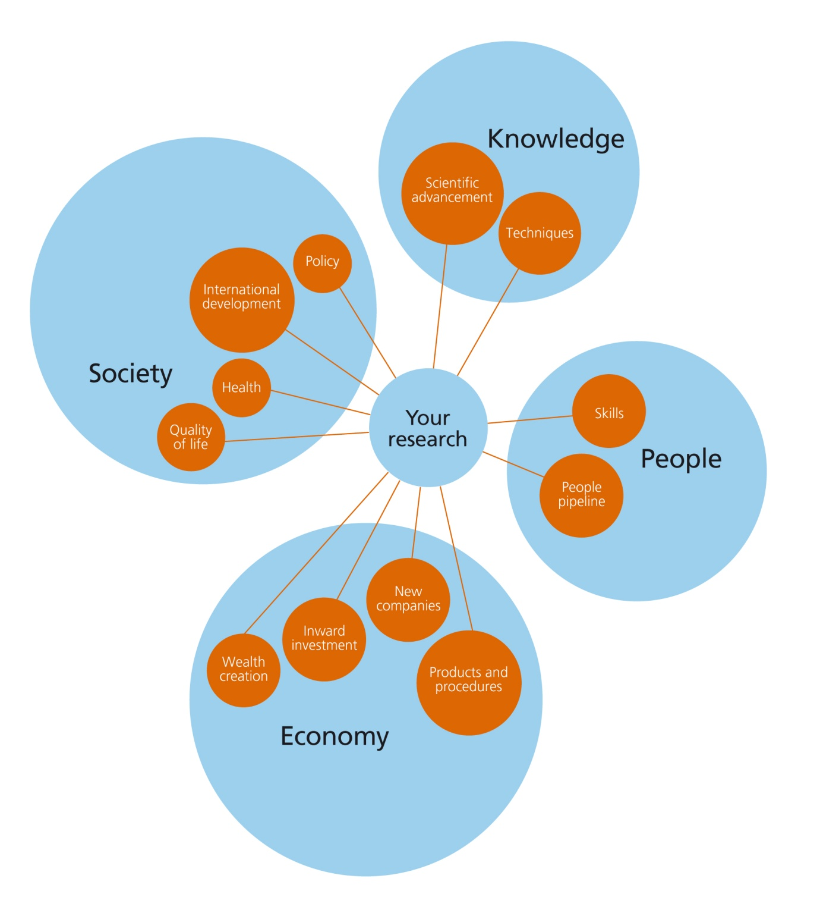
Impact
13
Notes:
13

Slide 14
Impact
Academic impact
The demonstrable contribution that excellent research makes to academic advances
Across and within disciplines
Including significant advances in understanding, methods, theory and application
Economic and societal impacts
The demonstrable contribution that excellent research makes to society and the economy.
Embrace all the extremely diverse ways in which research-related knowledge and skills benefit individuals, organisations and nations by
fostering global economic performance, and specifically the economic competitiveness of the United Kingdom,
increasing the effectiveness of public services and policy,
enhancing quality of life, health and creative output.
Engaging the public with research can improve the quality of research and its impact, raise your profile, and develop your skills. It also enables members of the public to act as informed citizens and can inspire the next generation of researchers.

Slide 15
The peer review process

Slide 16
Peer review principles
Transparency | Assessment criteria and details of the peer review process are published before applicants submit proposals.
Appropriateness | A peer review process appropriate to the proposed research, and in proportion with the investment and complexity of the work is used.
Managing interests | All participants are asked to declare interests when carrying out peer review activities so conflicts can be identified and managed.
Confidentiality | Proposals are treated in confidence, and we ask those who advise us to do the same.
Expert assessment | Expert peer reviewers, mainly from EPSRC’s College, assess the individual merit of all proposals against published criteria.
Prioritisation | Proposals that receive positive reviews are ranked for funding by assessing their merit against others.
Right to reply | Principal Investigators have the right to reply to reviewers’ comments before proposals are prioritised.
Separation of duties | Peer review of a proposal is separated from its funding decision: EPSRC staff make funding decisions based on peer review advice, but those acting as peers will not also be responsible for authorising its funding decision.
No parallel assessment | Multiple parallel assessments of a proposal’s relative merit are avoided.

Slide 17
The EPSRC standard Peer Review Process
Proposal
Portfolio Manager
Reviewers
Unsupportive
Supportive
PI-Response
Unfunded
Peer Review Panel
Rank Order
EPSRC College
Theme Lead
Budget
Unfunded
Funded

Slide 18
Peer Review Criteria
Excellence: Novelty, timeliness, context, ambition, adventure, methodology
Importance: The importance of the proposed research project to the UK in relation to other research in that area
Impact: Relevance and appropriateness of beneficiaries, collaborators, dissemination, knowledge exchange
Applicant: Skills, track record, research partners, ability to deliver
Resources & Management: Effectiveness of planning and management, appropriateness of resources and their justification
Overall assessment: Conclusion

Slide 19
Role of the Panel
Their primary role is:
To generate a rank ordered list of research proposals in priority order for funding
Based on:
The assessment of the reviewers
The applicant’s response to reviewers
Technical assessments from facilities (if relevant)

Slide 20
Advice

Slide 21
Consider your audience
Assume you are writing for an informed layperson
Set the context of the proposal
Avoid jargon
Assume nothing is self-evident, be explicit about:
Where the novelty and excitement lies
How you will undertake the research
Risks and how you will manage them
Who will contribute to the research
The resources needed for this

Slide 22
Get feedback
Ask for comments on your proposal from:
Collaborators
Experts in the field
Someone outside of the research area
People who are successful at gaining funding
People you trust
And always read the call documents and guidance

Slide 23
Any questions?

