Slide 1

Motivation and learning
Purposes
To appreciate a range of factors which may influence the effectiveness of learning
To relate these factors to learning theories examined

Slide 2

Think about a class that you teach
A learner’s motivation is high when …
A learner’s motivation is low when …

Slide 3
Motivated students
Develop positive attitudes towards learning
Develop their own learning strategies, self-regulation and capacity to persevere
Have ambitions and aspirations
Engage and participate in the classroom, and in lifelong learning
NfER/ QCA Literature review of Learner Motivation 3-19

Slide 4
Key areas that affect learner motivation
Teaching methods
student involvement and say in what they learn also..
practical and learner-centred teaching and learning such as using ICT, hands-on learning, investigative approaches and using learning journals
learning that is individually tailored, differentiated and supportive
The role of the teacher
teachers are not aware of the influence they can have on learner motivation. Continuity of teaching, teacher enjoyment, teacher role in mediating challenge and teachers’ awareness of their pupils’ motivation, all have an effect.
Curriculum and assessment
Relevance to real life
‘assessment for learning’,
the enriched curriculum, thinking skills, creative development and the arts.

Slide 5
Key areas that affect learner motivation
Characteristics of the learner
gender, academic self-belief, self-esteem, preferred learning styles, and goals and ambitions.
Boys in particular were shown to need pastoral support and help in areas such as planning, study management and perseverance.
Classroom climate
Classrooms that feel safe, non-controlling and that support learners’ autonomy, wellbeing and self-esteem
Site of learning
Out-of-hours study in sports centres or study centres, community-based programmes, and flexibility in the site of learning, particularly for older students, were all found to be beneficial.
NFER/QCA (2005) Learner Motivation 3-19: an International Perspective, NFER/QCA
www.ibe.unesco.org/publications/.../prac10e.pdf

Slide 6
Motivational orientations towards achievement
Learning orientation – a belief that effort leads to success
Performance orientation – a belief that ability leads to success
Carol Dweck

Slide 7
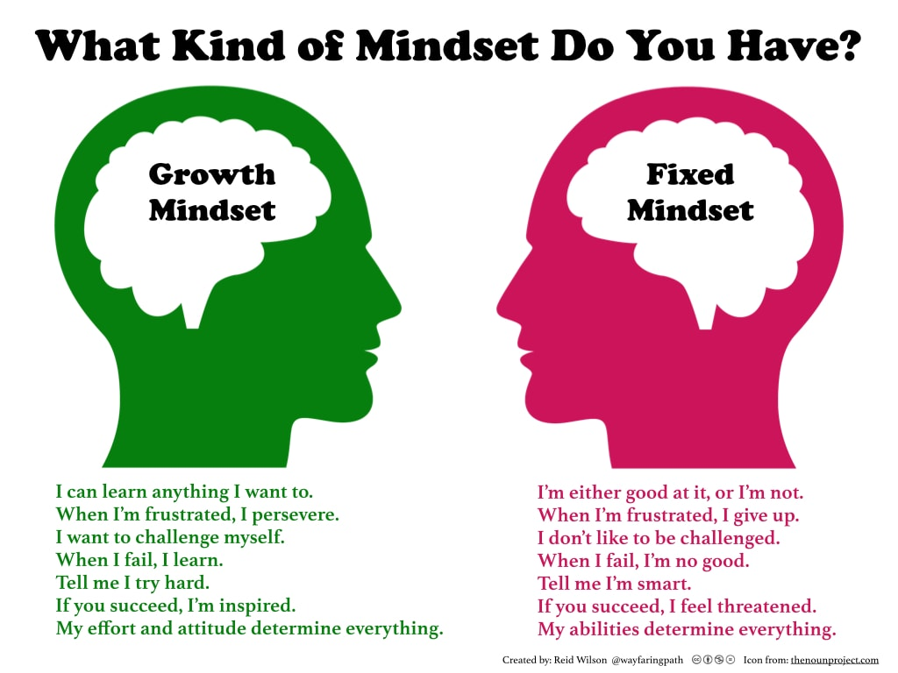

Slide 8

Two Ways of Thinking about Motivation
Internal/intrinsic
(“I am motivated to …”)
External/extrinsic
(“I motivate you to …”)

Slide 10

A Behaviourist Perspective
Motivation is a result of positive reinforcement (Skinner)
A student who receives verbal praise and good grades for correct answers is more likely to learn those answers effectively than one who receives little or no positive feedback for the same answers.
Human learners tend to avoid responses that are associated with negative reinforcements such as poor grades or negative feedback.

Slide 11
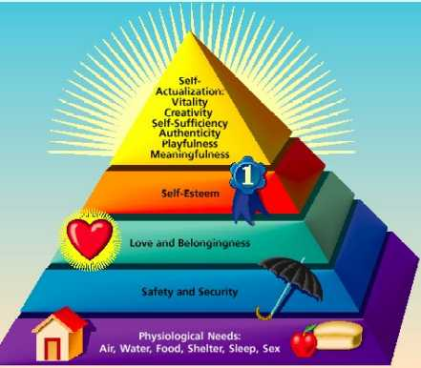
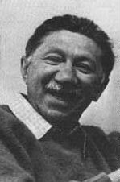
A Humanistic Perspective
Maslow’s Hierarchy
The essence of the hierarchy is the notion of pre-potency, which
means that you are not going to be motivated by any higher-level
needs until your lower-level ones have been satisfied.

Slide 12
Readiness to Learn? (‘Dubin’s Dichotomy’)
The relationship between consciousness and competence
Four possible states
Any examples?
What is the desirable starting point?
What is the desirable end point?
Robert Dubin

Slide 13
Unconscious Incompetence
Conscious Incompetence
Unconscious Competence
Conscious Competence

Slide 14
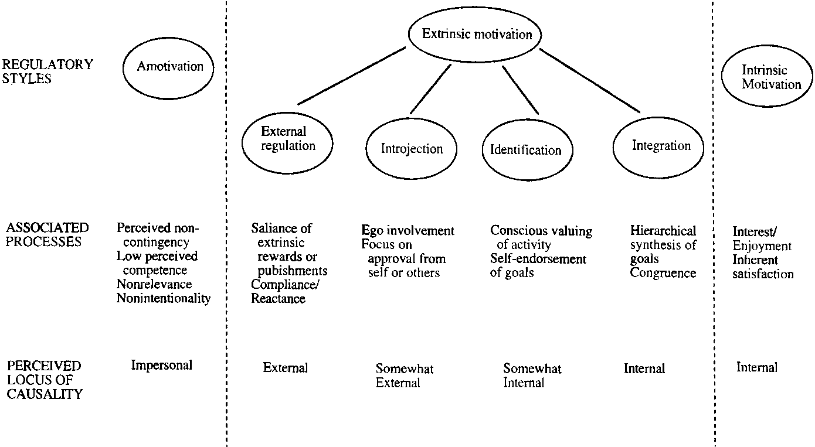
Self-Determination Theory
Ryan & Deci, 2000

