Slide 1
Learning about learning
To present the case for explicitly encouraging learners to think about the process of learning.
To discuss some examples of how learners can be taught thinking skills and think about their learning.
To look critically at how current ideas about learning are shifting from what is learned to how it is learned.

Slide 2
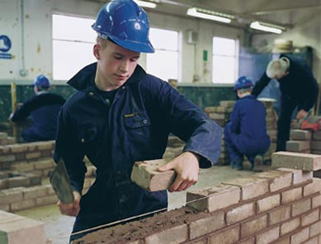
Emily and Todd
‘I guess I could call myself smart. I can usually get good grades. Sometimes I worry, though, that I’m just a tape recorder…I worry that once I’m out of school and people don’t keep handing me information with questions, I’ll be lost.’ Emily, aged 15, GCSE student
‘The thing that I’m scared of is, say I got laid off (lost my job), I’ve got nothing, nothing to help me get another job…I’ve got no other skill.’ Todd, aged 18, bricklayer
What is different about Emily and Todd?
What is similar about Emily and Todd in terms of their learning
Source, Claxton, QCA Futures website

Slide 3
“Emily and Todd are both, in their different
ways, illearnerate. They do not think of
themselves as effective real-life learners. They
think that school has not only failed to give them
what they need, it has actually compounded the
problem. …More fundamental even than the
concern with literacy and numeracy is the need to
protect and develop young people’s learnacy.”

Slide 4
Claxton’s Three Is and Three Rs
Three ‘Is’ (conceptions of intelligence):
Intelligence is … knowing (that) …
Intelligence is … knowing how/what to do when …
Intelligence is … knowing what to do when you don’t know what to do
Three ‘Rs’:
Resourcefulness
Resilience
Reflection

Slide 5
Teaching Thinking - examples
Feuerstein’s Instrumental Enrichment
Robert Fisher
Cognitive Acceleration (Video)
Thinking Hats

Slide 6
The Five Pillars of CASE

Slide 7
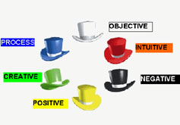
De Bono’s ‘Thinking Hats’
White hat = information What do we know?
Red hat = feelings What do we feel?
Purple hat = problems What are the drawbacks?
Yellow hat = positives What are the benefits?
Green hat = creativity What ideas have we got?
Blue hat = control What are our aims?

Slide 8
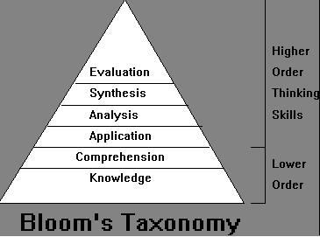
Key thinking skills
Many researchers have attempted to identify the key skills in human thinking, and the most famous of these is Bloom’s Taxonomy
… but don’t forget the other two domains – affective and psychomotor

Slide 9
Teaching thinking about thinking ‘Metacognition’
Tackling a task or problem intelligently
Being in charge of your behaviour
Managing your thinking

Slide 10
Is it possible to think about how you think?
Is ‘thinking’ always amenable to this sort of conscious analysis?
Should it be done in isolation or in the context of real learning?

Slide 11
Metacognitive strategies
Identifying "what you know" and "what you don't know."
Talking about thinking.
Keeping a thinking journal.
Planning and self-regulation.
Debriefing the thinking process.
Self-Evaluation.

