Slide 1
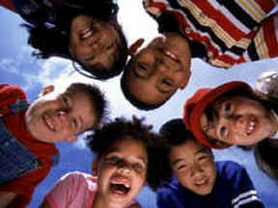
Learning, Memory and Intelligence
Purposes
To examine the concept of intelligence
To explore ideas about ‘multiple intelligences’
To introduce the IP model of memory
To identify the relationship between concepts of intelligence, models of memory and ideas about learning

Slide 2
Understandings of intelligence
What do you understand by intelligence?
What is the difference between being intelligent and intelligence?
What is being valued in our conception of intelligence?
What are the consequences of this?
Do different cultures value different things?

Slide 3
The concept of ‘g’
What’s being measured?
Verbal reasoning
Numerical reasoning
Visual thinking
Logical problem solving
Some issues
Value judgements about what is measured
It suggests that intelligence is fixed at birth

Slide 4
The concept of ‘g’
What’s in, what’s out?
Is it fixed, does it change with age?
How about gender, race, culture?
What about the role of environment?

Slide 5

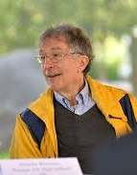
Howard Gardner extended ideas about intelligence after working with and observing brain damaged patients. He proposed that many different ‘kind of minds’ had evolved within the human brain – each of which had a separate intelligence
One intelligence or many?
“Gardner shattered the fixed intelligence myth”
Dryden and Vos, 2005

Slide 6
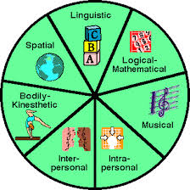

Slide 7
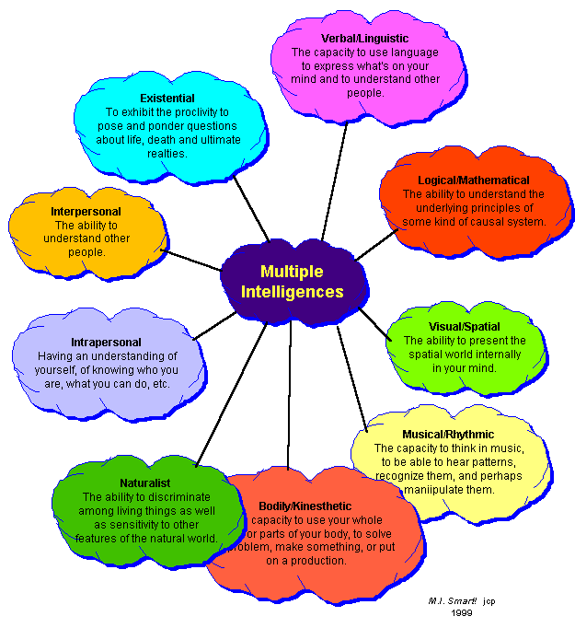

Slide 8
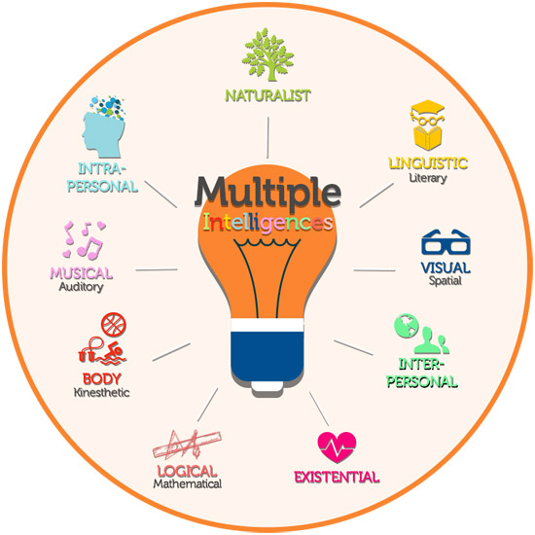

Slide 9
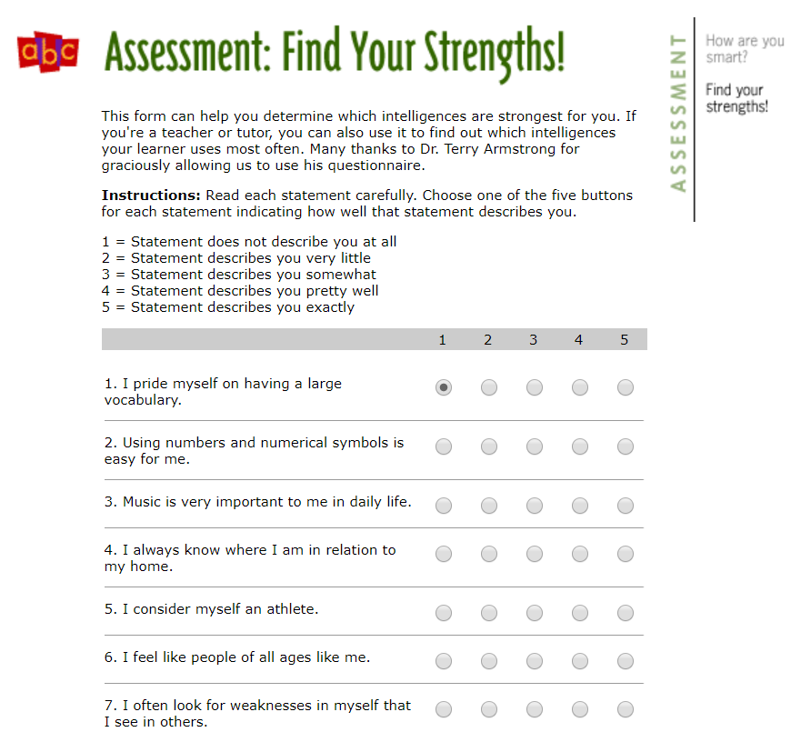
Multiple intelligence test!

Slide 10
MIT – the critics
“Because MI theory, the ME theory, and EI theory are not supported by sound or consistent validating empirical evidence, and because these theories do not respect the constraints provided by cumulative empirical evidence from cognitive neuroscience research, these theories should not be taught without providing the context of their existing empirical support.”
[Link]
Waterhouse, L. 2006. Multiple intelligences, the Mozart effect, and emotional intelligence: A critical review. Educational Psychologist 41 (4): 207–225.

Slide 11
MIT – the critics
“Enthusiasm for their application to classroom practice should be tempered by an awareness that their lack of sound empirical support makes it likely that their application will have little real power to enhance student learning beyond that stimulated by the initial excitement of something new.”
Waterhouse, L. 2006. Multiple intelligences, the Mozart effect, and emotional intelligence: A critical review. Educational Psychologist 41 (4): 207–225.

Slide 12

Memories are made of this
How do you remember things?
What’s the link between learning and memory?
Is the issue remembering or retrieving?
How do you conceptualise/model memory?

Slide 13
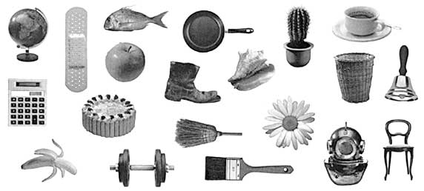
How many can you remember?

Slide 15
Mr. Apple wanted to gather a basket of bananas so he could make a banana cake. He stood on a chair and used a broom to knock bananas out of a tree. The chair tipped and he fell right into a cactus. Ouch! He got out the Band-Aids and . . .

Slide 16
What’s going on?
You probably remembered more things when you told a
story about them. When you tell yourself a story, you are
doing a couple of things:
First, you are connecting the different pictures so that when you remember one, you remember the others, too.
Second, you are making a mental picture that includes all these different things. Making a mental picture helps you remember something later. You may have discovered that making up a story didn't help you remember all the objects—but you may find that it helps you remember some of the objects for a lot longer. When you make a mental picture, you use your long-term memory, and that picture may stick with you.
From the Exploratorium’s Brain Explorer
http://www.exploratorium.edu/brain_explorer/memory.html

Slide 17
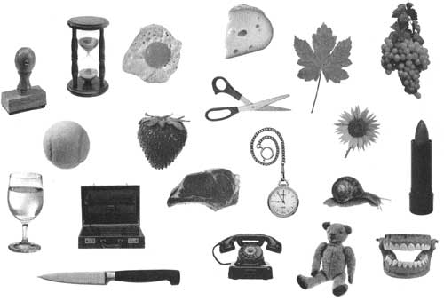

Slide 18
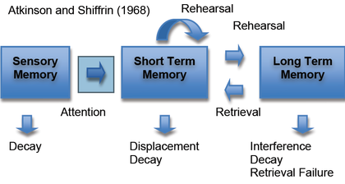
The Information Processing (IP) model of memory

Slide 19
A tempting analogy …
… computer technology
Sensory register
(Human Interface Devices – HIDs)
Working memory/short-term memory (STM)
(Random Access Memory – RAM)
Long-term memory (LTM)
(Hard drives, CD-ROMs)

Slide 20
But … does … ?
=

