Slide 1
How do we learn?
Understanding Learning and Learners

Slide 2
Purposes
To explore some definitions of learning
To consider the wide variety of ways in which we learn
To elicit your understandings of the process of learning.
To appreciate the importance of implicit theories of learning.
To consider some of the factors influencing learning

Slide 3
What is learning?
Take a moment to think about your own view and definition of learning
Learning is…

Slide 4
What is learning?
Here are some statements about learning
What view of learning do they give?
How far do you agree/ disagree with these statements?
In pairs discuss your reactions to each statement?

Slide 5
Process or product?
Learning as a quantitative increase in knowledge.
Learning is acquiring information or ‘knowing a lot’.
Learning as memorising. Learning is storing information that can be reproduced.
Learning as acquiring facts, skills, and methods that can be retained and used as necessary.
Learning as making sense or abstracting meaning.
Learning involves relating parts of the subject matter to each other and to the real world.
Learning as interpreting and understanding reality in a different way.
Learning involves comprehending the world by reinterpreting knowledge.
Saljo, R. (1979) Learning about learning. Higher Education, 8: 443-451

Slide 6
How do you learn?
What is being learned in the photo?
Did you learn to do this? When? How?
Sort the photographs according to how you learned (or attempted to learn) this.

Slide 7
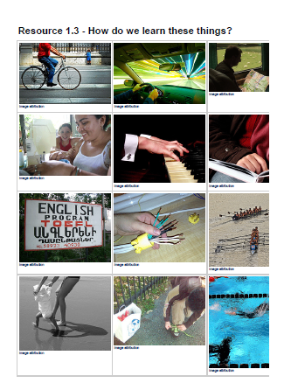
How do you learn?

Slide 8
Two broad categories
Formalized learning (Learning-conscious)
Learning is facilitated in some way
'educative learning'
people are aware that the task entails learning
guided episodes of learning
Acquisition learning (Task-conscious)
Happens in daily life, ‘experience’ e.g. parenting
concrete, immediate and confined to a specific activity
it is not concerned with general principles
the learner may not be conscious of learning but is usually aware of the specific task in hand
Rogers (2003)

Slide 9
Our learning ….. ?
There are a whole range of ways in which we learn
We learn different things in different ways
We can learn the same things in different ways from others
We can change the ways we learn over time
Learning does not always take place formally
We don’t always know how we’ve learned something
We can (sometimes) transfer learning from one context to another

Slide 10
(Some) ways of learning
‘Trial and error’
Rote learning
Copying
Patterning
Reflection
Immersion
Insight/revelatory
Un/sub-conscious
Play

Slide 11
Reflecting on learning
Think about a specific occasion (not necessarily in a formal setting) when you felt your learning was particularly effective and/or enjoyable.
What made it effective/enjoyable?

Slide 12
Reflecting on learning
Now think of the opposite – a situation where your learning was not effective/enjoyable.
What were the reasons?

Slide 13
Reflecting on learning
Can you draw up a list of common characteristics of ‘good’ and ‘bad’ learning experiences?

Slide 14

Metaphors for learning
A metaphor a figure of speech where one thing is
compared to another without using the word ‘like’.
These are all simple metaphors:
  He's a wizard with the ball
  They were swamped with orders
  The sun is a big yellow duster
  polishing the blue, blue sky
Sometimes the comparison is direct
and obvious but sometimes it isn’t
http://www.buzzin.net/english/metaphor.htm

Slide 15
Metaphors for learning
You have been given a series of images. They have been developed from teachers talking about their views about teaching.
Can you identify the metaphors being used?
Choose one which you feel comes closest to the way you teach.
Choose one which you feel comes closest to the way you prefer to learn.
Can you suggest any other metaphors for learning?

Slide 16
1: The Filling Station

Slide 17
2: The Pond

Slide 18
3: The Mountain Guide

Slide 19
4: The Potter

Slide 20
5: The Gardener

Slide 21
6: The Building Site

Slide 22
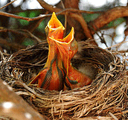
7: The Baby Bird
image source

Slide 23

8: The Lion Tamer

Slide 24
Implicit theories of learning
Transfer theory - convey, transmit, put over, tell ...
Shaping theory - develop, mould, produce, prepare ...
Travelling theory - lead, guide, direct ...
Growing theory - cultivate, encourage, enable, bring out ...

Slide 25
To summarise …
We all use a range of ways of learning
… but we may have preferences
Learning is a very individual process
… but some categorisation may be possible
Learning can be context-dependent
…and therefore, unpredictable
We may be able to explain how we learn some things
… but we may not be able to explain others
The implicit theories we hold will influence our own learning
… and may influence the way we teach

