Slide 1
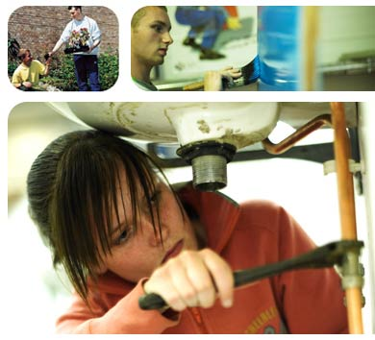
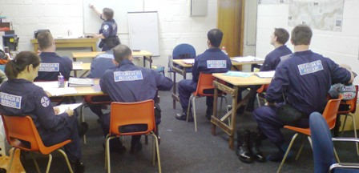
Experiential, Social & Adult Learning

Slide 2
Aims
To explore the importance of experiential learning models
To consider characteristics of learning in adults and in particular the concept of andragogy
To recognise the importance of social learning theories

Slide 3
Experiential Learning
“Experience is, for me, the highest authority. The touchstone of validity is my own experience. No other person's ideas, and none of my own ideas, are as authoritative as my experience. It is to experience that I must return again and again, to discover a closer approximation to truth as it is in the process of becoming in me. Neither the Bible nor the prophets - neither Freud nor research --neither the revelations of God nor man - can take precedence over my own direct experience. My experience is not authoritative because it is infallible. It is the basis of authority because it can always be checked in new primary ways. In this way its frequent error or fallibility is always open to correction.”
Carl Rogers (from ‘On Becoming a Person', 1961)

Slide 4
Experiential learning
Learning through experience …
…an active approach
Learning from experience …
…a reflective approach

Slide 5
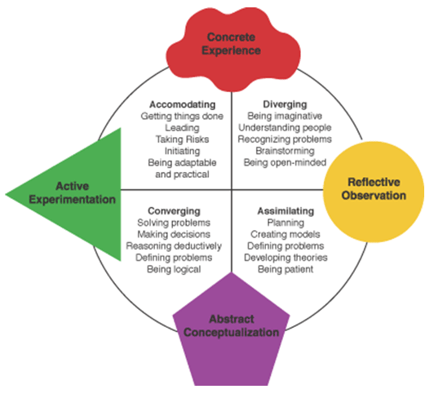
Experiential Learning

Slide 6
Experiential learning
Can you think of an example?
Talk through the four stages?
Is this a ‘good’ representation of real life situations?
Does the cycle always start at the top?
Does it always proceed sequentially as suggested?
Link

Slide 7
Adult learning
Formal/informal learning
Experiential learning
Work-based learning

Slide 8
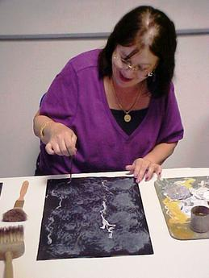
Discussion tasks
Are there differences between adult learners and child learners?
If so, what are they?
What are adults’ strengths and weaknesses as learners?
and so…
What are the implications for teaching adults – how can the teacher enhance adult learning?

Slide 9
Contrast adult learning with what children typically experience in primary and secondary education:
An authoritative atmosphere with subject-oriented instruction.
A teaching hierarchy who decide what subjects you learn, what the approach will be, when the instruction will take place and how you are to learn.
Little practical, how-to-use-this-in-your-life today instruction, unless you are in music, sports, or the arts.
A teaching model resembling a funnel with the teacher at the big end pouring in knowledge and the students at the little end filling their empty brains.
Malcolm Knowles, 1980

Slide 10
Adults are not a homogenous group, but when it comes to learning generally they:
Are much more self-directed than children.
Take responsibility for their learning experiences.
Seek learning experiences that are learner-oriented.
Have a large reservoir of life experiences to bring to and support new learning.
Flourish when their abilities and life achievements acknowledged and respected.
Prefer a practical and immediately relevant approach.

Slide 11
Learn readily from their peers.
Have formed a dominant learning style and know what it is.
Want immediate and regular feedback.
Are ready to learn when an event in their personal/professional life sparks "the need to know."
May be "education wounded" from earlier pedagogical experiences and require "unlearning" to become an effective adult learner.
Malcolm Knowles, 1980

Slide 12
Pedagogy
A term derived from the Greek stem paed (meaning child) and agogos (meaning leading)
Thus, an educational approach characterized by teacher-centredness. The teacher is viewed as an authority figure and students are not generally involved in decisions/actions in regard to learning

Slide 13
Andragogy
andr- ‘man’
agogos – ‘leading’
“… the art and science of helping adults learn”
Based on five assumptions about adult learning

Slide 14
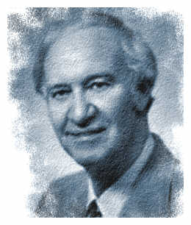
Five assumptions of andragogy
Self-concept – from dependence to self-direction
Experience – resource for learning
Readiness to learn – orientation towards fulfilment of social role
Orientation to learning – postponement of application to immediacy (subject-centredness to problem centredness)
Motivation to learn – extrinsic to intrinsic
Malcolm Knowles, 1980

Slide 15
Questioning the assumptions
How valid are these assumptions?
Is there really something different about these things for adults than children?
Is there therefore a clear distinction between andragogy and pedagogy?

Slide 16
A comparison of the assumptions of pedagogy and andragogy following Knowles (Jarvis 1985: 51)
 | Pedagogy | Andragogy
The learner | Dependent. Teacher directs what, when, how a subject is learned and tests that it has been learned | Moves towards independence. Self-directing. Teacher encourages and nurtures this movement
The learner's experience | Of little worth. Hence teaching methods are didactic | A rich resource for learning. Hence teaching methods include discussion, problem-solving etc.
Readiness to learn | People learn what society expects them to. So that the curriculum is standardized. | People learn what they need to know, so that learning programmes organised around life application.
Orientation to learning | Acquisition of subject matter. Curriculum organized by subjects. | Learning experiences should be based around experiences, since people are performance centred in their learning

Slide 17
Criticisms 1
Conception of andragogy is an attempt to build a comprehensive theory (or model) of adult learning that is anchored in the characteristics
of adult learners.
Such approaches may be contrasted with those that
focus on:
an adult's life situation (e.g. Jarvis)
changes in consciousness (e.g. Freire)

Slide 18
Criticisms 2
Knowles uses ideas from psychologists working in two quite different and opposing therapeutic traditions:
humanist – teacher as facilitator
behavioural - objectives/ learning contracts etc
Is this a theory/set of assumptions about learning, or a theory/model of teaching?
The assumptions 'can be read as descriptions of the adult learner... or as prescriptive statements about what the adult learner should be like'

Slide 19
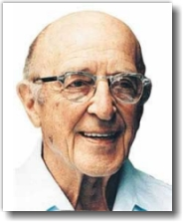
Social Learning
“I know I cannot teach anyone anything, I can only provide an environment in which he/she can learn.”
Carl Rogers, 1969

Slide 20
Significant learning
It has a quality of personal involvement
It is self-initiated
It is pervasive
It is evaluated by the learner
Carl Rogers (1969)
Rogers (1957) outlined 3 attitudinal qualities that a teacher, or in his words, a ‘facilitator’, should have to assist the learning process. They are empathy (seeing things from the students' view point), authenticity (being yourself) and acceptance (of students' ideas and opinions).

Slide 21
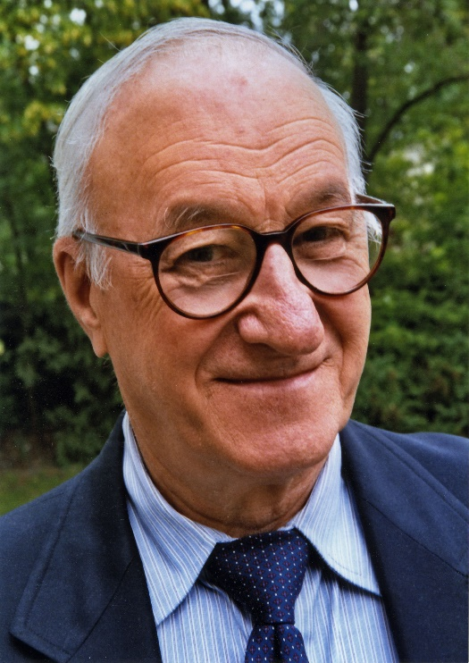
Social Cognitive Theory
Learning through observation of others (e.g. children learning from parents, peers and teachers)
Self-efficacy ("the belief in one’s capabilities to organize and execute the courses of action required to manage prospective situations“)
Not only believing in yourself but taking action in the light of that belief.
The Bobo Doll Experiment
Albert Bandura

Slide 22
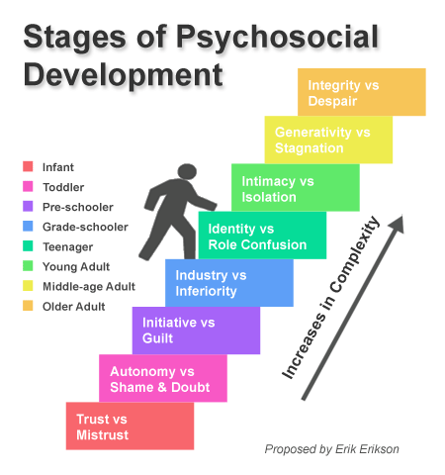
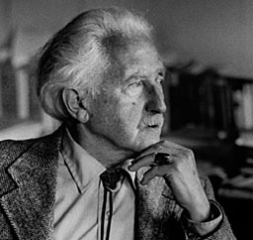
Psycho-Social Theory
Theory of development with implications for learning?
Erik Erikson

Slide 23
Self-Awareness (The Johari Window)
Known to self
Not known to self
Known to others
Public to all
Public to all but me
Open
Blind
Hidden
Unknown
Not known to others
Private to me
Not known to anyone
Link

Slide 24
The Variety of Theories of/about Learning
Dual coding theory
Functional context theory
Minimalism
Repair theory
Subsumption theory
Cognitive dissonance theory

Slide 25
Making Sense of Multiplicity
Society
Individual
Content
Incentive
Interaction
Environment
Holistic model (Illeris)

Slide 26
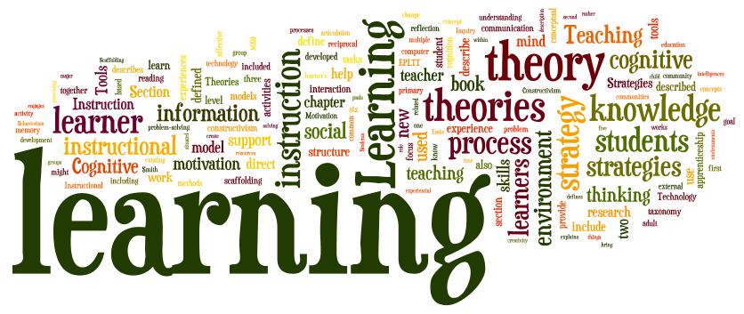
Investigate learning theories for yourself!

