Slide 1
Research Methods in Education Session 4
Questionnaires

Slide 2
Some general features
Often at the heart of survey approaches but can be used in other approaches
Consist of questions (!) distributed to respondents
Questions can be closed or open
Tendency towards ‘what?’ questions rather than ‘why?’
Need to balance breadth with depth

Slide 3
Potential advantages
data collection from large numbers of respondents
provide quantifiable results
standardisation of method employed with all involved (reduced researcher bias)
can be quick for recipients to fill in (paper-based or online)
offer anonymity to respondent
can be analysed quickly/efficiently (if closed items used)
useful for making comparisons
Notes:
2
MEE Session 2 - Louise Poulson, University of Bath

Slide 4
Potential disadvantages
extensive preparation required including piloting
inflexible (cannot respond to unanticipated, interesting responses)
poor response rates
analysis may be time consuming (with open questions)
loss of control for researcher
information gathered is often descriptive rather than explanatory
Notes:
3
MEE Session 2 - Louise Poulson, University of Bath

Slide 5
Questionnaire design
Clear instructions for completion/rubric
Language of questions: simple/clear/targeted/not ‘loaded’
Number of questions related to time to complete
Order of questions
Method of analysis to be used
Layout
Notes:
5
MEE Session 2 - Louise Poulson, University of Bath

Slide 6
Possible choice of question type
Factual (e.g. respondent’s age, length of experience)
Attitudinal (e.g. what do you think about …?)
‘Tick boxes’ vs ‘write in’?
Multiple choice
‘Likert-type’ scale (e.g. strongly agree … strongly disagree)
Semantic differential scales (e.g. easy … difficult)
How many points in the scale? Many? Few? Odd? Even?
Range of question types
Notes:
6
MEE Session 2 - Louise Poulson, University of Bath

Slide 7
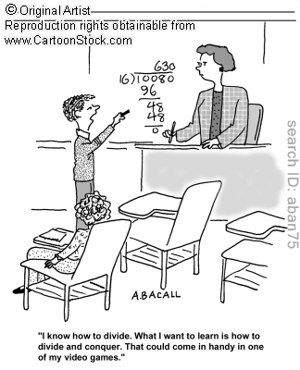
A researcher is trying to establish the effects of playing computer games at home on students’ performance in maths:
Design a simple questionnaire to be given to 10/11 year-olds.
Compare approaches to the collecting data.
Test it out on the other people in your group.
Notes:
7

Slide 8
Quality issues
Look at the data on the next slide which is from a questionnaire about attitudes towards school.
How could you compare the response from the two pupils?
Is this a good questionnaire? If not, why not?
Can you suggest some better questions to collect data about this issue?
Notes:
6
MEE Session 2 - Louise Poulson, University of Bath

Slide 9
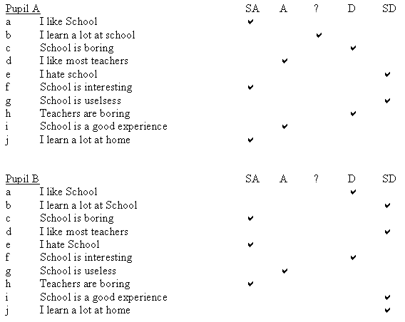

Slide 10
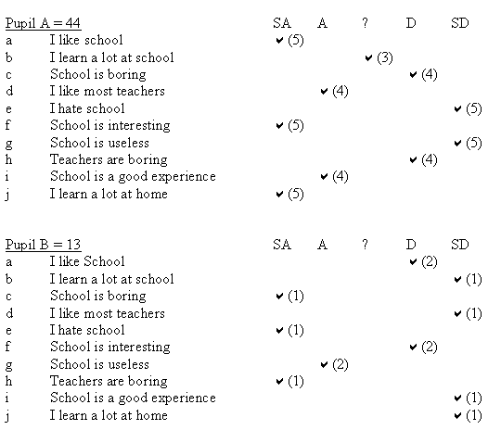

Slide 11
Questionnaire analysis Analysing Likert Scale data
Notes:
6
MEE Session 2 - Louise Poulson, University of Bath

