Slide 1
Research Methods in Education Session 2
Quantitative Approaches

Slide 2
The (quasi) experimental approach
Experiments are used to ascertain the presence, type and degree of a causal relationship between two variables.
At its simplest, an ‘experiment’ involves making changes in the value of one variable - the independent variable - and observing the effect on another variable - the dependent variable.

Slide 3
Experiments usually involve
The identification and control of variables
Observation and measurement
(Often) the use of ‘controls’ to compare circumstances

Slide 4
So let’s do an experiment!
Cut out one spinner and see how it flies.
Design a simple ‘experiment’ to investigate changing one variable which you think will affect its flight.
Collect some results to present to the group.
Identify possible sources of error in your experiment and suggest how it might be improved.

Slide 5
The origins of experimental approaches in agriculture and botany
borrowing ‘scientific methodology’ in the context of growing crops, where all or at least most variables could be controlled; all can be held constant while variations are introduced one at a time to investigate the effect upon subsequent growth. A statistical method of analysing the data and attributing significance can then be employed.
Researchers believed that the same methodology and analysis could be applied to educational research. Issues which arise in the context of educational research include the extent to which pupils behave like plants, i.e. can they be thought to be identical?, and can all variables be controlled?

Slide 6
Experimental design
Suppose you wish to investigate the effect of a teaching programme upon a group of pupils.
The simplest design you could adopt is:
Pre-test ………….…… (X) …..……………… Post-test
where pre- and post-tests are the same test and (X) is the ‘treatment’ applied to the group e.g. the teaching method.

Slide 7
Results of the Simplest Design
Assuming from the results that the distribution of data was reasonably symmetrical, and that they were reasonably separated, this might lead you to believe that a real difference exists between the pre-test results and the post-test results, which might have been caused by the teaching programme.

Slide 8
However …
Was it the teaching method (X) or was it something else like the ageing of the pupils that caused the change in test scores?
Was there any ‘Hawthorne effect’?
What is the effect of the pre-test upon the post-test?
A statistical test (t-test) could be applied to demonstrate the significance of the difference between pre- and post-test results.
What does the frequency distribution look like?.

Slide 9
A stronger design
Experimental group:
Pre-test …… (X) …… Post-test
Control group:
Pre-test ………….…… Post-test
The pre-test for both groups should be administered at the same time. The post-test for both groups should be administered at the same time. The control group does not experience the treatment (X).

Slide 10
Some questions
Are the groups identical?
Ethically, is it right to experiment on pupils where possibly you may deprive some of the experience (X)?
Still possible for their to be a Hawthorne effect with the control group?
Have you taken into account all the variables?
the time of day of the teaching
the age and ability of the pupils
the effectiveness of the teacher

Slide 11
A more sophisticated experimental design:
Experimental Groups:
Teacher A Pre-test ……… (X) ……… Post-test
Teacher B Pre-test ……… (X) ……… Post-test
Teacher C Pre-test ……… (X) ……… Post-test
Control Group:
Pre-test ………………………………..…. Post-test

Slide 12
Significance (a dangerous word!)
Significance in the statistical sense should always be quoted at a particular level.
Levels most commonly quoted are 5% (or 0.05) or 1% (or 0.01).
To say that a ‘relationship is significant at the 5% level’ means that the probability of that relationship happening by chance is less than or equal to 5 in 100: ie. the probability of it happening because of a particular reason is greater than 95 in 100.
Significance at the 5% level therefore indicates a stronger relationship than, e.g., significance at the 10% level.
Significance levels are used with, e.g., the t-test; a value for t is calculated and then a table is referred to in order to determine the level at which that value of t is significant, given the size of population under consideration.

Slide 13
Correlational research
Sometimes it is important to know how one set of figures compares with another set (e.g. maths results and English results for the same set of students).
The degree of agreement between two variables can be measured by calculating the coefficient of correlation (r).
The value of this quality always lies between -1 and +1.
Two sets of figures can also be shown diagrammatically, by plotting them on the two axes of a graph.

Slide 14
It’s bananas!
Suppose we wanted to look at the relationship between birth-rate and banana production on an island. What do we make of the data?
Birth rate
x
x
x
x
x
x
x
x
x
x
x
x
Banana production

Slide 15
It’s bananas!
What about if they looked like this?
Birth rate
x
x
x
x
x
x
x
x
x
x
x
x
Banana production

Slide 16
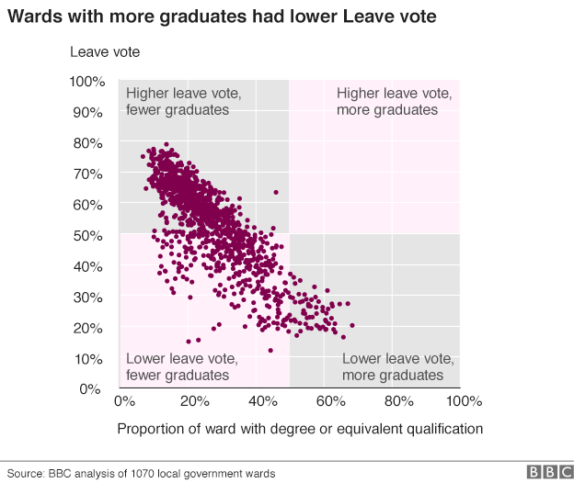
Brexit and educational attainment

Slide 17
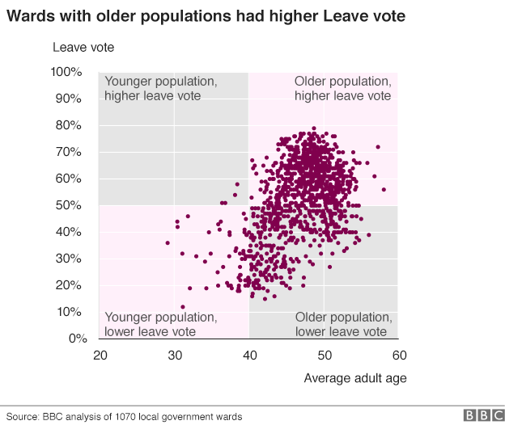
Brexit and age

Slide 18
Correlation and Causality
Correlation may be high, but what does this tell us about cause and effect?
Does one cause the other? If so, which way round?
Be careful about assuming causality in any relationship: high correlation does not necessarily mean that there is a causal relationship …
…… though it may indicate a possible relationship that merits further investigation

Slide 19
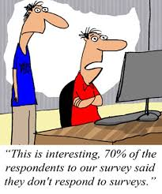
Surveys

Slide 21
Typically surveys gather data with the intention of …
describing the nature of existing conditions;
comparing existing conditions with a previously documented situation;
comparing existing conditions between different groups;
determining the relationship between different events.

Slide 22
Before starting a survey it is necessary to consider …
the exact purpose of the enquiry;
the population to be investigated;
the most appropriate sampling techniques (if any);
the resources available to the researcher.

Slide 23
On-line resources
Bristol Online Surveys (BOS)
Other on-line survey possibilities

Slide 24
Sampling

Slide 25
Populations and samples
Educational researchers can make inferences about a large group of people by studying a smaller group (or subset).
The large group is described as the population.
The smaller group is described as the sample.

Slide 26
Why sample?
In many cases complete coverage is not possible.
Complete coverage may not offer substantial advantage over a sample (extent of variation within the population).
Studies based on samples require less time and produce quick answers.

Slide 27
but ….
Surveys may require more administration, planning and programming than saturation surveys (because of the need to design appropriate sampling procedures).
Sample studies will always be open to criticism simply because of having to work with a sample..

Slide 28
Principles of sampling
A sample must be selected carefully so as to represent the overall population
Sample units must be identifiable and defined
Once selected, the sample should be used throughout the study
The sample must ensure a sufficient number of responses

Slide 29
Some common types of sample
Random sample: every member of the ‘parent population’ has an equal chance of being selected. The method involves selecting at random from a list of the population.
Systematic sample: members are selected according to a system rather than at random: for example, every tenth person on the list. The starting point for the selection is chosen at random.
Stratified random sample: the population is grouped (eg boys and girls, or different socioeconomic groups) before random selection is made. It is usual to select sample sizes from each group in proportion to the total size of the group.

Slide 30
Probability sampling
Based on the idea that the people/events you choose as the sample are chosen because you think it is probable (its likelihood) that they will be a representative cross section of the population/event in the whole population under study.

Slide 31
Some more common types of sample
Cluster sample: this uses pre-existing groups for the study. For example all pupils in a school or class may be selected for reasons of practicality.
Convenience/opportunity sample: a group is chosen because they are nearby (or in a convenient location), available, and willing to take part in the exercise.
Purposive sample: the cases in the sample are handpicked on the basis of professional judgement about their ‘typicality’.

Slide 32
Non- probability
Based on the idea that each member of the population does not have an equal chance of being selected. Thus, there is pre-defined rationale for selection.

Slide 33
Sample size … how many do I need?!
What is the variation within the population?
How much time/resources do I have to collect the data?
What is my response rate likely to be?
How much time/resources do I have to analyse the data?
At least 30 for any statistical analysis

Slide 34
Making sense of your data

Slide 35
Descriptive Statistics
Counts
Indices of centrality
Measures of dispersion

Slide 36
Indices of centrality
Mean – ‘average’ of all values
Median – mid-point in the range
Mode – most common value
9 21 22 23 23 25 25 26 27 28 28 28 31 32 33 45
Mean = 426/16 = 26.6 Median = 26.5 Mode = 28

Slide 37
Dispersion or spread
Range
Semi-interquartile range
Standard Deviation

Slide 38
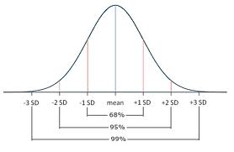
Normal distribution curves

Slide 39
Inferential statistics
These use descriptive statistics of samples to draw inferences about the corresponding population from which the samples are drawn.
t-test
correlation coefficients
factor analysis
Chi-squared test
Cronbach alpha
Graham Gibbs on YouTube

