Slide 1
Research Methods in Education Session 3
Case Study, Ethnography and Action Research

Slide 2
Three approaches at the ‘qualitative’ end of the research continuum – depth over breadth

Slide 4
Characteristics of case study research
it has clearly-defined boundaries (space/time/concrete/abstract) – what is the ‘case’?)
focusses around an ‘instance’
it uses in-depth methods focusing on relationships and processes (often qualitative)
it usually employs several methods

Slide 5
Characteristics of case studies
They generally involve a great deal of data collected by a variety of different methods
They can legitimately include both quantitative and qualitative methods of enquiry
They can be descriptive, exploratory or explanatory, or a combination of these
They have a quality of authenticity
Very often they are a study over time
They very often ‘offer a surrogate experience and invite the reader to underwrite the account’

Slide 6
Some strengths of case studies
Can give a deep rich picture
Offer a holistic view
Can be interesting and real to read
Can accommodate a variety of evidence within their framework
Are flexible in accommodating change of direction
Can explore complex social situations

Slide 7
Some possible limitations of case studies
Seen by some as a generally low status research method
Can lack rigour and may be too subjective in outcome
Can be long-winded and boring to read
Can take a long time to carry out
Do not readily allow generalisations (how ‘typical’ is the case?)
Tend to lack replicability
Can be over-descriptive and lacking in analysis

Slide 8
Case study (Fryer, 2009)
What is the ‘case’ here and what are its boundaries?
Is any rationale presented to justify the use of a case-study approach?
What is the principle source of data?
What sampling strategy was employed?
Are the conclusions justified by the data presented?
Are there any ways in generalisation is possible from this study?
Is this a case study?

Slide 9
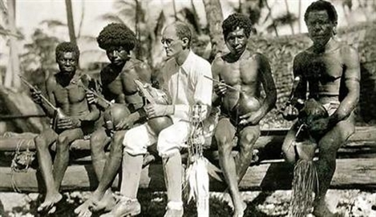
Ethnography

Slide 10
Ethnography
Ethnography deals with description of societies or groups; its basis is in anthropology
Involves participant observation studies;
Tends to take place over extended periods;
The researcher, or ‘ethnographer’:
is usually ‘immersed’ in the research;
seeks to adopt the perspective of the observed;
is usually a stranger to the situation studied.

Slide 11
Exploring ethnography
Use the Library search engine to find the journal Ethnography and Education.
Browse the contents of a recent edition and find a study which appeals to you.
Skim it to get a sense of the approach.
What sort of research questions might ethnographic studies address?

Slide 12
For discussion …
What sort of problems might emerge in ethnographic research?
Is it possible for a teacher to be an ethnographer?
What might be distinctive about data collection in ethnographic research?
What is the difference between a case study and an ethnographic account?

Slide 13
Action Research

Slide 14
Action research is …
developmental
collaborative
participatory
self-evaluative
reflective
emancipatory

Slide 15
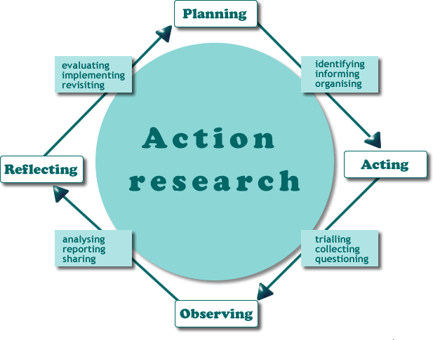
Always cyclical …

Slide 16
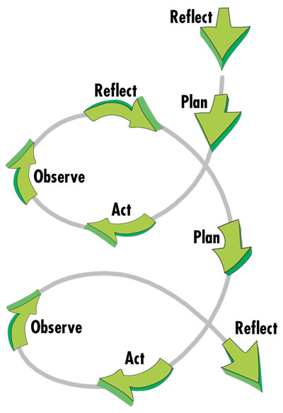
Often spiral …

Slide 17
Meta-cycles …

Slide 18
Is this action research?

Slide 19
From your reading of Cohen, et al. …
What are the strengths of an action research approach?
What are its limitations?
What is distinctively different about action research from other approaches?
Would you do it?

