Slide 1
Research Methods in Education Session 6
Observation and the use of video

Slide 2
Let’s look at a lesson

Slide 3
Observation
There are two types of observation research:
participant observation
non-participant observation

Slide 4
They share the same characteristics …
rely on direct observation by the researcher
take place in natural settings
are complicated by issues of perception

Slide 5
Perceptions can be influenced by:
Familiarity/knowledge
Expectations and experiences
Relationships
Sensitivity/empathy

Slide 6
Some questions
Who will be observed?
When will the observations will take place?
How often will the observations take place?
What will be observed?
What will be recorded?

Slide 7
Some issues for the observer
Non-Participant Observer:
Placing in room
Eye contact
Dress/personal style
Method of recording observations
Participant Observer:
How do you record?

Slide 8
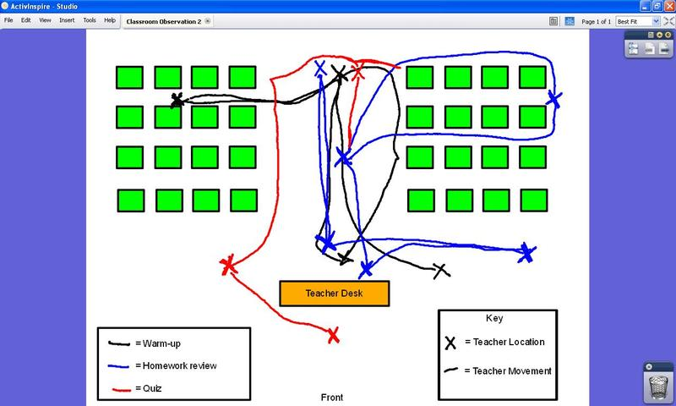

Slide 9
The need to be selective
Impossible to observe let alone record everything. Therefore need to establish a basis for selection of elements of observation:
Content/process
Interaction between individuals
Nature of language
Specific types of questions/responses

Slide 10
What might you look at? - Pupils
Physical setting
Number of pupils
Grouping of pupils
Use of classroom territory
Nature of transactions between pupils (if any)
Nature of transactions between pupils and teacher
Classroom conventions in behaviour (e.g. hand raising)
Division of labour amongst pupils

Slide 11
What might you look at? – Teachers
Use of classroom territory
Posture/tone/other personal characteristics
Complexity of vocabulary
Nature of questions
Explicit/implicit structure for lesson
Flexibility of teacher
Resources provided/available

Slide 12
Informal (unsystematic) observation
Perhaps better called non- formal observation i.e. no systematic framework for sampling/recording observations.
Observer decides what to record from observations.
Recording could be by written note or photographs.
Videorecording can be considered a informal research method.
Continuous (complete?) capture possible through use of video.

Slide 13
Systematic (formal) observation
Does not attempt to capture everything.
Pre-planned decisions about focus of observation.
Often employ a system of categories related to observable activities.
Usually observations made against a time interval baseline.
Produces data that can be presented in quantitative forms, and that can be summarised and related to other data using statistical techniques.

Slide 14
Systematic (formal) observation
Usually some form of coding sheet/observation inventory/schedule generated.
Once the procedures for recording, and the observation categories, have been decided, the role of the observer is one of following the protocol such that all observers of the same event should record it in an identical fashion (inter-observer reliability).
Video could be used with coding carried out at a later time.
Software available to record video and allow coding.

Slide 15
An example – FIAC
Flanders Interaction Analysis Categories
Teacher Talk:
Response: 1. Accepts feelings
2. Praises/Encourages
3. Accepts/uses pupil ideas
4. Asks questions
Initiation: 5. Lecturing
6. Giving directions
7. Criticising/justifying authority
Pupil Talk:
Response: 8. Pupil talk = response
Initiation: 9. Pupil talk = initiation
Silence:
10. Silence or confusion
Coding about every three seconds
(i.e. 20/25 codes per minute)

Slide 16
Some issues
Maintaining consistency of observations particular with short interval recording
Concentration
Partial picture of complex realities
Possibilities for use of technology to support observation (BOSS) to enhance validity and reliability.

Slide 17
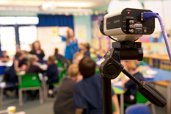
Using video in educational research
Supplement to ‘live’ observation
Replacement for ‘live’ observation
Self-evaluation
Lesson study
Action research
Stimulated recall

Slide 18
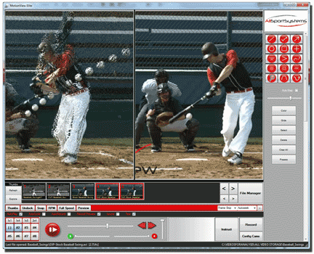
Analysing video data
Nvivo
ELAN
Anvil
ATLAS.ti
HyperResearch

