Slide 1
Research Methods in Education
Session 7
  Quality in Educational Research

Slide 2
Quality in the planning, conduct and reporting of educational research
Reliability
Validity
Trustworthiness
Ethics

Slide 3
Reliability
The extent to which a data-gathering instrument or procedure produces similar results under constant conditions on all occasions.
[i.e. reliability is concerned with consistency]
If another researcher, or the same researcher on a different occasion, can replicate the research and achieve sufficiently similar results, the process can be considered to be reliable.

Slide 4
Types of reliability
    Inter-judge/observer/coder reliability – the degree of agreement between two researchers using the same data-collecting instrument on the same or a similar phenomenon.
    Intra-judge/observer/coder reliability – the degree of agreement between two sets of results collected by the same researcher on different occasions measuring the same phenomenon.
Notes:
2
MEE Session 2 - Louise Poulson, University of Bath

Slide 5
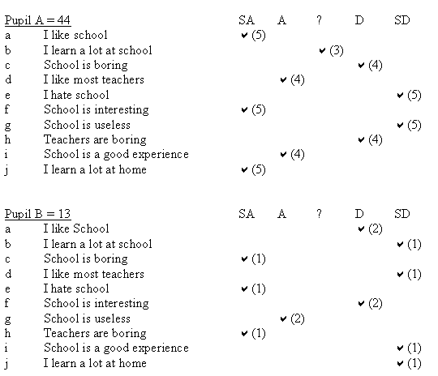

Slide 6
Checking reliability
Reliability can be checked by repeating with the SAME instrument (‘test-retest’).
With questionnaires, internal reliability can be checked by
‘equal and opposite’ items.

Slide 7
Validity
  The extent to which the data gathered, its analysis and any conclusions drawn actually reflect the original aims of the research and its research question(s)
Data collected cannot be valid if the data-gathering instrument is not valid
If the data collected are not valid, then the analysis and any conclusions drawn cannot be valid
If data are unreliable, they cannot be valid
[It is possible for data to be reliable without being valid!]
Notes:
3
MEE Session 2 - Louise Poulson, University of Bath

Slide 8
Types of validity
A four-level consideration of validity is often adopted. Here it is applied to the validity of data-gathering instrument:
      1) Face Validity
    The only claim for validity at this level is that the instrument looks as though it might be measuring what it is supposed to measure. It is the lowest of all levels of validity.
2) Content Validity
The instrument must cover all the relevant domains or content areas. This can be checked using a checking matrix.
Notes:
5
MEE Session 2 - Louise Poulson, University of Bath

Slide 9
Types of validity
    3) Construct Validity
To have this validity the instrument must measure the ‘construct’ it claims to measure: is the theory behind it sound? e.g. does a particular reading test actually measure reading, or does it in fact measure word recognition?
  (Consider the ‘construct validity’ of an IQ test in measuring ‘intelligence’?)
  [1),2) and 3) represent increasingly demanding levels of ‘internal validity.]
    4) External Validity
Is there validity beyond the immediate setting? Could this instrument be used in another context and yield comparable results? (i.e. generalisability)
Notes:
7
MEE Session 2 - Louise Poulson, University of Bath

Slide 10
Checking validity
Validity can be checked by:
    Comparing the instrument with the original intention (e.g. a ‘checking matrix’ for content validity).
    Gaining endorsement from peers (critical friends) at the design stage and in terms of analysis of data.
    Looking at the same phenomenon with a series of different measuring instruments i.e. by TRIANGULATION.

Slide 11

Triangulation
Triangulation refers to measuring an event using AT LEAST TWO DIFFERENT data-gathering techniques.
The greater the number of techniques used that suggest the same conclusion(s), the greater the confidence that can be placed in the validity of those conclusions.

Slide 12
Some types of triangulation
    Method: use a number of different types of data-gathering instrument e.g. questionnaires, observations, interviews
    Investigator: use a number of different researchers
    Time: investigate over a period of time
    Space: investigate in more than one context

Slide 13
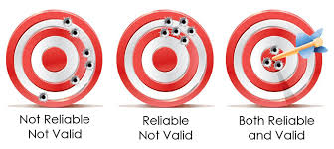
Reliable and Valid?

Slide 14
Quality in Qualitiative Research
Are these standards of reliability and validity appropriately applied to qualitative research?
    Credibility (in preference to internal validity)
    Transferability (in preference to external validity/generalisation
    Dependability (in preference to reliability)
    Confirmability (in preference to objectivity)
    (From Shenton (2004) based on Guba (1985)

Slide 15

Quality in Qualitiative Research
Meyrick, 2006

Slide 16

Quality in Qualitiative Research
Tracy, 2010

Slide 17
Exercise
Look at recent issues of any of the following:
  British Educational Research Journal (BERJ)
  Educational Research
  Journal of Research in International Education
  International Journal of Research and Method in Education
  European Education Research Journal
  American Educational Research Journal
  Review of Research in Education
Choose an article of interest that reports on an empirical research study. Review it in terms of whether or not it mentions any issues of quality. It might be in discussing the research design or in drawing conclusions.

Slide 18

Ethical issues
Researchers should consider how ..…
the rights and welfare of individuals are protected;
access to sites and participants can be gained;
issues of power and status are addressed;
the research is reported.

Slide 19
Ethical issues
Researchers should be.…
open about the nature and conduct of the research: purposes, protocols, methodology and reporting procedures;
honest and diplomatic;
non-threatening and faithful to purpose;
economical in terms of people's time: data gathering and reporting.
Please see:
British Educational Research Association (2018) Ethical Guidelines for Educational Research – 4th Edition.

Slide 20
Three key ethical principles
The interest of participants should be protected
Researchers should avoid deception or misrepresentation
Participants should give informed consent

Slide 21
1 Protecting the interest of participants
Participants should not be harmed by their involvement in research
  Physical harm; safety considerations
  Psychological harm
  Personal harm
Assurances of confidentiality
  Confidentiality vs. anonymity

Slide 22
2 Avoiding deception or misrepresentation
Researchers are expected to be open and truthful about the nature of their investigation and the role of participants in it
Ethical dilemmas can arise when total openness would bias results
Researchers are expected to report their results honestly

Slide 23
3 Gaining informed consent
Participation in research should be voluntary
Seek written consent
Participants have a right to withdraw
Vulnerable people e.g. children, people with learning difficulties

Slide 24
Exercise
With reference to the BERA Ethical Guidelines for Education Research, the Departmental Ethics Form and Hammersley, M. and Traianou, A. (2012) Ethics and Educational Research, review your own idea for a research study for ethical implications.

