Slide 1
MA Education
Introducing the MA Education Dissertation

Slide 2
Aims
By the end of this session I hope you will be able to answer the following questions:
What is a dissertation?
What is required and expected of you?
How will we support you?
What do I need to do to be successful?
What is the timeline?

Slide 3
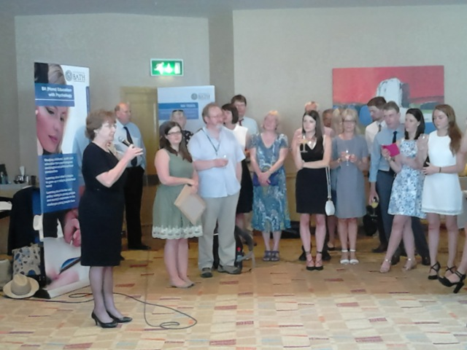


Slide 4
Key points
30 credits
500 hours work
Length – 15,000 words =/- 10%

Slide 5
What’s it about?
To provide a structured and supervised opportunity for students to design, conduct and evaluate a small-scale educational research project.
doing educational research rather than writing about the existing research and practice in this field of study

Slide 6
Key characteristics
you determine the focus and direction of your work … with some supervisor support and direction provided
there is typically a substantial research component to the project, requiring the collection of primary data and/or the analysis of existing/secondary data
prolonged engagement with the chosen subject… 'in-depth'

Slide 7
Dissertation Life Cycle
12-18 months

Slide 8

Starting your dissertation
Finish your five units including RME and ULL/E&S
You can’t start before you have completed the Academic Integrity test
Submit outline form

Slide 9

Choosing a topic….
A dissertation topic needs to be:
Large enough to keep you interested, and to say something significant
Small enough to be manageable!
If you are following a named pathway, it must be within that field

Slide 10
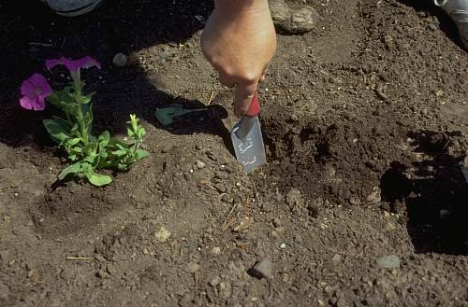

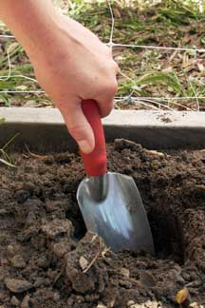
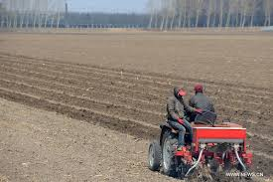
Remember: Drill down don’t plough a field

Slide 11

Ethics
The research that you do for your Dissertation will have ethical implications
Do no harm

Slide 12
Ethical approval
You must obtain ethics approval before you collect any data.
Ethics form – complete in draft then discuss with your supervisor
MUST BE
signed by you and your supervisor
uploaded to Moodle
included as an appendix in the dissertation

Slide 13
How do we help you?
1. The RME unit assignment can be linked to your Dissertation so feedback on your RME assignment will support your further dissertation planning.
2. Supervisors will provide formative feedback on your plans/ ideas at key stages in the dissertation process e.g. ethical approval, theoretical framework, methodology, fieldwork/ data gathering plans, methods of analysis.
3. Supervisors will provide formative feedback on one draft of each chapter of the dissertation (either separately or as a complete draft).

Slide 14
Supervisor
A supervisor will be appointed by the MA Director of Studies from Department of Education academic staff for each student according to their research focus

Slide 15
Example dissertation plan
Activity |  | Month
 | 1 | 2 | 3 | 4 | 5 | 6 | 7 | 8 | 9 | 10 | 11 | 12 | 13 | 14 | 15 | 16
Literature review (including chapter)
Read about/ decide on methodology/ tools. Methodology chapter
Refine research question
Ethical approval
Survey design
Survey administered
Survey analysed
Interviews
Interviews transcribed / analysed
Findings/ analysis chapter
Conclusions chapter
Introduction chapter plus revisions
Plus 2 months for contingency/ redrafting/ contents pages, etc.

Slide 16
Other resources to support your work
MA Wiki
MA Moodle
Your colleagues
University of Bath study support http://www.bath.ac.uk/asc/for-current-students/index.html

Slide 17
Structure
Introduction
Literature review
Methodology
Conclusion
Abstract
Findings/Analysis

Slide 18
The importance of TIME
You cannot rush research
You can not rush GOOD research
Research is REFLECTIVE practice
Don’t underestimate the value of your own thinking time and discussion with peers and critical friends

Slide 19
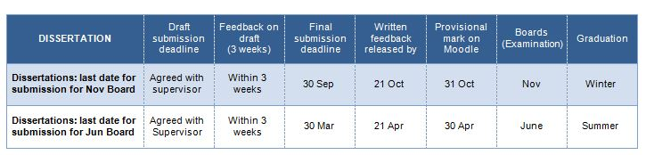
Submission for graduation ceremonies

Slide 20
Some thoughts on what makes for a good dissertation
1. Clarity of purpose and real engagement with this
“I like to see a clear and well focused research question (identified early on in the writing) that has real purpose and meaning for the student and that links in some way to the wider field of research (a gap?) and to the student’s professional context.”
“From here the student shows how they have endeavoured to find an answer to the research question (without preconception) throughout the dissertation activity from seeking answers and direction from theory and research in the literature through to developing the methodology and methods and so on.”
“Most importantly I like to see critical engagement with the endeavour to find answers to the research question, for example, not accepting things at face value, supporting and challenging ideas and exploring alternative explanations.”

Slide 21
Some thoughts on what makes for a good dissertation
2. An ethical approach
“I think a good dissertation shows clear evidence that the student has attempted to adopt an ethical approach to their research and engaged critically with the question of what makes for an ethical study. This would include
i] applying ethical guidelines
ii] considering (and discussing) what it means to do ethical research in relation to the specific research context
iii] analysing critically the approach they adopted and what they have learnt about doing (ethical) research.”

Slide 22

Important!
BACK EVERYTHING UP AND KEEP IT SECURE

Slide 23




