Slide 1
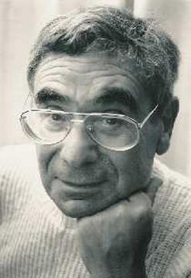
A Socio-Cultural Approach to Curriculum Theory: Basil Bernstein
Introduce Bernstein and his perspective on education
Explore some of Bernstein’s key concepts and ideas
Consider how they might be applied to the study of curriculum

Slide 2
Curriculum as power and control
Sociologist of education
Relationship between schools and social class structure within wider society
Key works: language and social class, school knowledge, and educational transmissions (Class, Codes and Control Volumes 1-3)

Slide 3
Bernstein’s approach
School knowledge is not neutrally ordered or transmitted
Interested in the underlying structures of power and control
Not concerned with content itself, but relations (‘boundedness’) between contents
Paired concepts of classification and frame used to illuminate underlying structure of curriculum (power dimension) and context of educational transmissions (control dimension)

Slide 4
Classification
does not refer to what is classified, but to the extent of separation between school knowledge, and so gives the basic structure of the curriculum
‘Where classification is strong contents are well insulated from each other by strong boundaries. Where classification is weak, there is reduced insulation between contents, for the boundaries are weak or blurred’
Strong classification is usually associated with a strong hierarchical ordering of content

Slide 5
‘Strong classification also creates a strong sense of membership in a particular class and so a specific identity’ (p. 90).
strong classification may in some ways reduce the power of the teacher, as the sharp boundaries between content determines what knowledge they are able to transmit

Slide 6
Frame
frame refers to the context in which knowledge is transmitted and received, and specifically the pedagogical relationship
Again, not concerned with contents themselves, but strength of boundaries around what may be transmitted and what may not
frame refers to ‘the degree of control teacher and pupil possess over the selection, organization, pacing and timing of the knowledge transmitted and received in the pedagogical relationship’ (p. 89)
When framing is strong, there are clear boundaries in what knowledge may be transmitted and received by teacher and pupil, whilst weak framing entails blurred boundaries in the kinds of knowledge which may be transmitted and received

Slide 7
Strong framing results in reduced options, whilst weaker framing creates a greater range of options
Strong framing therefore increases the power of the teacher in the pedagogical relationship, and means that pupils have less control in the selection, timing and pace of knowledge they acquire
Framing strength could differ between pupils, acting as a demarcatory force within school, with different pupils acquiring different kinds of knowledge at a different time and pace

Slide 8
Classification and framing
Strong classification tended to go with strong framing
BUT Bernstein said that this might not always be the case…

Slide 9
 |  | Classification
 |  | + | -
Frame | + | Knowledge is kept apart by strong ‘subject’ boundary maintainers, which also act to create particular subject identities, ‘geographer’, ‘historian’. Pupils have less control over what they receive, when they receive it, and at what pace. | Blurred boundaries keep knowledge together, with no obvious distinction made between different pieces of knowledge. At the same time, pupils have little control over what they receive, when, and at what pace.
 | - | Knowledge is neatly divided up and kept separate by subject boundaries. However, pupils have much more control over what they receive, when they receive it and at what pace. Still, pupils will know what is ‘maths’ and what is ‘science’. | Knowledge is knowledge, it is not bounded up into separate areas, instead it is kept together. Pupils are more free to select what knowledge they like, at whatever pace and time they choose. [Stenhouse’s process model would fit here]

Slide 10
 | Collection code | Integrated code
Classification | Strong | Weak
Framing | Strong | Weak

Slide 11
Collection code
‘Any organisation of educational knowledge which involves strong classification gives rise to … a collection code’ (Bernstein 1975: 90).
‘The extent of specialisation can be measured in terms of the number of closed contents publicly examined at the end of the secondary educational stage’ (p. 90)

Slide 12
Integrated code
‘Any organization of educational knowledge which involves a marked attempt to reduce the strength of classification is here called an integrated code’
‘Where we have integration, the various contents are subordinate to some idea which reduces their isolation from each other
‘Integrated code will not permit the variations in pedagogy and evaluation that are possible within collection codes’
‘there will be a pronounced movement towards a common pedagogy and a tendency towards a common system of evaluation. In other words, integrated codes will, at the level of the teachers, probably create homogeneity of teaching practice’
‘integrated codes may require a high level of ideological consensus, and this may affect the recruitment of staff’.

Slide 13
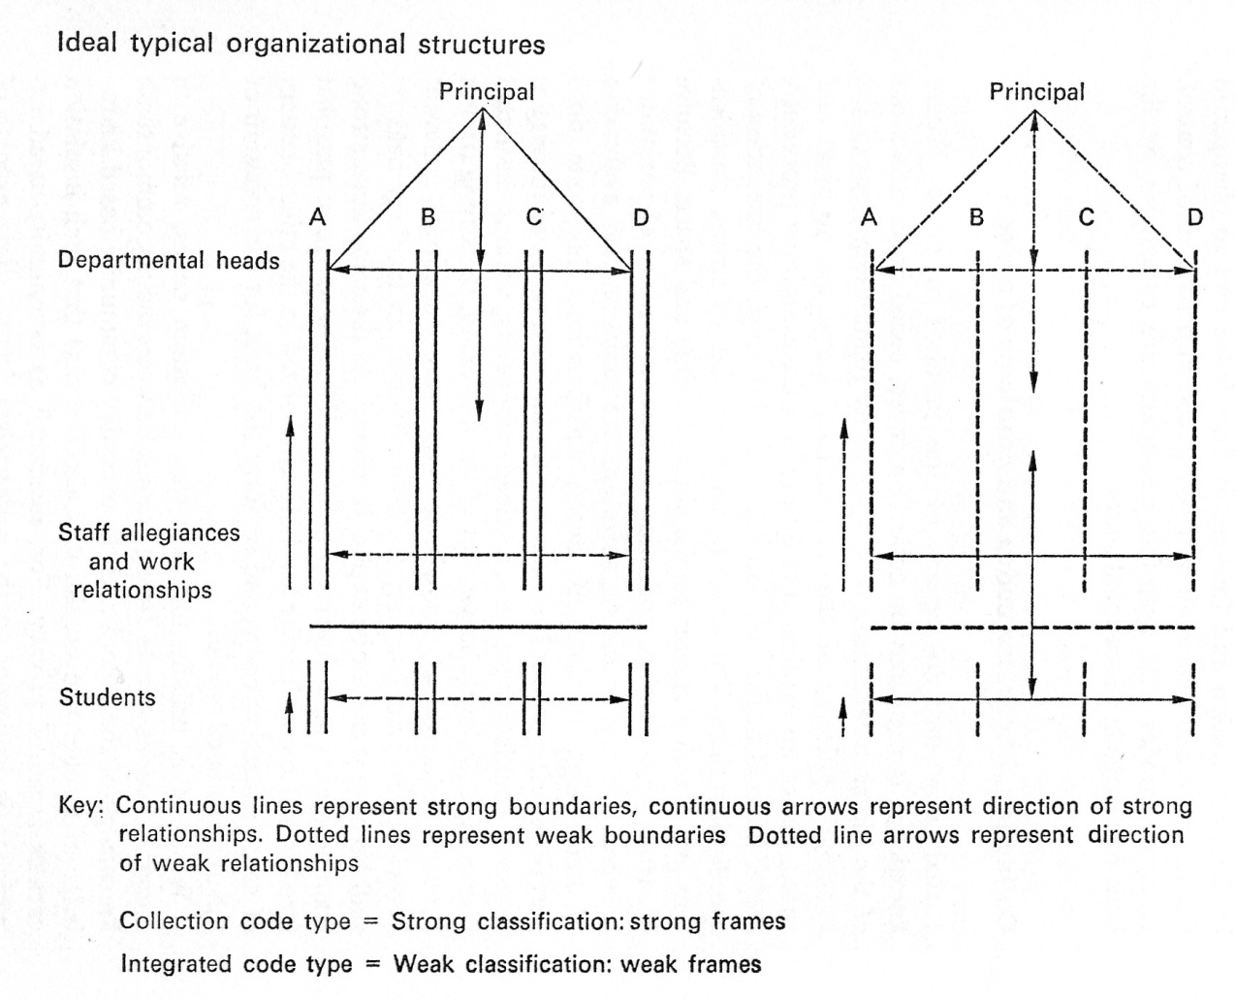
A link between 'the formal organization of the school and the disciplinary organization of knowledge' (Siskin 1994: 37)
COLLECTION
INTEGRATION
Strong boundaries between subjects
Weak boundaries between subjects
Strong hierarchical relationships between teachers in departments
Strong horizontal relationships between teachers across departments
Strong boundary between teachers and learners
Weak boundary between teachers and learners
How does this relate to your school setting?

Slide 14
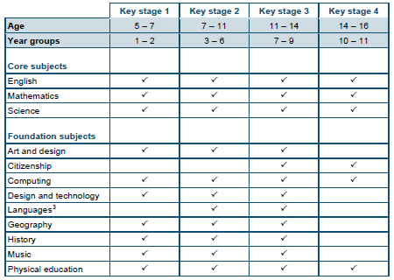
Applying Bernstein

