Slide 1
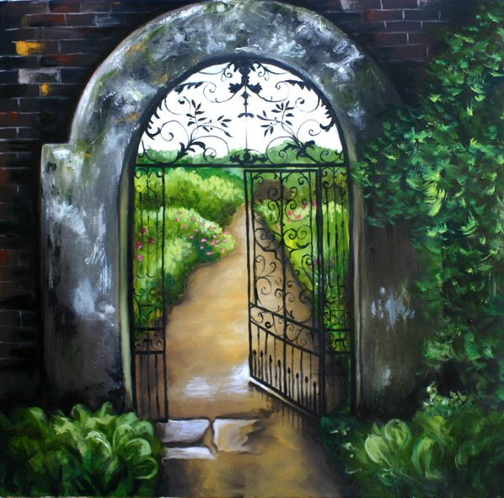
Thinking metaphorically about the curriculum

Slide 2
Garden metaphors for Curriculum (Ross 2000) baroque natural landscape ‘dig for victory’! cottage

Slide 3
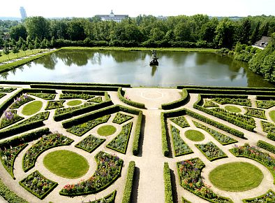

Slide 4
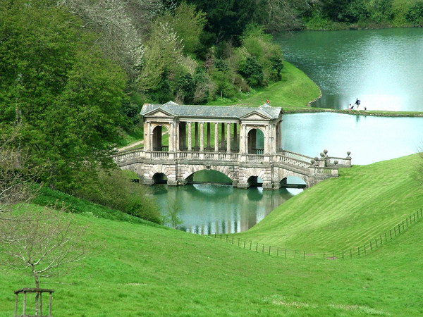

Slide 5
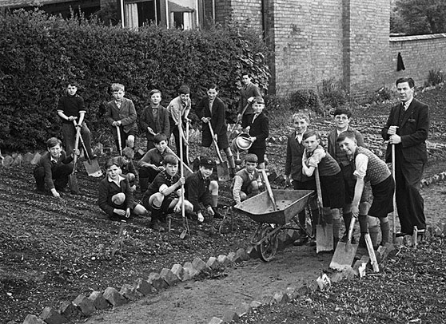

Slide 6
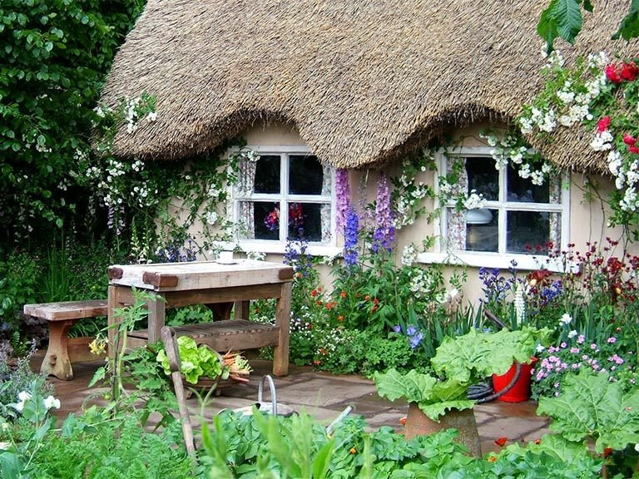

Slide 7
… and now?

Slide 8
