Slide 1
Assessment Norm-referenced Assessment and Criterion-referenced Assessment:
Poles apart?
A question of perspective?

Slide 2
Aims
to understand and distinguish between NRA and CRA and the extent to which they overlap
to appreciate that behind every criterion there is a norm

Slide 3
Assessment spectrum
Degrees
IB
‘SAT’s
GCSEs
Assessment of learning (AofL)
Assessment for learning (AfL)
summative
formative
selection, accountability
improving learning
norm-referenced (NRA)
criterion-referenced (CRA)

Slide 4
Types and purposes
Norm-referenced assessment (NRA)
Criterion-referenced assessment (CRA)
Ipsative - self-referenced assessment

Slide 5
NRA & CRA ~ Points of Reference
Norm-referenced assessment makes a comparison between an individual’s and a group’s performance, or between individuals
Criterion-referenced assessment makes a comparison between an individual’s achievement and performance criteria (which are pre-specified)

Slide 6
NRA & CRA ~ TGAT Report (1988)
Norm-referencing
An assessment system in which pupils are placed in rank order and pre-determined proportions are placed in the various grades. It implies that the grade given to a particular pupil depends upon a comparison between that pupil's performance and those of all the other pupils in the group, rather than upon the absolute quality of the performance.
Criterion-referencing
As defined for this report, an assessment system in which an award or grade is made on the basis of the quality of the performance of a pupil irrespective of the performance of other pupils: this implies that teachers and pupils be given clear descriptions of the performances being sought.

Slide 7
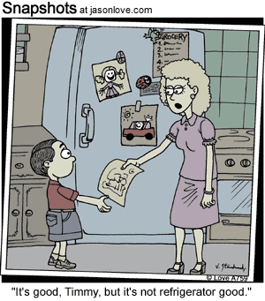

Slide 8
NRA & CRA – some examples
Sue came 5th in her class of 20
Everyone in the class can add two single digits
Adam has attained Level 4 in reading
Isaac scored 115 on the IQ test
Ali’s performance is above average this year
Steve passed his Academic Integrity test

Slide 9
Examples of referenced assessments
NRA
CRA
Ipsative
 | Formative | Summative

Slide 10
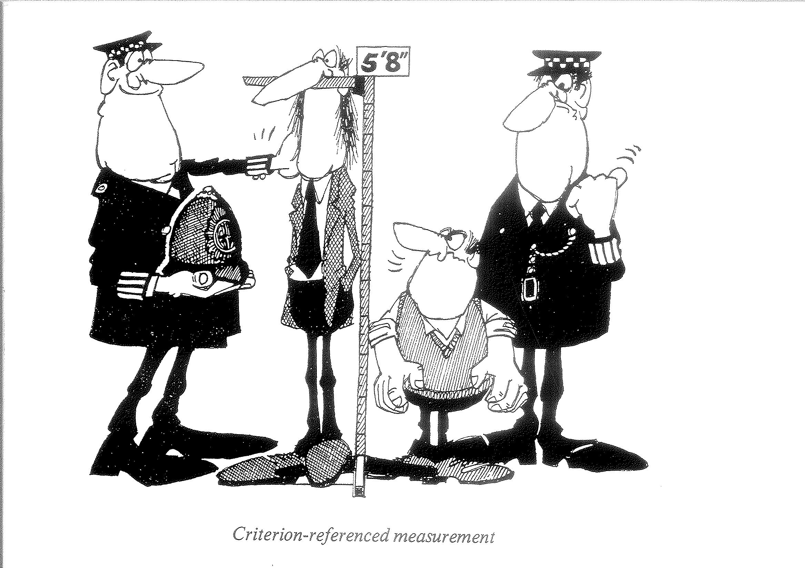

Slide 11
What do test items assess? – what is achieved or what is not achieved?
Item A
Item B
freq
freq
100
100
∙
∙
∙
∙
80
∙
80
∙
∙
∙
60
∙
60
∙
40
40
20
20
0
0
E
D
C
B
A
grade
E
D
C
B
A
grade

Slide 12
Marking an MA Assignment!
You will be given an assignment on NRA/CRA to read through and to attempt to grade in relation to current MA criteria.
When you have done this, you will have the opportunity to compare your grading with others in your group.
After that we will discuss the outcomes but, perhaps more importantly, the process.

Slide 13
MA Assessment assignment
What is being assessed?
To what extent is the assessment valid?
To what extent is the assessment reliable?
Is this CRA or NRA or both?
How might the reliability and validity or the assessment be improved?

Slide 14
Two Assessment Scenarios
Norming and conforming: responding to pressures and expectations

Slide 15
Scenario 1 ~ Grade awarding
The guidelines for awarding a Grade A are outlined in a programme document:
Outstanding: demonstrates thorough understanding and interpretation of topics and underlying theories being discussed, and shows a high level of critical thinking and synthesis. …
(Biggs & Tang, 2007, p.166)

Slide 16
You use the guidelines in grading the assessment tasks of our class of 100 students and find to your delight that 35 (35%) meet these criteria, so you award A to all of them. Your department head, however, is unhappy about this because you are ‘not showing enough discrimination between students and we don’t want this department to get a reputation for easy marking’. The results have not been announced yet, so he suggests that you regrade so that only 15% of your students are given an A.
What do you say?

Slide 17
Your response?
a) You agree you must have been too lenient, so you do as he says, giving A to the top 15 only, the remaining of the original As being given B.
b) You compromise, splitting the difference: you give As to 25 students.
c) You say something like ‘Sorry, but the guidelines are clear. I must in all conscience stick with the original. The conclusion to be drawn is that this was an exceptionally good group of students and that they were taught well.’
d) ‘I must stick with the guidelines. However, I am prepared to entertain a second opinion. If I can be persuaded that I have been too lenient I will change my grades.’
e) Other

Slide 18
Scenario 2 ~ Weighting issue
A department is trying to arrive at a policy on the proportion of final examination to coursework assignments. In discussing the issue, the head collates data over the past few years and it becomes very clear that coursework assessments are consistently higher than examination results. In discussing this phenomenon, the following opinions are voiced. Which argument would you support?
(Biggs & Tang, 2007, p.168)

Slide 19
a) Such results show that coursework assessments may be too lenient and because the conditions under which they are undertaken are not standardised, and are unsupervised, the results may well be inflated by collaboration and outright plagiarism. Examination conditions control for these factors. Therefore, final exams must be a higher proportion of the final grade than coursework assessment.

Slide 20
b) The conditions under which final examinations are conducted are artificial: working under time pressure, little and often no access to tools or data sources, and the mode of assessment limited to written expression or MCQ means that exam performances are sampling only a narrow range of students’ learning. Therefore, coursework assessments must be a higher proportion of the final grade than exams.
c) Other?

Slide 21
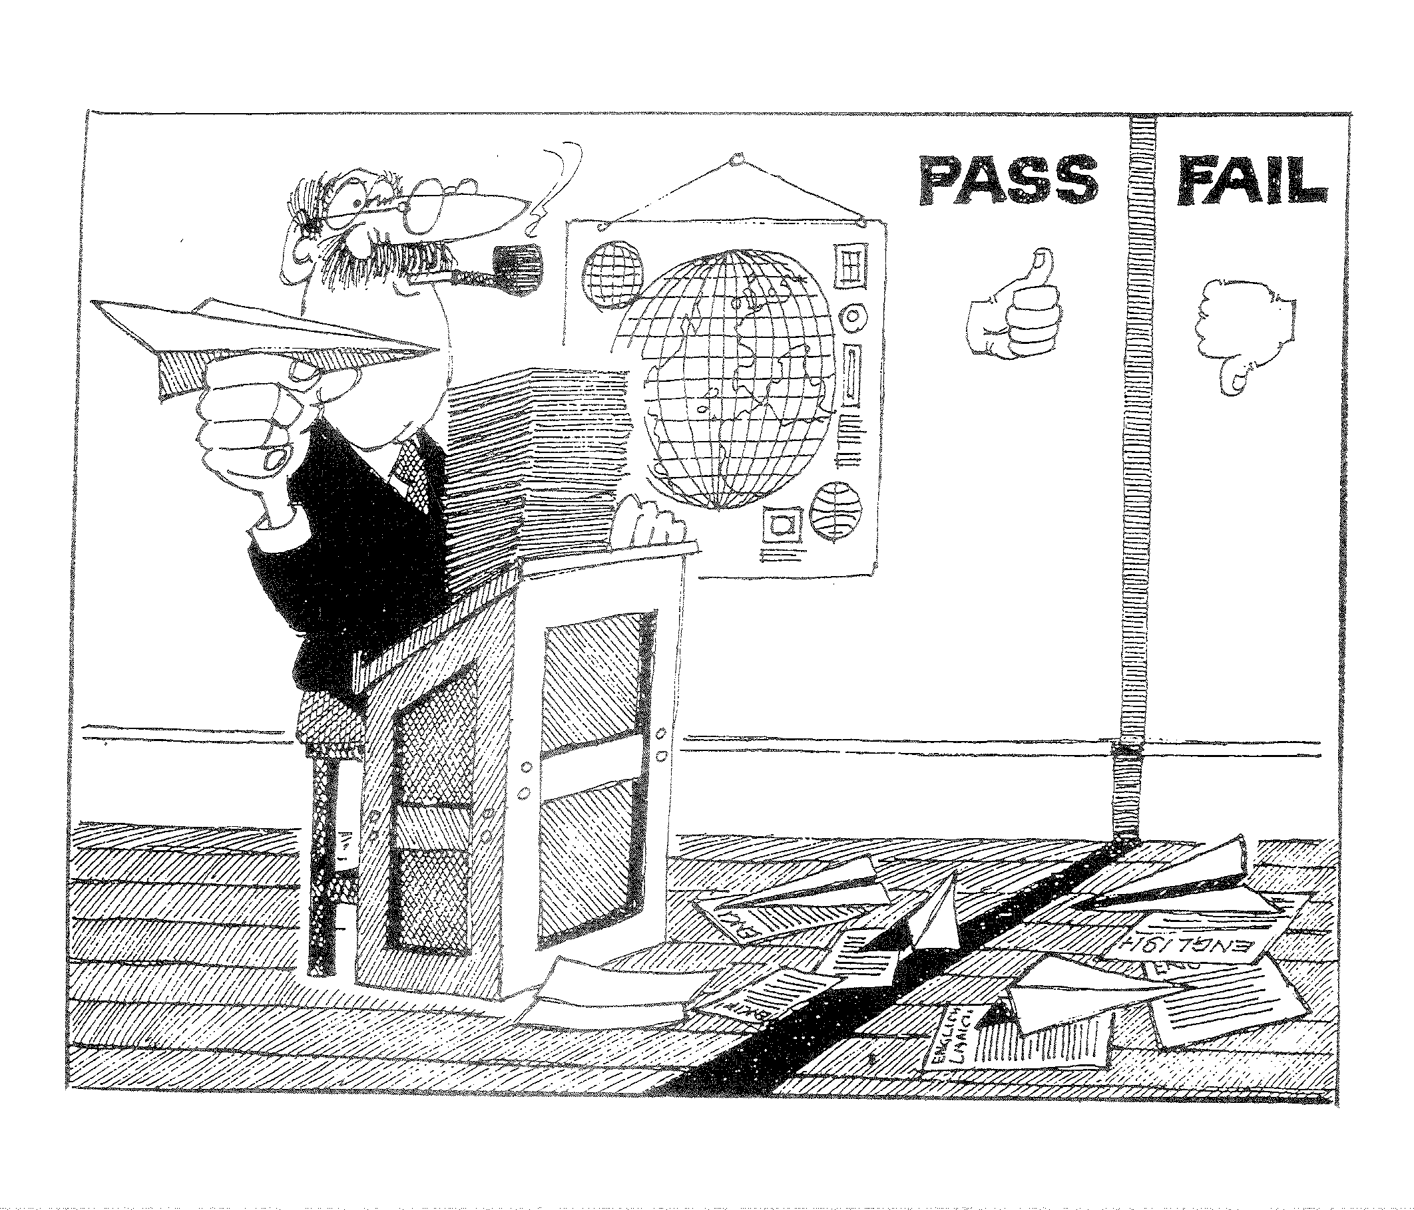
CRA?

Slide 22
TGAT ~ what might have been
Any system of assessment should satisfy certain general criteria. For the purpose of national assessment we give priority to the following four criteria:
the assessment results should give direct information about pupils' achievement in relation to objectives: they should be criterion-referenced;
the results should provide a basis for decisions about pupils' further learning needs: they should be formative;
the scales or grades should be capable of comparison across classes and schools, if teachers, pupils and parents are to share a common language and common standards: so the assessments should be calibrated or moderated;
the ways in which criteria and scales are set up and used should relate to expected routes of educational development, giving some continuity to a pupil's assessment at different ages: the assessments should relate to progression.

