Slide 1
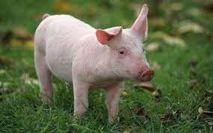
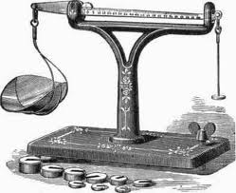
Quality in Assessment
Reliability, Validity and Fitness for Purpose

Slide 2
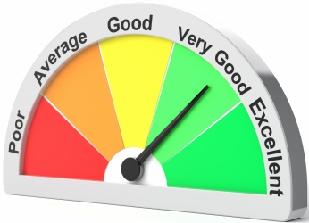
What’s ‘good’ about assessment?
What makes an assessment a good one?
Accuracy?
Confidence?
Utility?
Value?
Truth?
Fairness?

Slide 3
The challenge?
“A grade is an inadequate report of an inaccurate judgement by a biased and variable judge of the extent to which a student has attained an undefined level of mastery of an unknown proportion of an indefinite material.”
[Dressel, P. 1983. One more tilt at the windmill. In, A. W. Cickering ed. AAHE Bulletin]

Slide 4
The importance of quality
If we are using assessment evidence to help us make decisions about learners then we need to have confidence that, as far as possible, those decisions are the right ones, that they are justifiable. The more important the decisions are, or the more difficult it is to reverse them, the more important it is that we have confidence in the evidence on which the decisions are based and in our interpretation of that evidence.

Slide 5
Reliability and Validity
In particular, we must be sure that we can trust the evidence and we must be sure that the evidence is appropriate to the decision that we are making. The first of these conditions is covered by the concept of reliability and the second by the concept of validity.

Slide 6
Reliability and Validity
These constructs can apply to assessment instruments themselves, to the way they are administered and to the interpretation of data that they generate.

Slide 7
Reliability
What confidence can we have in a particular assessment result?
Reliability can be defined as the extent to which an assessment instrument produces the same results by ‘assessed’ and ‘assessor’ under the same conditions on all occasions

Slide 8
Reliability
Reliability is concerned with consistency
The extent to which the ‘assessed’ would respond to the same instrument in the same way on another occasion …
… and/or …
… the extent to which another ‘assessor’ (or the same ‘assessor’ on another occasion) is able to replicate the results, using the same assessment instrument.

Slide 9
Types of Reliability
Inter-assessor (examiner, marker) reliability
the extent of agreement between two (or more) assessors in recording their assessment of the same achievement
Intra-assessor reliability
the extent of agreement between assessment made by the same assessor of the same achievement on different occasions

Slide 10
Making confident judgements
List as many factors as you can think of that might influence your judgement when it comes to assessing
This might involve factors relating to yourself, to the time, to the context, to aspects of the work or performance you are judging, etc.
Suggest ways in which these different threats to reliability might be countered
What do you do in your own assessment practice to ensure high reliability?

Slide 11
Types of Reliability (cont)
Test reliability
the extent to which the lack of reliability of the assessment procedure is due to a lack of reliability of the assessment instrument
[e.g. the results of a multiple choice test paper could be unreliable if the questions were ambiguous]

Slide 12
Possible Threats to Reliability
The assessor(s)
- inter-assessor variability (lack of consistency)
- intra-assessor variability
The test, or assessment instrument
- the assessment process
- the assessment instructions
The students
- variability from day to day
- variability from question to question

Slide 13
Some forms of reliability can be measured in some contexts (such as large-scale exam board use of multiple choice exams): e.g. test-retest, parallel forms, ‘split halves’, Cronbach’s alpha, Kuder Richardson 20, item to test)
Far preferable is to take steps to build in/enhance the reliability of the assessment process from the outset and throughout.

Slide 14
Enhancing and ensuring reliability
Review the reliability of assessment processes which you use.
What steps can we take to ensure our assessment is as reliable as possible?

Slide 15
Validity
Validity is … the extent to which an assessment does that which it is designed to do
(Broadfoot, 1986)
Validity is … the appropriateness of the interpretations made from test scores and other evaluation results, with regard to a particular use
(Gronlund, 1985)
A valid assessment measures what it claims to measure
(NFER, 1994)

Slide 16
Validity
The main question to be asked therefore is:
Does the assessment measure what it claims to measure?
If the exam claims to assess higher order skills, does it do that? (or does it really only assess recall?)
If the formative assessment claims to assess the child’s ability to read, does it do that? (or does it really only assess the ability to recognise words?)

Slide 17
N.B.
Assessment can be lacking in validity if implicit, as well as explicit, claims are not met.
e.g. a test intended to be for the entire class will lack validity if it discriminates in some way against one sub-group (e.g. boys, girls, non-native English speakers) – even if unintentionally, and even if it was only implicitly intended that the test should not discriminate

Slide 18
Types of Validity
Face validity
the extent to which the assessment instrument looks as though it might be measuring what it claims to measure
Content validity
the extent to which the assessment instrument covers all the relevant content
[e.g. if the exam claims to assess IB HL Physics, does it cover all the relevant areas of the syllabus?]

Slide 19
Types of Validity
Criterion-related validity
do the assessment scores match performance on some other valued measure?
Predictive validity: the extent to which assessment will predict performance on an educationally meaningful criterion [e.g. IGCSE results as a predictor of IB DP achievement]
Concurrent validity: the extent to which assessment agrees with assessment results on another independent assessment [e.g. results from a written paper and results from coursework assessment]

Slide 20
Types of Validity cont ……
Construct validity
The extent to which an assessment measures the underlying ‘construct’ that it is assumed to measure.
This aspect is measured after the assessment and usually involves a comparison with performance on a test measuring a ‘similar’ aspect or construct e.g. IQ.

Slide 21
Extending the concept of validity
“An overall evaluative judgement of the adequacy and appropriateness of actions and inferences based on test scores …
… for a fully unified view of validity, it must also be recognised that the appropriateness, meaningfulness and usefulness of score-based inferences depend as well on the social consequences of the testing.”
Messick, S. (1995). "Validity of psychological assessment: Validation of inferences from persons' responses and performances as scientific inquiry into score meaning". American Psychologist. 50: 741–749

Slide 22
Extending the concept of validity
Validity of test interpretation and validity of test use
Is the test any good as a measure of the characteristic we want to assess?
Should the test be used for the proposed purposes?
Which leads us (controversially) to …

Slide 23
… Consequential Validity
What are the intended and unintended consequences of the test use?
Can these consequences be justified?
This requires ethical, not just technical, judgements!
Puts the onus on the assessment designer to consider not only the design, but also the likely uses of the outcomes, and includes consideration of social consequences of the assessment (process).

Slide 24
Enhancing and ensuring validity
So, what can we do to ensure a high level of validity?
What steps can we take to ensure our assessment is as valid as possible?

Slide 25
Unlike reliability, it is not possible to measure validity – it is a matter of professional judgement about whether a test is or is not valid (according to what aspects of validity one is considering)
Like reliability, it is desirable to take steps to build in/enhance the validity of the assessment process from the outset and throughout.

Slide 26
Enhancing validity
At the curriculum/ course design stage:
Aims and assessment objectives should be as clear as possible
Curriculum should be designed by expert(s) in the field (e.g. teachers, university lecturers, other experts)

Slide 27
Enhancing validity
At the assessment design stage:
Assessment instruments should be designed by experts in the field (e.g. teachers, university lecturers)
Assessment instruments should be selected that are appropriate to the knowledge/ skills to be assessed
For exams, a specification should be drawn up (to gauge content validity of the instruments)
The weighting of any marks derived from assessment instruments should reflect their relative importance as indicated in the curriculum/ course design

Slide 28
Enhancing validity
The time allocated to each assessment instrument should be appropriate for the purpose intended
For formal exams a ‘mark scheme’ should be devised, and for less formal assessment a clear statement should be made, indicating clearly how credit is allocated in accordance with relative importance of the assessment objectives
For formal exams, external independent checking should be undertaken of the assessment instruments and marking criteria/mark schemes
Where possible, for formal exams questions (especially multiple choice) should be trialled in advance

Slide 29
Validity and Reliability
In order to be valid, assessment must also be reliable
… but …
Assessment can be reliable without being valid
e.g. a multiple choice test may not be a valid test of students’ skills of manipulation in science, but may be totally reliable in consistently generating the same results

Slide 30
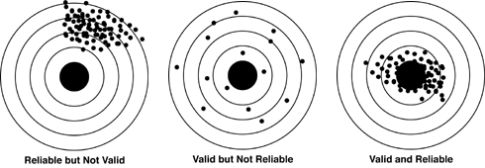
Validity and Reliability

Slide 31
Alternative Quality Indicators
Curriculum fidelity: construct validity for the real world of educational assessment
Dependability: the co-optimisation of reliability and validity
Public credibility: consistency and comparability
Transferability: Does the assessment tell us anything useful for the real world?

Slide 32
Alternative Quality Indicators
Manageability: how much time, expertise and other resources does the assessment take, and is it worth it?
Equity: is it a fair test?
(Gipps, 1994)

Slide 33
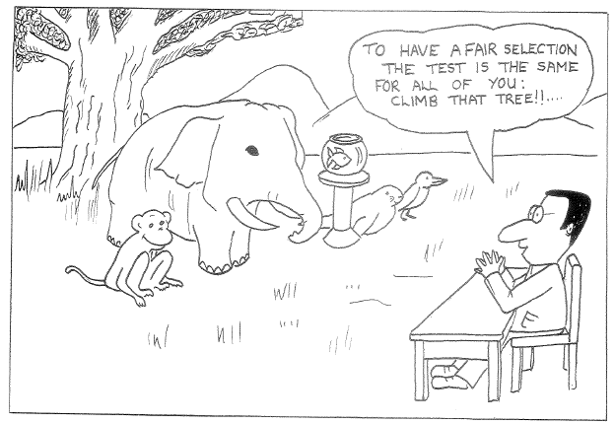
Tests and Fairness

Slide 34
Tests and Fairness
What is your reaction to this cartoon?
On what grounds might we argue that the animals are indeed being given a 'fair test'?
On what grounds might the test be considered 'unfair'?
One argument about 'unfairness' in assessment is that assessment simply reproduces and legitimises existing inequalities in society. How might assessment do this? Is it a problem?

Slide 35
Tests and Fairness
An alternative argument is that an assessment instrument can itself be a source of inequality, by favouring some groups or individuals over others. How might it do this? Are there any ways of dealing with this?
How do you think 'fair assessment' can be achieved (or approached) in practice? How would we know in practice if an assessment is in fact 'fair'?

Slide 36
Validity and Reliability: Can We Have Both?
“… the greater the attempt to control an assessment task in order to ensure reliable measurement, the greater is the temptation to diminish its ‘reality’, meaning or validity. The question often comes down to where we wish to draw the line between accurate measurement of the trivial, and unstable measurement of the important.”
Schwarz, P. & Webb, G., eds., 2002. Assessment: Case studies, experience and practice from Higher Education. London: Kogan Page. (p.4)

Slide 37
Fitness for Purpose
Quality can only be judged in relation to the purpose of the assessment
Any or all of the indicators can be considered, but always in relation to why you are doing the assessment
So how fit is the assessment for its purpose, in terms of …

Slide 38
Fitness for Purpose
nature of the curriculum area (e.g. art, mathematics)
aims and objectives of the curriculum
consistency with philosophy of teaching and learning
purpose for which assessment outcomes are required
prior knowledge or skills of students to be assessed
time available (preparation, analysis)
who will use the results? how will the results be interpreted?

Slide 39
Fitness for Purpose
The judgement of fitness for purpose will generally involve determining whether an 'appropriate' balance has been achieved across a range of quality indicators
The appropriateness of the balance will be judged in terms of the purpose(s) for which the assessment is being carried out

Slide 40
Some Readings
Black, P., 1998. Testing: Friend or Foe. London: Falmer.
Crooks, T. J., Kane, M. T. & Cohen, A. S., 1996. Threats to the Valid use of Assessments. Assessment in Education, 3(3), pp.265-285.
Gipps, C., 1994. Beyond Testing: Towards a theory of educational assessment. London: Falmer.
Harlen, W., ed., 1994. Enhancing Quality in Assessment. London: Paul Chapman.
Harlen, W., 2005. Trusting teachers’ judgement: research evidence of the reliability and validity of teachers’ assessment used for summative purposes. Research Papers in Education, 20(3), pp.245-270.
Wiliam, D., 1992. Some technical issues in assessment: a user’s guide. British Journal of Curriculum and Assessment, 2(3), pp.11-20.

