Slide 1
Assessment of Learning and Assessment for Learning

Slide 2
Aim
To understand the distinctions between the different purposes and characteristics of AoL and AfL and hence their use, and some of the consequences, with particular emphasis on AfL.

Slide 3
Overview
Starting points
Background and context
Definitions
Some of the benefits of AfL
A closer look at the ‘Black Box’
Strategies
Feedback
Questioning
Self- and peer-assessment

Slide 4
The (UK) context …
Politicisation of education
National Curriculum
NC Assessment
Emphasis on the summative/terminal
Accountability and control

Slide 5
Definitions …
Assessment of learning (AoL)
?
Measuring what has been learned (already)
Purpose(s) of AoL?
Assessment for learning (AfL)
?
A process by which pupils are made aware of how they can make progress
Purpose(s) of AfL?

Slide 6
Do you agree?

Slide 7
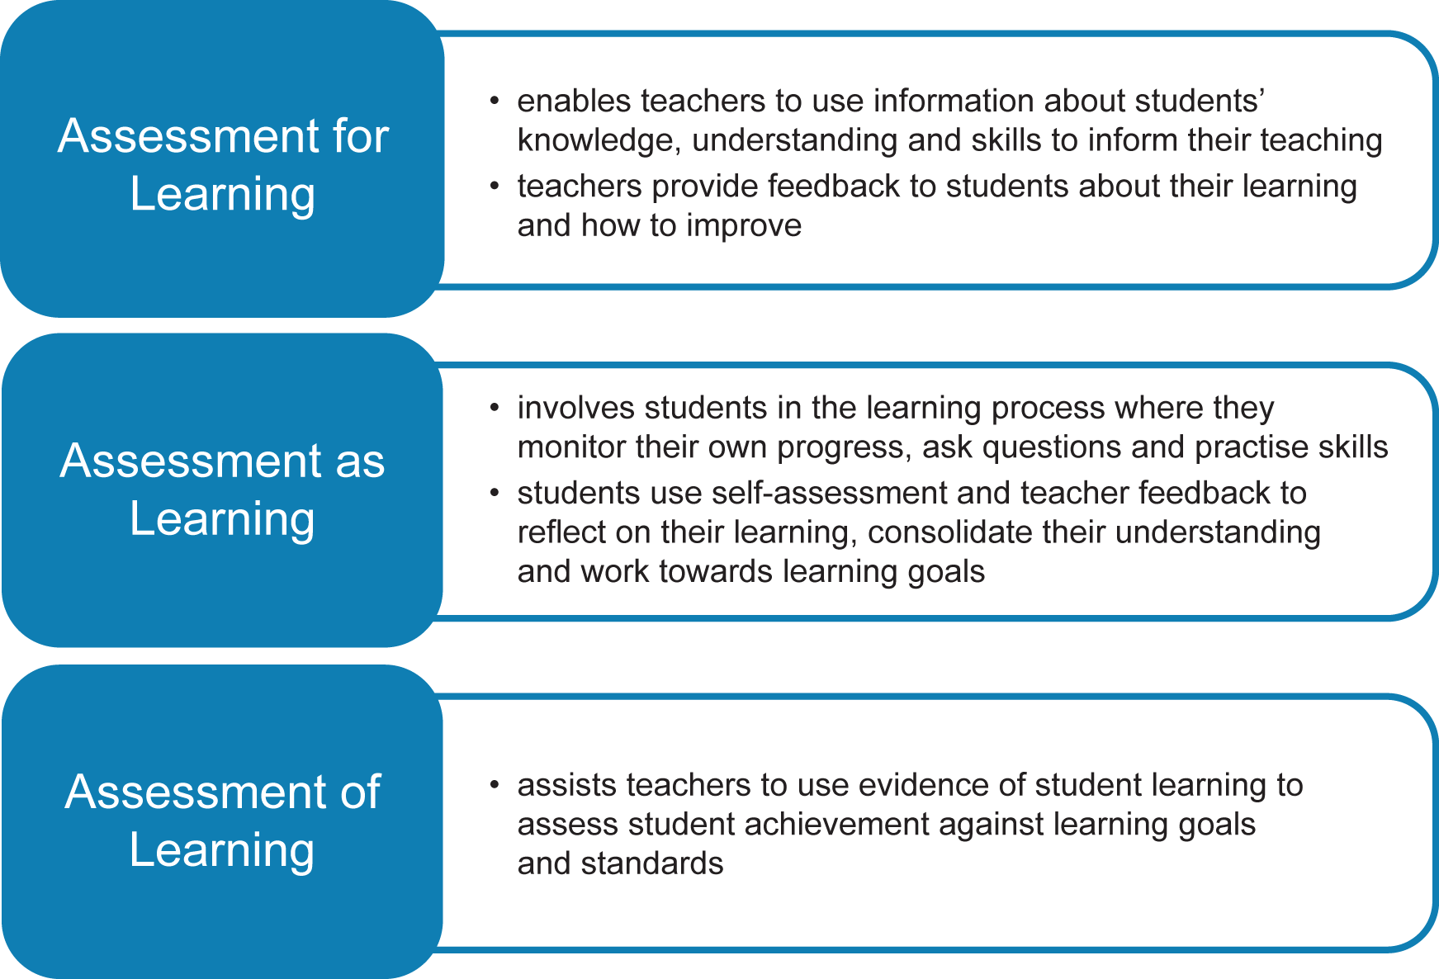
What about AaL?

Slide 8
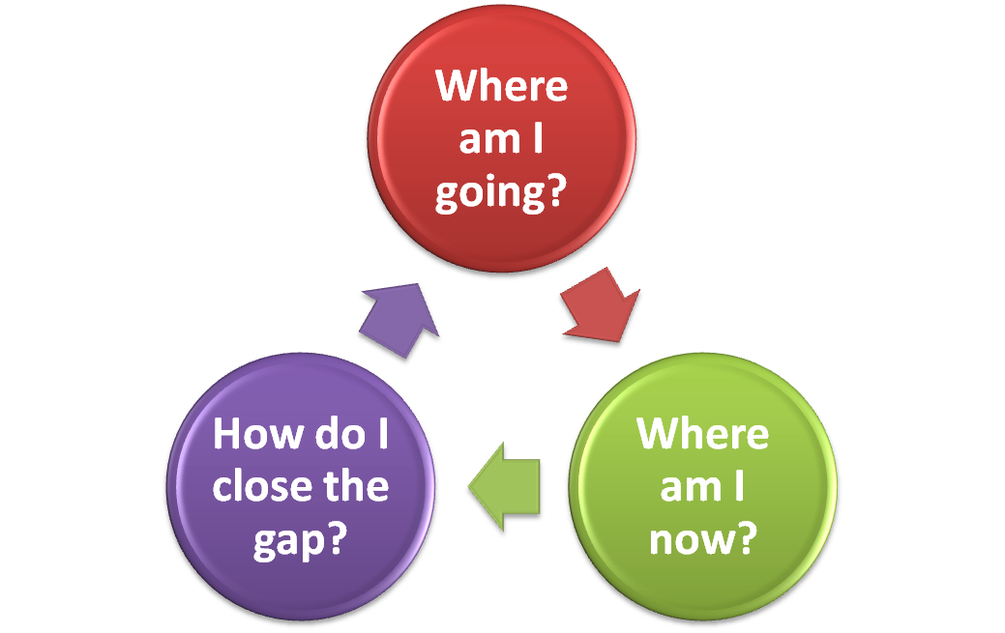
Formative assessment
Concerns knowing how to improve …
… from where you are …
… to where you’re going.
So, first you need to know where you are before you can move in the right direction!

Slide 9
Formative assessment
[Black and Harrison 08:20-14:30]

Slide 10
Assessment Reform Group
“Assessment for learning is the process of seeking and interpreting evidence for use by learners and their teachers to decide where the learners are in their learning, where they need to go and how best to get there.”

Slide 11
Learning and assessment paradigm shifts
Teaching/ learning paradigm
transmission constructivist
Assessment paradigm
traditional authentic

Slide 12
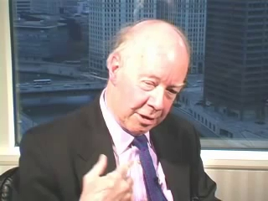
AoL & AfL in perspective
AoL and summative assessment
has traditionally ‘held sway’ and dominated classroom assessment
AfL and formative assessment
has latterly influenced assessment in classrooms, largely as a result of work originally at King’s College, London by Paul Black and Dylan Wiliam

Slide 13
AfL and AoL
To what extent do you think AfL and AoL overlap (2)?
What is your reasoning, and can you give examples to support this?
Can you identify examples where this overlap creates a tension?
Where they are distinct (1 and 3) can you give examples.
AfL
AoL
1
2
3

Slide 14
‘Inside the Black Box’
What was the aim of this publication? Why was it written?
To what extent do you agree with the principles outlined? Does it match your experience?
What one thing would you take from it?
Are there any outstanding issues in your view?

Slide 15
Pre-Black Box: shortcomings in formative assessment practice
tests that encourage rote learning
no sharing of assessment practices
no critical review of practices
marks and grading over-emphasised
giving advice and learning under-emphasised
inter-pupil comparison; competitive emphasis
feedback for social and managerial purposes
record-keeping for its own sake

Slide 16
IBB: the key questions
Is there evidence that improving formative assessment raises standards?
Is there evidence that there is room for improvement?
Is there evidence about how to improve formative assessment?

Slide 17
IBB: main findings
Improving the practice of formative assessment can produce substantial learning gains*
The gains are often greatest for lower achievers
* It has been suggested that this could shift UK to the top of international comparisons

Slide 18
IBB: conditions for successful learning
learners understand the goals they are aiming for;
learners are motivated;
learners have the skills to achieve success.

Slide 19
IBB: factors affecting improvement
the provision of effective feedback to pupils
the active involvement of pupils in their own learning
adjusting teaching to take account of the results of assessment
a recognition of the influence assessment has on the motivation and self-esteem of pupils
the need for pupils to be able to assess themselves and understand how to improve
Assessment Reform Group, 1999. Assessment for Learning: beyond the black box. Cambridge, University of Cambridge School of Education
Black, P. and Wiliam, D., 1998. Assessment and classroom learning, Assessment in Education, 5(1), pp.7-74

Slide 20
Practical ways for assessment to promote learning (Black & Wiliam)
'Better' questioning in class that promotes thought and discussion.
Taking students' answers seriously, not just as 'right' or 'wrong'.
Setting tasks in ways that require students to apply certain skills or ideas.
Asking students to communicate their thinking in a variety of different ways.
Giving less attention to marks and grades and more to directed feedback.
Giving feedback that helps students recognise their next steps and how to take them.
Assessing the quality of learning, not just amount of work or its presentation.
Sharing learning goals with students.
Involving students in self- and peer-assessment.
Which would you consider to be the most important for you to do (if not already)?

Slide 21
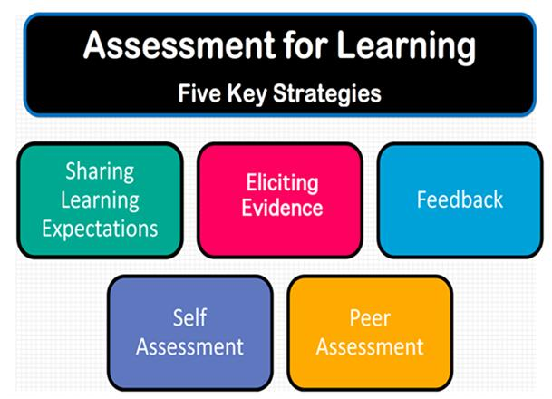
Summary of Principles of AfL
[Black and Harrison 00:00-06:32]

Slide 22
