Slide 1
Assessment What to Assess

Slide 2
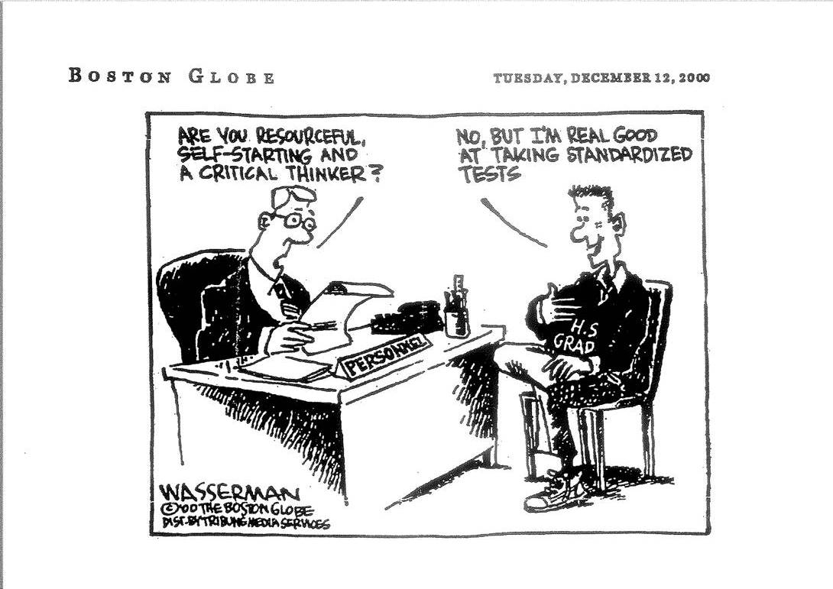

Slide 3
Starters
What do you assess?
How do you decide what to test or assess?
What degree of choice do you have in the matter?
How confident are you that you are assessing what you want to assess?
On what do you base your confidence?

Slide 4
What is assessed and what is taught
teaching and learning content and activities
assessment content and format
curriculum (syllabus)
to what extent does this match your experience?
to what extent is assessment bolt on? - or is it built in?

Slide 5
… or even!?
teaching and learning content and activities
assessment content and format
curriculum (syllabus)

Slide 6
… alternatively?
curriculum (syllabus)
teaching and learning content and activities
assessment content and format
Is this any different?

Slide 7
The conventional approach …
teaching and learning content and activities
assessment content and format
curriculum (syllabus)

Slide 8
Comparison of syllabuses
Consider the two syllabuses from the perspective of their assessment.
What advantages and disadvantages are there in the two approaches, from the point of view of the:
teacher?
examiner?
students?

Slide 9
Would it be possible to write a biology syllabus in the form used for the Scottish Higher Certificate English?
Would it be possible to write an English syllabus in the form used for the IB biology?
For the Scottish Higher Certificate English syllabus, how would you decide what achievements to assess?
Could you write a question for the IB Diploma Biology exam based on what you have here? Try it. Could you mark a student's answer to that question?
Now try writing a question for the Scottish Higher Certificate English paper. What problems do you have with this, if any?

Slide 10
Curriculum specification
Type 1: Based on a set of specific objectives/learning outcomes
e.g. ‘At the end of this course, the students will ... know A ... be able to do B ...’
The only 'fair' assessment for such a specification then takes the form:
'Do you know A? Can you do B? ...’

Slide 11
Curriculum specification
Type 2: Based on a set of learning experiences and opportunities
e.g. 'During this course, students should have the opportunity to ... explore this ... try doing that ... investigating this ...'
If no precise learning outcomes are specified then a 'fair' assessment should take the form:
‘What have you learned? What can you do?'

Slide 12
A matter of perspective?
Elliot Eisner (1985) suggests that these two approaches reflect different views of the nature of education, which he labelled 'industrial' and the 'biological'. Each has its own implications for the role and nature of assessment:
Industrial: teachers work as engineers to process students (raw materials) to product specifications: Assessment as quality control
Biological: education is the nurturing of individual needs and potential, with the student involved in planning and control: Assessment as (in)formative

Slide 13
The dominant approach

Slide 14
A Taxonomy of Assessable Objectives
One way of deciding what we want to assess is to list the sorts of skills we want the learners to have
Probably the most famous such ‘list’ – and one that has had huge influence on the design and assessment of curricula – is that of Benjamin Bloom and colleagues (1956)
Bloom et al suggested that there are 3 broad skills areas (or domains) that we address in education

Slide 15
Bloom’s Domains
Cognitive – knowledge and thinking skills
Affective – values and attitudes
Psychomotor – physical performance
Each domain was broken down into a set of categories of behaviour that could be observed (and therefore assessed)
These categories could then be described as a set of objectives and associated action verbs that can be used to set tasks to be assessed

Slide 16
Using Bloom’s taxonomy
Below are some examples of questions from a history exam on the Second World War. Use the summary of Bloom's Taxonomy (cognitive domain) to allocate each of these questions to one of his six categories.
1 Distinguish between the policies of the UK and the USA during the latter period of World War II.
2 In which year did the Second World War begin?
3 Using examples, show how the pace of World War II varied over the six years that it lasted.
4 Describe in one sentence the incident which was the 'trigger' leading to the declaration of war.
5 Assess the evidence for and against the possibility of such a war ever occurring again.
6 Organise the information [given] to summarise the extent of differences within the British Government in the period leading up the outbreak of World War II.

Slide 17
Aims, Objectives & Behavioural Objectives
An Aim is a general statement of intent (usually stated in terms of the ‘teacher’)
An Objective is a more precise statement of intent (usually stated in terms of the learner)
A Behavioural Objective is a very precise statement of intent (again, stated in terms of the learner)

Slide 18
A Behavioural Objective should include three elements:
A statement of the terminal behaviour of the learner
The condition under which the behaviour should be exhibited
The standard to which it should be performed

Slide 19
Examples of behavioural objectives (1)
The child should be able to write a complete sentence -
unaided by others or by a dictionary or other material
using both a capital letter and a full stop in the correct places, and spelling all words correctly

Slide 20
Examples of behavioural objectives (2)
The student should be able to recite the names of all Presidents of the United States of America -
from memory, starting from any point given by the teacher
with no more than one error in the sequence

Slide 21
Examples of behavioural objectives (3)
The student should be able to produce a 2-dimensional representation of a given solid object -
using only paper and a specified range of graphite pencils
producing a recognisable 3-dimensional image

Slide 22
Using Bloom’s Taxonomy

Slide 23
The cognitive domain
6 major classes, in ascending hierarchy of complexity:
Knowledge (ability to recall)
Comprehension (ability to interpret, translate)
Application (ability to apply general principles, rules)
Analysis (ability to break down information)
Synthesis (ability to assemble several components)
Evaluation (ability to judge value of methods)

Slide 24
The affective domain
(e.g. interests, attitudes, appreciations, values)
Receiving (willing to give attention to)
Responding (willing to respond to and react)
Valuing (willing to accept or reject an event)
Organising (when encountering situations to which more than one value applies)
Characterising (consistently acts in accordance with accepted values)

Slide 25
The psychomotor domain
This domain was not developed in any detail by Bloom and colleagues
Anita Harrow (1972) developed six categories of movement for this domain: reflex movements, basic fundamental, perceptual abilities, physical abilities, skilled movements, non-discursive communication
Details are rarely seen of the affective and psychomotor domain

Slide 26
Activity
Think about writing behavioural objectives for one or more of the following, or for a chosen specified area of the curriculum:
ability to play a musical instrument
ability to cook a main course for a meal
ability to participate in team sports
ability to organise an activity for the peer group
Discuss possible issues in carrying this out.

Slide 27
Relationship between domains?
Cognitive
Affective
Psychomotor

Slide 28
… or?
Affective
Cognitive
Psychomotor

Slide 29
Beyond Bloom?
21st Century learning moves beyond the content of what is learned towards an emphasis on the process of learning and further on the understanding of that process by the learner.
Can we escape the legacy of Bloom?
In programmes that with less traditional aims, are changes in fundamental conceptions of assessment required?

Slide 30
IB Mission Statement
The International Baccalaureate aims to develop inquiring, knowledgeable and caring young people who help to create a better and more peaceful world through intercultural understanding and respect.
To this end the organization works with schools, governments and international organizations to develop challenging programmes of international education and rigorous assessment.
These programmes encourage students across the world to become active, compassionate and lifelong learners who understand that other people, with their differences, can also be right.

Slide 31
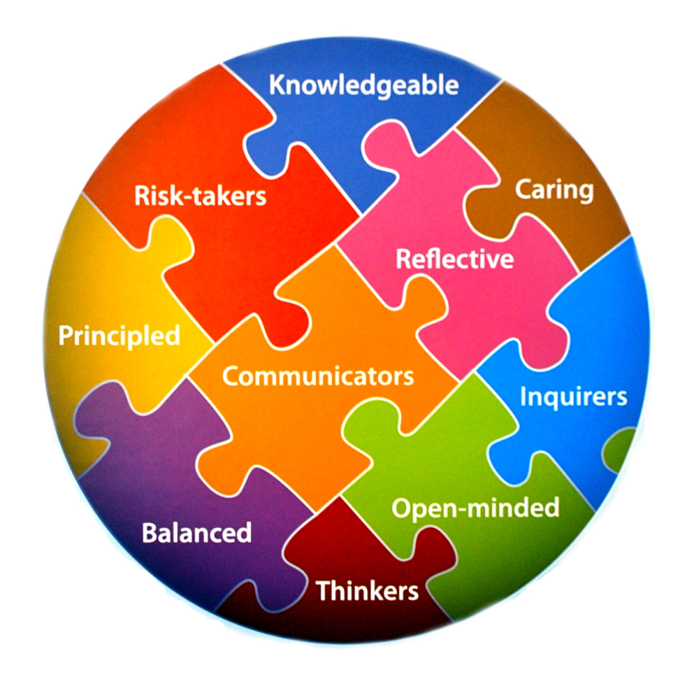
IB Learners strive to be …
“The IB mission statement translated into a set of learning outcomes for the 21st century” (IB website)

Slide 32
The IB Learner Profile
Should these outcomes be assessed?
If no, what are the consequences?
If yes, how might they be assessed?
What difficulties might there be in assessing them?
Does whether or not they are explicitly assessed across all three programmes have an impact on teaching/ learning?

Slide 33
Gardner’s Multiple Intelligences
Bodily-kinaesthetic
Interpersonal
Verbal-linguistic
Mathematical-logical
Naturalistic
Intra-personal
Visual-spatial
Musical
Would we want to attempt to assess all of Gardner’s multiple intelligences in our students?
What effect would there be on teaching/learning if we were to do so?

