Slide 1
Trends in assessment

Slide 2
Current areas of Interest
Formative assessment/Assessment for Learning
Portfolio assessment
E-assessment
Comparative judgement

Slide 3
E-portfolios
Why E-portfolios?
Example using the Mahara platform
Google e-portfolios
e-scape

Slide 4
E-assessment
E-tests/e-examinations
E-marking
Data analysis
Peer assessment
Group/Project assessment

Slide 5
E-assessment
MYP!

Slide 6
E-assessment
MYP!

Slide 7
E-assessment
MYP!
High stakes e-assessment
Re-Engineering Assessment Practices
JISC Guides

Slide 8
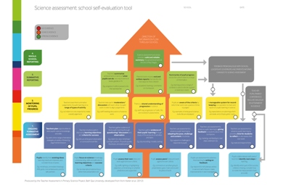
Bath taps

