Slide 1
MA Education Assessment The Nature and Purposes of Educational Assessment
Paul Denley

Slide 2
Introductions
Who am I?
Experience of assessing and being assessed
Development of local and national examinations
Involvement with examination quality assurance
Who are you?
What do you hope to get out of the unit?
What experience do you bring?

Slide 3
Aims of the unit
To develop and apply a critical understanding of some of the important contemporary issues and discourses in assessment.
To become familiar with some of the key terms and concepts used in assessment.
To share experience and ideas amongst practitioners from a wide range of backgrounds.
To contribute to your own professional development in this field.

Slide 4
by …
considering principles, theories, practice and changes in practice;
considering the same in relation to your own experience and practice;
developing a framework/rationale for your own theories and practice.

Slide 5
Session content
The nature of assessment in education
What shall we assess and how?
Assessment of/for/as learning
Peer and self assessment
Quality issues in assessment
Referencing systems
Who should assess and report, and to whom?
Where is assessment going?
Assignment Presentations

Slide 6
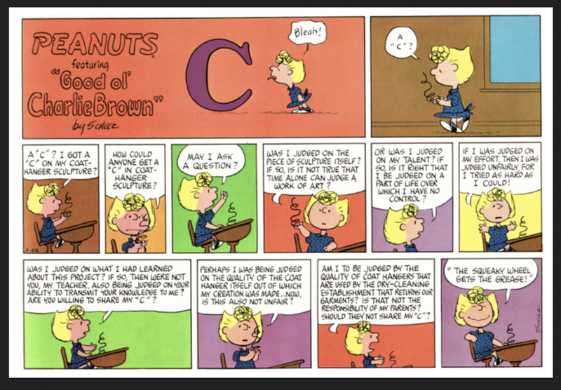

Slide 7
… the complexity of assessment
“May I ask a question? Was I judged on the piece of sculpture itself? If so, is it not true that time alone can judge a work of art? Or was I judged on my talent? If so, is it right that I be judged on a part of life over which I have no control? If I was judged on my effort, then I was judged unfairly, for I tried as hard as I could! Was I judged on what I had learned about this project? If so, then were not you, my teacher, also being judged on your ability to transmit your knowledge to me? Are you willing to share my ‘C’? Perhaps I was being judged on the quality of the coat hanger itself out of which my creation was made . . . now, is this also not unfair? Am I to be judged by the quality of coat hangers that are used by the drycleaning establishment that returns our garments? Is that not the responsibility of my parents? Should they not share my ‘C’?”
Schultz, C. in Mehrens, W. A. & Lehmann, I. J., 1991.
Measurement and Evaluation in Education and Psychology. 4th ed. Fort Worth: Holt.

Slide 8
Myths and Challenges
Assessment ≠ Testing
Assessment does not always involve writing
Assessment does not always have to involve stress
Assessment doesn’t always need the active involvement of the assessed
Assessment should always have a clear purpose
The tail should not wag the dog!

Slide 9
A definition of assessment
Write down what comes to mind when you think of assessment
Discuss with your neighbour(s) what you have written about assessment
Can you agree on a definition?

Slide 10
Some starting points
Is assessment about measuring or learning, or both?
Is assessment about teaching or about learning, or both?
Does assessment provide information about the individual or the institution?
Is assessment for the teacher or the student, or both?
Should assessment reflect the learning process, or support it?

Slide 11
Some key basic questions …
Why do we assess?
What do we assess?
How do we assess?
Who assesses?
When do we assess?
What do we do with the results?

Slide 12
Why do we assess?
Think of the various times when you assess your students (or when you were assessed as a student).
Why are you assessing them? (Or why were you assessed?) Do these change?
What are the purposes?
What are we doing when we assess?

Slide 13
A working definition …
Assessment is about obtaining and interpreting evidence about the achievement of learners to help someone make decisions about those learners and/or the teaching and learning process
(Evaluation is broader than assessment)

Slide 14
A caveat
‘Assessment’ is NOT the same as ‘examining’ or ‘testing’.
They are just particular forms of assessment.
‘Assessment’ is not the same as ‘evaluation’.

Slide 15
Assessment and Evaluation
We measure distance, we assess learning, and we evaluate results in terms of some set of criteria
Perhaps assessment is more about collecting data … and evaluation is about interpreting it.
Whilst these terms are connected they also have different and distinct functions and purposes.

Slide 16
Obtaining evidence
Make a list of all the ways you can think of for obtaining evidence about students’ achievement.
Some ways are ‘formal’ – separate from the everyday practice of the classroom;
Some ways are ‘informal’ – part of the teaching and learning activities of the classroom.
Can you divide your list into formal and informal ways of assessing?

Slide 17
Interpreting the evidence
What difficulties might there be in interpreting what the evidence tells us about the learners and their achievements?
How might we ensure that our interpretations are ‘correct’?

Slide 18
Making decisions
What sort of decisions might be informed by assessment data?
(Think about decisions at different levels: individuals, classes, schools and wider society.)
Who makes these decisions and how do they use the assessment data to make them?

Slide 19
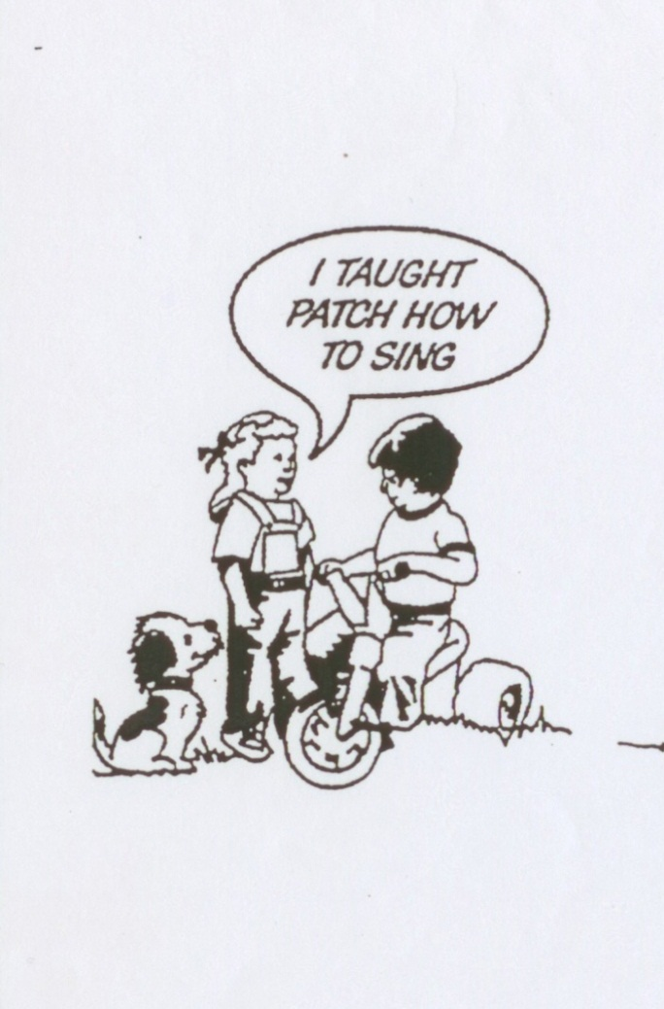
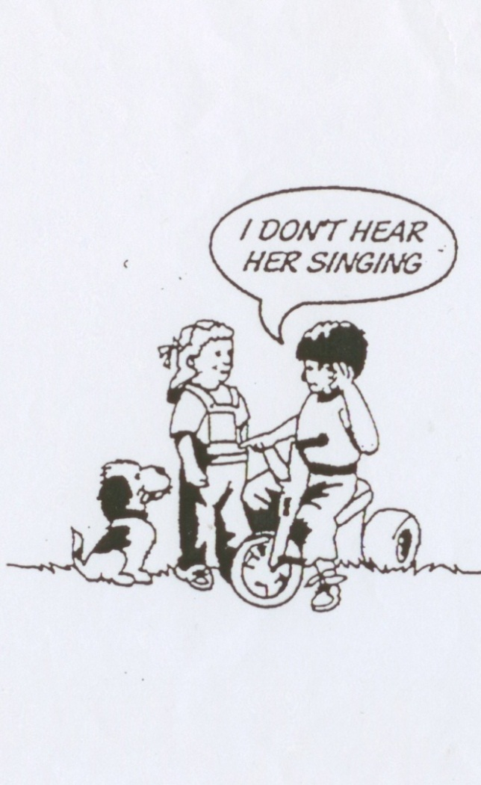
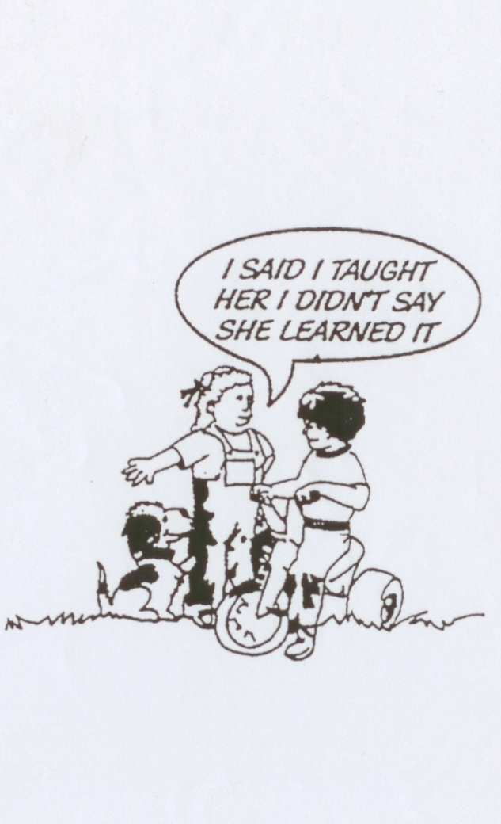
The vital link!

Slide 20
Why do we assess?
Before we start teaching
… to discover what our students know/ don’t know … can do/ can’t do
Diagnostic assessment

Slide 21
Why do we assess?
While we are teaching
… to monitor and support our students’ learning … and our own teaching
Formative assessment

Slide 22
Why do we assess?
After we have finished teaching
… to summarise what our students have learned/ can do … and to report on it
Summative assessment

Slide 23
For what purpose is the boy suggesting his assessment grades will be used?
What impact might this use (or threatened use) have on the teacher’s approach to teaching and assessment in her classroom?

Slide 24
Assessment …
has a particular purpose
involves a judgement or measurement by an ‘expert’ of a ‘learner’
results in an outcome which should be linked to the learner in some way and to the purpose in some way

Slide 25
Some purposes of assessment
obtaining information about abilities, skills, knowledge …
allocating students to groups, classes – if homogeneity is required
comparing progress – of individuals, groups …
comparing progress – of teachers
informing users – parents, teachers, students, employers about progress and attainment

Slide 26
One school’s assessment purposes
To recognise and celebrate the variety of positive achievements of our pupils
To involve our pupils in taking responsibility for their own learning
To evaluate the effectiveness of our teaching programmes
To provide a summary document appropriate for potential users
To encompass the principles of equal opportunities

Slide 27
Consequences of assessment
These might be termed the intended consequences of assessment.
What might some of the unintended consequences be?

Slide 28
Unintended consequences of Assessment
Labelling and consequent prejudice
Self-fulfilling prophecy effect
Excessive competition and individualism
Curriculum backwash: teaching (and learning) for the examination
Replacement of the important by the measurable
Reinforcement and legitimation of social disadvantage
Extrinsic goals replace intrinsic goals
‘Qualificationism’
Acceptance of hierarchies

Slide 29
Teaching to the Test?
“The result of any assessment is almost invariably used to make inferences beyond the immediate items assessed, in other words as an index of performance. If it is easier to increase a student’s score on a test, without increasing the student’s competence on the domain, and the results of the test matter, then we should not be surprised that the teacher’s efforts are directed towards the indicator rather than the indicated.”
(Wiliam, D., 1992. Technical issues in criterion-referenced assessment: evidential and consequential bases. Paper presented at the 18th annual conference of the International Association for Educational Assessment, St Patrick’s College Dublin, 16 September 1992)

Slide 30
Or Measurement-Driven Instruction?
“If properly conceived and implemented, measurement-driven instruction currently constitutes the most cost-effective way of improving the quality of public education.”
(Popham, J. W., 1987. The Merits of Measurement-Driven Instruction. Phi Delta Kappan, 68(9), pp.679-682.)
(and see also the counter-argument in the article that follows this one)

Slide 31
‘High stakes’ assessment
Think of a formal test or examination that you would class as ‘high stakes’ assessment:
What are the ‘stakes’ involved? What do the students (and/or the teachers) gain if they do well, or lose if they do not do well?
In what ways are students prepared for this examination? How long before they take the exam does the preparation start?
Does the ‘washback/backwash’ effect of this examination benefit teaching and learning or have a negative effect?

Slide 32
A sociological account of assessment
Certification of competence: who wants to be operated on by an incompetent surgeon?
Selection for limited opportunities: how do we decide who gets what? How do we legitimate exclusion?
Control of the individual and the system:
- quality control
- accountability
(Broadfoot 1996)

Slide 33
What do the learners think are the purposes?

Slide 34
Purposes of SATs

Slide 35
Who are SATs for?

Slide 36
Assessment ~ a possible framework
“Assessment is the flipside of learning”

Slide 37
Assessment ~ a possible framework
assessment
pedagogy
curriculum
learning

Slide 38
A framework of learning-oriented assessment*
Judging achievement
Maintaining standards
Students’ experiences of (and values relating to) assessment
Promoting learning
Tutors’ experiences of (and values relating to) assessment
Assessment tasks as learning tasks
Students as self-evaluators
Feedback as feedforward
Desired learning outcomes
* Carless et al (2006) How Assessment Supports Learning

Slide 39
Evaluating Assessment?
“As someone who has spent his entire career doing research, writing and thinking about educational testing and assessment issues, I would like to conclude by summarizing a compelling case showing that the major uses of tests for student and school accountability over the past 50 years have improved education and student learning in dramatic ways.
Unfortunately, that is not my conclusion.”
Linn, R., 2000, Assessment and accountability, Educational Researcher, 29(2), pp4-16

Slide 40
A paradigm shift in educational assessment?
From a ‘psychometric’ paradigm to an ‘educational’ one
From a ‘traditional’ approach to an ‘authentic’ one
From behaviourist views about learning to constructivist ideas
From a testing and examination culture to an ‘assessment culture’
Beyond Testing, Caroline Gipps

Slide 41
The psychometric tradition
derived from intelligence testing
assumes innate, fixed attributes, ‘normally’ distributed in a population
concerned with finding the ‘correct score’ for an individual
norm-referenced; interpretation by comparison
designed to differentiate between individuals
standardisation essential for comparisons
emphasis of reliability of instruments

Slide 42
Educational assessment
seeks to measure competence rather than intelligence
competence recognised as developable and variable with time and context
looks for ‘best’ rather than ‘typical’ performance
variable conditions of assessment; comparisons made difficult
aims to help and develop the individual rather than label
performance judged in relation to the individual not the group
reliability is not so ‘critical’

Slide 43
Which paradigm?
Can you identify aspects of the Psychometrics Testing paradigm in your own experience of educational assessment, or in your institution's current practices?
Can you identify aspects of the Educational Assessment paradigm in your own experience or practice?
Is there room for both approaches in schools?
Is each more appropriate than the other for certain purposes?

Slide 44
National Curriculum Assessment in England
“National curriculum assessment (NCA) in England has been in place for 20+ years. It has its origins in a political desire to regulate education, holding schools accountable. However, its form and nature also reflect educational and curriculum concerns and technical assessment issues.
NCA in England has evolved over 20 years, from an attempt at a criterion-referenced system based on tasks marked by the children’s own teachers through to an externally marked examination system. This change reflects the political purposes of the system for accountability, and the pressure associated with this has led to growing criticism of the effects on children and their education. Nonetheless, the results provided are widely used by the public and government, and the reasons for the survival of the system lie in both its utility and the difficulty of identifying a new system which is necessarily an improvement for all the stakeholders involved.”
Whetton, C.,2009. A brief history of a testing time: national curriculum assessment in England 1989-2008, Educational Research, 51(2), pp.137-159.

Slide 45
Some food for thought
Do teachers make a difference?
[9:34-12:45]
Standards?
Performance related pay?
Good teachers?
Class size?

Slide 46
Further food for thought
Should assessment be about …
… celebrating individual differences?
… or …
…eliminating individual differences?

