Slide 1
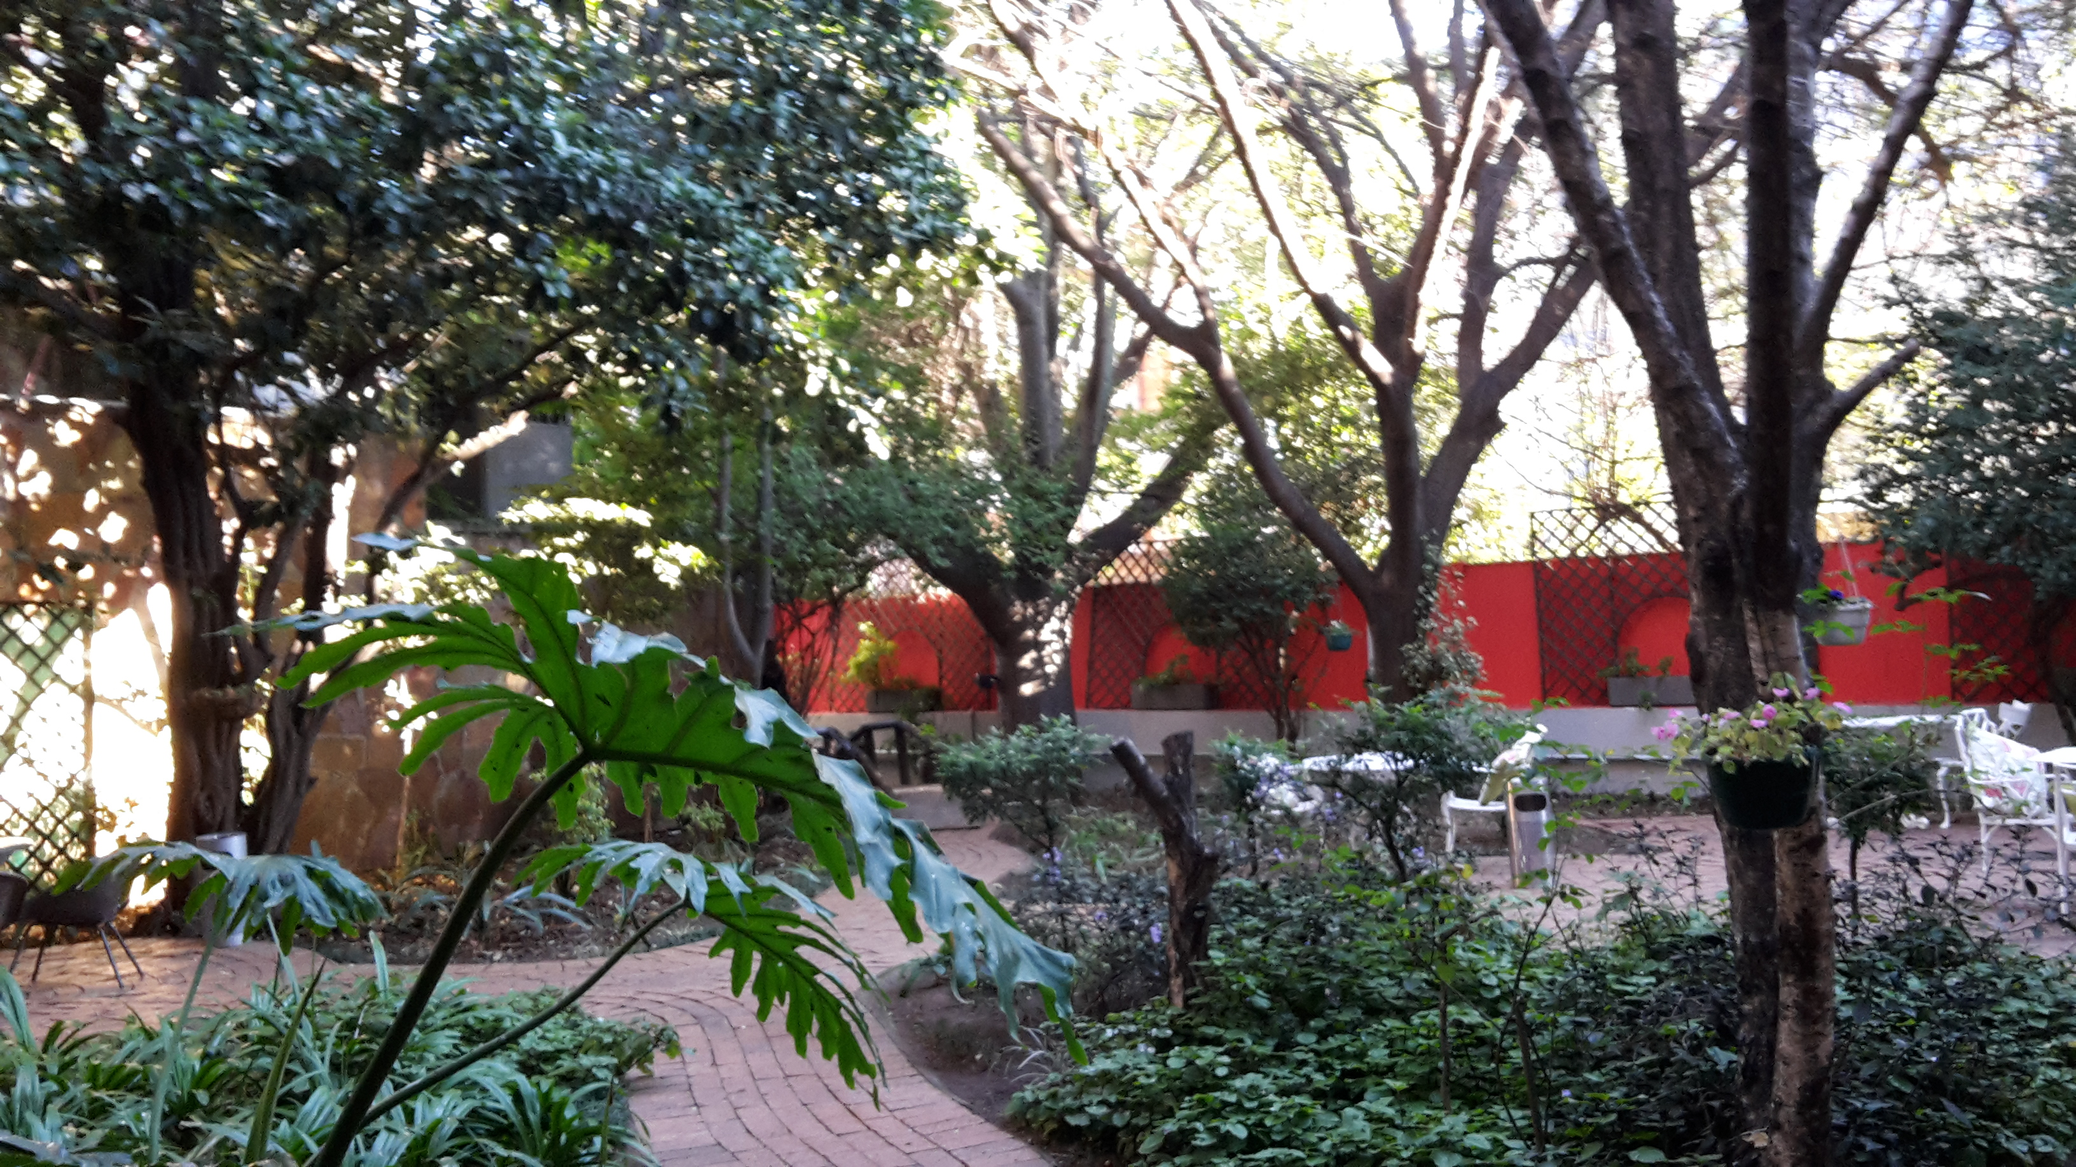
Reflecting on your learning journey

Slide 11
So what does your learning journey feel like at the start of this week?
We would like you to do a simple drawing which represents where you are – and maybe where you’ve come from and where you are going.
It doesn’t have to be a work of art! Could you include a short paragraph to explain or put some labels on your diagram!
It shouldn’t take more than 10 minutes then compare your drawing with the person next to you and see how they are similar or different.
Finally, talk about ways you can support one another on your journeys.

