Slide 1
Measuring the Effectiveness of a Maths Support Service
Matthew Taylor

Slide 2
Personal Background
Greater Manchester, England
2nd Year Student
BA German & Mathematics

Slide 3
Project Aims
Maximize efficiency of a MSS model
Simulation
‘What if…?’ scenarios
Alternate models

Slide 4
Simul8 – An Overview
What is Simul8?
Simulation software package
Accounts for limiting factors
Discrete simulation
Methodology
Simulation ‘a visual model depicting a real-life system’ Pidd (2004)
Validation ‘the process of determining whether a simulation model is an accurate representation of the system’ Law (2007)
Analysis ‘information can be extrapolated to envisage how the actual system will respond’ Bunday (1996)

Slide 5
Simul8 – An Overview

Slide 6
Simul8 – An Overview

Slide 7
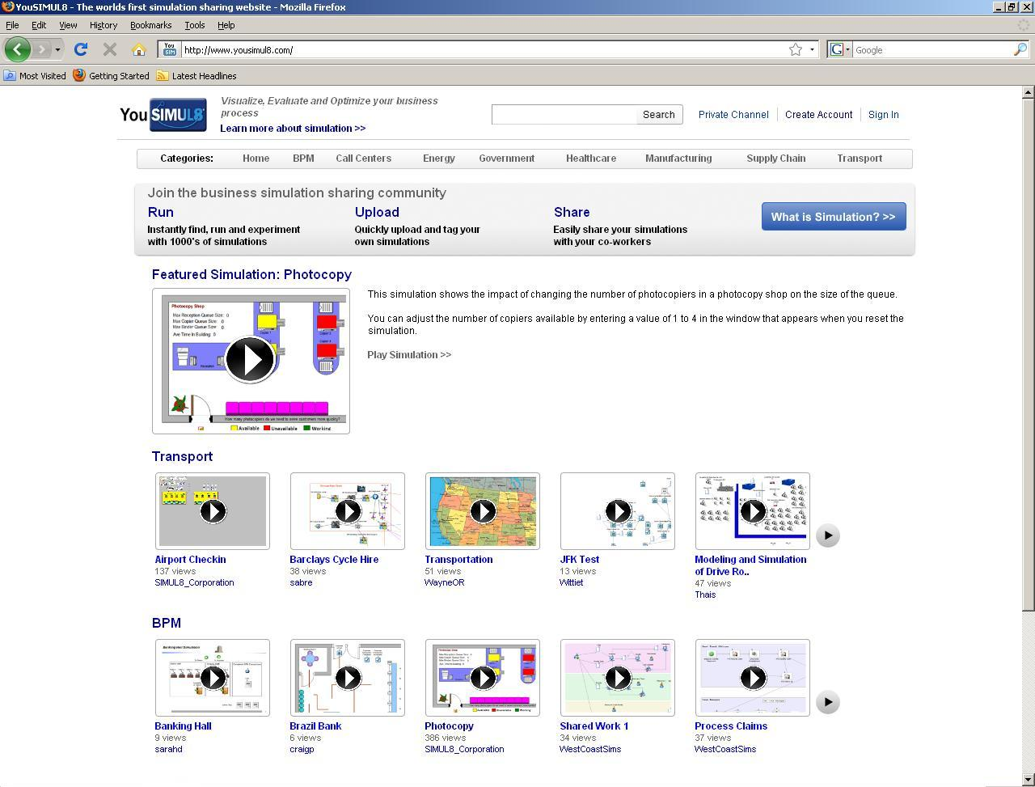
End Targets
YouSimul8

Slide 8
Interaction
MSS Models
Parameters
Student Opinion
Data
Method for collection
Teamwork

