Slide 1
“But my supervisor said…”
Cheryl Voake-Jones
C.Voake-Jones@bath.ac.uk

Slide 2

“I’m a distance learner.”

Slide 3
“Can I record you?”
I’m going to record this. I hope they don’t mind.
I’m going to record this. I hope they don’t notice.

Slide 4
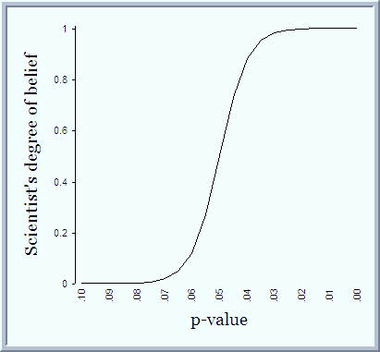
“So p less than 0.05 is the good one, right?”

Slide 5
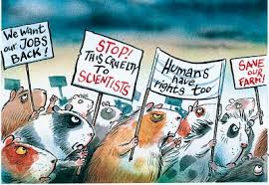
“I just need to know n for my ethics form.”

Slide 6

“Can you help me understand the reviewers’ comments on my paper?”
“Can you help me review this paper?”
“Can you help me write this up for a paper?”

Slide 7

“This data that I need you to look at is highly confidential.”

Slide 8

“Can you read through my report and check it makes sense?”

Slide 9
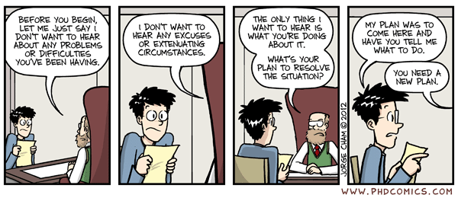
“But my supervisor said….”
“…ignore the assumptions.”
“…I could just stick with loads of t-tests instead of ANOVA.”
“…I need to do something more complicated, but (s)he doesn’t know what. Or how.”
“…you’d be able to do the stats for me.”

Slide 10

“I’m a distance learner.”
“Can I record you?”
“So p less than 0.05 is the good one, right?”
“I just need to know n for my ethics form.”
“Can you help me understand the reviewers’ comments on my paper?”
“This data that I need you to look at is highly confidential.”
“Can you read through my report and check it makes sense?”
“But my supervisor said….”

