Slide 1
Compressing first-order proofs in deep inference using epsilon-terms
Cameron Allett
PhD Student, University of Bath

Slide 2
Introduction
Aim to better understand first-order proof theory and its normalisation theory, in particular Herbrand’s Theorem and cut elimination

Slide 3
Introduction
Aim to better understand first-order proof theory and its normalisation theory, in particular Herbrand’s Theorem and cut elimination
Recent interest in developing first-order proof systems with non-elementary speedups over traditional Gentzen systems for cut-free proofs

Slide 4
Introduction
Aim to better understand first-order proof theory and its normalisation theory, in particular Herbrand’s Theorem and cut elimination
Recent interest in developing first-order proof systems with non-elementary speedups over traditional Gentzen systems for cut-free proofs
In today’s talk:
overview Herbrand’s Theorem and cut elimination
overview deep inference speedups over traditional proof systems
how the epsilon-calculus can improve normalisation properties and provide a semantic explanation for the non-elementary speedups

Slide 5
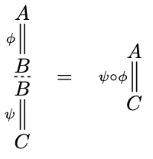
Deep Inference
More flexible composition mechanism than traditional Gentzen systems using the open deduction formalism (Guglielmi, Gundersen, Parigot, 2010)
Notes:
Stress that the emphasis is on the *space* of proofs, not the proof systems themselves

Slide 6
Deep Inference
More flexible composition mechanism than traditional Gentzen systems using the open deduction formalism (Guglielmi, Gundersen, Parigot, 2010)
Notes:
Stress that the emphasis is on the *space* of proofs, not the proof systems themselves

Slide 7
Deep Inference
More flexible composition mechanism than traditional Gentzen systems using the open deduction formalism (Guglielmi, Gundersen, Parigot, 2010)
Applying inference rules at arbitrary depth yields improved normalisation properties
Notes:
Stress that the emphasis is on the *space* of proofs, not the proof systems themselves

Slide 8
Proof System
equality rules for connective commutativity, quantifier ordering, vacuous quantification, quantifier renaming
Notes:
Each rule has a dual
Mention atomicity

Slide 9
Proof System
equality rules for connective commutativity, quantifier ordering, vacuous quantification, quantifier renaming
Propositional rules can be decomposed to atomic form in deep inference
Notes:
Each rule has a dual
Mention atomicity

Slide 10
Proof System
equality rules for connective commutativity, quantifier ordering, vacuous quantification, quantifier renaming
Proofs are derivations with premise t (true)
Notes:
Each rule has a dual
Mention atomicity

Slide 11
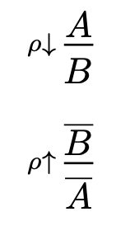
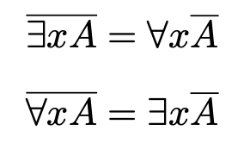
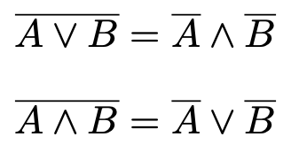
Proof System
equality rules for connective commutativity, quantifier ordering, vacuous quantification, quantifier renaming
Each inference rule has a dual inference rule
Notes:
Each rule has a dual
Mention atomicity

Slide 12
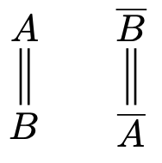
Proof System
equality rules for connective commutativity, quantifier ordering, vacuous quantification, quantifier renaming
Each inference rule has a dual inference rule
Notes:
Each rule has a dual
Mention atomicity

Slide 13
Herbrand’s Theorem
Existential contraction rules may be viewed semantically as case analyses on the witnesses to the existential quantifiers in the premise

Slide 14
Herbrand’s Theorem
Existential contraction rules may be viewed semantically as case analyses on the witnesses to the existential quantifiers in the premise
Semantically natural to extract these case analyses

Slide 15
Herbrand’s Theorem
Existential contraction rules may be viewed semantically as case analyses on the witnesses to the existential quantifiers in the premise
Semantically natural to extract these case analyses
Accumulate existential contraction rules into Herbrand expanders (Ralph, 2016) for convenience in normalisation

Slide 16
Herbrand’s Theorem
In a deep-inference setting, Brünnler (2001) has presented a proof of Herbrand’s Theorem in the form of a decomposition theorem
Notes:
Mention that cuts do not need to be eliminated from the proof, unlike in traditional Gentzen procedures

Slide 17
Herbrand’s Theorem
In a deep-inference setting, Brünnler (2001) has presented a proof of Herbrand’s Theorem in the form of a decomposition theorem
∀x.A’ is referred to as a Herbrand disjunction for A
Notes:
Mention that cuts do not need to be eliminated from the proof, unlike in traditional Gentzen procedures

Slide 18
Herbrand’s Theorem
In a deep-inference setting, Brünnler (2001) has presented a proof of Herbrand’s Theorem in the form of a decomposition theorem
∀x.A’ is referred to as a Herbrand disjunction for A
Reduction of undecidable first-order provability to decidable propositional provability
Notes:
Mention that cuts do not need to be eliminated from the proof, unlike in traditional Gentzen procedures

Slide 19
Herbrand’s Theorem
In a deep-inference setting, Brünnler (2001) has presented a proof of Herbrand’s Theorem in the form of a decomposition theorem
∀x.A’ is referred to as a Herbrand disjunction for A
Reduction of undecidable first-order provability to decidable propositional provability
Large (non-elementary) blowups in proof complexity
Notes:
Mention that cuts do not need to be eliminated from the proof, unlike in traditional Gentzen procedures

Slide 20
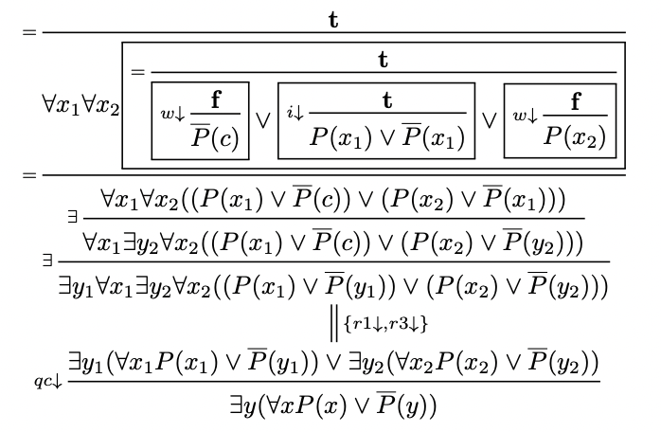
Example: The Phone Paradox
Amongst any audience, there exists a person such that if they are looking at their phone, everyone is looking at their phone
Herbrand disjunction:

Slide 21
Cut Elimination
Elimination of cut rules from a proof
Notes:
Cut elimination is not the main focus of the talk
Can extend to first-order by first performing a Herbrand stratification
Confluence!

Slide 22
Cut Elimination
Elimination of cut rules from a proof
In Gentzen systems, cuts are eliminated by permuting cut rules up the proof, resulting in non-determinism from certain reduction steps
Notes:
Cut elimination is not the main focus of the talk
Can extend to first-order by first performing a Herbrand stratification
Confluence!

Slide 23
Cut Elimination
Elimination of cut rules from a proof
In Gentzen systems, cuts are eliminated by permuting cut rules up the proof, resulting in non-determinism from certain reduction steps
Large (non-elementary) blowups in proof complexity for first-order proofs
Notes:
Cut elimination is not the main focus of the talk
Can extend to first-order by first performing a Herbrand stratification
Confluence!

Slide 24
Cut Elimination
Cuts may be decomposed to atomic form in deep inference
Notes:
Cut elimination is not the main focus of the talk
Can extend to first-order by first performing a Herbrand stratification
Confluence!

Slide 25
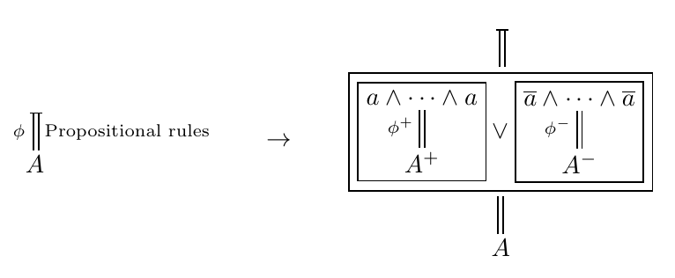
Cut Elimination
Cuts may be decomposed to atomic form in deep inference
In propositional deep inference, a semantically natural cut-elimination procedure exists, known as the experiments method (Guglielmi, 2002; Ralph, 2019)
Notes:
Cut elimination is not the main focus of the talk
Can extend to first-order by first performing a Herbrand stratification
Confluence!

Slide 26
Cut Elimination
Cuts may be decomposed to atomic form in deep inference
In propositional deep inference, a semantically natural cut-elimination procedure exists, known as the experiments method (Guglielmi, 2002; Ralph, 2019)
Can be extended to first-order by first translating to Herbrand normal form
Notes:
Cut elimination is not the main focus of the talk
Can extend to first-order by first performing a Herbrand stratification
Confluence!

Slide 27
Quantifier-Shifts

Slide 28
Quantifier-Shifts
Theorem (Aguilera, Baaz, 2019): For a class of tautologies S due to Statman (1979), there is no elementary function (a function definable by a quantifier-free formula from +, × and exp) bounding the length of the shortest cut-free LK proof of any formula in S by its shortest cut-free LK + QS proof

Slide 29
Quantifier-Shifts
Theorem (Aguilera, Baaz, 2019): For a class of tautologies S due to Statman (1979), there is no elementary function (a function definable by a quantifier-free formula from +, × and exp) bounding the length of the shortest cut-free LK proof of any formula in S by its shortest cut-free LK + QS proof
Corollary: First-order deep-inference systems have non-elementary speedups over Gentzen systems for cut-free proofs

Slide 30
Relationship Between First-Order Phenomena
Traditionally, in the sequent calculus, Herbrand’s Theorem is proved as a corollary to cut elimination

Slide 31
Relationship Between First-Order Phenomena
Traditionally, in the sequent calculus, Herbrand’s Theorem is proved as a corollary to cut elimination
Brünnler’s proof of Herbrand’s Theorem using deep inference does not require cuts to be eliminated from the proof, establishing a kind of independence between Herbrand’s Theorem and cut elimination

Slide 32
Relationship Between First-Order Phenomena
Traditionally, in the sequent calculus, Herbrand’s Theorem is proved as a corollary to cut elimination
Brünnler’s proof of Herbrand’s Theorem using deep inference does not require cuts to be eliminated from the proof, establishing a kind of independence between Herbrand’s Theorem and cut elimination
Cut elimination and Herbrand’s Theorem require quantifier-shifts to be decompressed, resulting in non-elementary blowups. Can quantifier-shifts help us to understand the relationship between these theorems?
Notes:
Existing proofs for both cut elimination and Herbrand’s Theorem require quantifier-shifts to be decompressed, resulting in non-elementary blowups. Can a semantic understanding of quantifier-shifts help us to better understand the relationship between Herbrand’s Theorem and cut elimination?

Slide 33
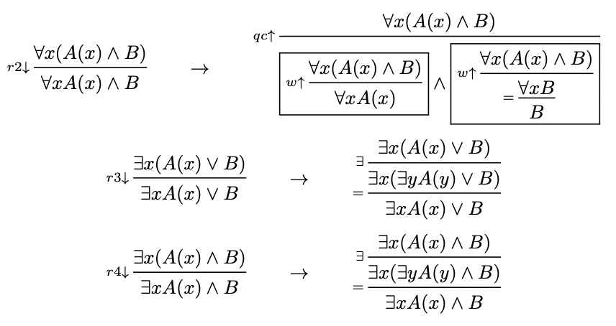
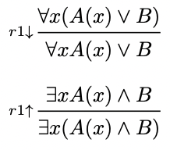
Elimination of Quantifier-Shifts
Most quantifier-shifts are derivable with other rules, with the exceptions of the rules r1↓ and r1↑

Slide 34
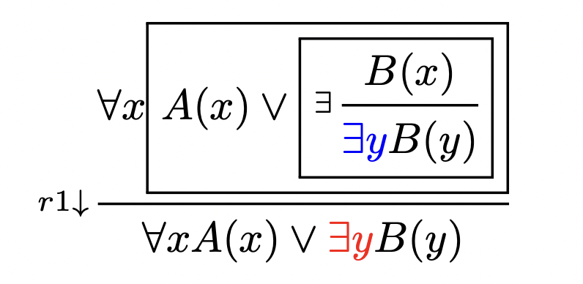
Falsifiers
No constructive witness to ∃y constructed in the derivation

Slide 35
Falsifiers
No constructive witness to ∃y constructed in the derivation

Slide 36
Falsifiers
No constructive witness to ∃y constructed in the derivation
Quantifier-shifts conceal the epsilon-calculus!

Slide 37
Epsilon-Calculus
Expand the language of the predicate calculus by epsilon-terms:

Slide 38
Epsilon-Calculus
Expand the language of the predicate calculus by epsilon-terms:
Introduced by Hilbert (1927), as a tool for developing consistency proofs

Slide 39
Epsilon-Calculus
Expand the language of the predicate calculus by epsilon-terms:
Introduced by Hilbert (1927), as a tool for developing consistency proofs
It is known that the epsilon-calculus may be used to obtain non-elementary speedups in the computation of Herbrand disjunctions from proofs over traditional methods (Baaz, Leitsch, Lolic, 2017)

Slide 40
Falsifier Rule
Notes:
“This kind of looks like a quantifier-shift”

Slide 41
Falsifier Rule
Existential rules can be permuted down through quantifier-shifts
Notes:
“This kind of looks like a quantifier-shift”

Slide 42
Falsifier Rule
Equivalent to r1↓ when x does not occur free in B
Notes:
“This kind of looks like a quantifier-shift”

Slide 43
Falsifier Rule
r1↑ rules may be eliminated using falsifiers – ∃x may be assigned an explicit disjunction of witnesses
Notes:
“This kind of looks like a quantifier-shift”

Slide 44
Falsifier Rule
Provides a better semantic understanding of the non-elementary speedups yielded by quantifier-shifts
The epsilon-calculus provides a syntax for expressing non-constructive witnesses to existential quantifiers generated in proofs
New perspective on quantifier-shifts: altering witnesses to existential quantifiers rather than quantifier-dependency
Notes:
“This kind of looks like a quantifier-shift”

Slide 45
Extraction of Case Analyses
A semantically natural operation to perform on a first-order proof is to extract the case analyses

Slide 46
Extraction of Case Analyses
A semantically natural operation to perform on a first-order proof is to extract the case analyses
Herbrand’s Theorem also decompresses quantifier-shifts by making the proof constructive, resulting in non-elementary blowups – can falsifiers prevent this?

Slide 47
Extraction of Case Analyses
A semantically natural operation to perform on a first-order proof is to extract the case analyses
Herbrand’s Theorem also decompresses quantifier-shifts by making the proof constructive, resulting in non-elementary blowups – can falsifiers prevent this?
Simple case analysis extraction by permuting quantifier contraction rules

Slide 48
Non-Termination of Case Analysis Extraction
Notes:
Semantic explanation of superfluous qc rules

Slide 49
Non-Termination of Case Analysis Extraction
Superfluous qc↓ rules are created, despite the witnesses to the existential quantifiers being equal
Notes:
Semantic explanation of superfluous qc rules

Slide 50
Non-Termination of Case Analysis Extraction
Superfluous qc↓ rules are created, despite the witnesses to the existential quantifiers being equal
Notes:
Semantic explanation of superfluous qc rules

Slide 51
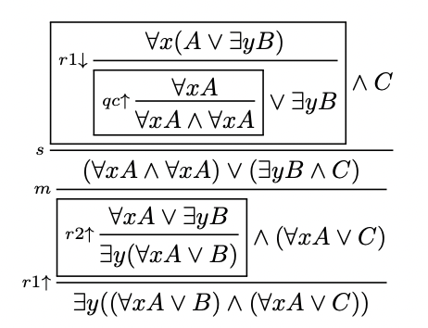
Non-Termination of Case Analysis Extraction
Superfluous qc↓ rules are created, despite the witnesses to the existential quantifiers being equal
Notes:
Semantic explanation of superfluous qc rules

Slide 52
Non-Termination of Case Analysis Extraction
Superfluous qc↓ rules are created, despite the witnesses to the existential quantifiers being equal
Notes:
Semantic explanation of superfluous qc rules

Slide 53
Non-Termination of Case Analysis Extraction
Superfluous qc↓ rules are created, despite the witnesses to the existential quantifiers being equal
Notes:
Semantic explanation of superfluous qc rules

Slide 54
Non-Termination of Case Analysis Extraction
Superfluous qc↓ rules are created, despite the witnesses to the existential quantifiers being equal
Notes:
Semantic explanation of superfluous qc rules

Slide 55
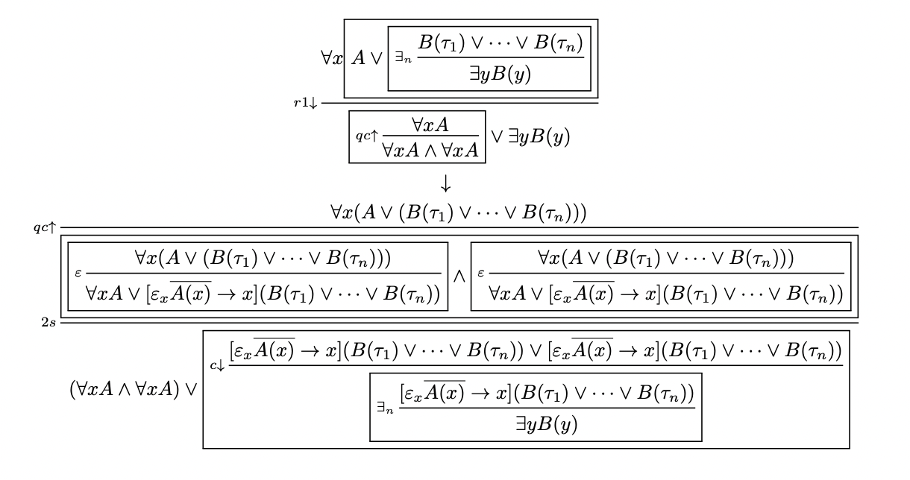
Termination Using Falsifiers

Slide 56
Termination Using Falsifiers
The more expressive epsilon syntax can recognise that the terms are equal – there is no need for a case analysis and so no superfluous qc↓ rules are created

Slide 57
Extraction of Case Analyses
Extract case analyses from a first-order proof in two phases:
Phase 1: Permute existential rules down to the bottom of the proof
Phase 2: Permute universal cocontractions up, until they are eliminated

Slide 58
Extraction of Case Analyses
Extract case analyses from a first-order proof in two phases:
Phase 1: Permute existential rules down to the bottom of the proof
Phase 2: Permute universal cocontractions up, until they are eliminated
First eliminate quantifier-shifts, as shown

Slide 59
Phase 1: Permute Existential Rules Down
Accumulate existential contraction rules into Herbrand expanders

Slide 60
Phase 1: Permute Existential Rules Down
Accumulate existential contraction rules into Herbrand expanders
Duplicate rules inside the context of Herbrand expanders, resulting in exponential blowups

Slide 61
Phase 1: Permute Existential Rules Down
r1↑ rules are eliminated by the above permutation

Slide 62
Phase 1: Permute Existential Rules Down
r1↑ rules are eliminated by the above permutation
Herbrand expanders trivially permute through falsifier rules

Slide 63
Phase 2: Permute Universal Cocontractions Up
Duplicate rules inside the context of universal cocontractions, resulting in exponential blowups

Slide 64
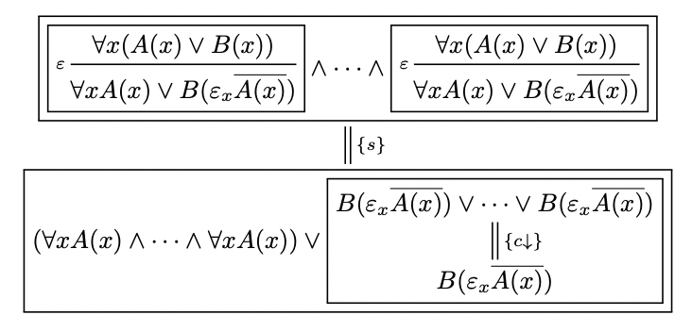
Phase 2: Permute Universal Cocontractions Up
Duplicate rules inside the context of universal cocontractions, resulting in exponential blowups
When permuting a universal cocontraction up through a falsifier rule, we employ the following construction, which is invariant under the permutation

Slide 65
Falsifier Normal Form
I call A’ a falsifier disjunction for A

Slide 66
Falsifier Normal Form
I call A’ a falsifier disjunction for A

Slide 67
Falsifier Normal Form
I call A’ a falsifier disjunction for A
Non-elementary speedups over Herbrand disjunctions and Herbrand proofs
}

Slide 68
Falsifier Normal Form
Unlike Herbrand’s Theorem, we have extracted the case analyses from the proof but left the quantifier-shifts intact, in the form of falsifier rules
Epsilon-terms represent non-constructive elements of the domain generated in the proof

Slide 69
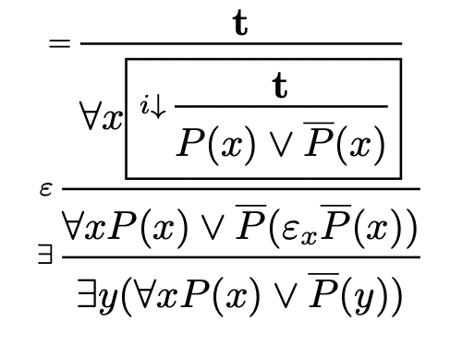
Example: The Phone Paradox
Herbrand disjunction:
Falsifier disjunction:

Slide 70
Example: The Phone Paradox
Traditional critical-axiom-based proof in the epsilon-calculus
Falsifier disjunction:

Slide 71
Example: The Phone Paradox
Traditional critical-axiom-based proof in the epsilon-calculus
Falsifier disjunction:

Slide 72
Example: The Phone Paradox
Traditional critical-axiom-based proof in the epsilon-calculus
Falsifier disjunction:

Slide 73
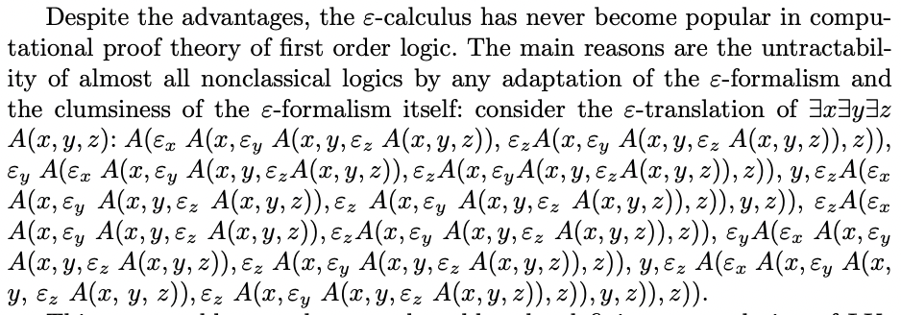
“Clumsiness” of Encoding Quantifiers With Epsilon-Terms
From Baaz, Leitsch, Lolic, 2017:

Slide 74
“Clumsiness” of Encoding Quantifiers With Epsilon-Terms
From Baaz, Leitsch, Lolic, 2017:
Falsifiers do not do this

Slide 75
Ongoing Work: Falsifiers as an Intermediate Between Herbrand’s Theorem and Cut Elimination
First-order proof
Case analysis extraction
Falsifier normal form
Epsilon-extended experiments method?
Epsilon substitution?
Herbrand’s Theorem
Cut Elimination

Slide 76
Conclusion and ε-agitprop
A new perspective on the epsilon-calculus, guided by considerations of complexity, normalisation and semantics

Slide 77
Conclusion and ε-agitprop
A new perspective on the epsilon-calculus, guided by considerations of complexity, normalisation and semantics
First-order proof theory is far from being fully understood – the central problem lies in the behaviour of existential quantifiers and their witnesses

Slide 78
Conclusion and ε-agitprop
A new perspective on the epsilon-calculus, guided by considerations of complexity, normalisation and semantics
First-order proof theory is far from being fully understood – the central problem lies in the behaviour of existential quantifiers and their witnesses
Expanding the language of the predicate calculus by epsilon-terms yields:
improved normalisation properties of quantifier-shifts
termination of case analysis extraction
better semantic understanding of non-elementary speedups
syntax for expressing non-constructive behaviour of existential witnesses
Notes:
Less cumbersome than worst use cases of the epsilon-calculus
Epsilon-calculus was introduced almost a century ago for the sake of establishing consistency proofs
I am NOT encoding quantifiers with epsilon-terms

