Slide 1
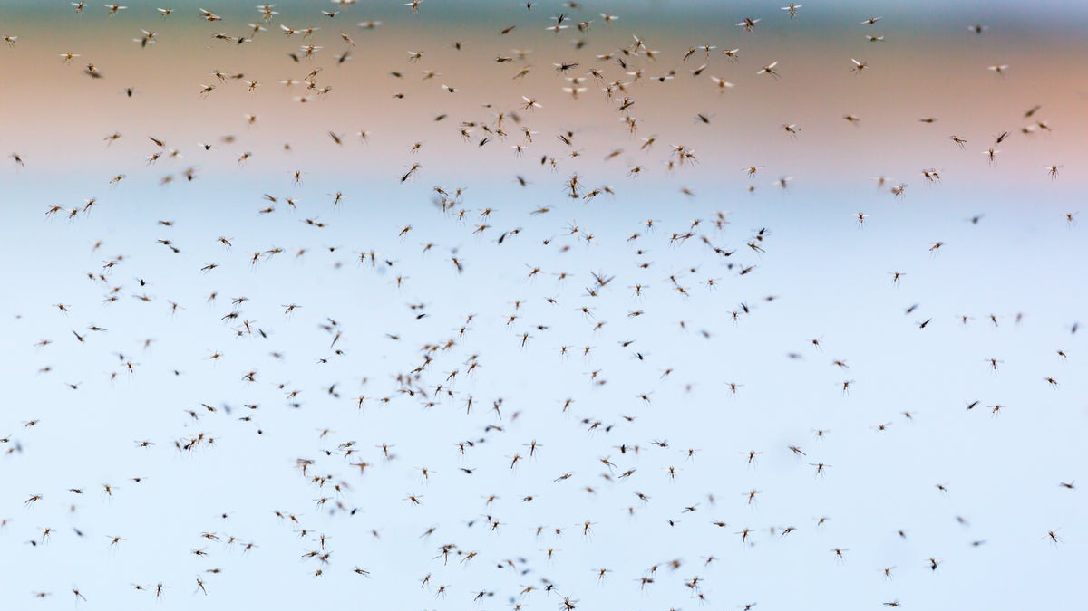


A household model for the introduction of Wolbachia to control dengue
Abby Barlow, PhD candidate
Supervisor: Ben Adams
Source: https://www.kayak.co.uk/Cairns.23637.guide
Source: https://www.scientificamerican.com/article/researchers-to-release-genetically-engineered-mosquitoes-in-africa-for-first-time/
Notes:
Thanks for the introduction
Toledo: 20 mins (no more than 15 talking)
Bath: 20 mins (15-20 mins talking)

Slide 2


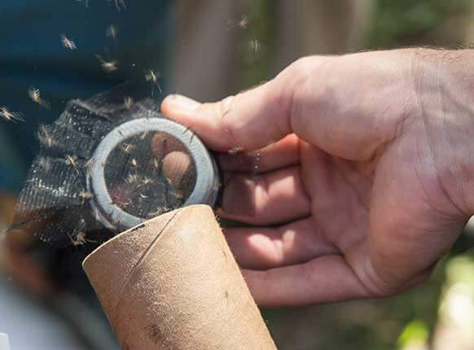

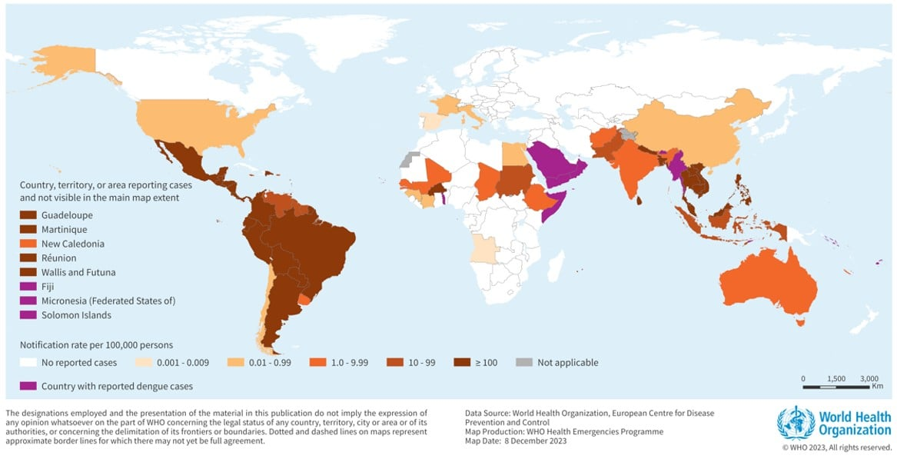
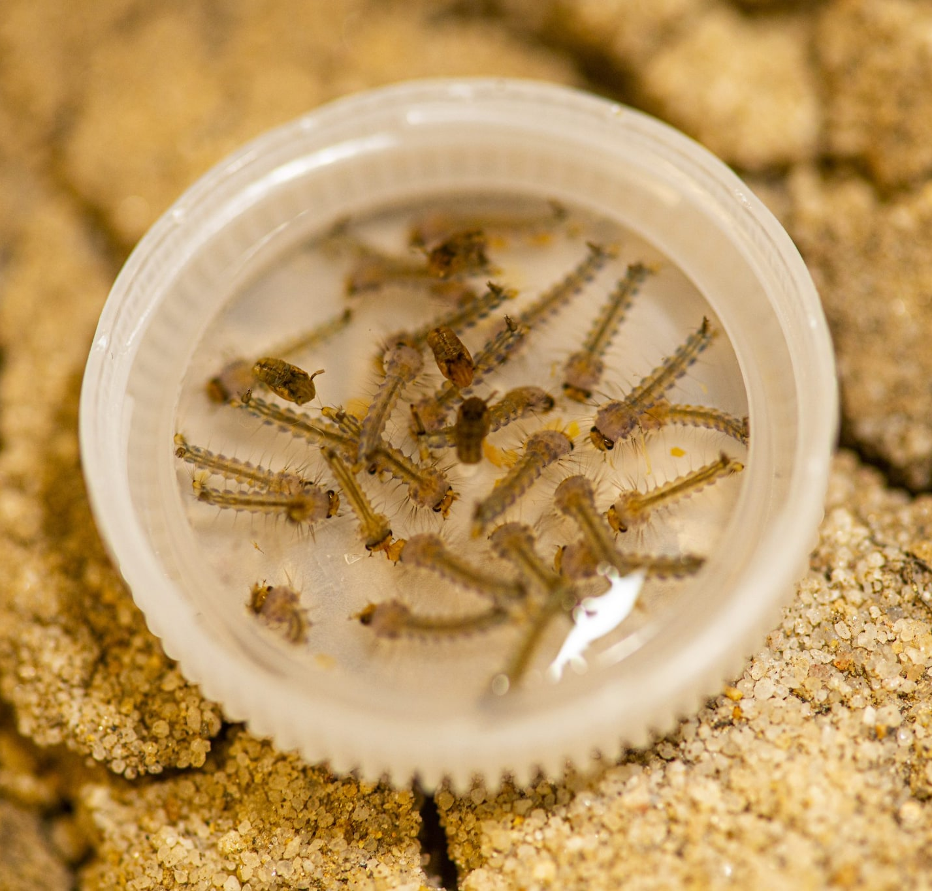
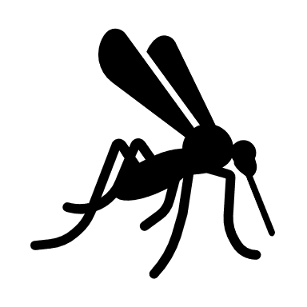




Dengue and Wolbachia
Dorigatti, Ilaria, et al. "Using Wolbachia for dengue control: insights from modelling." Trends in parasitology 34.2 (2018): 102-113.
$$×$$
$$×$$
$$×$$
$$×$$
https://www.miamidade.gov/global/news-item.page?Mduid_news=news1561568226336963
The CI effect
https://edition.cnn.com/2019/09/18/health/dengue-asia-outbreak-climate-intl-hnk/index.html
https://www.who.int/emergencies/disease-outbreak-news/item/2023-DON498
Zeng, Z., Zhan, J., Chen, L., Chen, H., Cheng, S.: Global, regional, and national dengue burden from 1990 to 2017: A systematic analysis based on the global burden of disease study 2017. EClinicalMedicine 32 (2021)
Household structure
Notes:
To give a bit of background…
Dengue is a common vector borne disease with an estimated global burden of 100 to 400 million cases and around 40,000 deaths per year.
It circulated endemically across tropical and subtropical regions affecting over 100 countries.
The infection is passed down to humans via the bite of an infected mosquito.
It’s most common vector is the aedes aegypti mosquito, which are often found in urban areas since they favour artificial water containers as breeding sites (see bottle cap).
An innovative control measure which has gained traction over the last decade is the releasing mosquitoes that are infected with a type of bacteria called Wolbachia.
The bacteria can alter the host’s biology in numerous ways to reduce mosquito population size and inhibit vector competence.
We focus here on a mechanism called cytoplasmic incompatibility…
Aedes aegypti mosquitoes often live in and around the same dwellings as the people they bite and the invasion dynamics unfold stochastically within small household mosquito populations. Wolbachia releases may even be conducted at the household scale with the objective of generating localised protection against dengue.

Slide 3
Deterministic model
Notes:
I will first introduce a deterministic framework to model the introduction of Wolbachia infected mosquitoes into a household infested with wildtype mosquitoes. Later, we will make comparison to a stochastic equivalent and observe how the bistability between a wildtype only and Wolbachia only outcome changes.

Slide 4


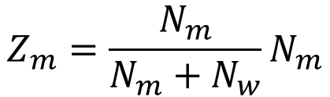

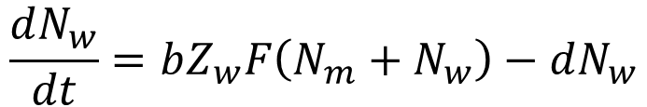

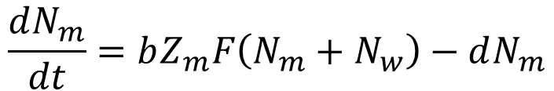

Deterministic model
$N_{m}$ : adult female wildtype mosquito population density
$N_{w}$ : adult female Wolbachia-infected mosquito population density
$$\frac{dN_{m}}{dt}=bZ_{m}F\left(N_{m}+N_{w}\right)−dN_{m}$$
$$\frac{dN_{w}}{dt}=bZ_{w}F\left(N_{m}+N_{w}\right)−dN_{w}$$
intraspecific larval competition function
$$Z_{m}=\frac{N_{m}}{N_{m}+N_{w}}N_{m}$$
and
$$Z_{w}=φN_{w}$$
$$b$$
: per capita birth rate (wildtype)
: per capita death rate
: reproductive cost of infection
Probability of encountering wildtype male
$$d$$
$$1−φ$$
Hughes, H., Britton, N.F.: Modelling the use of Wolbachia to control dengue fever transmission. Bull math biol. 75(5), 796–818 (2013)
Dye, C.: Models for the population dynamics of the yellow fever mosquito, Aedes aegypti. The Journal of Animal Ecology, 247–268 (1984)
Notes:
We adapt a previously published mean-field model, scaling it to a household population.
We have a system of two differential equations, the first describing the rate of change of the adult female wildtype mosquito density. The second….
We assume the population contains the same number of males as females.
b is the per capita birth rate, d is the death rate, d’=delta*d.
Z_m and Z_w are the maximum number of female wildtype and Wolbachia-infected offspring produced in a household of N_m wildtype females and N_w infected females
F is a function describing the intraspecific competition between the mosquito larvae. It can be any heuristic function, monotonically decreasing with mosquito population size.
… I won’t go into more details here as it’s not too important but the parameters are all explained on the next slide…

Slide 5
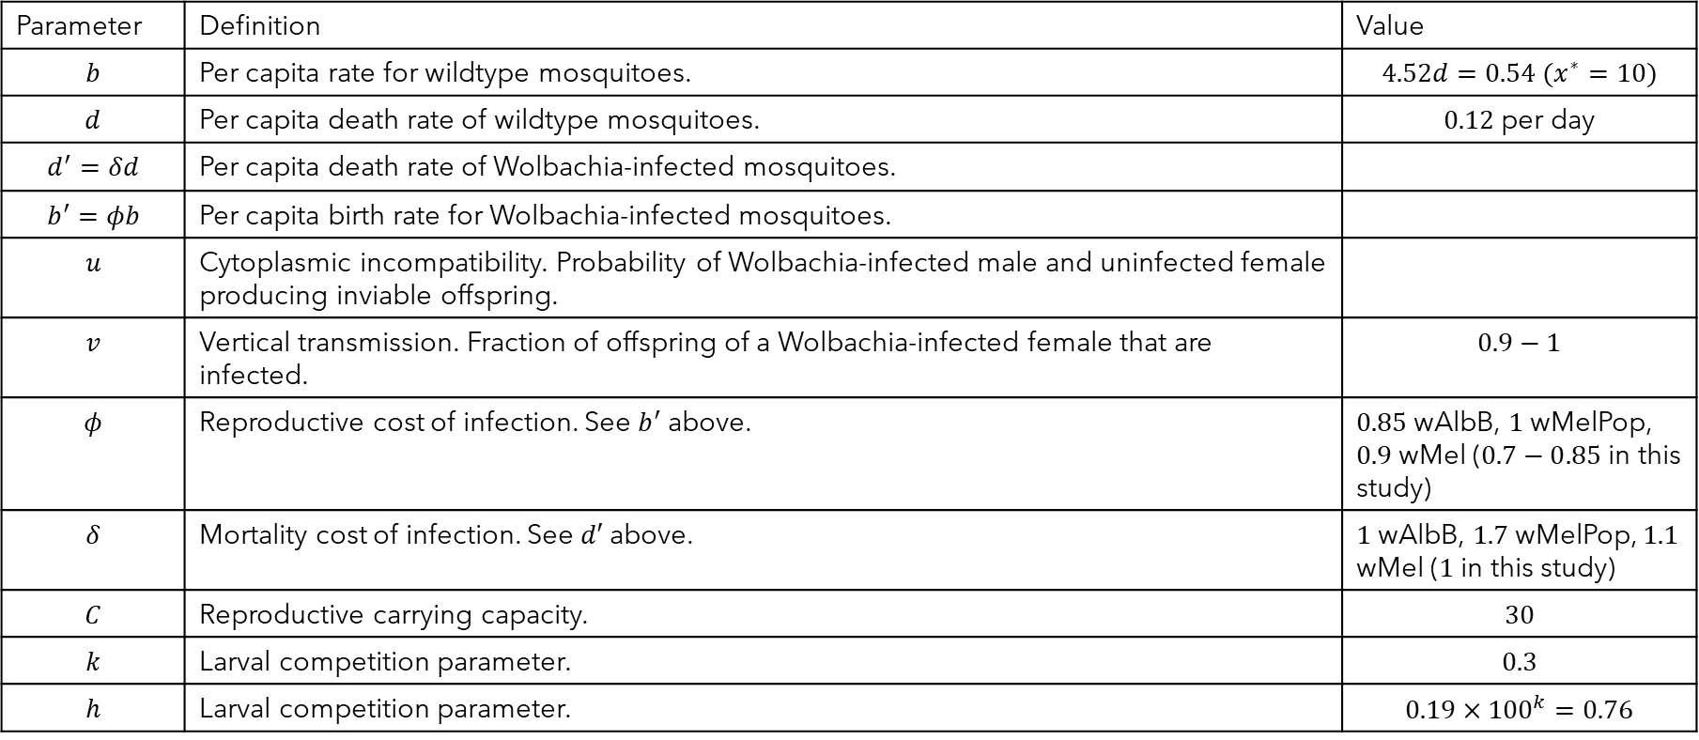
Parameters
Parameter | Definition | Value
$$b$$ | Per capita rate for wildtype mosquitoes. | $$4.52d=0.54 (x^{∗}=10)$$
$$d$$ | Per capita death rate of wildtype mosquitoes. | $0.12$ per day
$$d^{′}=δd$$ | Per capita death rate of Wolbachia-infected mosquitoes.
$$b^{′}=φb$$ | Per capita birth rate for Wolbachia-infected mosquitoes.
$$u$$ | Cytoplasmic incompatibility. Probability of Wolbachia-infected male and uninfected female producing inviable offspring.
$$v$$ | Vertical transmission. Fraction of offspring of a Wolbachia-infected female that are infected. | $$0.9−1$$
$$φ$$ | Reproductive cost of infection. See $b^{′}$ above. | $0.85$ wAlbB, $1$ wMelPop, $0.9$ wMel ($0.7−0.85$ in this study)
$$δ$$ | Mortality cost of infection. See $d′$ above. | $1$ wAlbB, $1.7$ wMelPop, $1.1$ wMel ($1$ in this study)
$$C$$ | Reproductive carrying capacity. | $$30$$
$$k$$ | Larval competition parameter. | $$0.3$$
$$h$$ | Larval competition parameter. | $$0.19×{100}^{k}=0.76$$
Hughes, H., Britton, N.F.: Modelling the use of Wolbachia to control dengue fever transmission. Bull math biol. 75(5), 796–818 (2013)
Dye, C.: Models for the population dynamics of the yellow fever mosquito, Aedes aegypti. The Journal of Animal Ecology, 247–268 (1984)
Notes:
Can explain how b is found later on. Phi and delta values are for different strains, taken from literature. We will keep delta=1 and phi between 0.7 and 0.9.

Slide 6
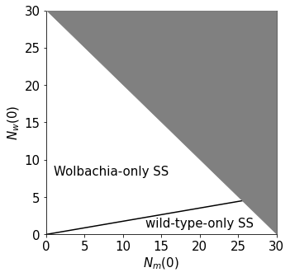
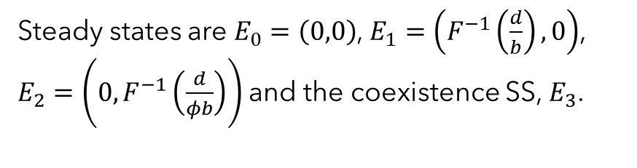
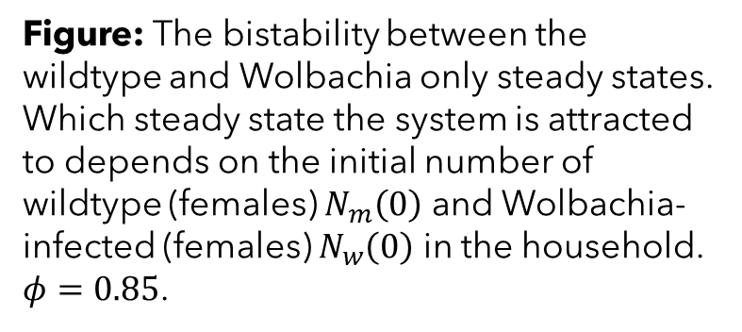
Stability analysis
Steady states are $E_{0}=\left(0,0\right)$, $E_{1}=\left(F^{−1}\left(\frac{d}{b}\right),0\right)$, $E_{2}=\left(0,F^{−1}\left(\frac{d}{φb}\right)\right)$and the coexistence SS, $E_{3}$.
Figure: The bistability between the wildtype and Wolbachia only steady states. Which steady state the system is attracted to depends on the initial number of wildtype (females) $N_{m}\left(0\right)$ and Wolbachia-infected (females) $N_{w}\left(0\right)$ in the household. $φ=0.85$.
Invasion threshold
Hughes, H., Britton, N.F.: Modelling the use of Wolbachia to control dengue fever transmission. Bull math biol. 75(5), 796–818 (2013)
Stender, M., Hoffmann, N.: bSTAB: an open-source software for computing the basin stability of multi-stable dynamical systems. Nonlinear dynamics 107(2), 1451–1468 (2022)
Notes:
Steady states are, extinction, wildtype only, Wolbachia only and coexistence.
$E_{1}$ and $E_{2}$ are bistable when u,v are close to 1.
In (a) total household size is 10, invasion threshold is the proportion of Wolbachia-infected mosquitoes needed to reach the Wolbachia only SS attracting region. As phi increases the region increases.
**Line is the invasion threshold – the proportion of mosquitoes Wolbachia-infected needed for a successful invasion.
In (b) we show the basins of attraction after relaxing the condition that total household size is 10. Grey space can be neglected as outside the parameter space. The line from 10 to 10 in (b) corresponds to a slice of the plot at phi=0.85 in (a). We observed that the proportion of Wolbachia infected mosquitoes at the boundary remains fixed close to 0.15.

Slide 7
Stochastic model
Notes:
In the next sections I will present a stochastic model equivalent for the invasion of Wolbachia into a wildtype population at a household level and discuss how stochasticity impacts the bistability.
First, I will discuss the theory we will make use of and how it can be applied to our context.
The deterministic model described the dynamics of the household population sizes directly, whereas the stochastic model will describe the dynamics of the household state probabilities.

Slide 8
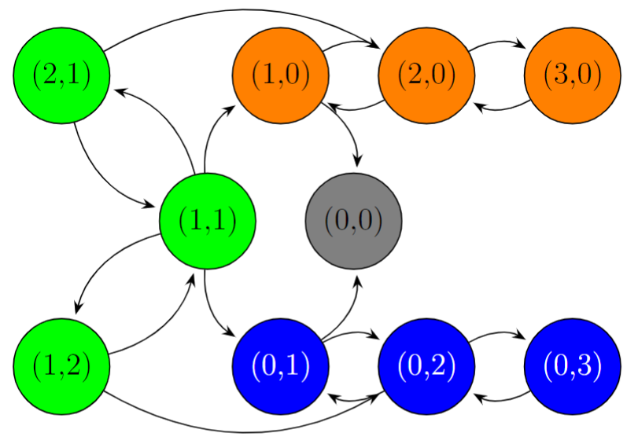
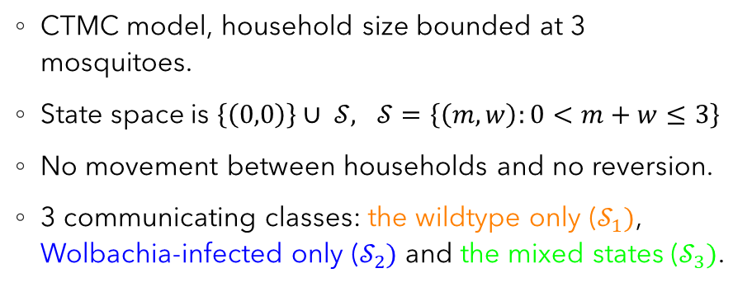
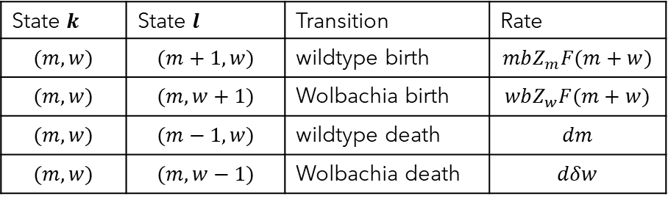
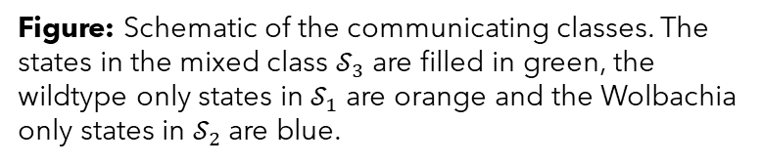
3 mosquito tutorial model
CTMC model, household size bounded at 3 mosquitoes.
State space is $\left\{\left(0,0\right)\right\}∪ 𝒮,$ $𝒮=\left\{\left(m,w\right):0<m+w≤3\right\}$
No movement between households and no reversion.
3 communicating classes: the wildtype only ($𝒮_{1})$, Wolbachia-infected only ($𝒮_{2})$ and the mixed states ($𝒮_{3})$.
State $k$ | State $l$ | Transition | Rate
$$(m,w)$$ | $$(m+1,w)$$ | wildtype birth | $$mbZ_{m}F(m+w)$$
$$(m,w)$$ | $$(m,w+1)$$ | Wolbachia birth | $$wbZ_{w}F(m+w)$$
$$(m,w)$$ | $$(m−1,w)$$ | wildtype death | $$dm$$
$$(m,w)$$ | $$(m,w−1)$$ | Wolbachia death | $$dδw$$
Figure: Schematic of the communicating classes. The states in the mixed class $𝒮_{3}$ are filled in green, the wildtype only states in $𝒮_{1}$ are orange and the Wolbachia only states in $𝒮_{2}$ are blue.
Table: Transition rates from household state k to state l. The rates are the same for the 3 mosquito and 30 mosquito CMTC models
Notes:
Purpose of this model is to get to grips with theory and understand how to interpret it.
Some parameters here simply chosen to best illustrate the example.
CTMC model
Households are fixed at maximum of 3 mosquitoes.
Transition rates given in the table.
Per capita birth rate found by setting overall birth rate of a wildtype only population equal to the overall death rate at imposed steady state value $m^{∗}$.
Our state space contains the absorbing state (0,0) and all other possible combinations of 3 mosquitoes.
We partition the state space into its communicating classes.
Two states are said to communicate with one another if the first state can reach the second with positive probability via a series of state transitions and vice versa. A communicating class contains all the states in the state space that communicate with one another.
In the schematic observe there are 3 communicating classes: the wildtype only, Wolbachia only and the mixed states.
We assume no movement and that Wolbachia infected females produce only infected offspring.
This means that the wildtype and Wolbachia only classes are only accessible via the mixed class and will eventually leave via extinction to (0,0).

Slide 9
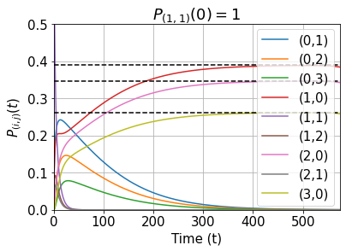
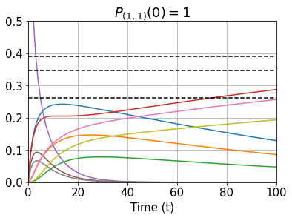
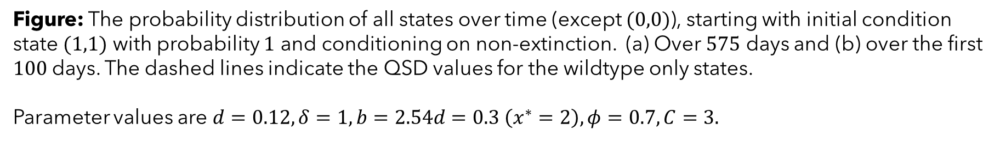

QSD and eigenvalue relationship
$$λ_{𝒮_{1}}^{max}>λ_{𝒮_{2}}^{max}>λ_{𝒮_{3}}^{max}$$
(a)
(b)
Figure: The probability distribution of all states over time (except $(0,0)$), starting with initial condition state $(1,1)$ with probability $1$ and conditioning on non-extinction. (a) Over $575$ days and (b) over the first $100$days. The dashed lines indicate the QSD values for the wildtype only states.
Parameter values are $d=0.12, δ=1, b=2.54d=0.3 \left(x^{∗}=2\right), φ=0.7, C=3.$
Notes:
In the deterministic model, the outcome of introducing Wolbachia infected mosquitoes into the population is strictly determined by whether the initial introduction exceeds the invasion threshold. In the stochastic model, any Wolbachia introduction has a non-zero probability of leading to successful invasion i.e. reducing the wildtype population to zero, or unsuccessful invasion. However, the probability of success does depend on how many infected mosquitoes are introduced.
Here, we consider the QSD, which we will use to untangle the behaviour of the probability distribution of the household being in each possible state over time. The QSD tells us how the probability mass of the household states are characterised after the initial transient stage has passed but before the final stationary distribution has been reached, which we know is (0,0) with probability one.
In the figures, I plot the probability distribution over time, conditioned on non-extinction, so that the distribution will eventually converge to the QSD. Starting from the zoomed in version in figure (b), we observe the probability mass in the mixed class decays away very quickly. After this, most of the probability mass will be in the wildtype only and Wolbachia only classes, but remember in the figures we are conditioning on non-extinction, so in reality, some probability will also be in (0,0).
We then enter the stage we are most interested in, where the household will move into either the wildtype or Wolbachia only class and stay there until reaching extinction. Now, under the QSD we are conditioning on non-extinction, and the probability mass hangs around for the longest in the wildtype only states (there is no cost to the birth rate), so the wildtype only class dominates the QSD.
We note that the dynamics of the probability mass moving through the household states, as depicted in the figures, is governed by the eigenvalues of the transition matrix of the CTMC. All the eigenvalues corresponding to the states except (0,0) are negative, indicating the probability mass in these states decays to 0. The overall minimal magnitude eigenvalue corresponds to the wildtype only class so that the probability mass in this class decays away most slowly. Whereas the smallest magnitude eigenvalue from the mixed class is the largest out of all the classes and therefore holds the fastest rate of decay.

Slide 10
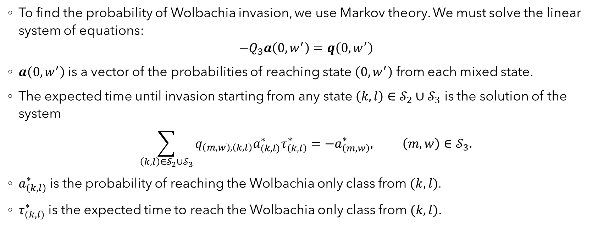
Wolbachia invasion
$𝒮_{1}$- wildtype only, $𝒮_{2}$ - Wolbachia only, $𝒮_{3}$- mixed
To find the probability of Wolbachia invasion, we use Markov theory. We must solve the linear system of equations:
$$−Q_{3}a\left(0,w^{′}\right)=q\left(0,w^{′}\right)$$
$a\left(0,w^{′}\right)$ is a vector of the probabilities of reaching state $\left(0,w^{′}\right)$ from each mixed state.
The expected time until invasion starting from any state $\left(k,l\right)∈𝒮_{2}∪𝒮_{3}$ is the solution of the system
$$\sum_{\left(k,l\right)∈𝒮_{2}∪𝒮_{3}}{q_{\left(m,w\right),\left(k,l\right)}a_{(k,l)}^{∗}τ_{\left(k,l\right)}^{∗}}=−a_{\left(m,w\right)}^{∗}, \left(m,w\right)∈𝒮_{3}.$$
$a_{\left(k,l\right)}^{∗}$ is the probability of reaching the Wolbachia only class from $(k,l)$.
$τ_{(k,l)}^{∗}$ is the expected time to reach the Wolbachia only class from $(k,l)$.
G ́omez-Corral, A., L ́opez Garc ́ıa, M.: Extinction times and size of the surviving species in a two-species competition process. Journal of mathematical biology 64, 255–289 (2012)
Norris, J.R.: Markov chains. Cambridge university press (1998)
Notes:
Remove?
We can use standard Markov theory to find the probability of Wolbachia invasion and the expected time until invasion.
The probability of reaching a given Wolbachia only state from any mixed state is defined by….
(remember the probability of reaching it from a wild-type only state is 0)
To find these probabilities we need to solve the following linear system.
q(0,w’) is the column vector containing the transition rates from each state in S_3 to (0,w’).
The expected time to invasion is found by solving the following linear system
a*(k,l) is the probability of reaching S_2 from the state (k,l) \in S_2 U S_3.
\tau*(k,l) is the expected time S_2 is reached from state (k,l).
a*(m,w) is the probability of reaching S_2 from state (m,w).

Slide 11
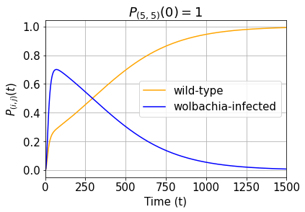
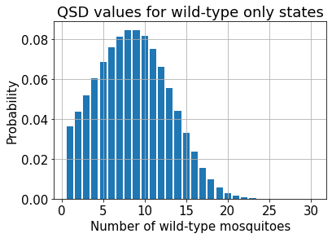
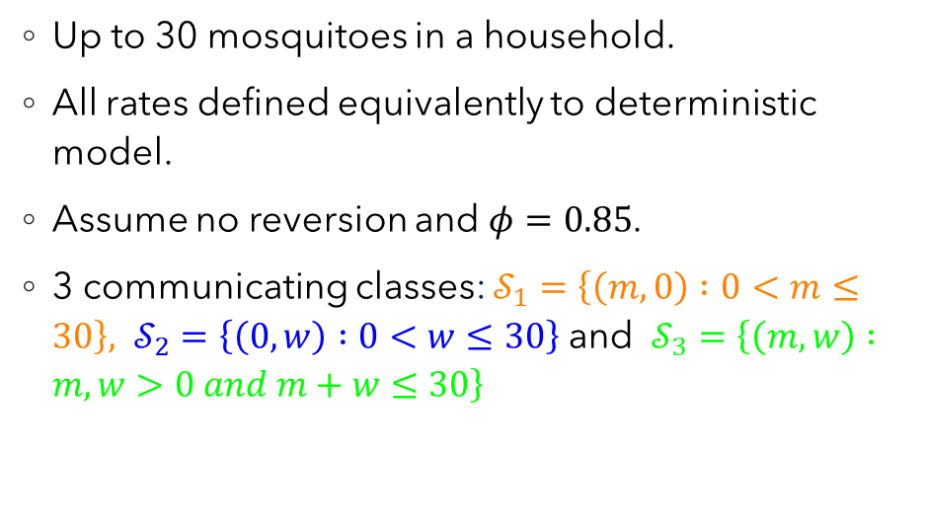
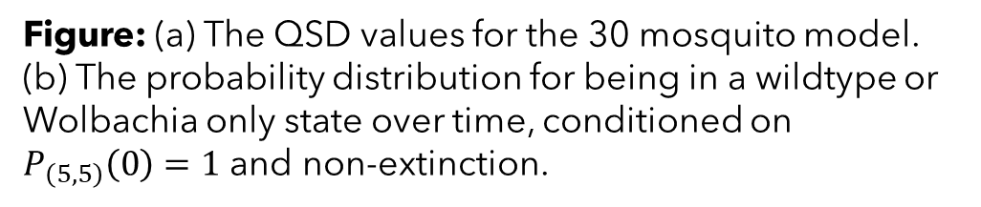
30 mosquito model
(a)
Up to 30 mosquitoes in a household.
All rates defined equivalently to deterministic model.
Assume no reversion and $φ=0.85$.
3 communicating classes: $𝒮_{1}=\left\{\left(m,0\right) :0<m≤30\right\}, 𝒮_{2}=\left\{\left(0,w\right) :0<w≤30\right\}$ and $𝒮_{3}=\left\{\left(m,w\right) :m,w>0 and m+w≤30\right\}$
(b)
Figure: (a) The QSD values for the 30 mosquito model. (b) The probability distribution for being in a wildtype or Wolbachia only state over time, conditioned on $P_{\left(5,5\right)}\left(0\right)=1$ and non-extinction.
Notes:
Bound female mosquito household size at 30, more realistic upper bound on household size.
All rates defined the same as before but we impose an artificial steady state of 10 mosquitoes in order to fit the birth rate.
The 3 communicating classes are as before but will contain much larger numbers of states.
Transition rates given in the table.
We observe the same pattern as before with the probability mass in the mixed class disappearing away quickly and we slowly move towards the QSD which again only contains non-zero probability mass in the wildtype only states. We plot the probability distribution over time for the total wildtype only and Wolbachia only classes.
Observe the QSD fem population size drops off nicely before 30.

Slide 12
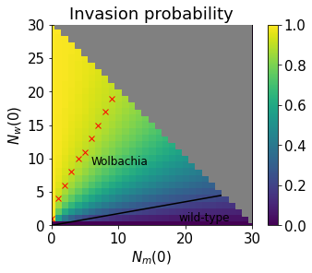

The stochastic invasion threshold
Figure: Colour plot of the invasion probabilities over a range of initial number of wildtype (females) $N_{m}\left(0\right)$ and Wolbachia-infected (females) $N_{w}\left(0\right)$ in the household. $φ=0.85$.
Overlayed is the deterministic invasion threshold. The red crosses denote the boundary where the probability of invasion is $≥0.9$.
Invasion threshold
Notes:
We can calculate the probability of Wolbachia invasion (and the expected time until invasion) using standard Markov theory which involves solving linear systems of equations.
Here we show colour plot of the probability of Wolbachia invasion for a range of Wolbachia fitness values and proportions of Wolbachia infected mosquitoes in the household when the total (fem) household size is fixed at 10. We do the same for when household size is not fixed but set phi=0.85.
Observe how in the deterministic model (which we overlay the result of) there was a hard boundary separating the basins of attraction, whereas in the stochastic model there is not.
We can interpret this as long as some proportion of the household is Wolbachia-infected, there is some probability that Wolbachia invasion will be successful under the stochastic model.
In (a), the probability of invasion decreases along the deterministic boundary as phi is increased. This is due to the fixed population size.
In (b) along the boundary/ invasion threshold, the probability of invasion stays close to 0.2 (when more than 3 mosquitoes in the household).
The red crosses in both figures indicate where the invasion probability is at least 0.9.

Slide 13


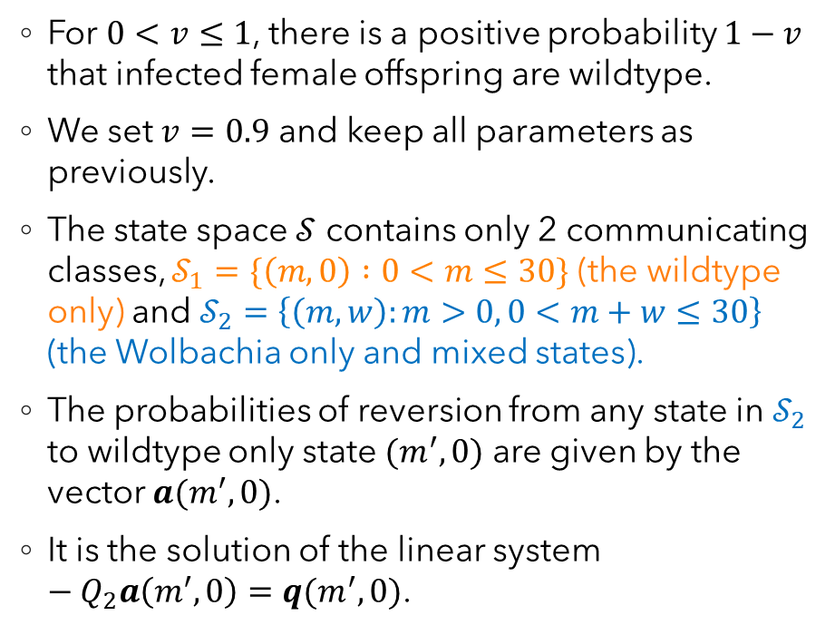
Reversion
Unsuccessful transmission at birth
For $0<v≤1$, there is a positive probability $1−v$ that infected female offspring are wildtype.
We set $v=0.9$ and keep all parameters as previously.
The state space $𝒮$ contains only 2 communicating classes, $𝒮_{1}=\{\left(m,0\right) :0<m≤30\}$ (the wildtype only) and $𝒮_{2}=\left\{\left(m,w\right):m>0, 0<m+w≤30\right\}$ (the Wolbachia only and mixed states).
The probabilities of reversion from any state in $𝒮_{2}$ to wildtype only state $(m^{′},0)$ are given by the vector $a(m^{′},0)$.
It is the solution of the linear system $−Q_{2}a\left(m^{′},0\right)=q(m^{′},0)$.
Wildtypes cannot produce infected offspring
Notes:
We now consider the likely scenario that there is a positive probability that an infected female produces offspring that is uninfected.
Now the household can escape the Wolbachia-only state space, meaning the wildtype population is able to reinvade, we call this reversion. i.e. A Wolbachia infected offspring is wildtype with probability 1-v meaning the system can move into the mixed state class and eventually the wildtype only.
We can calculate the re-invasion probability of the wild-types using similar methods to before (Markov theory, make sure understand how to derive).
Just need to solve the linear system, then can condition on the QSD of the Wolbachia only system, assuming this has been reached… i.e. assume the probability of the wildtype population reinvading before the Wolbachia only QSD is reached is very low…
*** Note that the S_2 class is now made up of both the Wolbachia only states and the mixed states.
q(m',0) represents the column vector which contains the transition rates from each state in S_2 to (m',0).
a(m’,0) is the vector of probabilities of transitioning from each state in S_2 to (m’,0)
Q_2 is the sub transition matrix for the S_2 class.

Slide 14
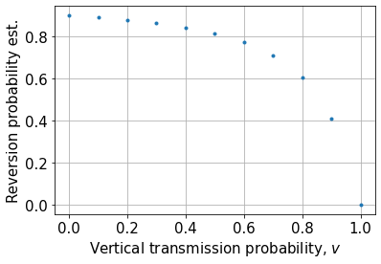
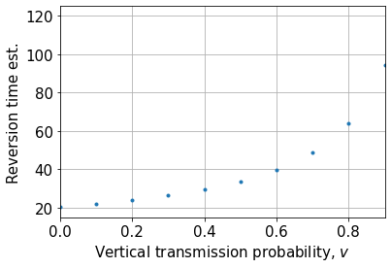
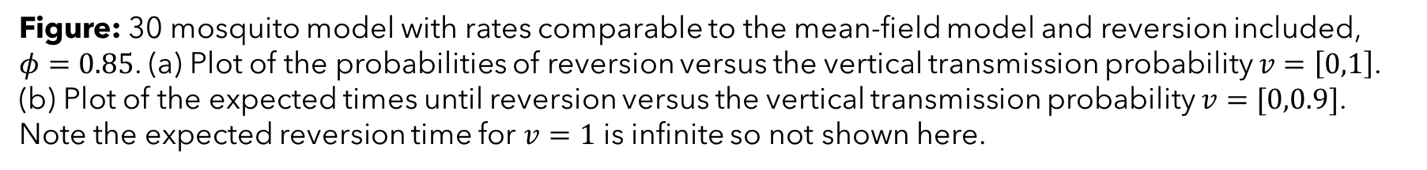
Probability and expected time until reversion
(a)
(b)
Figure: 30 mosquito model with rates comparable to the mean-field model and reversion included, $φ=0.85$. (a) Plot of the probabilities of reversion versus the vertical transmission probability $v=\left[0,1\right]$. (b) Plot of the expected times until reversion versus the vertical transmission probability $v=[0,0.9]$. Note the expected reversion time for $v=1$ is infinite so not shown here.
Notes:
Here we look at how the probability of vertical transmission of Wolbachia influences the probability and expected time until reversion.
As we increase v, the reversion probability decreases and the expected time to reversion increases as you might expect.
Note if v=1 reversion cannot happen.
Remove?

Slide 15



Thanks for listening!
Collaborators:
Dr Ben Adams (supervisor),
University of Bath,
Dept. of mathematical sciences
Email: ahb48@bath.ac.uk
Webpage: people.bath.ac.uk/ahb48/index.html
Notes:
Thanks very much for listening.
SUMMARISE KEY POINTS
In this talk, we’ve developed tools to study the invasion of Wolbachia-infected mosquitoes at a household scale, used as a control measure against Dengue infection.
We reviewed a previous deterministic model and then developed a stochastic equivalent.
We used the QSD to help untangle the dynamics of the probability mass moving between the household states.
We found that deterministic invasion does not necessarily correspond to stochastic invasion. In fact, the deterministic boundary between the two basins of attraction of the wildtype only and Wolbachia only steady states corresponds to a relatively small invasion probability of about 0.2.
Everything I’ve talked about today is from a project I’ve been working on for my PhD and was supervised by Dr Ben Adams, also from the University of Bath.

