Slide 1

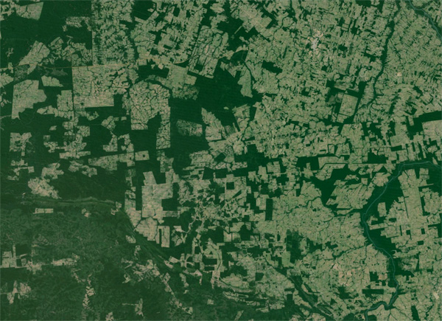


Towards integrated tick management strategies in fragmented peridomestic environments
Abby Barlow,
The University of Bath
https://news.mongabay.com/2015/03/worlds-fragmented-forests-are-deteriorating/

Slide 2
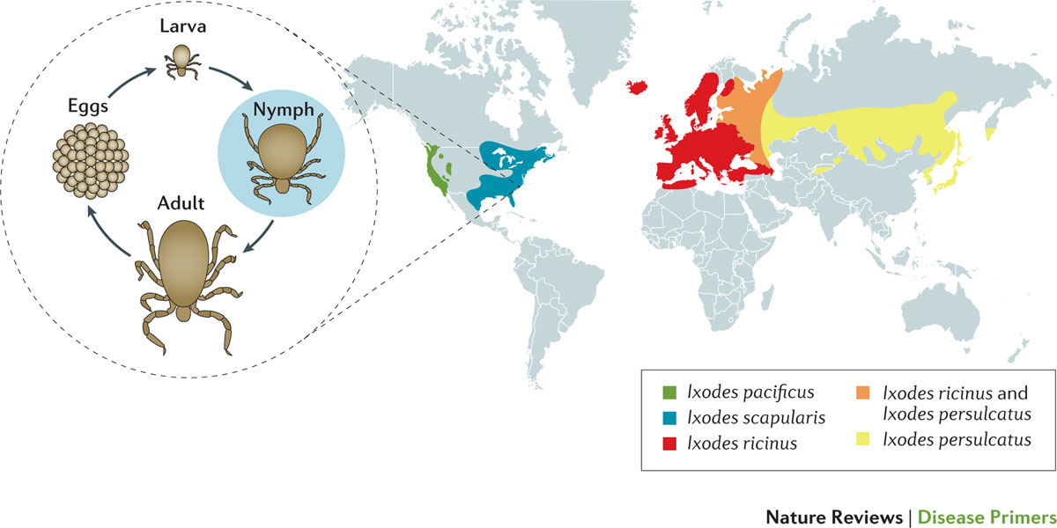



Tick phenology and Lyme disease
~30,000 cases per year
White-tailed deer
Ixodes Scapularis life cycle
Adult
eggs
nymphs
larvae
White-footed mice
Steere, A. C. et al. (2016) Lyme borreliosis
Nat. Rev. Dis. Primers doi:10.1038/nrdp.2016.90
Johnstone-Robertson, S. P. Et al. (2020). Incorporating tick feeding behaviour into R0 for tick-borne pathogens. Theoretical population biology, 131, 25-37.
Land use
Human behaviour
Climate change
Host abundance

Slide 3
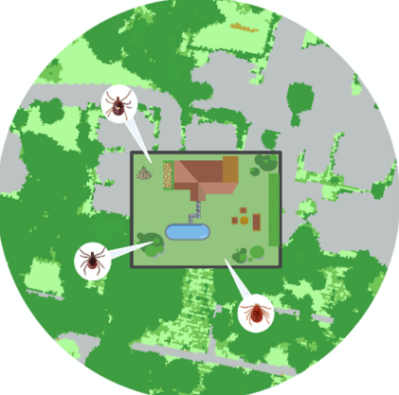


Fragmented habitats
Deer forage around edges
Spillover risk
Forested areas
Residential properties leading into woodland
Gregory, N et al. (2022). Risk of tick-borne pathogen spillover into urban yards in New York City. Parasites & Vectors, 15(1), 288.

Slide 4



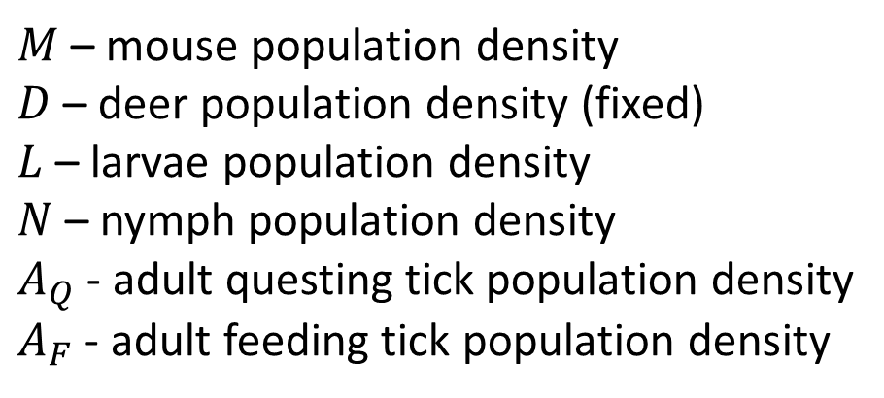










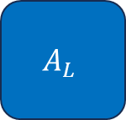
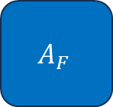




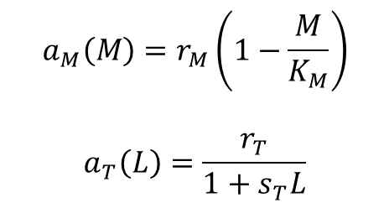
Tick population model
$$a_{M}\left(M\right)M$$
$M$ – mouse population density
$D$ – deer population density (fixed)
$L$ – larvae population density
$N$ – nymph population density
$A_{Q}$ - adult questing tick population density
$A_{F}$ - adult feeding tick population density
$$a_{M}\left(M\right)=r_{M}\left(1−\frac{M}{K_{M}}\right)$$
$$a_{T}\left(L\right)=\frac{r_{T}}{1+s_{T}L}$$
$$M$$
$$d_{M}M$$
feeding / moulting
$$β^{LN}MLm$$
$$β^{LN}MNm$$
$$β^{A}DA_{Q}$$
$$σA_{F}$$
$$L$$
$$N$$
$$A_{Q}$$
$$A_{F}$$
$$A_{L}$$
$$a_{T}\left(L\right)A_{L}$$
births
$$1−m$$
$$1−m$$
deaths
$$d_{L}L$$
$$d_{N}N$$
$$d_{A}A_{Q}$$
$$d_{AL}A_{L}$$
Rosà, R., & Pugliese, A. (2007). Effects of tick population dynamics and host densities on the persistence of tick-borne infections. Mathematical biosciences, 208(1), 216-240.
Notes:
Add A_L?

Slide 5


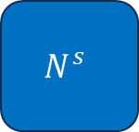
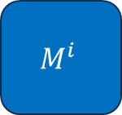


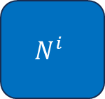



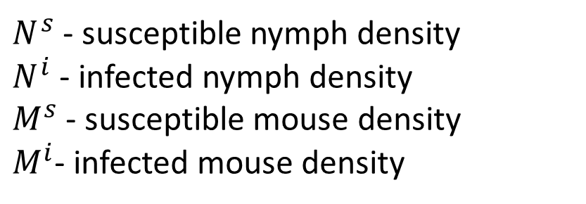
Transmission model
$N^{s}$ - susceptible nymph density
$N^{i}$ - infected nymph density
$M^{s}$ - susceptible mouse density
$M^{i}$- infected mouse density
$$q^{N}β^{LN}N^{i}M^{s}$$
$$M^{s}$$
$$M^{i}$$
White-tailed deer
Ixodes Scapularis life cycle
$$β^{LN}\left(M^{s}+\left(1−p^{L}\right)M^{i}\right)mL$$
$$N^{s}$$
Adult
$$L$$
$$1−m$$
eggs
$$β^{LN}p^{L}M^{i}mL$$
$$N^{i}$$
Nymph infects mouse
nymphs
larvae
$$1−m$$
White-footed mice
Mouse infects larvae, becomes nymph
Rosà, R., & Pugliese, A. (2007). Effects of tick population dynamics and host densities on the persistence of tick-borne infections. Mathematical biosciences, 208(1), 216-240.

Slide 6
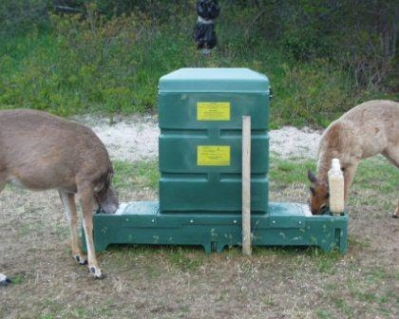
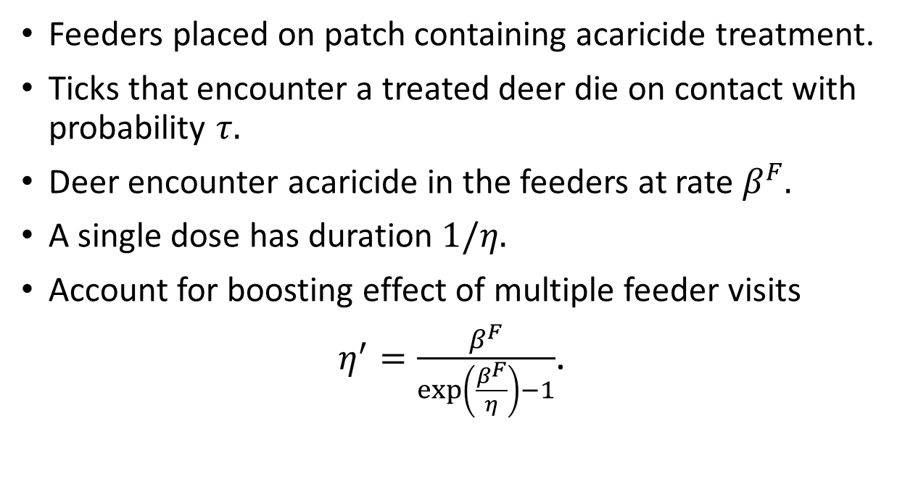


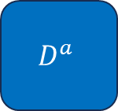
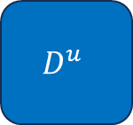
Incorporating treatment
$$β_{F}D^{u}$$
$$D^{u}$$
$$D^{a}$$
Feeders placed on patch containing acaricide treatment.
Ticks that encounter a treated deer die on contact with probability $τ.$
Deer encounter acaricide in the feeders at rate $β^{F}.$
A single dose has duration $1/η.$
Account for boosting effect of multiple feeder visits
$η^{′}=\frac{β^{F}}{\exp\left(\frac{β^{F}}{η}\right)−1}$.
$$η^{′}D^{a}$$
https://sphweb.bumc.bu.edu/otlt/MPH-Modules/PH/LymeDisease/LymeDisease_print.html
Aron, J.L., May, R.M.: The population dynamics of malaria. In: The Population Dynamics of Infectious Diseases: Theory and Applications, pp. 139–179. Springer, (1982)

Slide 7
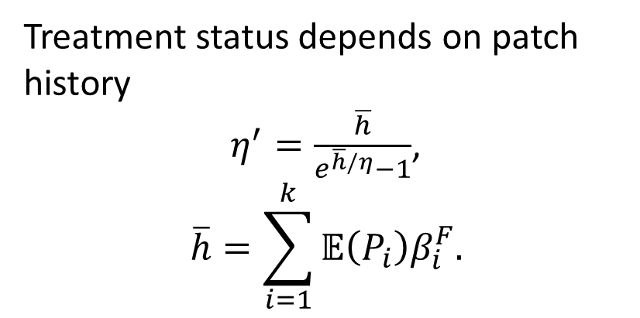
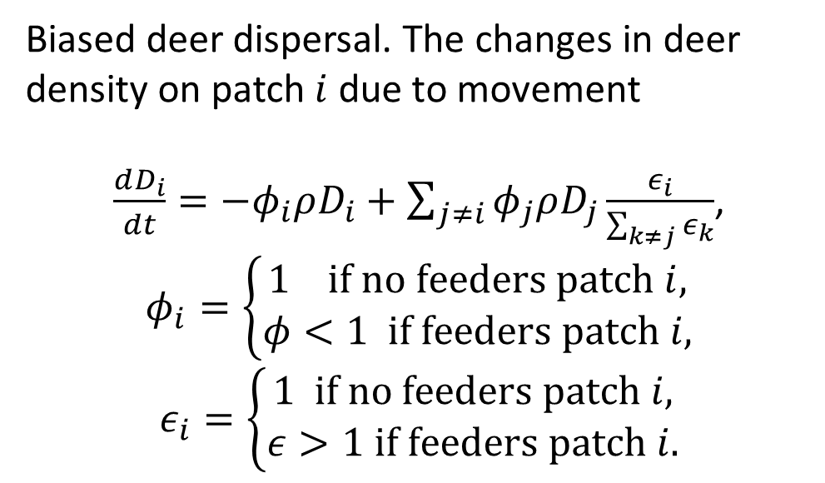

Multiple patches
Treatment status depends on patch history
$η^{′}=\frac{\overline{h}}{e^{\overline{h}/η}−1}$,
$$\overline{h}=\sum_{i=1}^{k}{𝔼\left(P_{i}\right)β_{i}^{F}.}$$
Biased deer dispersal. The changes in deer density on patch $i$ due to movement
$\frac{dD_{i}}{dt}={−φ}_{i}ρD_{i}+\sum_{j≠i}{φ_{j}ρD_{j}\frac{ε_{i}}{\sum_{k≠j}{ε_{k}}}}$,
$$φ_{i}=\left\{\begin{aligned}1 if no feeders patch i, \\ φ<1 if feeders patch i,\end{aligned}\right.$$
$$ε_{i}=\left\{\begin{aligned}1 if no feeders patch i, \\ ε>1 if feeders patch i.\end{aligned}\right.$$
$$ρ{φ_{2}D}_{2}$$
Patch 1
Patch 2

Slide 8
Hybrid modelling
Couple ODEs for the ‘fast reactions’ and stochastic simulation methods for the ‘slow reactions’.
A differential jump equation describes when the next slow reaction ‘fires’.
Reactions involving deer:
Deer treated;
Treatment wanes;
Deer moves;
Tick encounters deer;
Tick drops off deer
Reactions not involving deer ….
Small populations
Medium/ large populations
Large populations
Stochastic,
slow reactions
Deterministic,
fast reactions
Haseltine, E.L., Rawlings, J.B.: Approximate simulation of coupled fast and slow reactions for stochastic chemical kinetics. The Journal of chemical physics 117(15), 6959–6969 (2002)
Liu, Z., Pu, Y., Li, F., Shaffer, C.A., Hoops, S., Tyson, J.J., Cao, Y.: Hybrid modelling and simulation of stochastic effects on progression through the eukaryotic cell cycle. The Journal of chemical physics136(3) (2012)

Slide 9
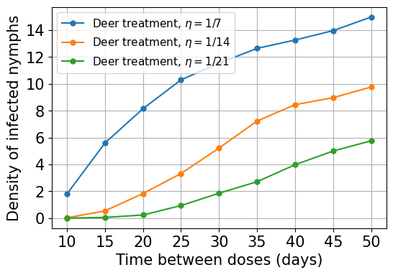
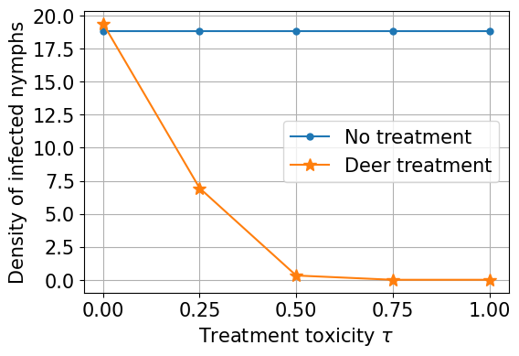
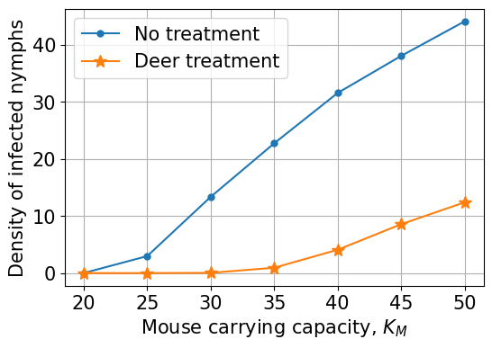
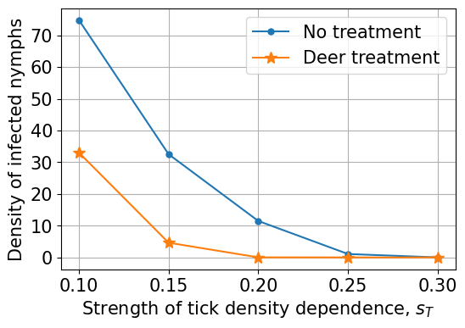
Single patch results
Treat?
Figure: DIN in a single residential patch after 2000 days when no treatment is used (blue dots) and when treated deer feeders are placed in the patch at 200 days (orange stars). We take intermediate values for the rate a single dose wanes $η=0.0714$and the rate deer encounter feeders is $β_{F}=0.0714$. Treatment toxicity is $τ=0.5$.

Slide 10
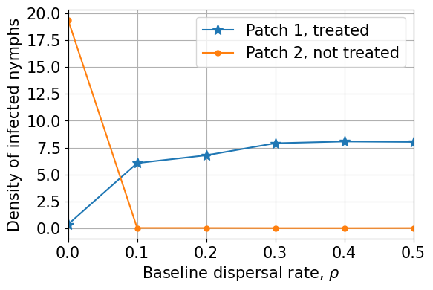
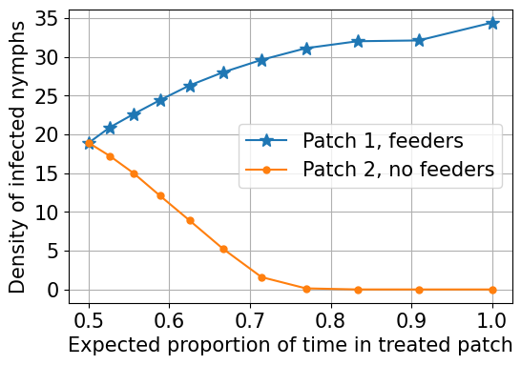
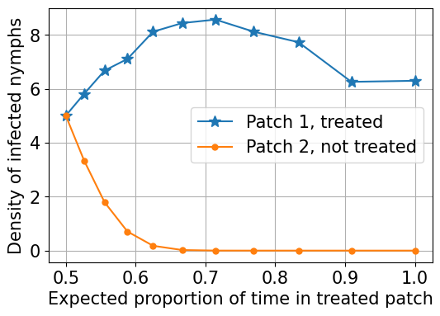
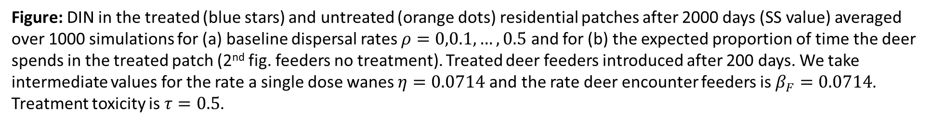
Multi-patch results
treat
(a)
(b)
no treat
Figure: DIN in the treated (blue stars) and untreated (orange dots) residential patches after 2000 days (SS value) averaged over 1000 simulations for (a) baseline dispersal rates $ρ=0,0.1,…,0.5$ and for (b) the expected proportion of time the deer spends in the treated patch (2nd fig. feeders no treatment). Treated deer feeders introduced after 200 days. We take intermediate values for the rate a single dose wanes $η=0.0714$and the rate deer encounter feeders is $β_{F}=0.0714$. Treatment toxicity is $τ=0.5$.

Slide 11



Thanks for listening!
This work was supervised by Dr Ben Adams, University of Bath. Pre-print coming soon.
Email: ahb48@bath.ac.uk
Webpage: people.bath.ac.uk/ahb48/index.html

