Slide 1
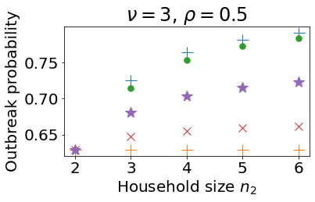
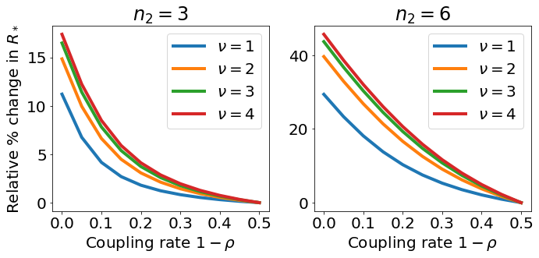
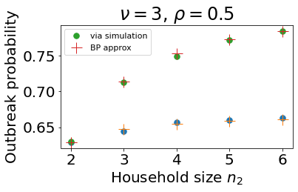
Epidemiological dynamics in neighbourhoods of households
Abby Barlow, Ben Adams, Sarah Penington
Key words: Epidemiology, mathematical model, household, metapopulation, reproduction number, outbreak, surveillance
1. Background
The spread of an infectious disease depends on contacts between individuals in the population. Often, transmission between cohabiting individuals is stronger than transmission in the local community, which in turn is stronger than transmission in the wider population. Therefore, an epidemiological framework with multiscale structure can be insightful.
Here we:
Introduce a metapopulation framework for a population structured into neighbourhoods of households.
Analyse this model to understand how household size and connectivity between neighbourhoods influence outbreak probability and the expected number of initial infections.
Discuss how this research can inform surveillance and control strategies.
2. The model
Population composed of two neighbourhoods of households. Neighbourhood $i$ is made up of $h_{i}$ households of size $n_{i}$. Neighbourhood populations are equal in size. Total population size is $\sum_{i=1}^{2}{N_{i}}=\sum_{i=1}^{2}{n_{i}h_{i}}$.
Two levels of mixing:
Contact within-households occurs at fixed rate $β$.
Contact outside of households occurs at fixed rate $α$.
Proportion of contacts outside household and within own neighbourhood $ρ$.
Households
Households are defined by their configuration $(s,i,r)$. This is the number of individuals in the household who are
$s$ – susceptible
$i$ – infectious
$r$ – recovered from infection.
Infection process within small household population modelled stochastically.
Infection process in larger neighbourhood populations of households described by ODE model. For households size 1, the model reduces to a simple metapopulation framework [1].
ODE model for households $n_{i}≥2$
Infection process over the neighbourhoods (for neighbourhood $j$) is described by [2,3]:
$H_{sir}^{j}$: proportion of households (neighbourhood $j$) in configuration $(s,i,r)$.
$I_{j}$ : proportion of infectious individuals (neighbourhood $j$).
infection from outside the household
within household infection
recovery
$$s+i+r=n_{1}$$
Within-household transmission rate
$$βsi/(n_{1}−1)$$
Transmission rate outside of the household
$$αs(ρI_{1}+\left(1−ρ\right)I_{2})$$
3. Calculating $R_{∗}$
The household reproduction number $R_{∗}$ is the expected number of secondary households infected by the primary infected household.
There are closed form expressions for single neighbourhoods of households size 2:
$$R_{∗}=\left(1+\frac{β}{β+γ}\right)\left(\frac{α}{γ}\right)$$
and size 3.
For larger household sizes we use the numerical methods [3,4].
For 2 neighbourhoods, $R_{∗}$ is the spectral radius of the matrix
$$\left(\begin{matrix}R_{∗}^{11} & R_{∗}^{12} \\ R_{∗}^{21} & R_{∗}^{22}\end{matrix}\right)$$
and $R_{∗}^{ij}$ is the expected number of secondary households infected in neighbourhood $j$ by the primary household from neighbourhood $i$.
Parameter | Meaning
$$n_{i}$$ | Household size
$$N_{i}$$ | Neighbourhood population size
$$β$$ | Within-household contact rate
$$α$$ | Contact rate outside of household
$$ρ$$ | Proportion of contacts shared with own neighbourhood
$$γ$$ | Recovery rate
Figure 1
Neighbourhood $1$
Household size $n_{1}$
Neighbourhood $2$
Household size $n_{2}$
6. Surveillance and control strategies
Compare the ‘true’ outbreak probability from a single initial infected individual in neighbourhood 2; $n_{1}=2$ fixed; $n_{2}$ varied.
With calculated outbreak probabilities that neglect some of the demographic structure.
The household size of the initial case is important, but not necessarily the neighbourhood structure.
No n’hood struc, $n=n_{2}$
True
Initial infection in unknown n’hood
Initial infection in n’hood 2
No n’hood struc, $n=n_{1}$
Figure 4
4. Impact of household size and connectivity
between neighbourhoods on infection risk
If household size in neighbourhood 1 fixed, $R_{∗}$ increased by larger household size in neighbourhood 2 and decreased by greater connectivity between neighbourhoods.
Change in $R_{∗}$ when varying neighbourhood connectivity is more significant when household size in neighbourhood 2 is larger and within-household transmission is stronger than outside transmission (governed by $ν$).
Figure 3
5. Probability of an outbreak
Gillespie SSA results (50,000 realisations) for probability of outbreak in the total population originating from an initial infected individual in neighbourhood 2.
Multi-type branching process and the path-integral theory of [3,5] can be adapted to find an analytic expression for the probability of an outbreak under given initial conditions.
Outbreak probability increases with household size mainly locally.
Neighbourhood 2
nm
Neighbourhood 1
isolated neighbourhoods
proportional mixing
7. Conclusions and future work
We developed a multi-scale epidemic model with neighbourhoods of households.
We constructed a household reproduction number which can be generalised for $k$ neighbourhoods.
We found that both household size and neighbourhood connectivity influence epidemiological dynamics.
Household size information is an important determinant of whether an outbreak will occur.
Future work will consider more complex demographic structures e.g. more neighbourhoods, non-uniform household size distributions and more complex epidemiological structures e.g. vector-borne diseases.
$$6$$
$$6$$
Figure 2
This is me, Abby, come and say hi!
Email: ahb48@bath.ac.uk
This work is supported by a scholarship from the EPSRC Centre for Doctoral Training in Statistical Applied Mathematics at Bath (SAMBa), under the project EP/S022945/1.
Affiliations: Department of Mathematical Sciences, University of Bath, Claverton Down, Bath BA2 7AY, United Kingdom.
References
[1] Keeling, Matt J., Ottar N. Bjørnstad, and Bryan T. Grenfell.: Metapopulation dynamics of infectious diseases. Ecology, genetics and evolution of metapopulations. Academic Press, 415-445 (2004)
[2] Ross, J.V., House, T., Keeling, M.J.: Calculation of disease dynamics in a population of households. PLoS One 5(3), 9666 (2010)
[3] Adams, B.: Household demographic determinants of Ebola epidemic risk. J Theor Biol. 392, 99–106 (2016)
[4] Joshua V Ross and Andrew J Black. Contact tracing and antiviral prophylaxis in the early stages of a pandemic: the probability of a major outbreak. Math Med Bio., 32(3):331–343 (2015)

