Slide 1

How Maths Helps us to fight COVID-19
Chris Budd OBE, University of Bath

Slide 2
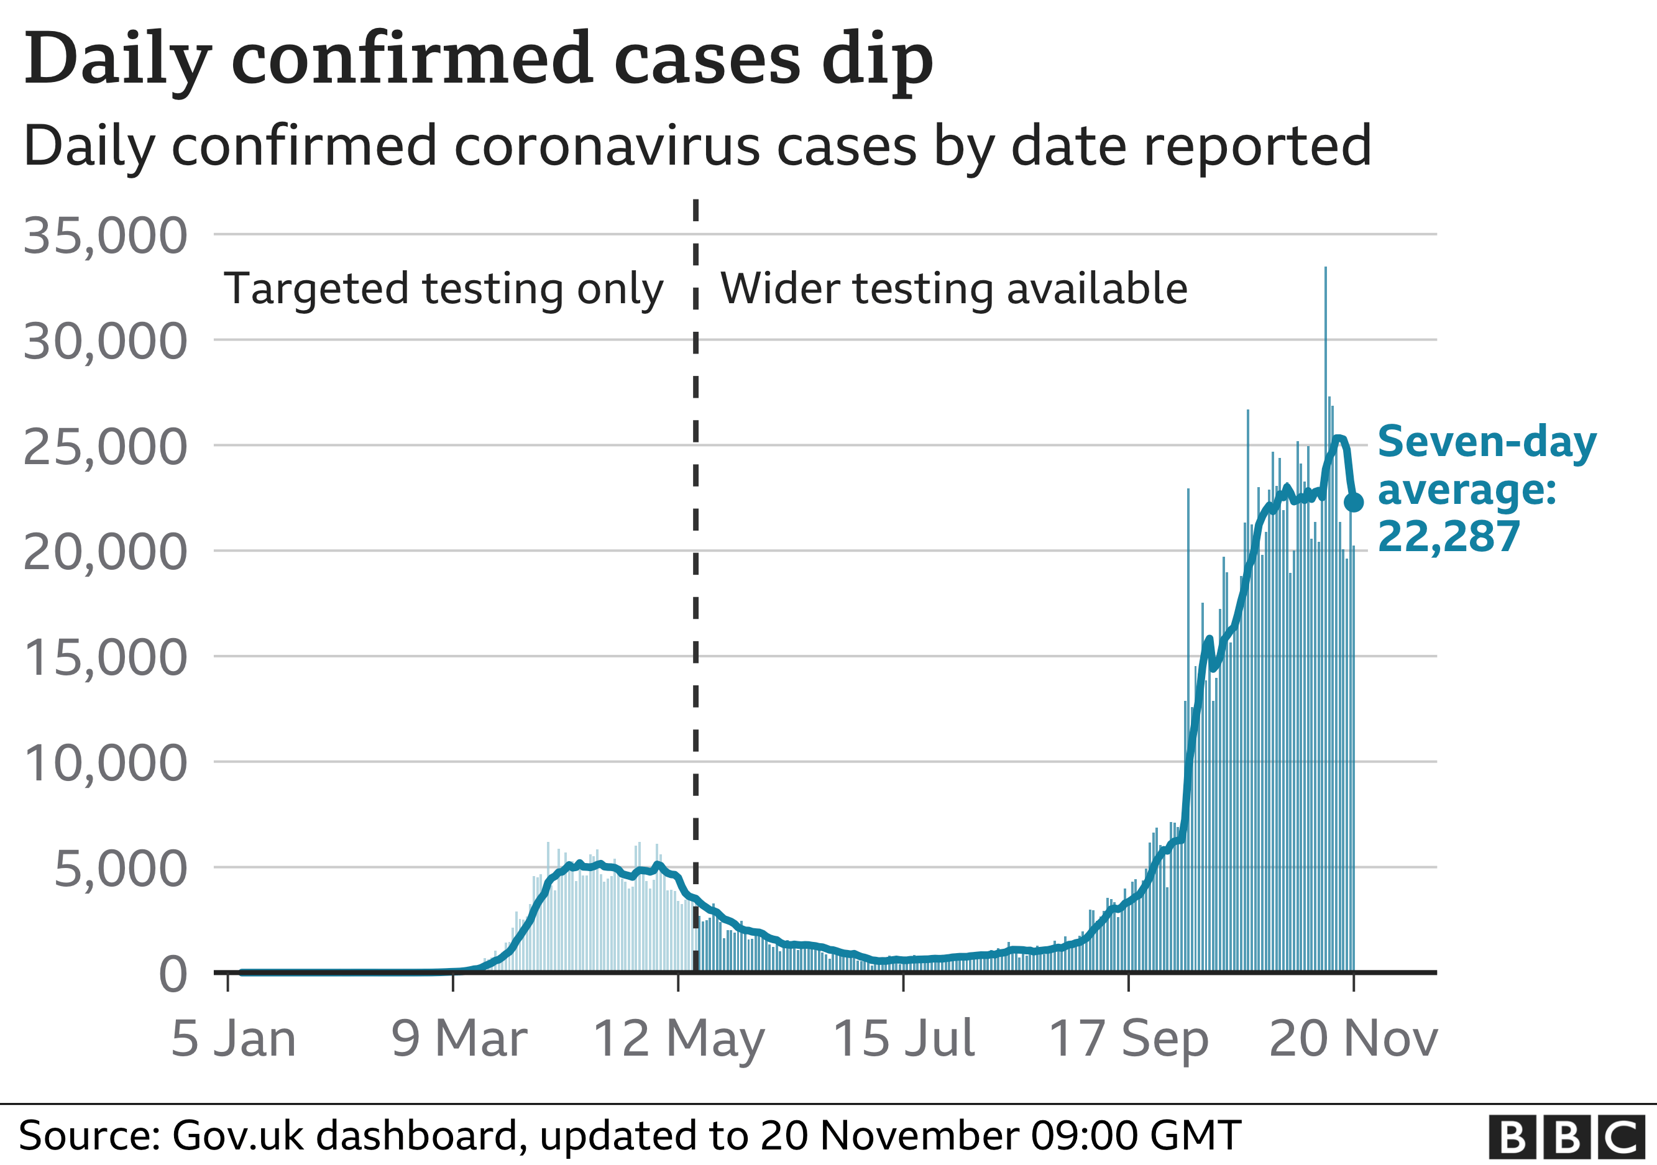
The problem

Slide 3
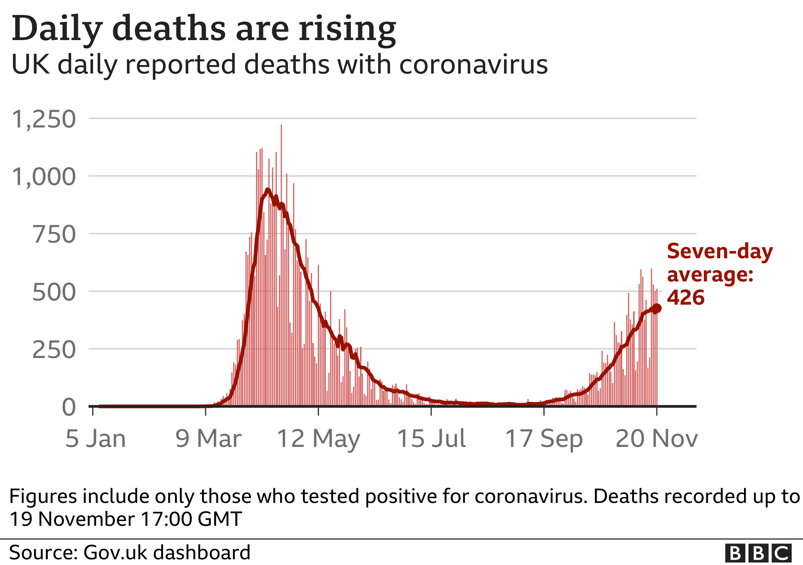

Slide 4
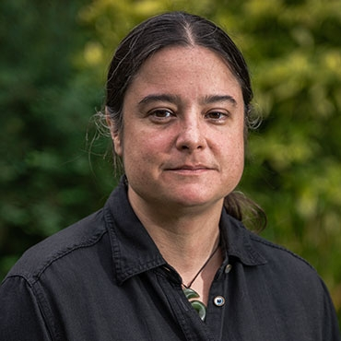
Mathematical Science Response to the Pandemic
SAGE
Policy
SPI-M (SPI-B)
Policy / Science
Julia Gog OBE
RAMP
IDP
V-KEMS
Project
Royal Society
INI
ICMS
KTN
Infrastructure
V-KEMS
Academic mathematicians
Science Base
Industry, Third Sector and OGDs

Slide 5
What do mathematicians do?
Try to understand what is happening now
Try to predict what may happen next
Advise on how to control what will happen next

Slide 6
But what has this got to do with maths?

Slide 7
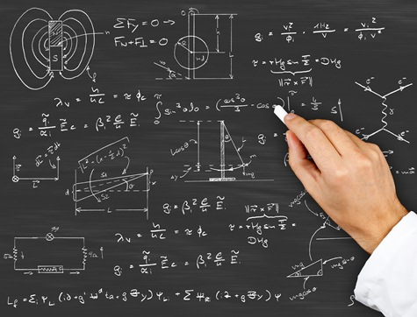
Mathematical Modelling
Constructing a mathematical twin of a real situation that is
Simple enough to analyse and make predictions with
Complex enough to be realistic

Slide 8
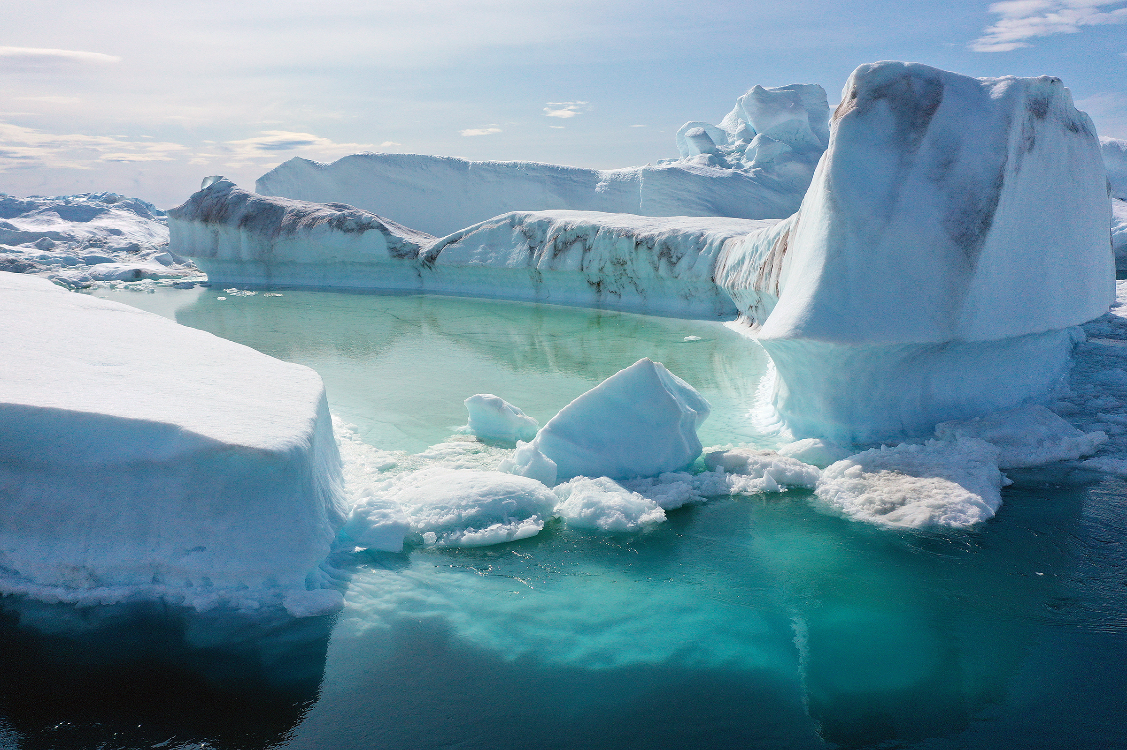
Examples
Climate modelling
Models of the solar system
Models of traffic flow
COVID-19 modelling

Slide 9
All models are wrong, but some of them are still useful
G. Box
A model should be as simple as possible, and no simpler
A. Einstein

Slide 10
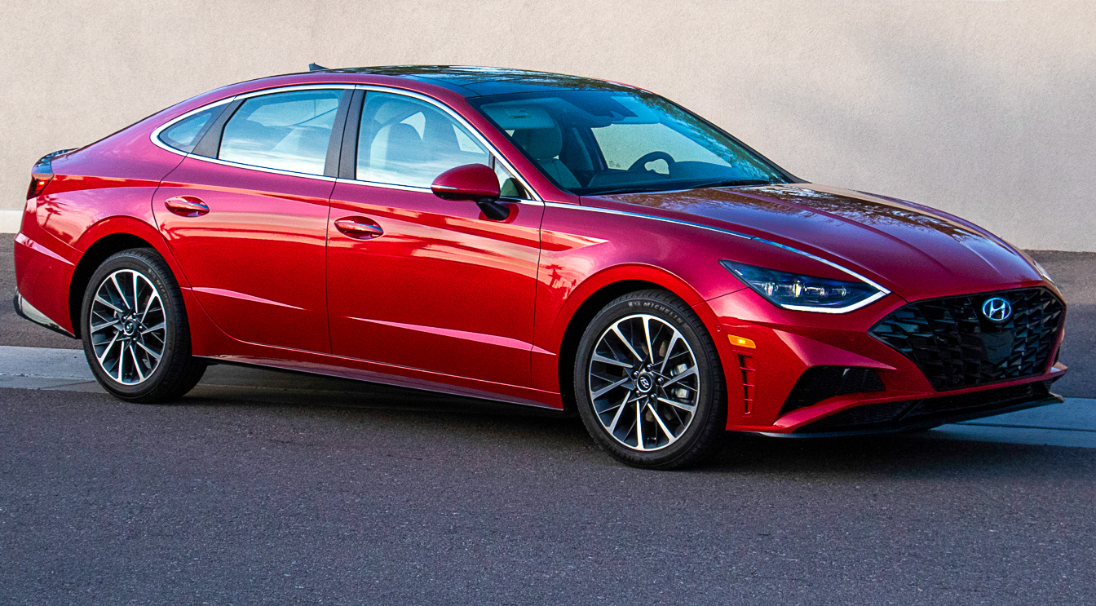
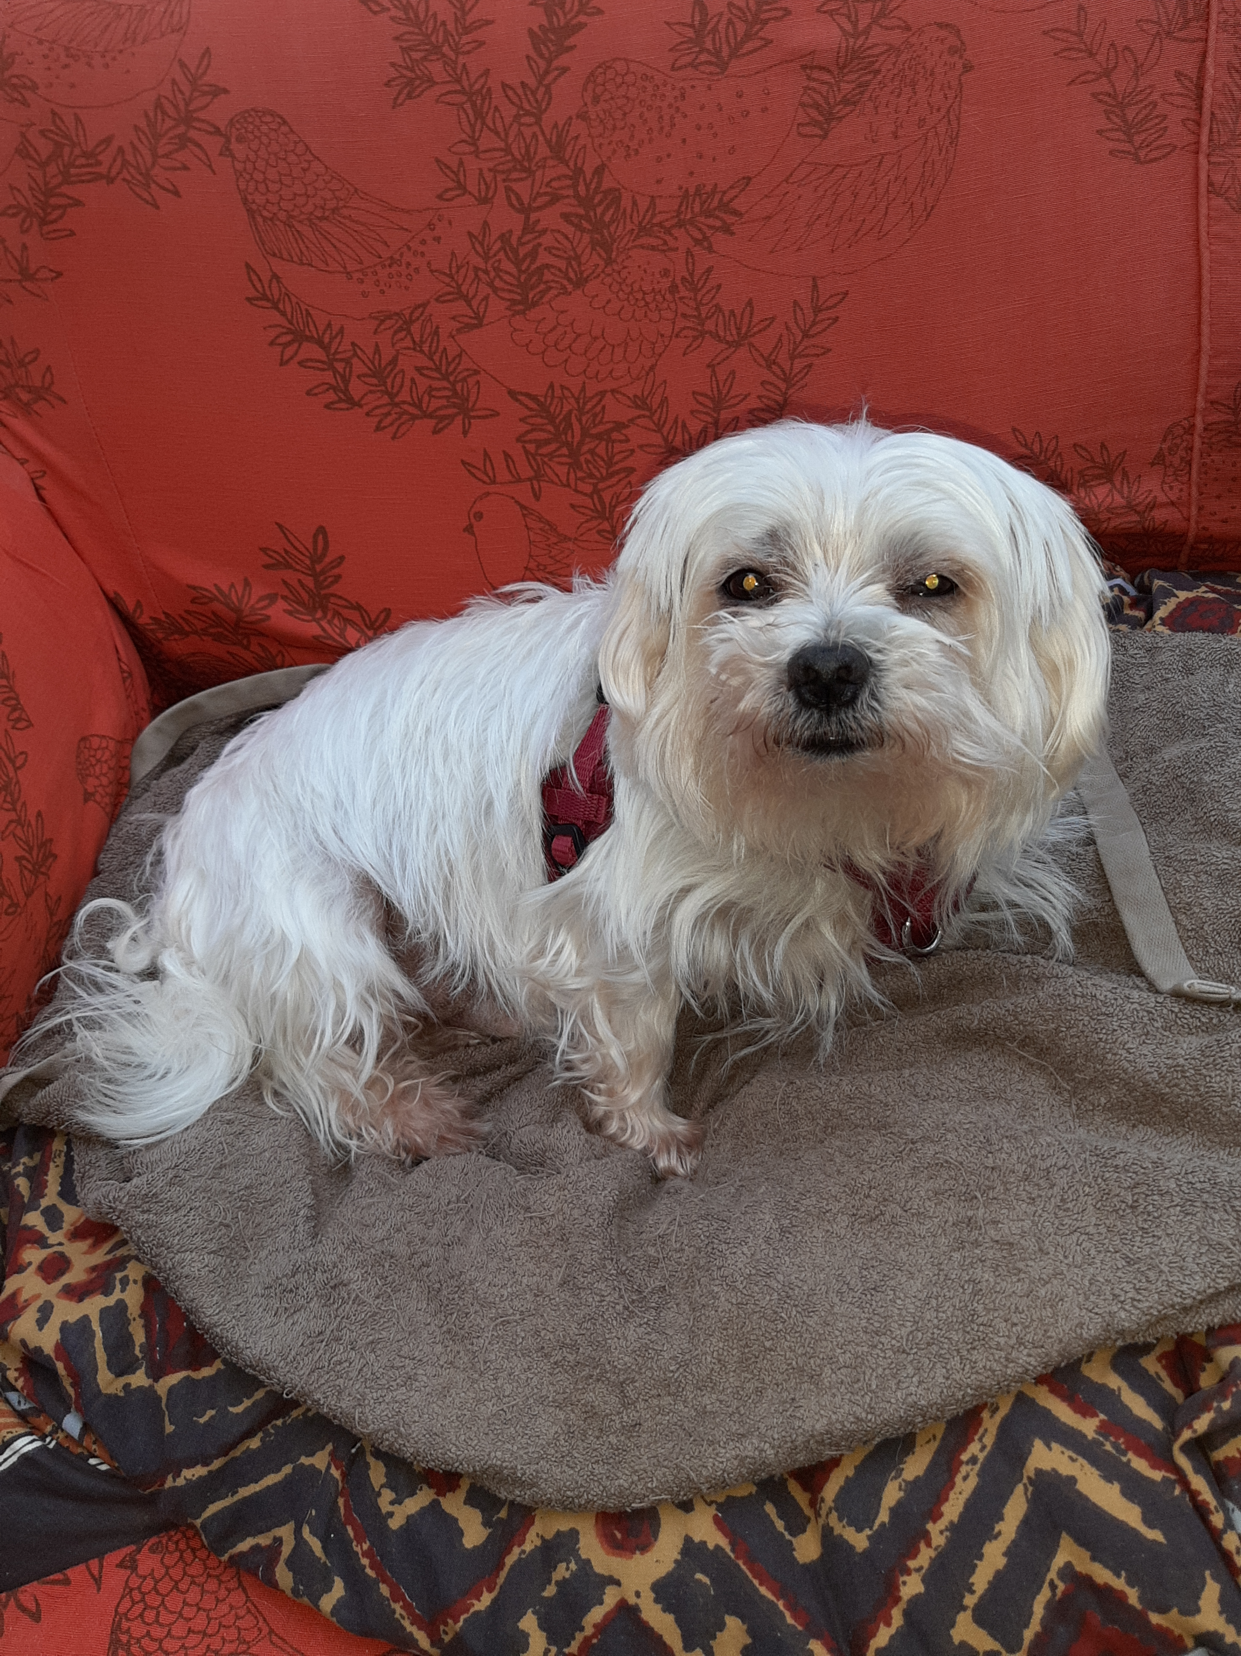
Example: How to save a dog from a speeding car?

Slide 11
First Mathematical Model
Car speed: V
Mass of the car: M
Braking force: F
Distance of car from the dog: d

Slide 12
(Kinetic) energy of the car:
Energy needed to stop in a distance d:
These must be the same

Slide 13
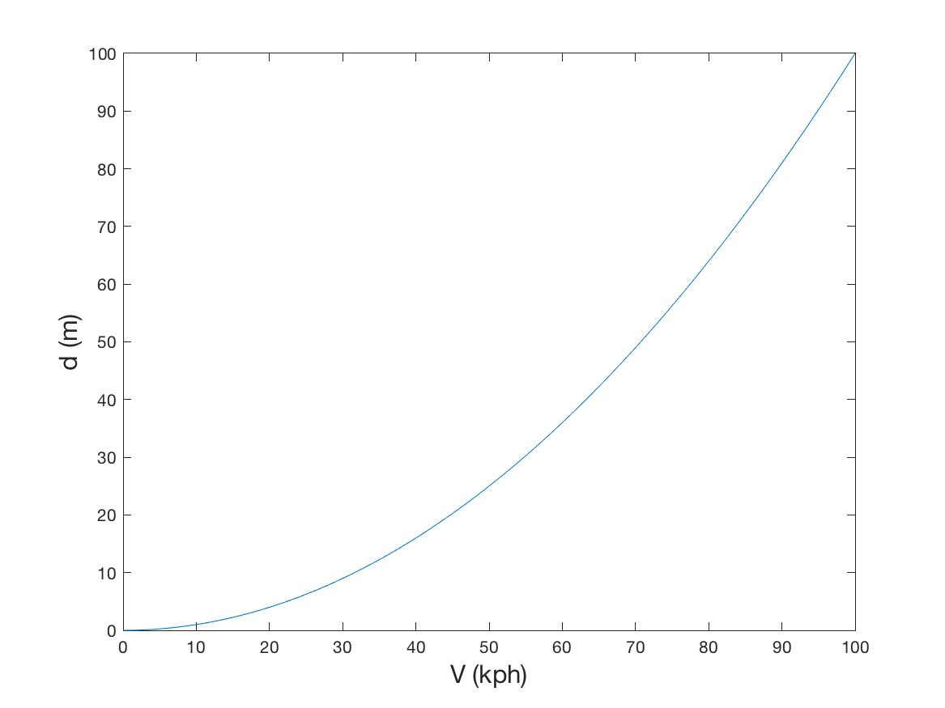
Plot the Results for my car

Slide 14
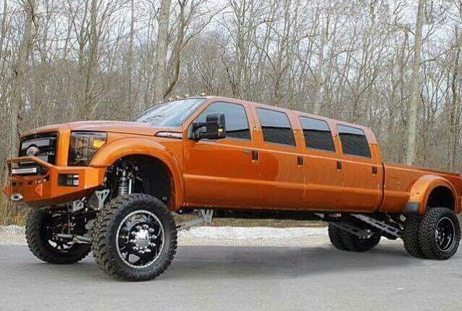
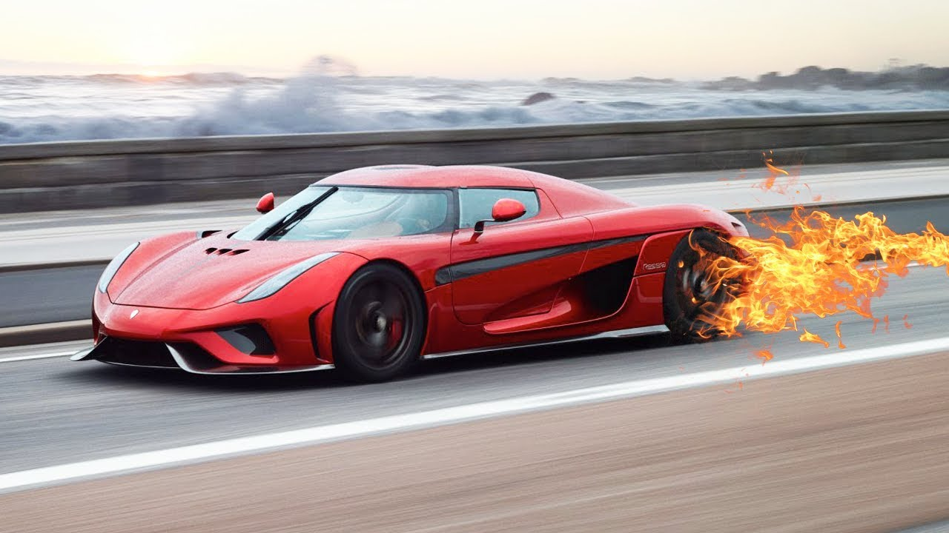
Make predictions
Double the mass of the car
The stopping distance doubles
Double the speed of the car
The stopping distance quadruples

Slide 15
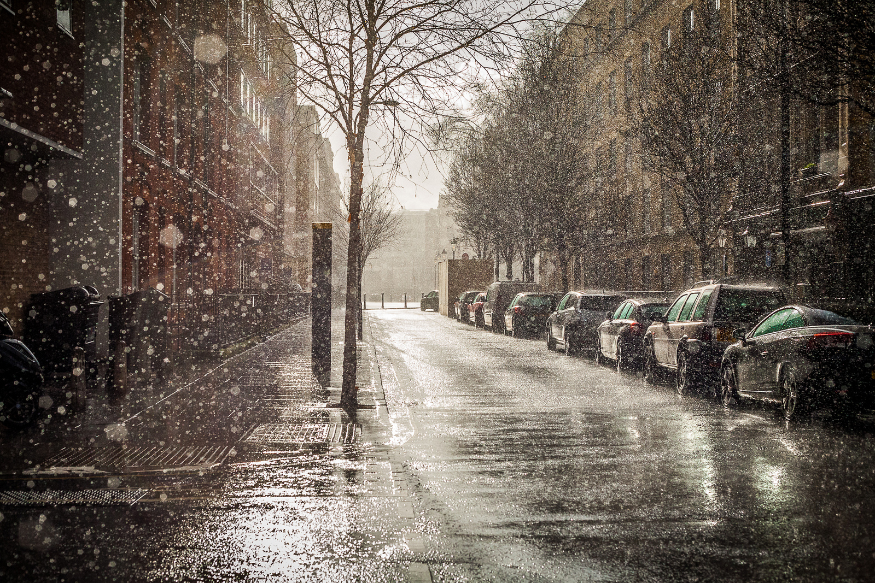
Think of ways of making the model more realistic
Adding in the reaction time of the driver
Allowing for different road conditions
eg. wet roads
Allowing for hills and bends in the road

Slide 16
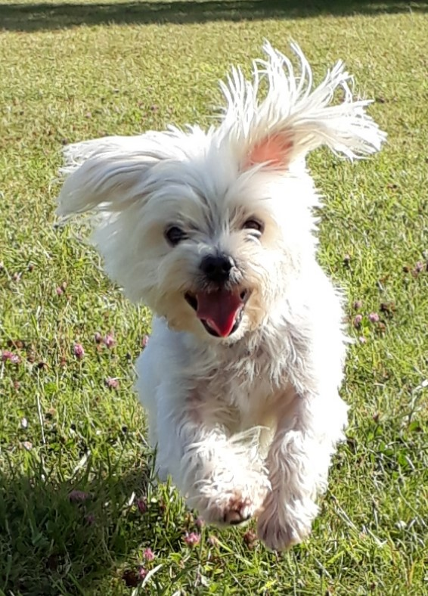

Slide 17
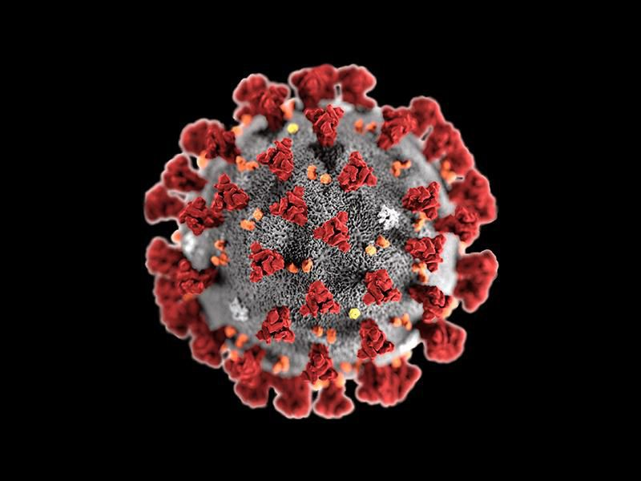
Modelling the COVID-19 Epidemic
What do we want to understand
How will the epidemic grow if we don’t do anything?
How can we stop it growing?
How should we change our behaviour to keep safe?

Slide 18
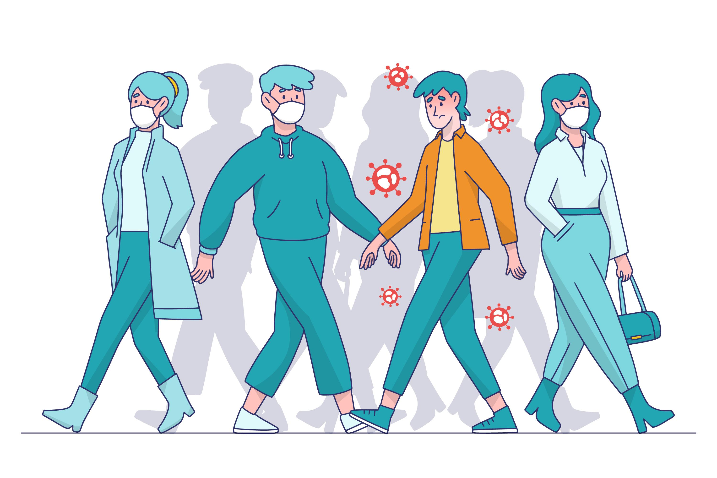
How does an infection spread on its own?
One infected person infects other people
I infected people infect other people

Slide 19
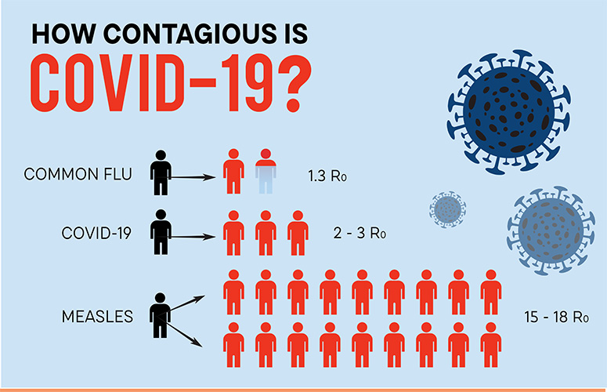

Slide 20
Suppose that
Generation | Number I
1 | 1
2 | 2.5
3 | 6.25
4 | 15.625
5 | 39.0625
6 | 97.65625
7 | 244.14
8 | 610.35
9 10 | 1525.88 3814.7

Slide 21
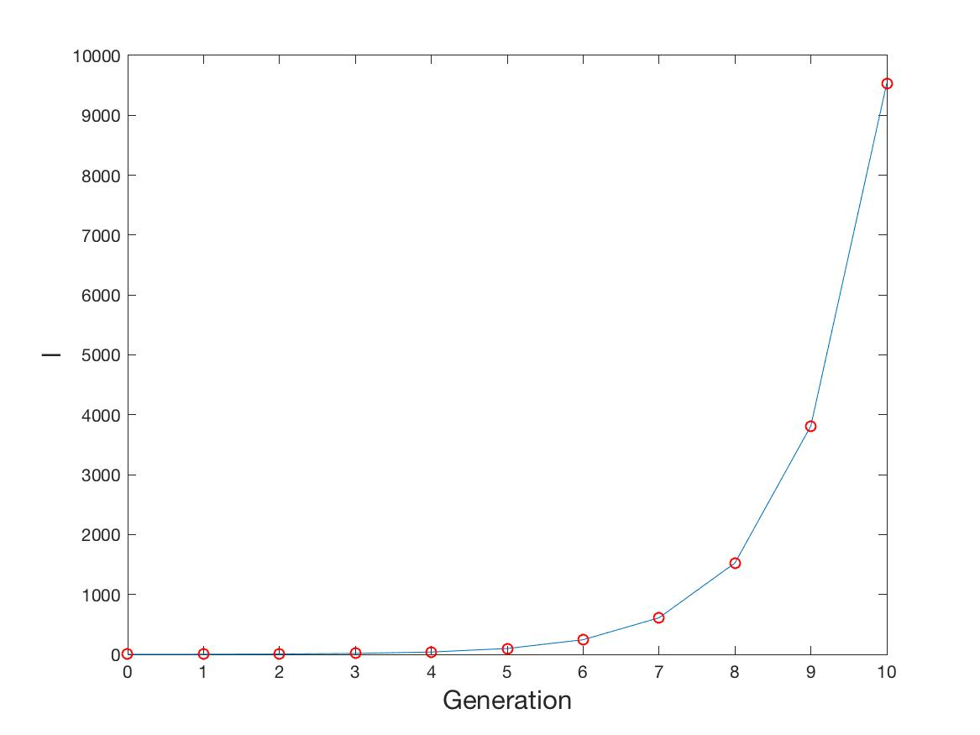
Exponential Growth

Slide 22
Exponential growth

Slide 23
Not quite as bad as this
Not everyone can catch COVID-19
Some people are immune
Some people get vaccinated
Some people are in lockdown
Many people recover

Slide 24
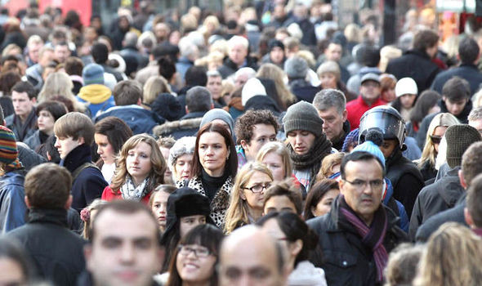
Population of N people
S of these are susceptible to COVID-19

Slide 25
I number of people who are infected by COVID-19
These infect new people
Number infected is:

Slide 26
R bigger than 1
Infections increase exponentially
R less than 1
COVID-19 under control

Slide 27
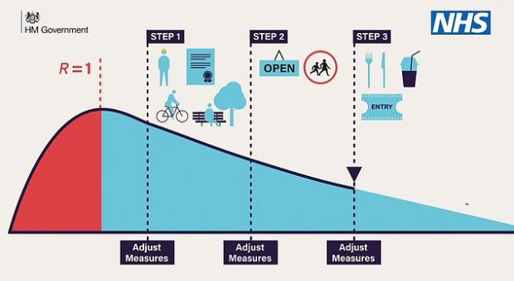

Slide 28
How to reduce R:
Herd immunity: Let lots of people catch it and then
recover
Lockdown: Reduce the possibility of catching
COVID-19
Vaccine: Make people immune to COVID-19

Slide 29
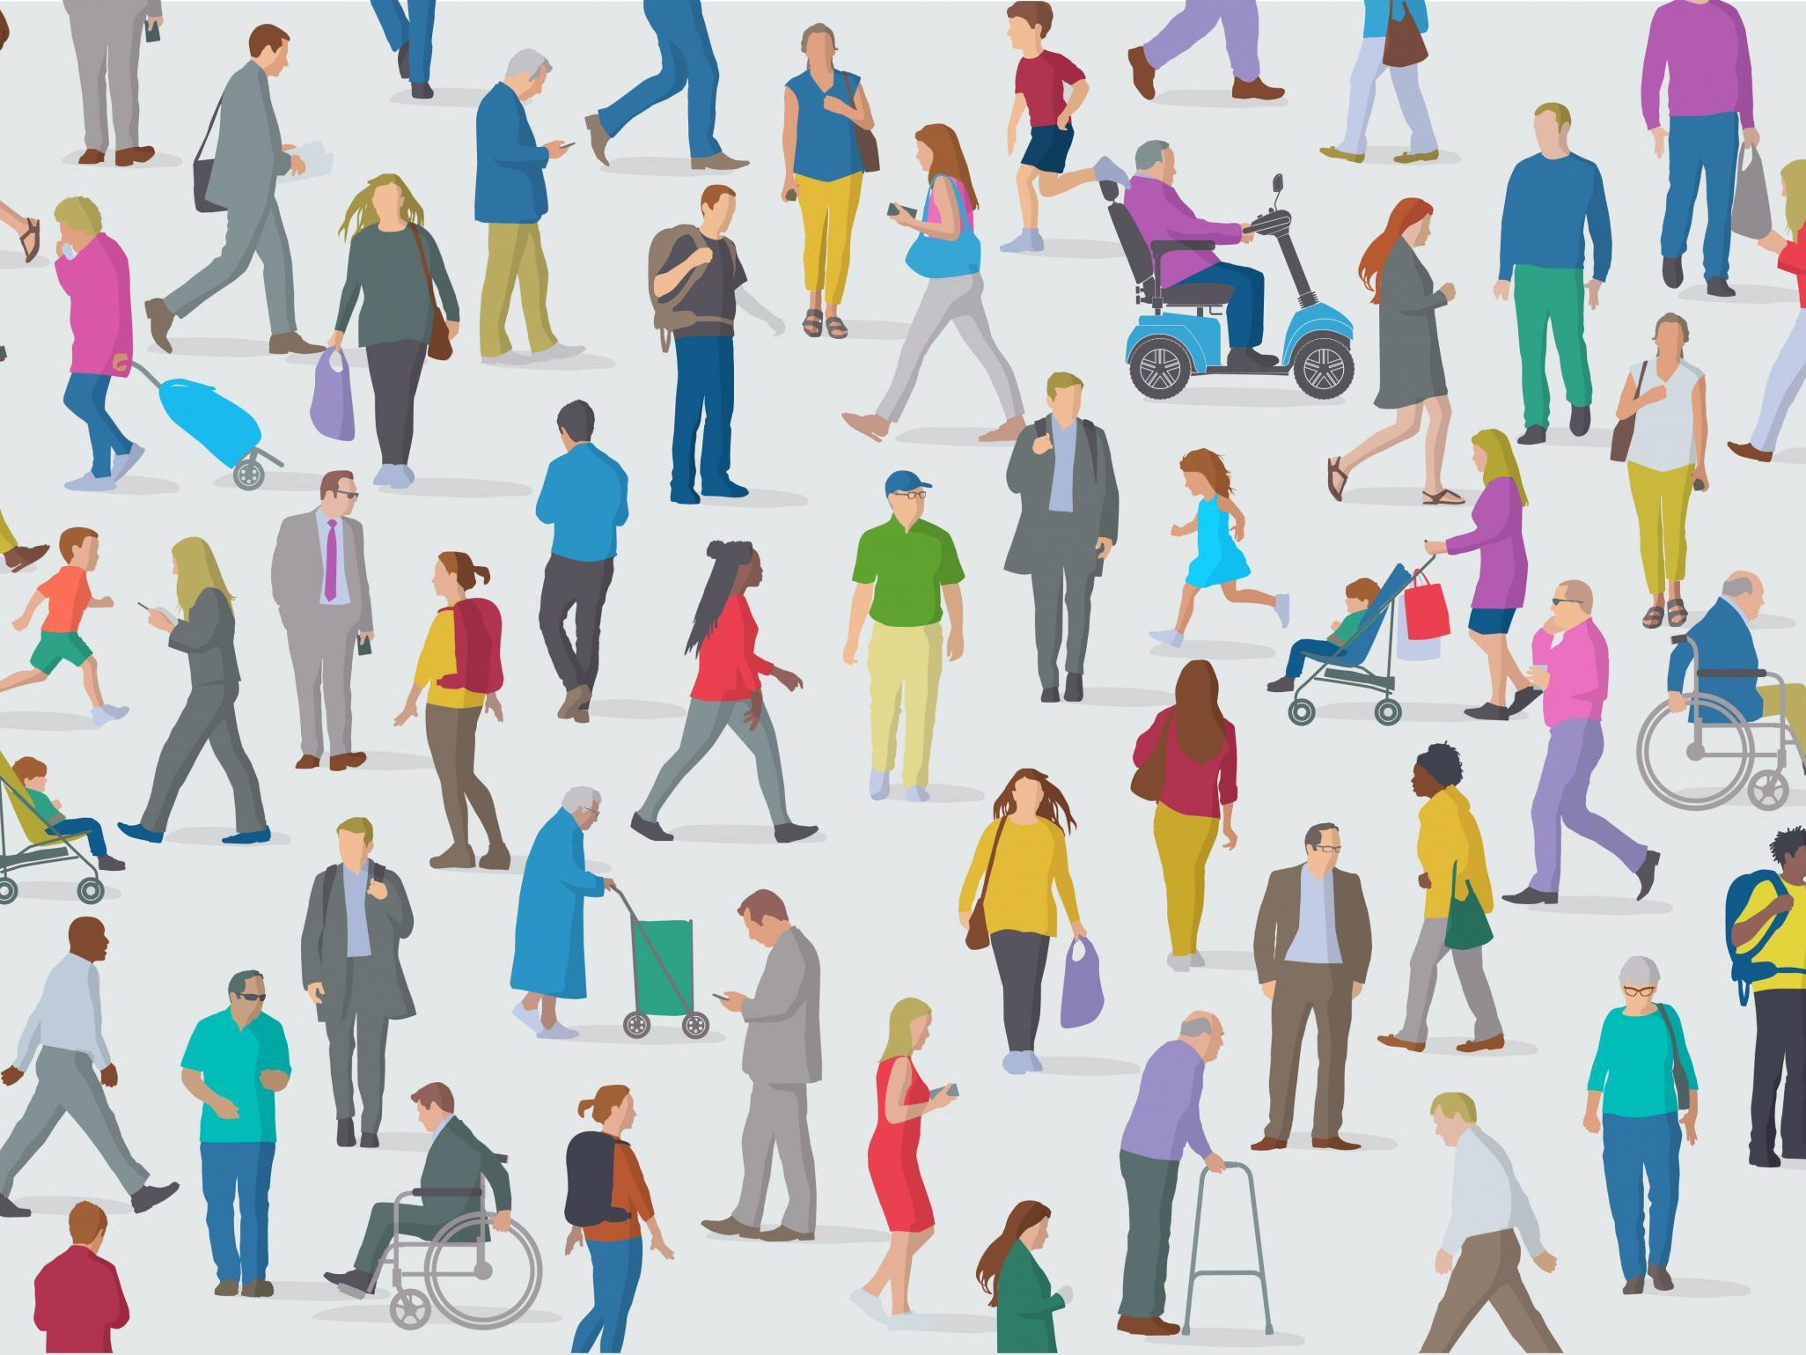
Herd Immunity
S decreases as more people get Infected
and then Recover.
S I R model
R eventually drops below 1 after a big peak

Slide 30
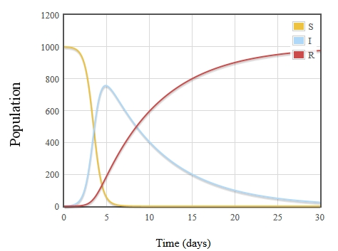
Problem:
Peak predicted for the UK was VERY large and would have led to MANY deaths

Slide 31
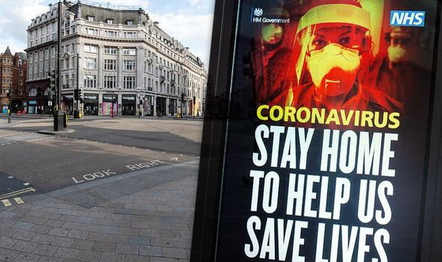
UK Opted for Lockdown Instead

Slide 32
Lockdown starts
Lockdown starts
Lockdown ends

Slide 33
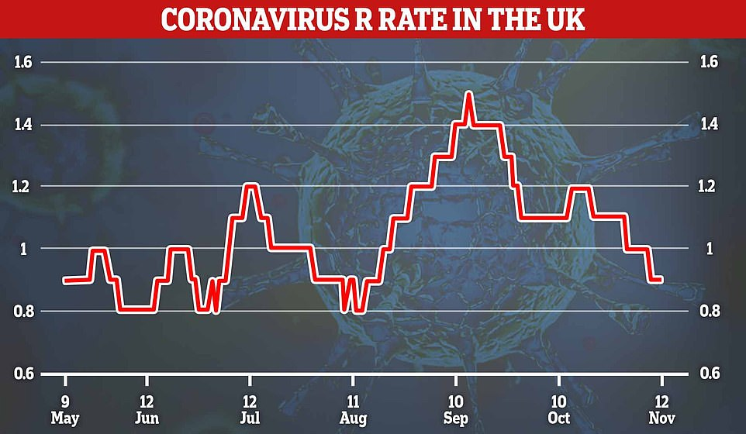

Slide 34
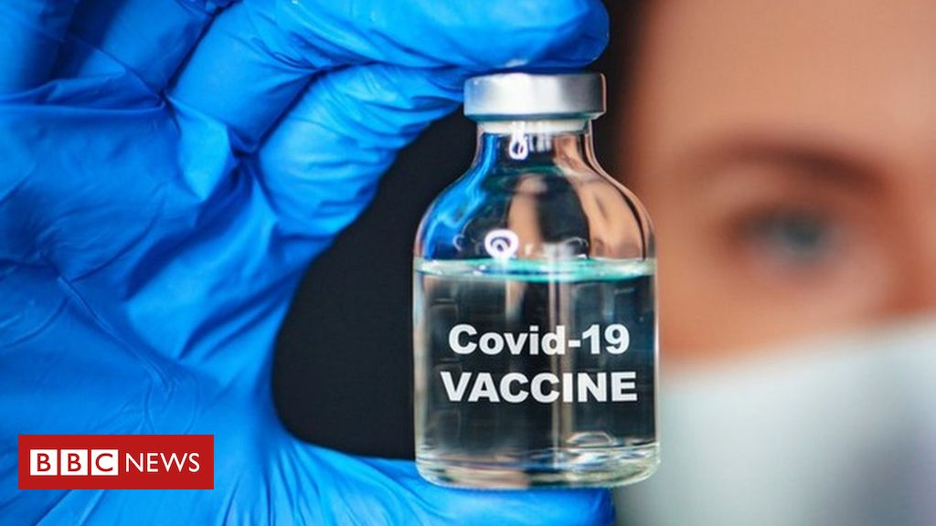
Vaccination
Reduces R by reducing number of susceptible people
How many people do we need to vaccinate?

Slide 35
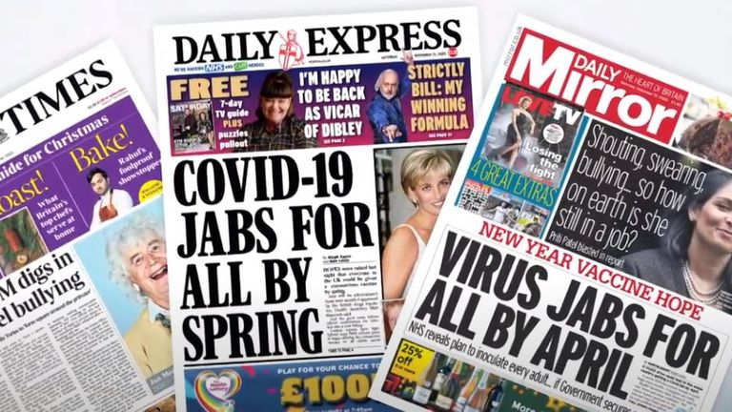
Must vaccinate 60% of the population
UK population is 66 600 000
Must vaccinate 40 000 000 people

Slide 36
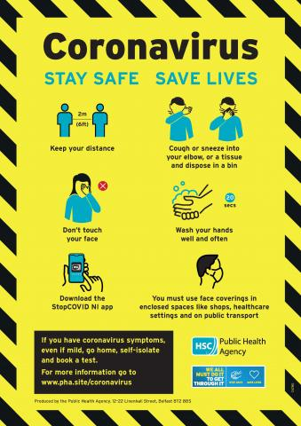
How to keeper safer by modifying our behaviour

Slide 37
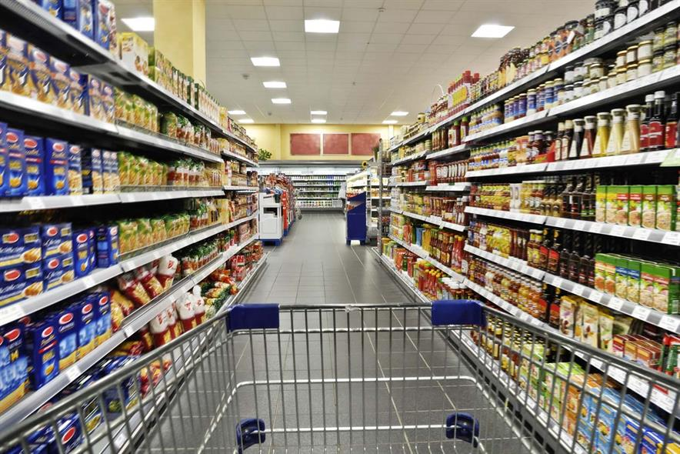
Maths keeps us safe in the shops

Slide 38
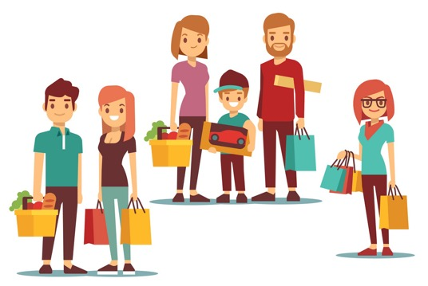
We all need to go shopping!
Shopping involves a lot of short interactions with an open group of people
Two issues: 1. Moving around in the shop. e.g. a supermarket
2. Queuing to be served e.g. a takeaway
Which is the safest?
What is the best way to organise a shop?

Slide 39
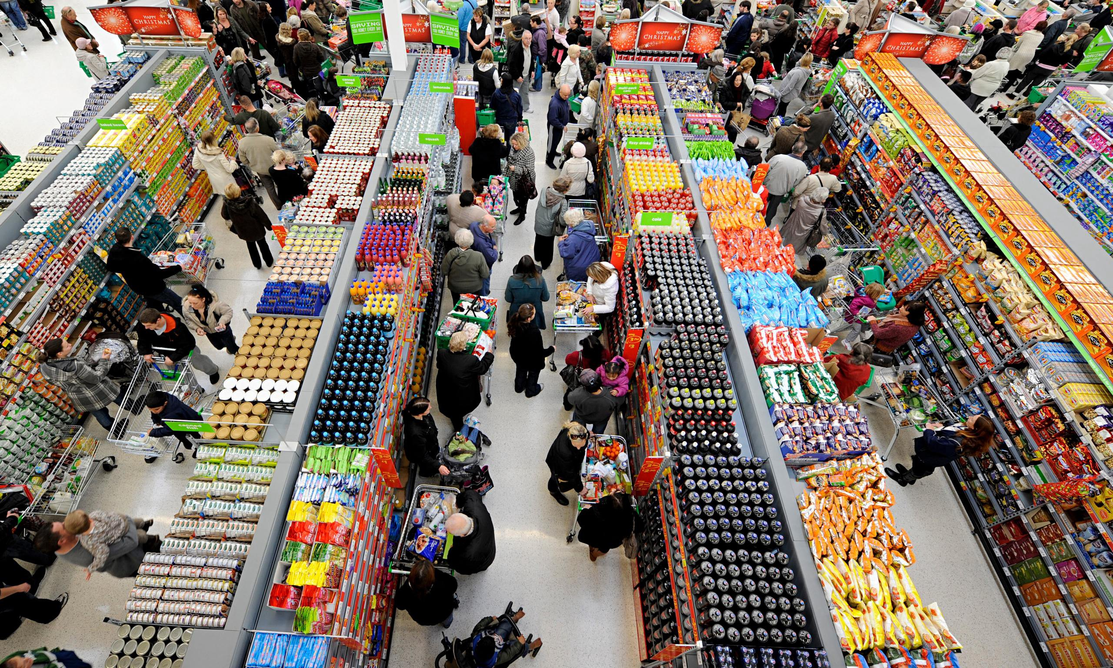

Slide 40
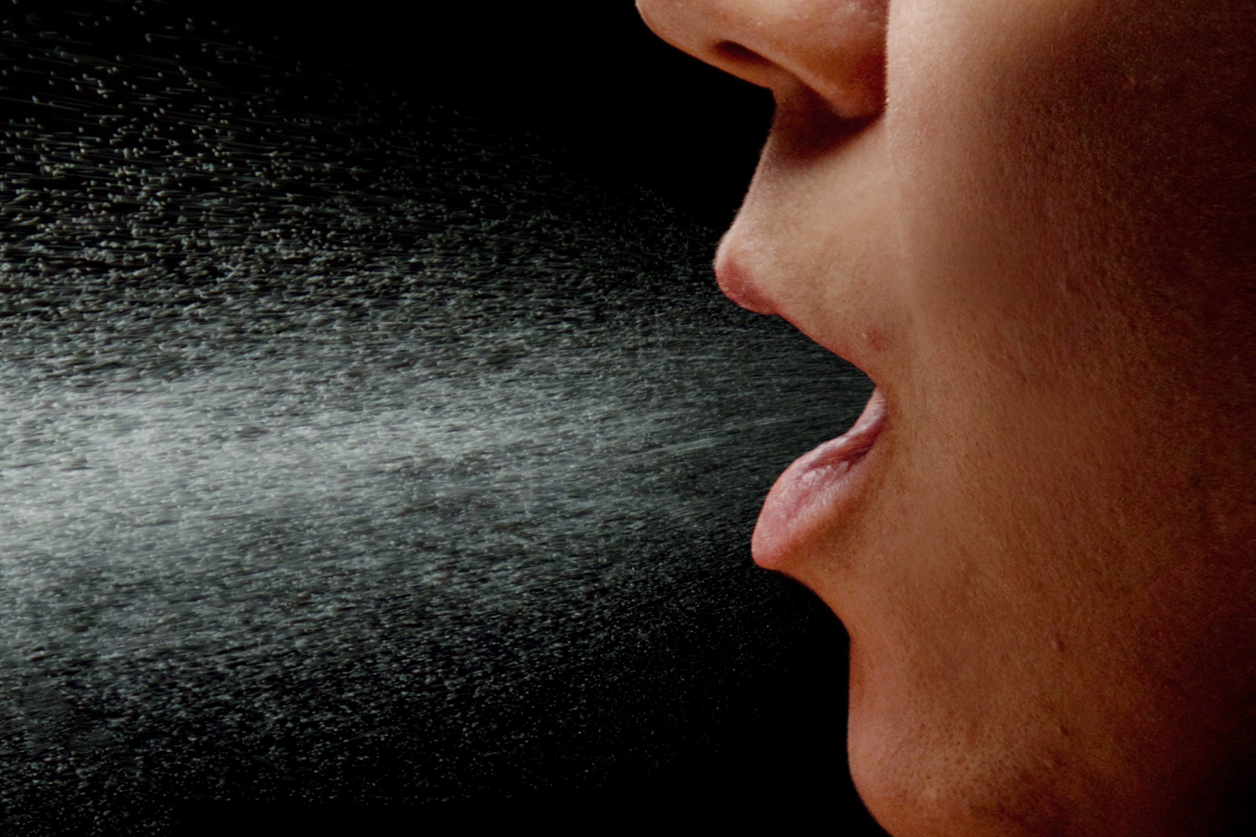
How do we model the shopping experience?
People move around the shop in a crowd either under their own free will or following shop directions
They then queue to pay at the end
At all times infected people can
be spreading the virus by breathing
And susceptible people can get exposed to the virus

Slide 41
We can simulate the crowd walking through a shop using maths
Model for the crowd motion
2. Model for the virus transport
Random shopping list

Slide 42
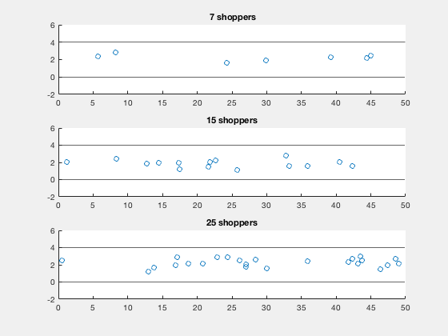
Resulting Movement of shoppers

Slide 43
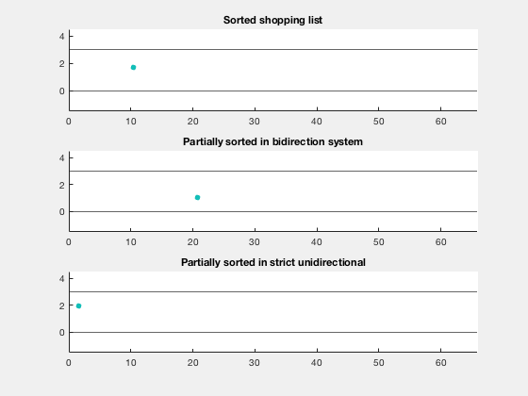
Motion of a single shopper

Slide 44


Results
Plots of viral exposure for one person E(t) over time t
 | One way structured queue
Social distancing
Distancing disrespected

Slide 45


Conclusions
Plots of viral exposure for one person E(t) over time t
 |  | Free movement
Social distancing
Distancing disrespected

Slide 46
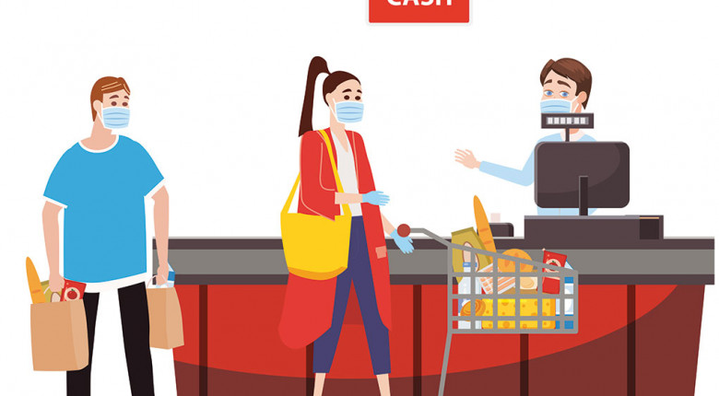
Conclusions
Random shopping is usually safer than guided shopping
Avoid queuing

Slide 47
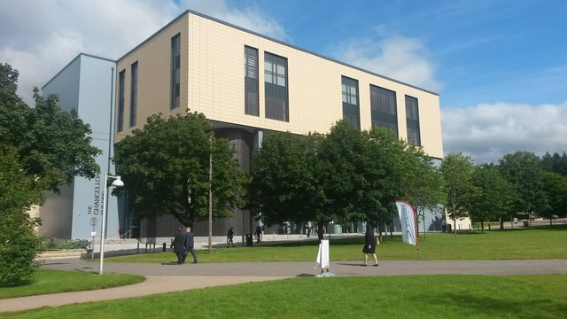
Maths Keeps Universities Safer

Slide 48
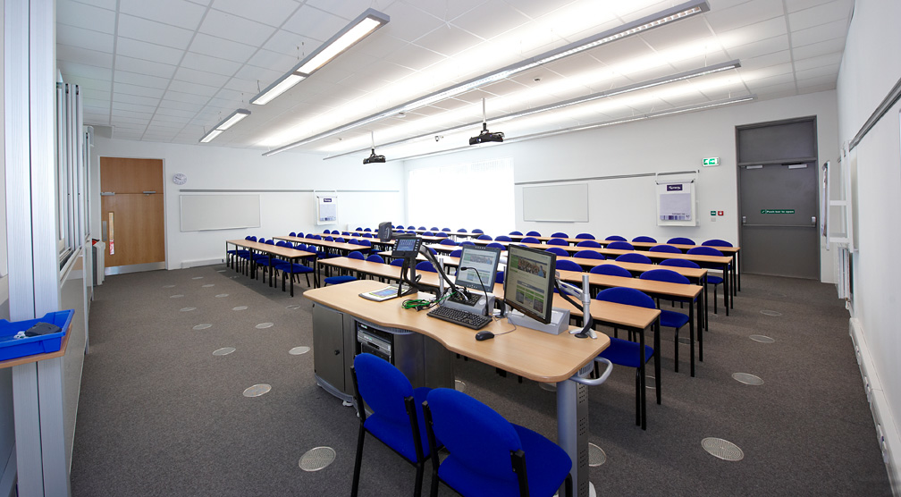

Slide 49
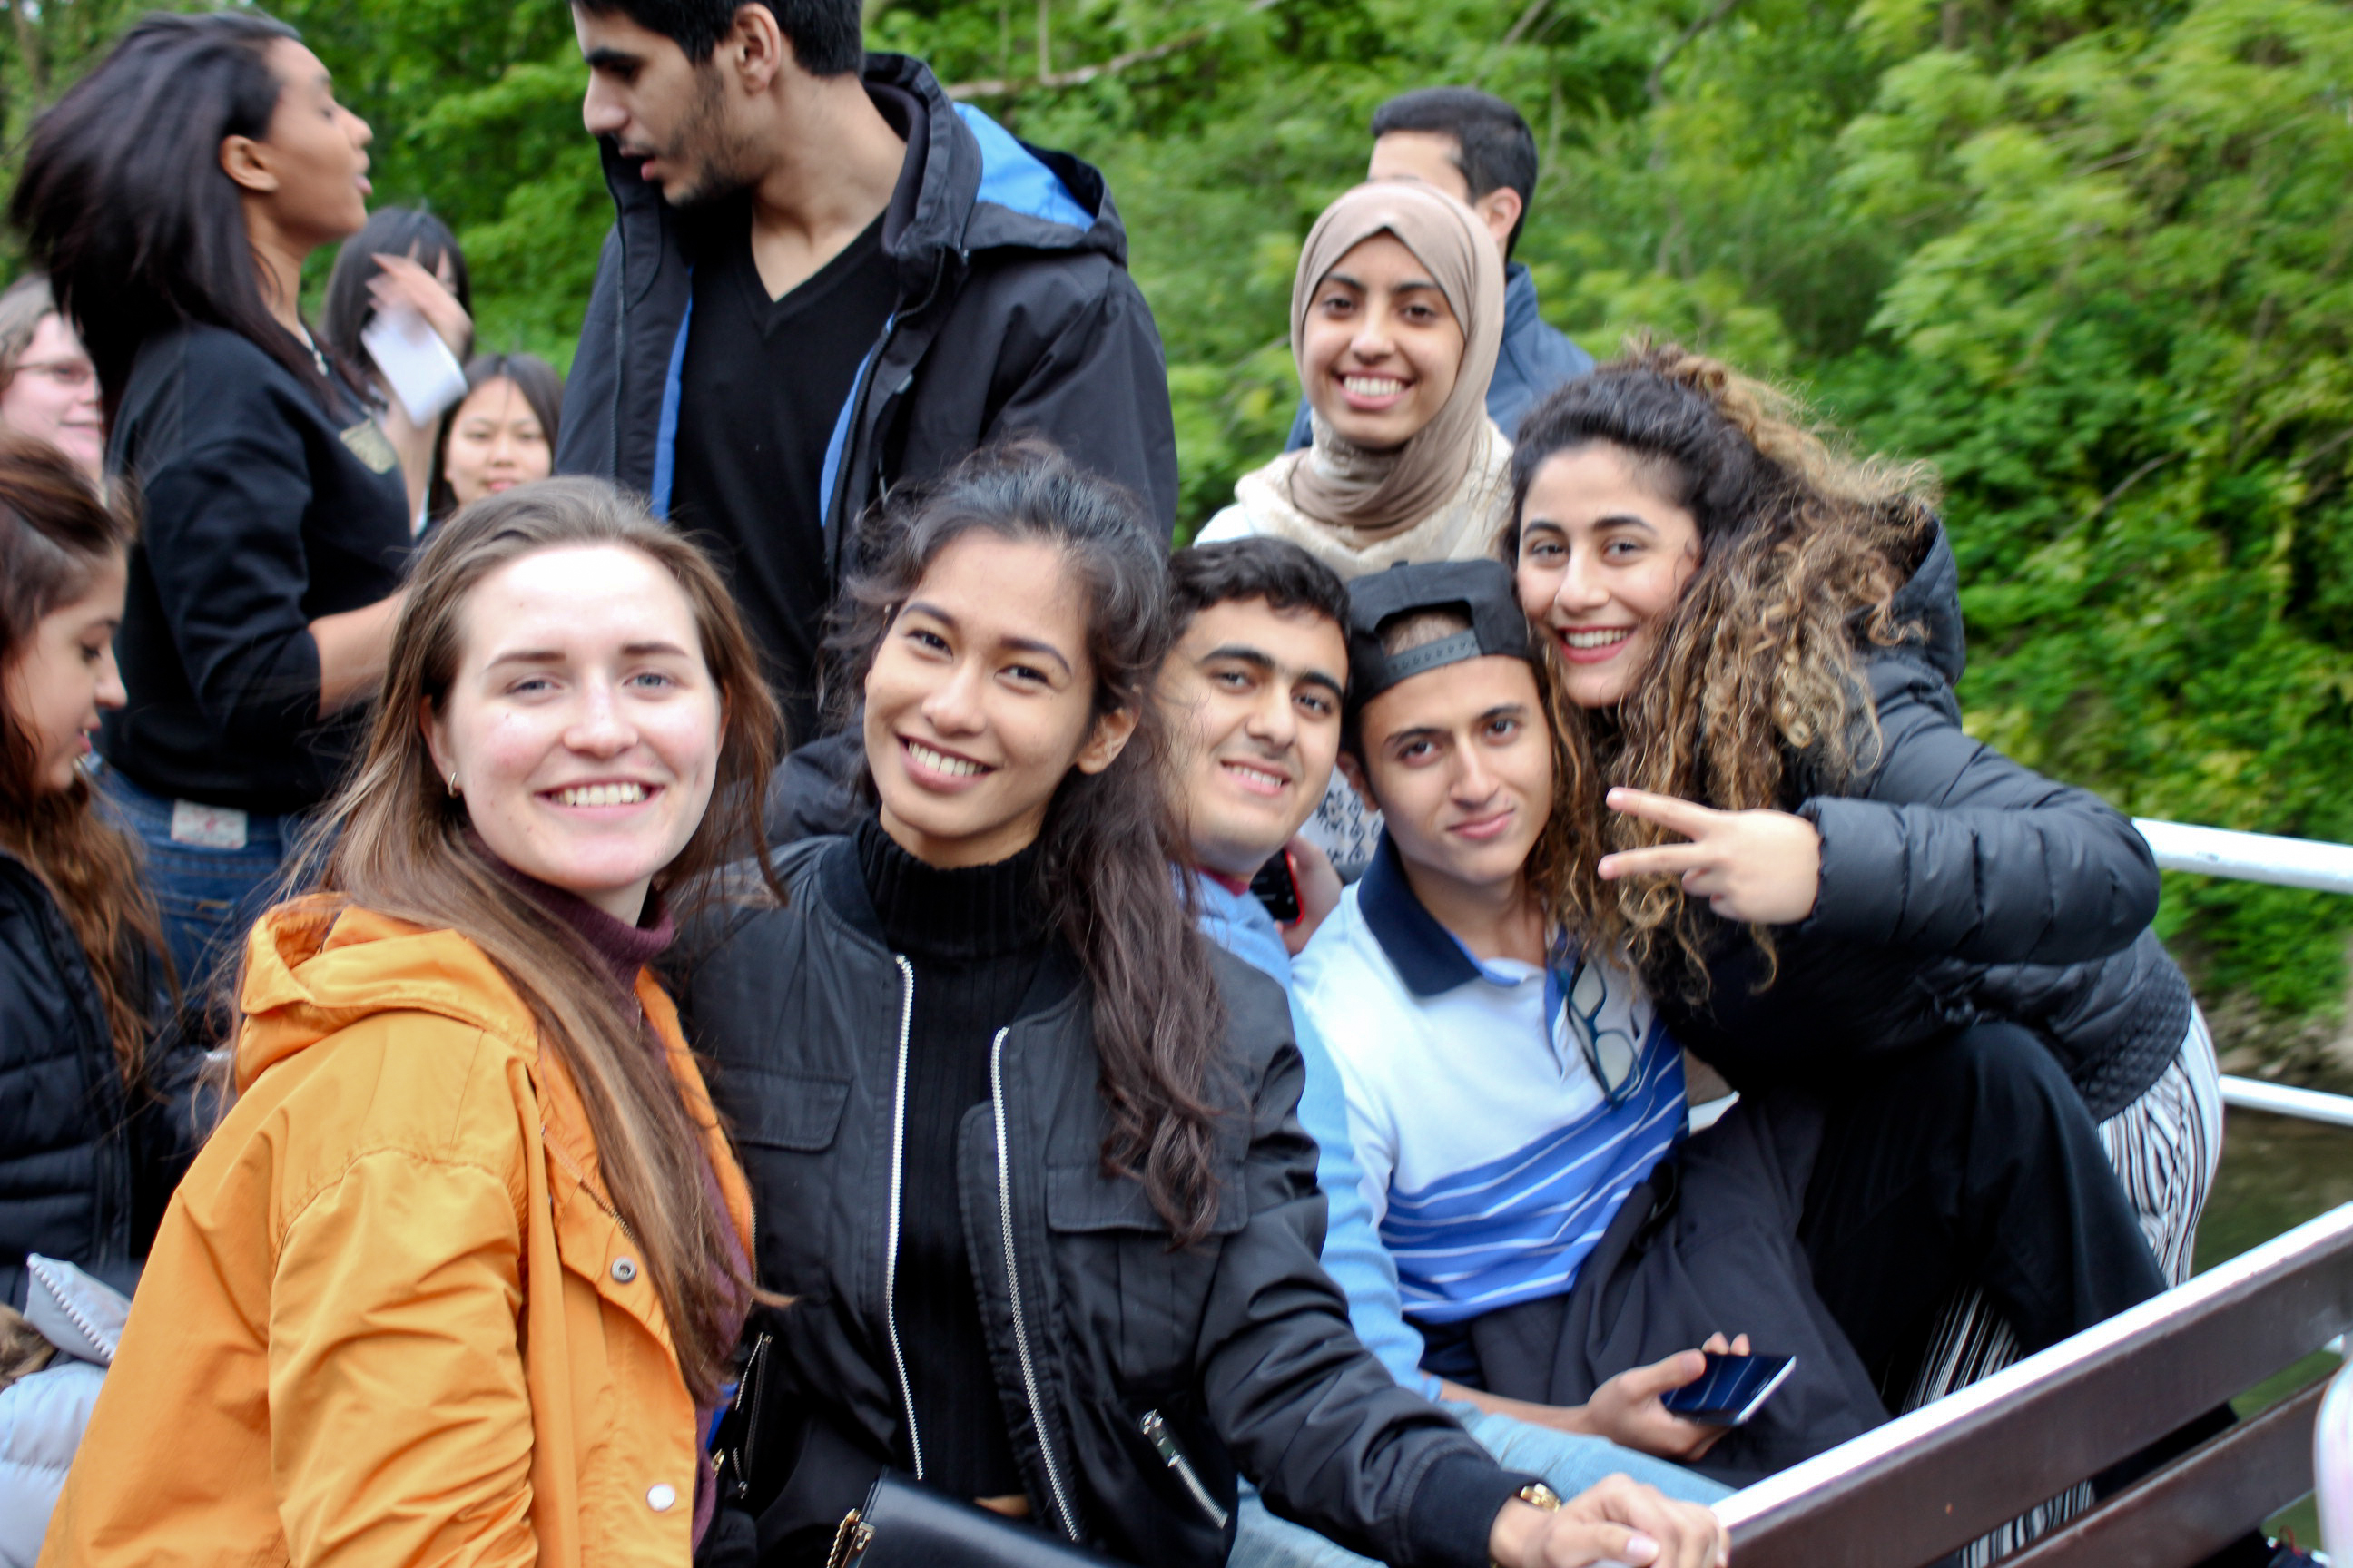
What is the best size for a lecture?
Group of S students

Slide 50
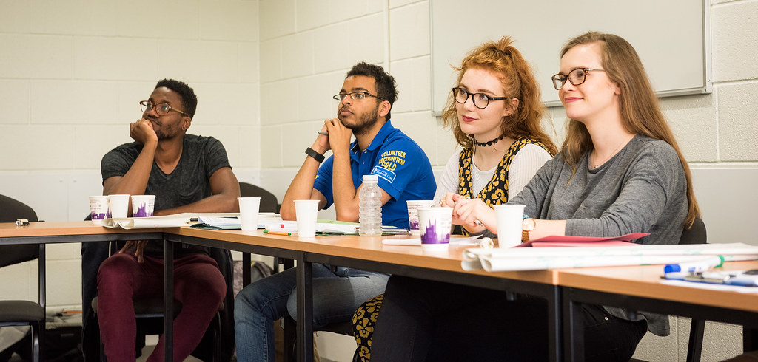
Divide up into K equal sized classes
Each class N students in it
N = S/K

Slide 51
Model
Risk to the students
Risk to the lecturer

Slide 52
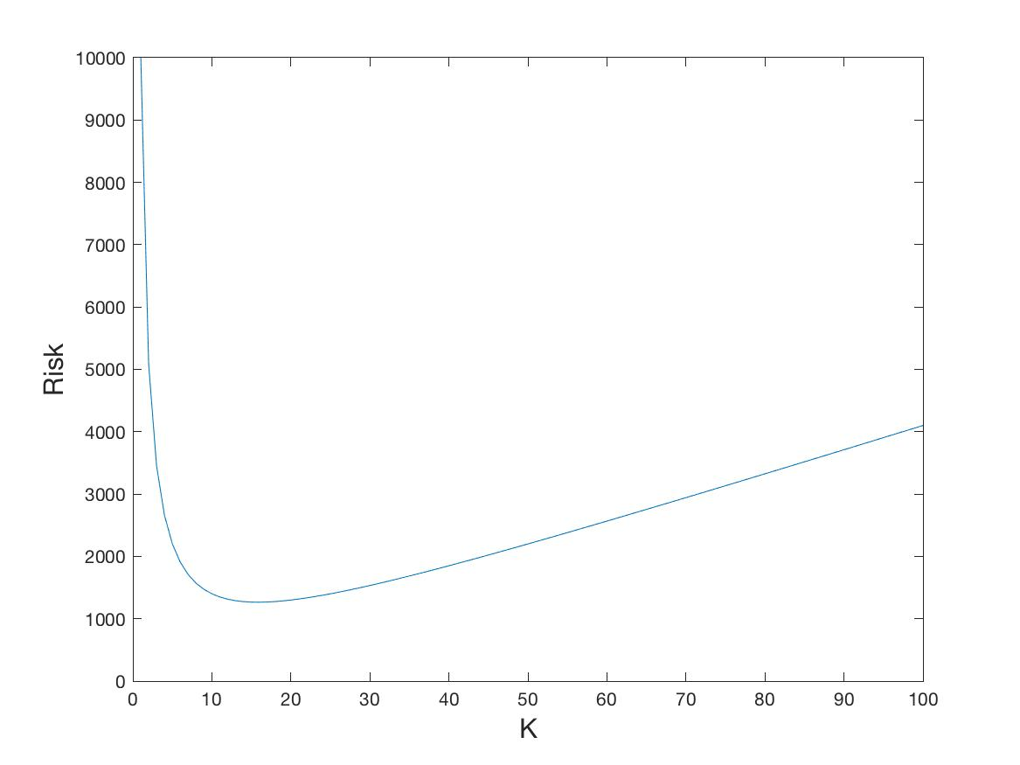
Total Risk:
Best number of classes

Slide 53
Optimal number of classes balances the risks to the students and the lecturer
So that
Optimal Class Size

Slide 54
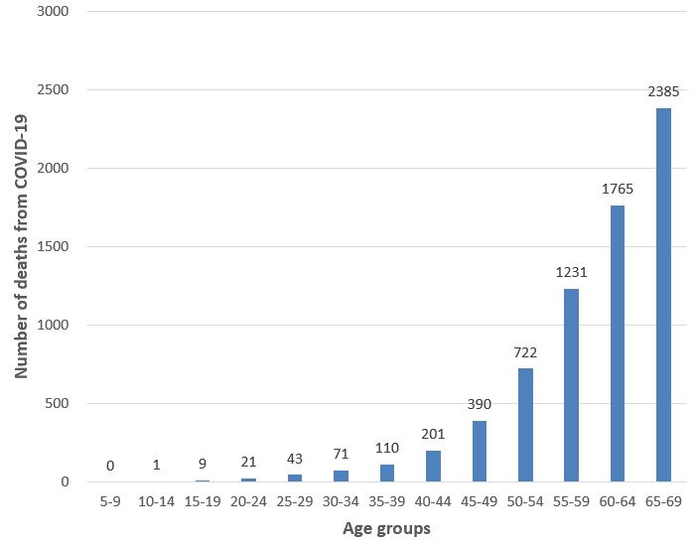
Optimal class size

Slide 55
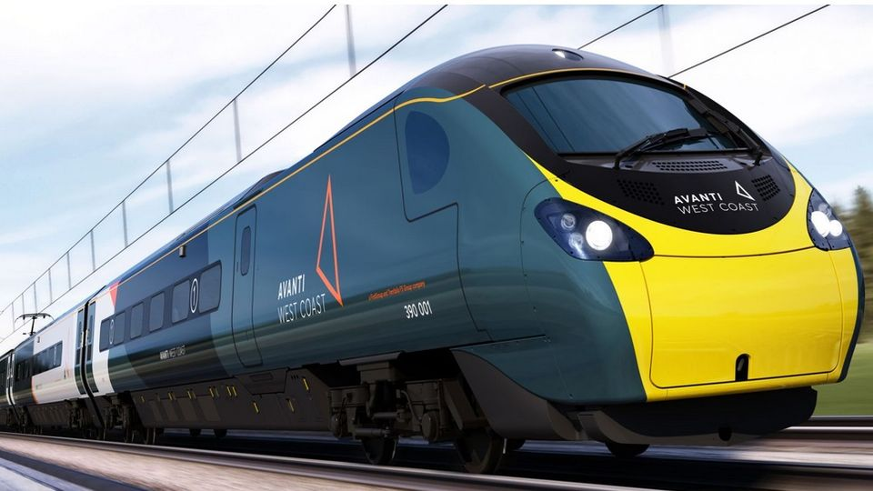
Other ways that maths is useful in the fight against COVID-19
Keeping the trains safe
Getting food to us
Helping in hospitals
Keeping the lights on

Slide 56
Conclusions
Mathematics helps us all to
Stay safe!

