Slide 1
Samsung: Data Augmentation and Eye Gaze Detection
Jesús Contreras, Pedro Salazar, Margaret Duff, Judith Esquivel, Guillermo Herrera, Alan Reyes

Slide 2
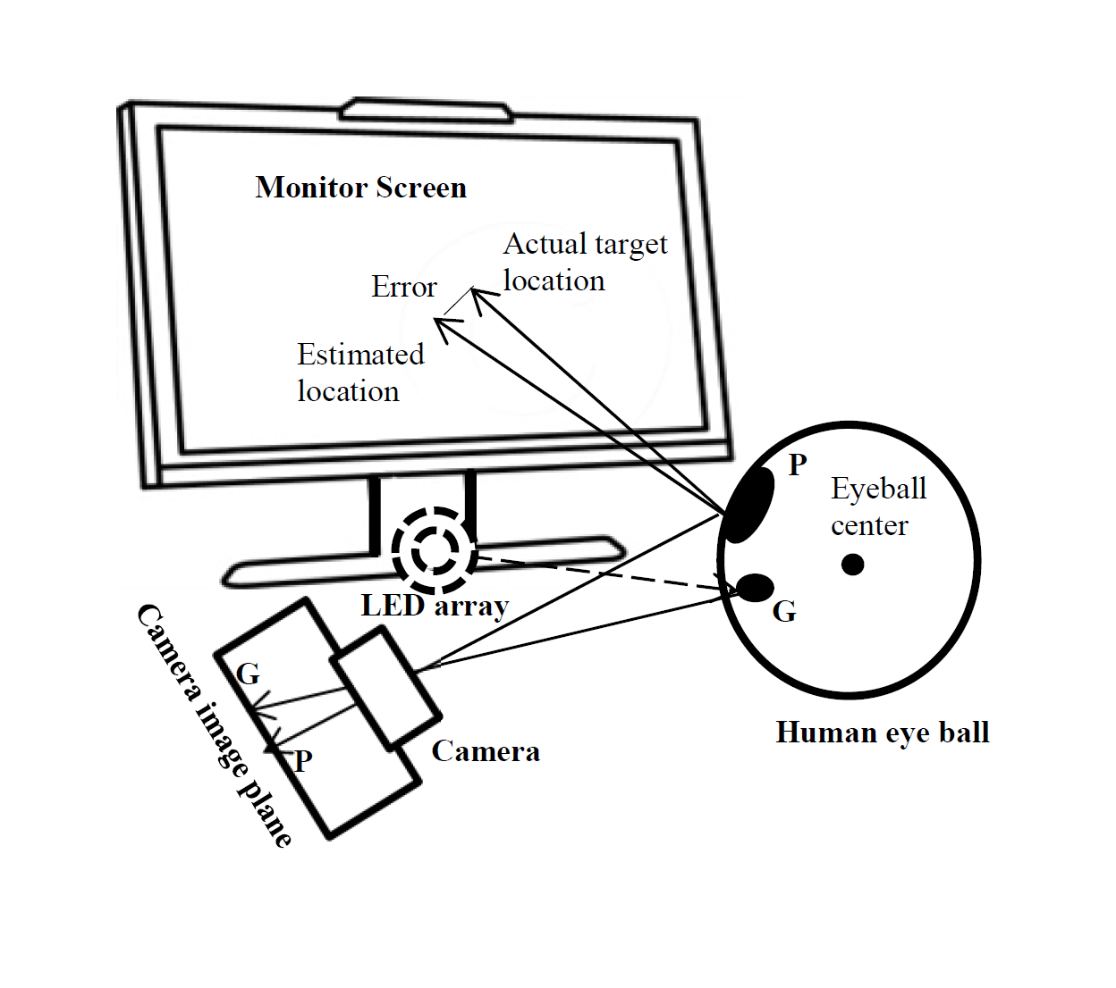
The (sub)problems
Face detection/eye detection
Eye tracking
For one frame
For a sequence of frames (video)
Data augmentation on the black box face detection
Eye Gaze Detection| BUCS ITT | August 2019

Slide 3
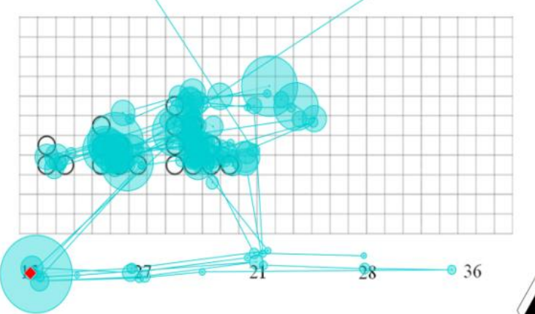
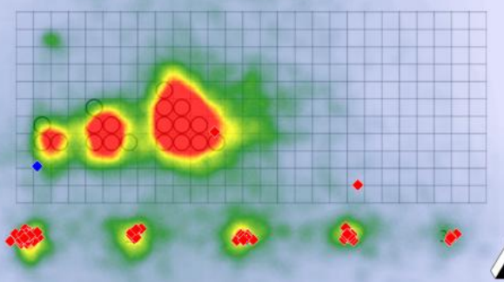
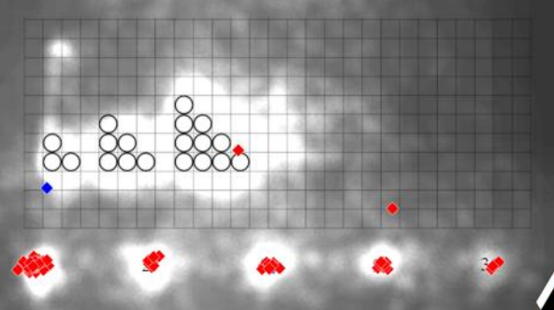
Possible Outputs
Attention point curve
Heat map
Attention map
Eye Gaze Detection| BUCS ITT | August 2019

Slide 4
y’’
Screen plane
Screen
$$π$$
O’’
$$p$$
$$p_{R}$$
x’’
z’’
$$p_{L}$$
$$K∘H^{−1}$$
$$H$$
$$ℓ_{R}$$
$$ℓ_{L}$$
Right eyeball
y
$$q_{R}$$
z
O
y’
$$q_{L}$$
Left eyeball
z’
x
Camera
Plane
O’
$$K$$
Head (world)
frame
Camera
x’
Head
Eye Gaze Detection| BUCS ITT | August 2019

Slide 5
H and K are homographies (invertible projective transformations):
$L_{R}$ and $L_{L}$ are the Plücker matrices associated to lines $ℓ_{R}$ and $ℓ_{L}$ (in O’’):
and $π={\left(u:v:w:z\right)}^{T}$ is the equation for the screen plane (in O’’).
$H:ℝℙ^{3}→$ $ℝℙ^{3}$
$$H=\left(\begin{matrix}R∈O\left(3\right) & t \\ 0 & 1\end{matrix}\right)=\left[R | t\right]$$
$K:ℝℙ^{3}→$ $ℝℙ^{3}$
$$K=\left(\begin{matrix}S∈O\left(3\right) & u \\ 0 & 1\end{matrix}\right)=\left[S | u\right]$$
$L_{R}=\left(\begin{matrix}\begin{matrix}0 & a_{R} \\ −a_{R} & 0\end{matrix} & \begin{matrix}−b_{R} & c_{R} \\ d_{R} & −e_{R}\end{matrix} \\ \begin{matrix}b_{R} & −d_{R} \\ −c_{R} & e_{R}\end{matrix} & \begin{matrix}0 & f_{R} \\ −f_{R} & 0\end{matrix}\end{matrix}\right)$, ${ L}_{L}=\left(\begin{matrix}\begin{matrix}0 & a_{L} \\ −a_{L} & 0 \end{matrix} & \begin{matrix}−b_{L} & c_{L} \\ d_{L} & −e_{L}\end{matrix} \\ \begin{matrix}b_{L} & −d_{L} \\ −c_{L} & e_{L}\end{matrix} & \begin{matrix}0 & f_{L} \\ −f_{L} & 0\end{matrix}\end{matrix}\right)$
How to compute attention point P?
$$p_{R}=L_{R}KH^{−1}π$$
$$p_{L}=L_{L}KH^{−1}π$$
$$\hat{p}=\frac{1}{2}\left(p_{R}+p_{L}\right)={\frac{1}{2}(L}_{R}+L_{L})KH^{−1}π$$
Eye Gaze Detection| BUCS ITT | August 2019

Slide 6
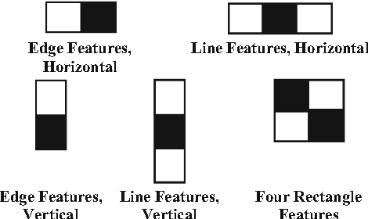
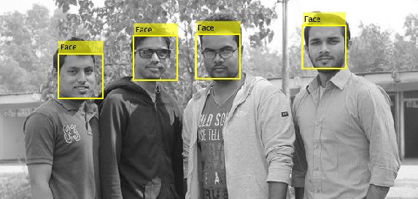
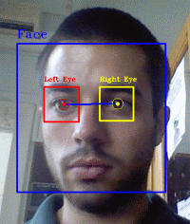
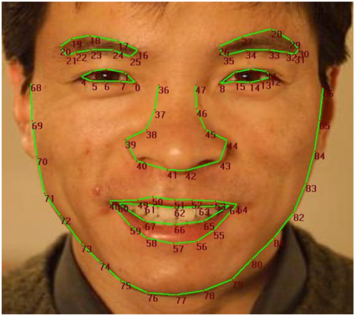
Face and Eye detection
Produce bounding box for face / eyes.
Detect featured points over the face (edges, corners, nose, mouth, eyes).
Haar Filters and
Cascade
Easy
Fast
Viola-Jones algorithm
Reference: Viola and Jones. Rapid Object Detection using a Boosted Cascade of Simple Features (CVPR 2001).
Eye Gaze Detection| BUCS ITT | August 2019

Slide 7
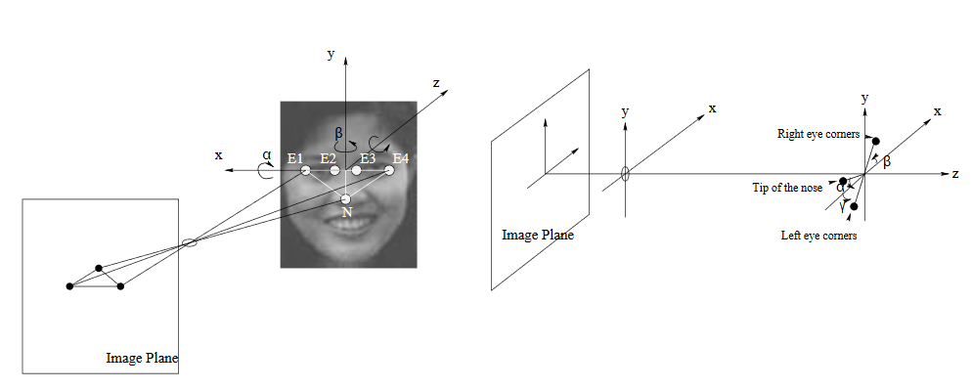
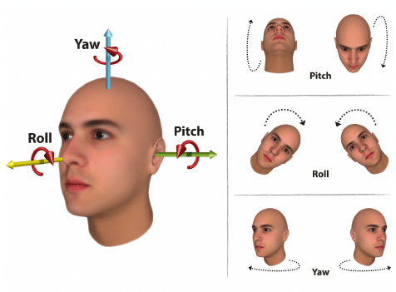
Head Pose Estimation
Consider coordinate system with origin in the focal point of the camera.
Compute 3 angles to determine pose: Roll, Yaw and Pitch.
Reference: Davis, L. et al. Computing 3D Head Orientation from a Monocular Image Sequence. (2010).
Eye Gaze Detection| BUCS ITT | August 2019

Slide 8
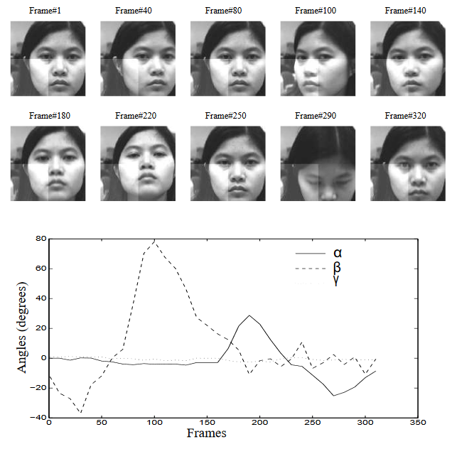
Roll and Yaw can be computed using 5 points.
For the Pitch, a categorization of the observed face is needed. Then use tabulated anthropometric data according to the category.
Eye Gaze Detection| BUCS ITT | August 2019

Slide 9
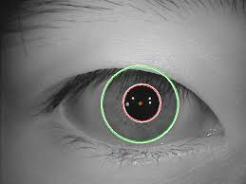
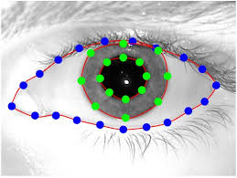
Center of Eye Estimation
Active Eye Localization Systems
Expensive
Auxiliar Equipment
Feature Based Methods
Passive Eye Localization Systems
Hybrid Methods
Model Based Methods
Valenti-Gevers +
Pang, Z. et al
Reference: Pang, Z. et al. Robust Eye Center Localization through Face Alignment and Invariant Isocentric Patterns. (2015)
Eye Gaze Detection| BUCS ITT | August 2019

Slide 10
Estimating gaze direction (with head direction)
For informal interactions, it is generally not possible to directly observe the eyes in the sensory data. An alternative is to use the head pose as a cue for gaze direction
Modelling the relationship between these two variables
where, at time t,
𝐻: Head direction.
𝐺: Gaze direction..
𝑅: Gaze direction which is likely to be equal to the head direction
Eye Gaze Detection| BUCS ITT | August 2019

Slide 11
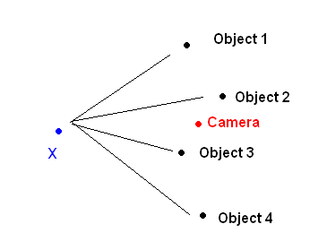
Estimating gaze direction (with head direction)
Let V be the focus of attention of a person in position X.
Bayesian Temporal Formulation:
Eye Gaze Detection| BUCS ITT | August 2019

Slide 12
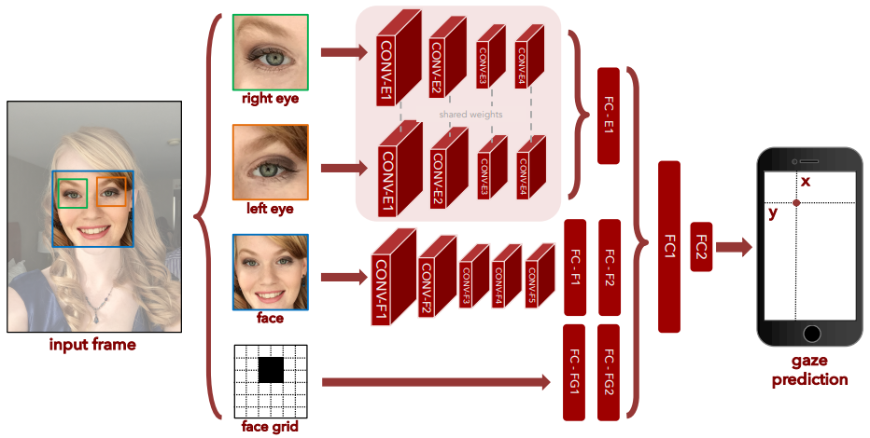
Front-end methodologies
Use of deep learning (convolutional neural networks).
Reference: Krafka, Khosla et al. Eye-tracking for Everyone (CVPR 2016).
Eye Gaze Detection| BUCS ITT | August 2019

Slide 13
Future Work: Eye Gaze Estimation
Perform sensitivity analysis
Solution highly sensitive to errors
Correction methods for the frame sequence
Kalman filter
Particle filters
Eye tracking for multiple users (Bayesian approach)
Develop a front-end methodology (deep learning)
Expand training dataset
Eye Gaze Detection| BUCS ITT | August 2019

Slide 14
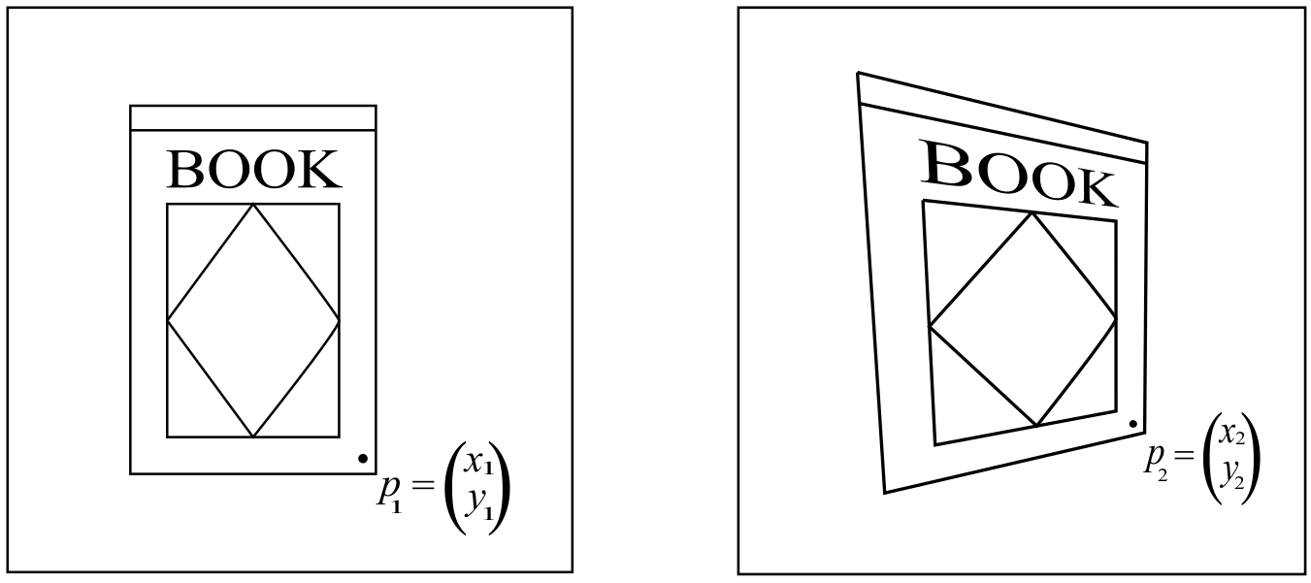
Data Augmentation: Homographies
Eye Gaze Detection| BUCS ITT | August 2019

Slide 15
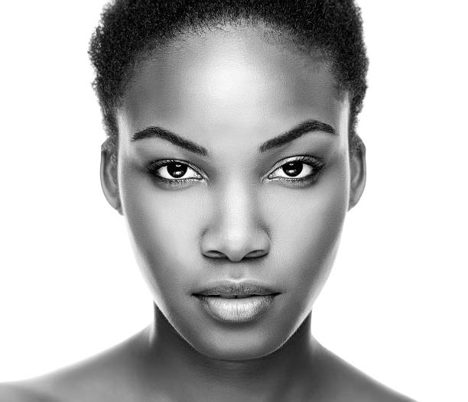
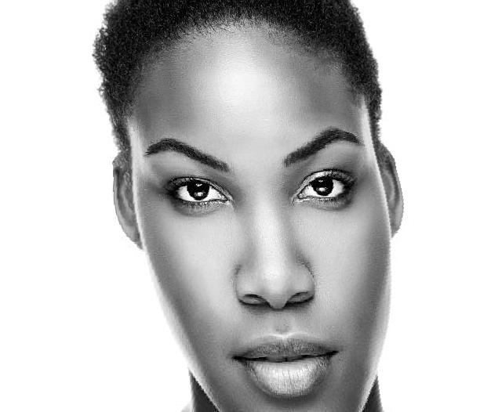
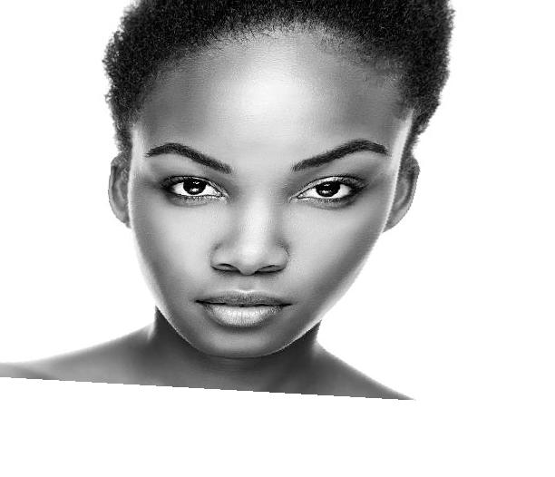
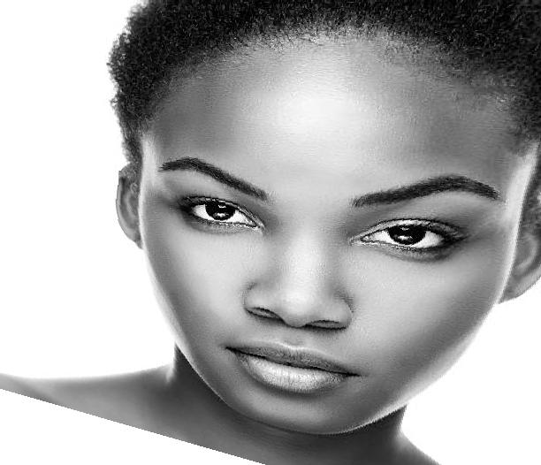
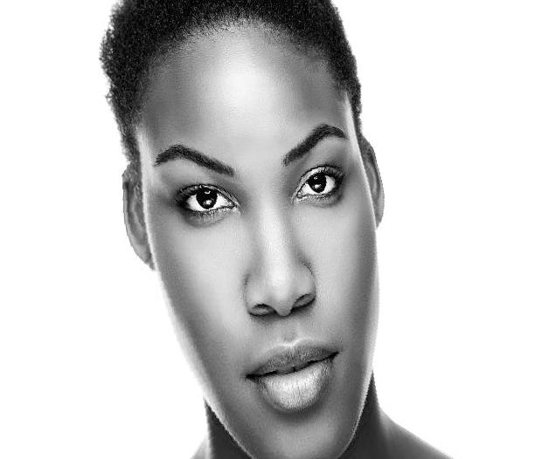
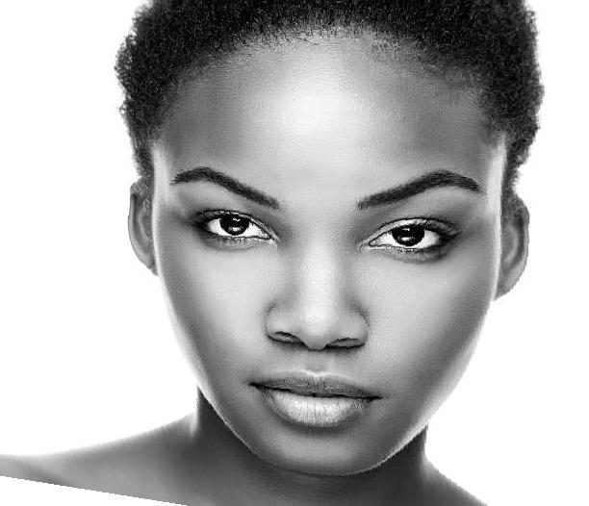
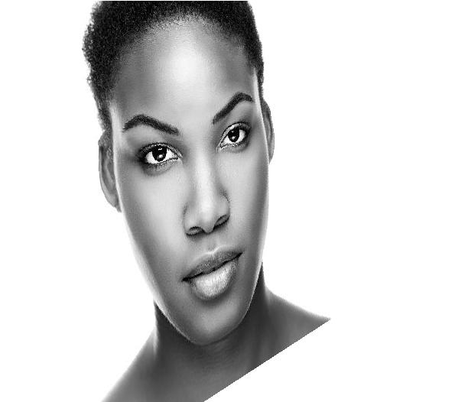
Data Augmentation: Homographies
Eye Gaze Detection| BUCS ITT | August 2019

Slide 16
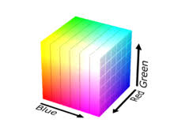
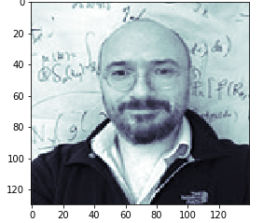
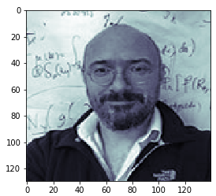
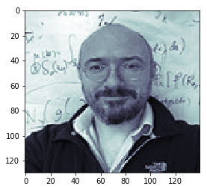
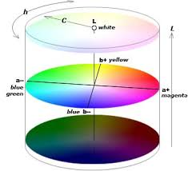
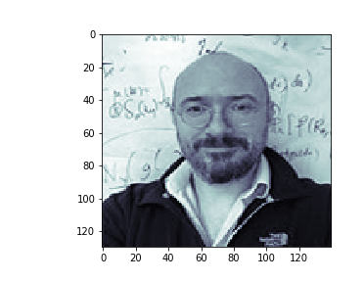
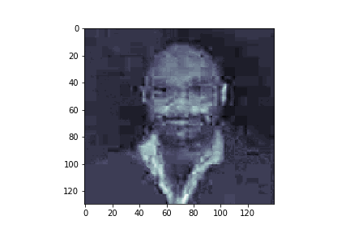
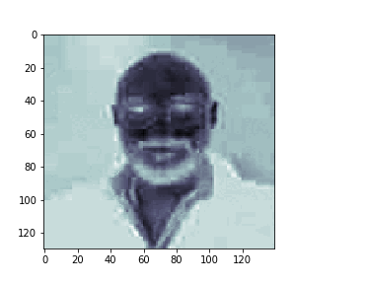
Data Augmentation: Changing the Illumination
RGB colour map R G B
LaB colour map L a B
Eye Gaze Detection| BUCS ITT | August 2019

Slide 17
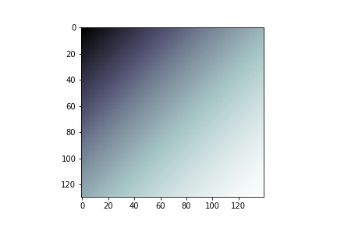
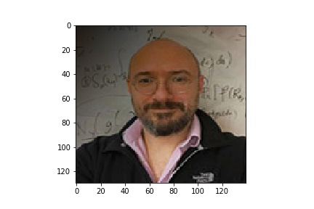
Data Augmentation: Changing the Illumination
Pointwise Multiplication
L
a
B
Eye Gaze Detection| BUCS ITT | August 2019

Slide 18
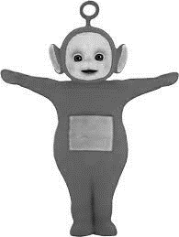
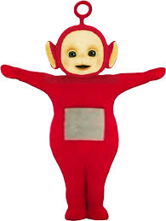
Data Augmentation Future Work: Transferring Colour to Grayscale Images
Paper by Tomihisa Welsh, Michael Ashikhmin, Klaus Mueller
Our Idea
+
+
OR
=
=
Eye Gaze Detection| BUCS ITT | August 2019

Slide 19
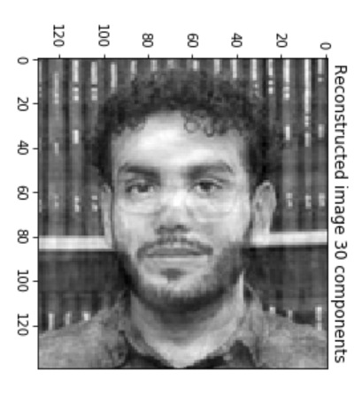
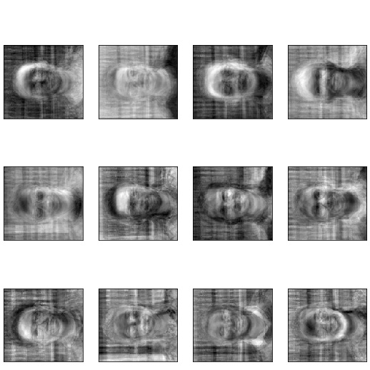
Future Work: Latent Variable Models
Eigenfaces:
Further work: more sophisticated generative models, e.g. GANs, VAEs
Eye Gaze Detection| BUCS ITT | August 2019

