Slide 1
The Blobby One
Michele Firmo, Guido Baardink, Margaret Duff, Anton Souslov, Claire Delplancke, Silvia Gazzola, Peter Mosley
ITT11, January 2020

Slide 2
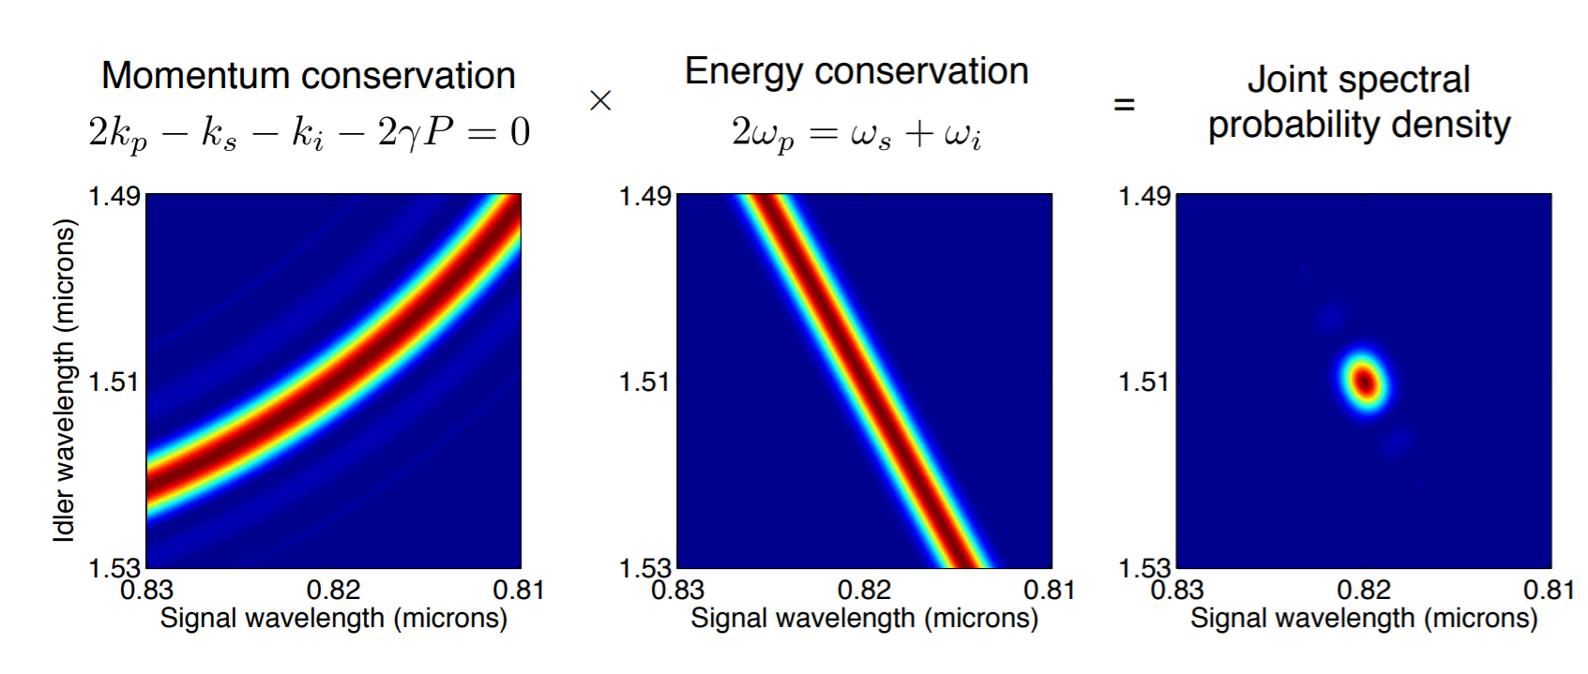
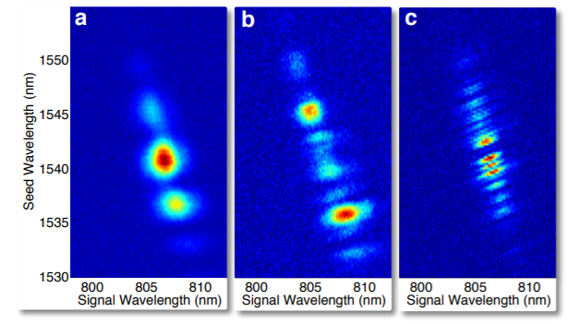
What’s the problem?
Aim of the experiments: produce photon pairs with known attributes
The Blobby One| ITT12 | January 2020

Slide 3
Inverse problem
Aim: Find the geometry which solves the inverse problem
$$\arg{\min\left\{{\left\|Y−f\left(Λ,\frac{Λ}{d}\right)\right\|}^{2}\right\}, } s.t. z∈\left[0,L\right]→\left(Λ\left(z\right),\frac{d}{Λ}\left(z\right)\right)$$
The Blobby One| ITT12 | January 2020

Slide 4
Forward Problem
Optical fibres are described by physical parameters:$Λ\left(z\right),\frac{d}{Λ}\left(z\right)$
Gives dispersion relation $k\left(ω, z\right) \text{and} \text{the} \text{phase} \text{mismatch}$:
$$Δk\left(ω_{s}, ω_{i}, z\right)=2k\left(ω_{p}, z\right)−k\left(ω_{s}, z\right)−k(ω_{i}, z)$$
3. Evaluate ${Y=\left|φ\left(ω_{s}, ω_{i}\right)\right|}^{2}$ , where
The centres of the blobs are the local maxima of $Y$
The Blobby One| ITT12 | January 2020

Slide 5
Direction 1: Numerics
Optical fibres are described by physical parameters: $Λ\left(z\right),\frac{d}{Λ}\left(z\right)$
Gives dispersion relation $k\left(ω, z\right) \text{and} \text{the} \text{phase} \text{mismatch}$:
$$Δk\left(ω_{s}, ω_{i}, z\right)=2k\left(ω_{p}, z\right)−k\left(ω_{s}, z\right)−k(ω_{i}, z)$$
3. Evaluate ${Y=\left|φ\left(ω_{s}, ω_{i}\right)\right|}^{2}$ , where
The Blobby One| ITT12 | January 2020

Slide 6
Numerics: A single step change
What can we learn from a model with a single step change?
The Blobby One| ITT11 | January 2020

Slide 7
Numerics: Changing step size
The Blobby One| ITT11 | January 2020

Slide 8
Numerics: Changing step position
The Blobby One| ITT11 | January 2020

Slide 9
Numerics: Continuous vs Discrete Changes
Question: Do the discrete blobs occur even with a continuous change?
Variations of size <1%
The Blobby One| ITT11 | January 2020

Slide 10
Numerics: Increasing number of segments
The Blobby One| ITT11 | January 2020

Slide 11
Direction 2: Analytical approach
Optical fibres are described by physical parameters: $Λ\left(z\right),\frac{d}{Λ}\left(z\right)$
Gives dispersion relation $k\left(ω, z\right) \text{and} \text{the} \text{phase} \text{mismatch}$:
$$Δk\left(ω_{s}, ω_{i}, z\right)=2k\left(ω_{p}, z\right)−k\left(ω_{s}, z\right)−k(ω_{i}, z)$$
3. Evaluate ${Y=\left|φ\left(ω_{s}, ω_{i}\right)\right|}^{2}$ , where
The Blobby One| ITT12 | January 2020

Slide 12
Goal: compute the “phase matching” pdf
Ansatz: small variations in material properties along the fiber
Expansion to first order in $ε$

Slide 13
Paradox:
- Small variation in $k(ω)$ gives small correction to $φ(ω_{1},ω_{2})$
$$ε=0$$
$$ε=.25$$
$$ε=.5$$
$$ε=.75$$
$$ε=1$$

Slide 14
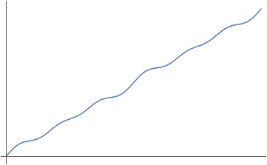
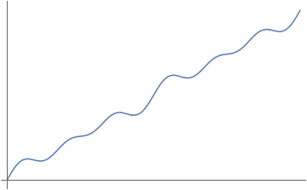
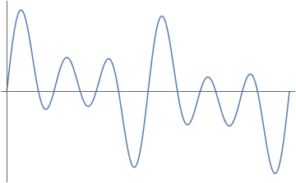
Analytical approach II: Stationary phase approximation
$$\int_{0}^{L}{e^{i Δk z}dz}\text{= }\sum{ \sqrt{\frac{2π}{f^{′′}}}e^{iφ}}$$
Stationary points
f = $zΔk$
$$zΔk$$
$$zΔk$$
$$z$$
$$z$$
$$z$$
$Δk$ large: No stationary points, evaluates to low value
$Δk$ small: A few stationary points, part of peak
$Δk \sim 0$ many stationary points,
near-maximum value
Evaluate amplitude using the stationary points of $zΔk$

Slide 15
Conclusions
We gained an understanding of the forward model using numerical simulations
The number of the step changes is not equal to the number of blobs
Continuous changes can cause blobs
We identified two possible tools to solve the problem analytically
Expansion on small variations in fibre properties
Generalization of stationary phase approximation
The Blobby One| ITT12 | January 2020

Slide 16
Next steps
Further development of analytical tools
Investigate the feasibility of the inverse problem
Choice of the space of parameters
"Simpler" approximation of the forward operator?

