Slide 1
Battery Lifetime Prediction

Slide 2
Problem Statement
Predicting remaining lifetime of a battery (e.g. in an EV)
Can consider multiple causes of failure
We assume that we are only interested in the time to failure, not the cause of the failure

Slide 3
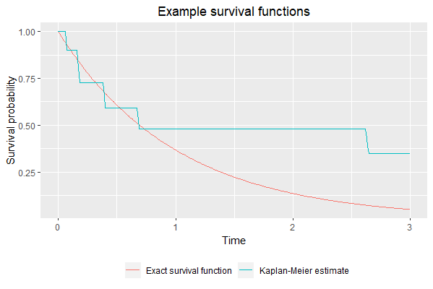
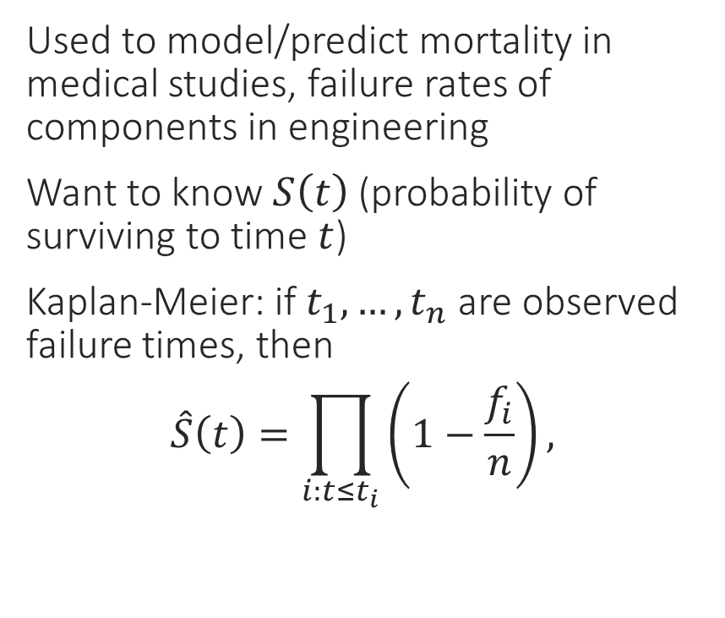
Survival Analysis
Used to model/predict mortality in medical studies, failure rates of components in engineering
Want to know $S\left(t\right)$ (probability of surviving to time $t$)
Kaplan-Meier: if $t_{1},…,t_{n}$ are observed failure times, then
$$\hat{S}\left(t\right)=\prod_{i:t≤t_{i}}{\left(1−\frac{f_{i}}{n}\right)},$$

Slide 4



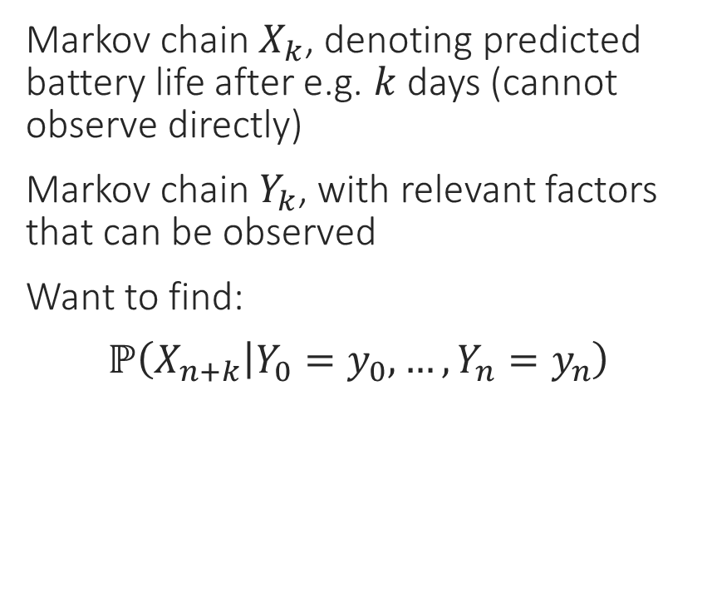



Hidden Markov Model
Markov chain $X_{k}$, denoting predicted battery life after e.g. $k$ days (cannot observe directly)
Markov chain $Y_{k}$, with relevant factors that can be observed
Want to find:
$$ℙ\left(X_{n+k} | Y_{0}=y_{0},…,Y_{n}=y_{n}\right)$$
HMMs as a Bayesian network:
$$X_{0}$$
$$X_{1}$$
$$X_{2}$$
Hidden
$$Y_{0}$$
$$Y_{1}$$
$$Y_{2}$$
Observed

