Slide 1
Statistical methods related to* air pollution
Theresa Smith
10 June 2019
*Possibly useful for

Slide 2
Overview
Ways to measure air pollution and its ‘causes.’
Statistical issues.
Ideas for some starting places.

Slide 3
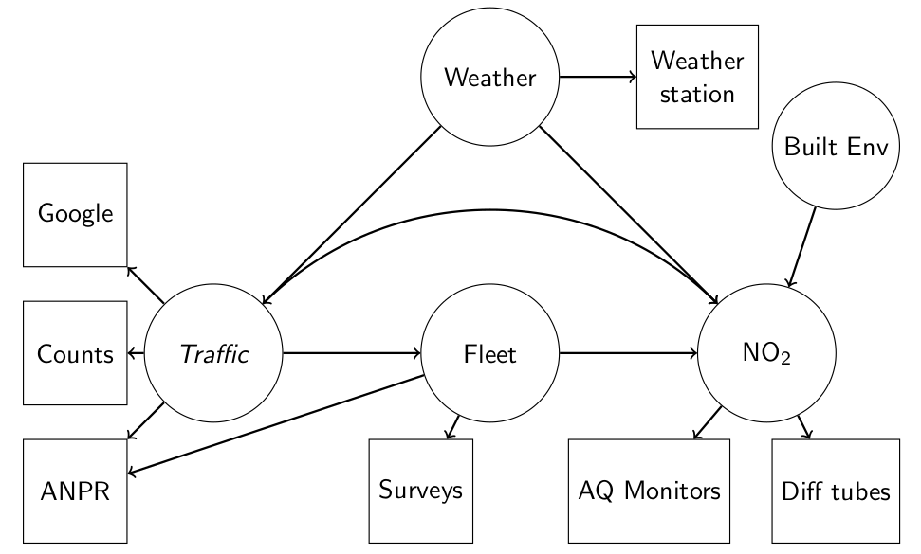
Circles = what we want to know about Squares = what we can measure

Slide 4
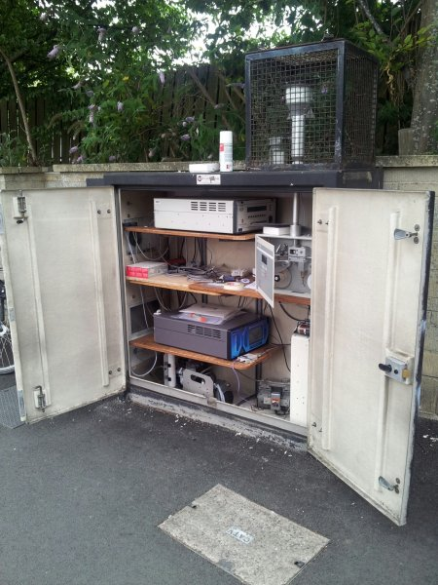
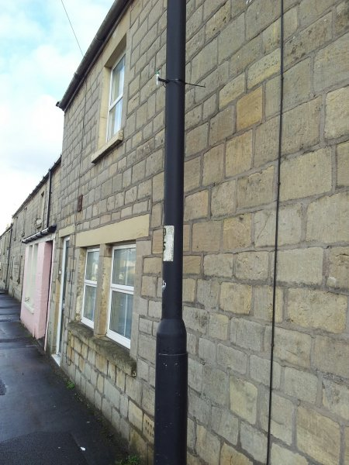
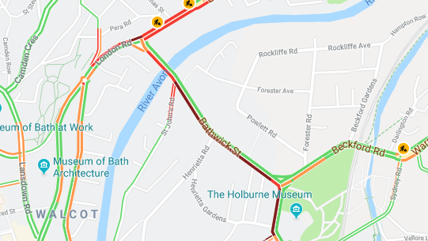
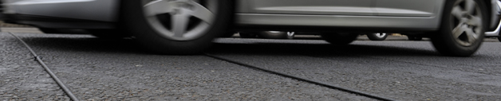
Windsor Bridge
Diffusion tube
ATC Rubber Tubes

Slide 5
Statistical issues
Imprecise or indirect measurements of the processes of interest.
Unknown functional forms relating traffic/fleet/weather to air pollution.
Correlation within and between data streams.
Probably loads more!

Slide 6

Measurement error
Data on traffic will be noisy: might have model output, some detailed data over a short window, proxies (Google Maps), all of the above.
Ignoring the noise causes bias & over/under estimates of uncertainty.
Measurement error model: statistically describe how the data was collected and add this as an additional layer in your model:

Slide 7
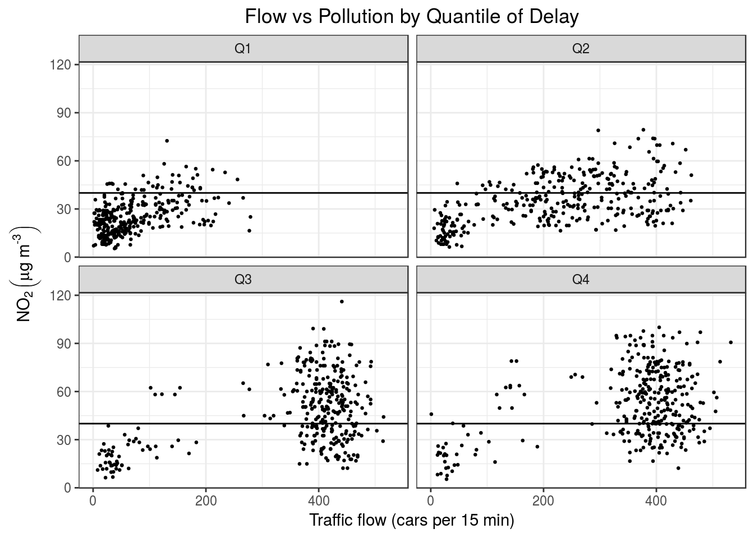
Unknown functional forms
Possible starting places:
Smoothers (splines, GAMs).
Machine learning.
Hidden Markov models.
How to add in fleet and emissions class data?

Slide 8
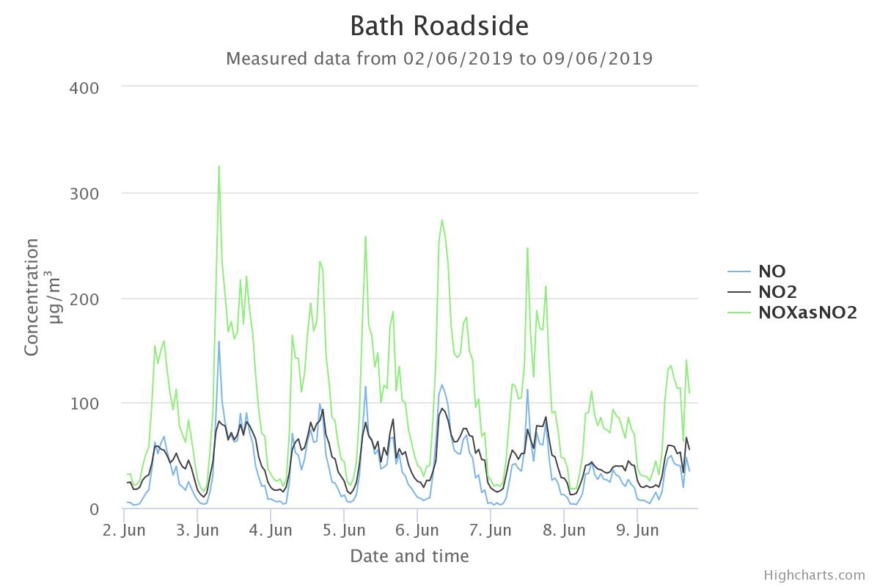
Correlation and collinearity

Slide 9
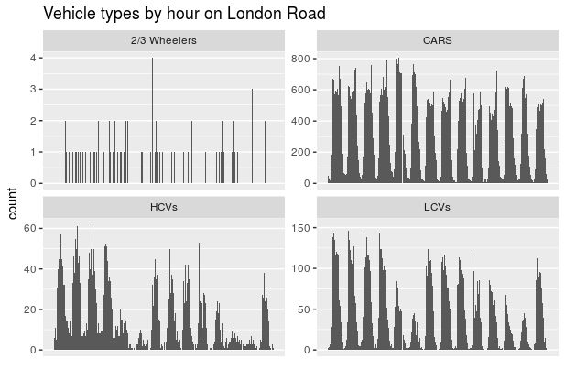
Correlation and collinearity

Slide 10
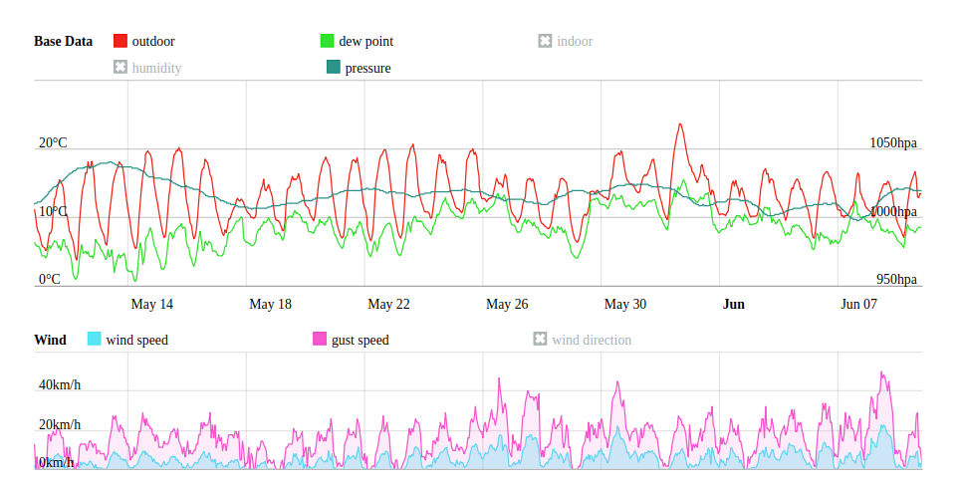
Correlation and collinearity
Possible starting places: Multivariate time series, dimension reduction (e.g., PCA), Network models.

Slide 11
Further resources:
Live air quality data in Bath
ANPR Data
Defra’s Air Pollution site
Bath’s Air Pollution site
Thanks!

