Slide 1


Anomaly Detection in Test Fields
Sandipan Roy, Margaret Duff, Lizhi Zhang, Clarice Poon, Matthew Nunes, Georg Seewald (AVL), Corinna Kindhofer (AVL)
ITT10, June 2019

Slide 2


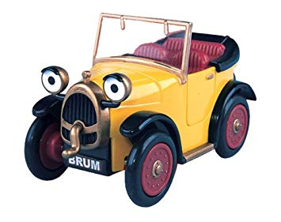
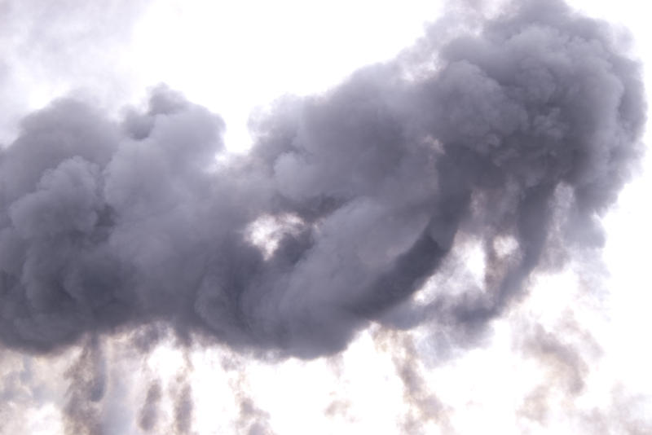

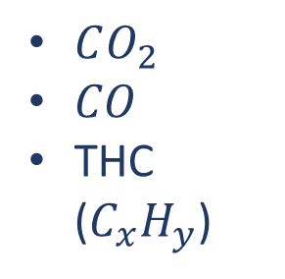
$CO_{2}$
$CO$
THC ($C_{x}H_{y}$)
Why is this problem difficult?
Anomaly Detection in Test Fields | ITT10 | June 2019

Slide 3
The Plan
Inverting formula for carbon balance
Compare the observed values of one sensor with values predicted from the other two sensors
Machine Learning: classification
3. Looking for changes in distribution
Treat results as sampling from some unknown distribution
Look for evidence of changes in distribution
Anomaly Detection in Test Fields | ITT10 | June 2019

Slide 4
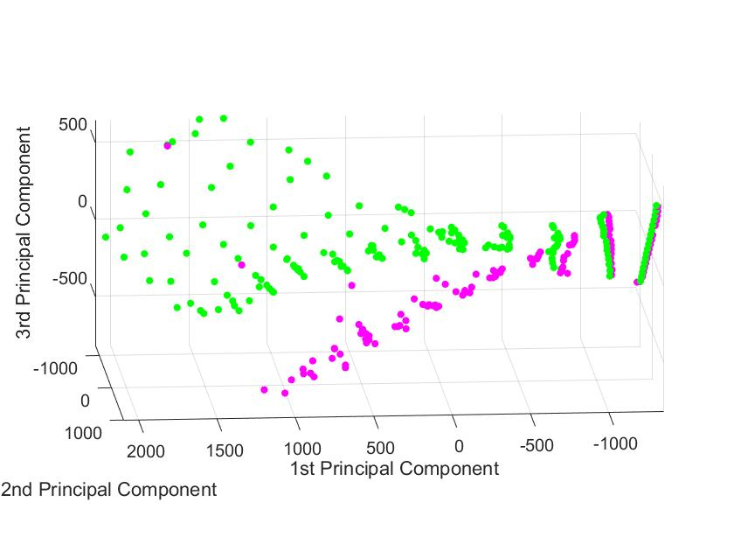
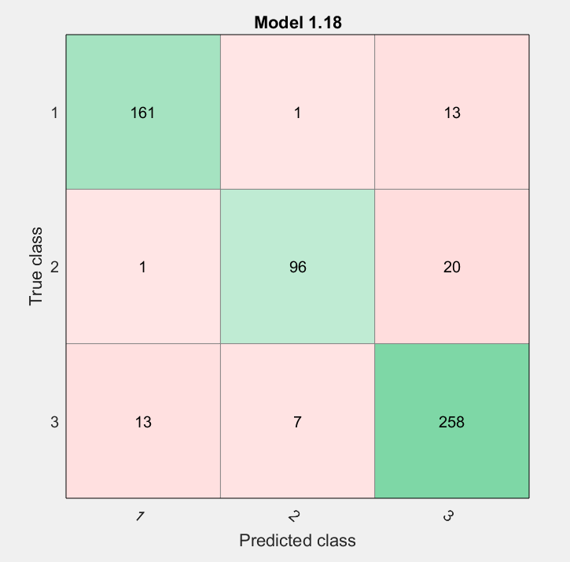
Classification Results
Dataset of all unbalanced samples with faults
Each set of steady state measurements labelled with Sensor 1, Sensor 2 or Both broken
Some success, especially considering only individual sensors breaking.
Anomaly Detection in Test Fields | ITT10 | June 2019

Slide 5
The Plan
Inverting formula for carbon balance
Compare the observed values of one sensor with values predicted from the other two sensors
Machine Learning: classification
3. Looking for changes in distribution
Treat results as sampling from some unknown distribution
Look for evidence of changes in distribution
Anomaly Detection in Test Fields | ITT10 | June 2019

Slide 6
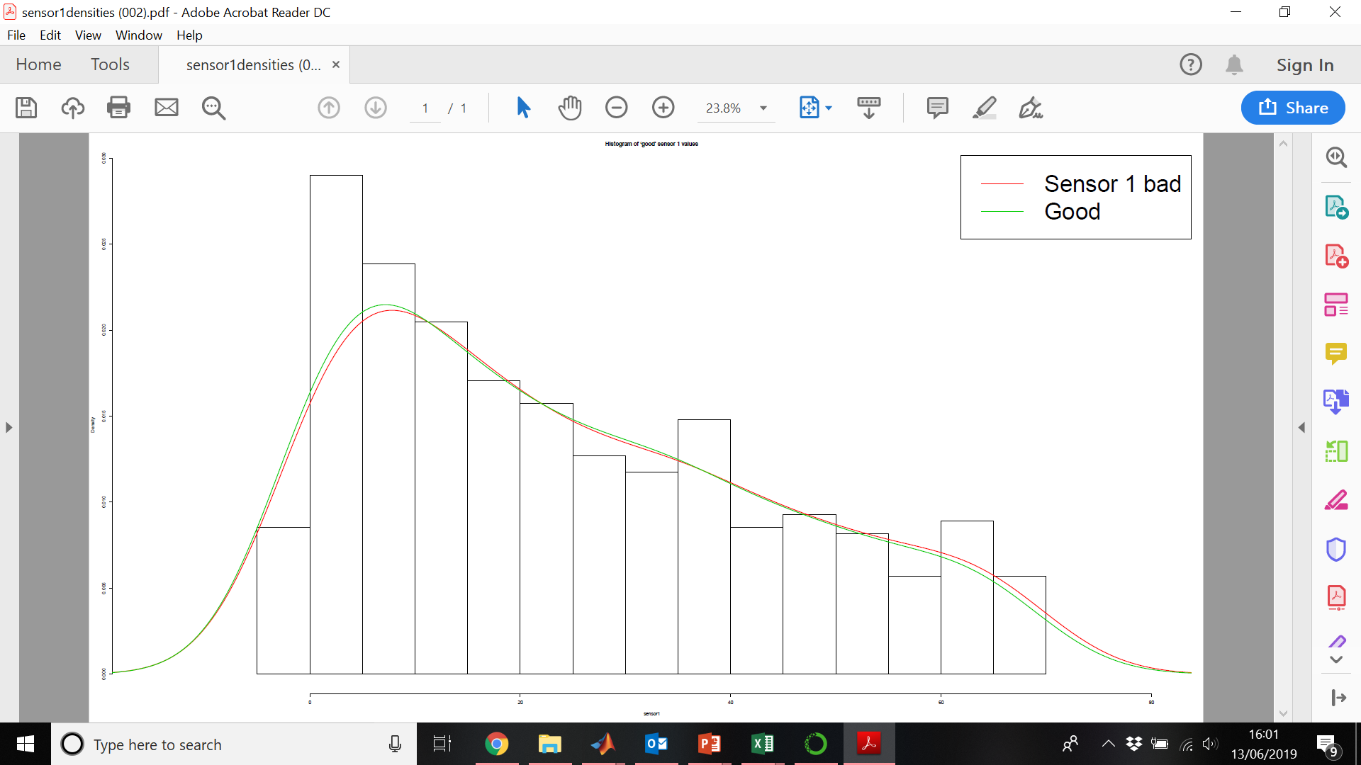
The Idea
Anomaly Detection in Test Fields | ITT10 | June 2019

Slide 7
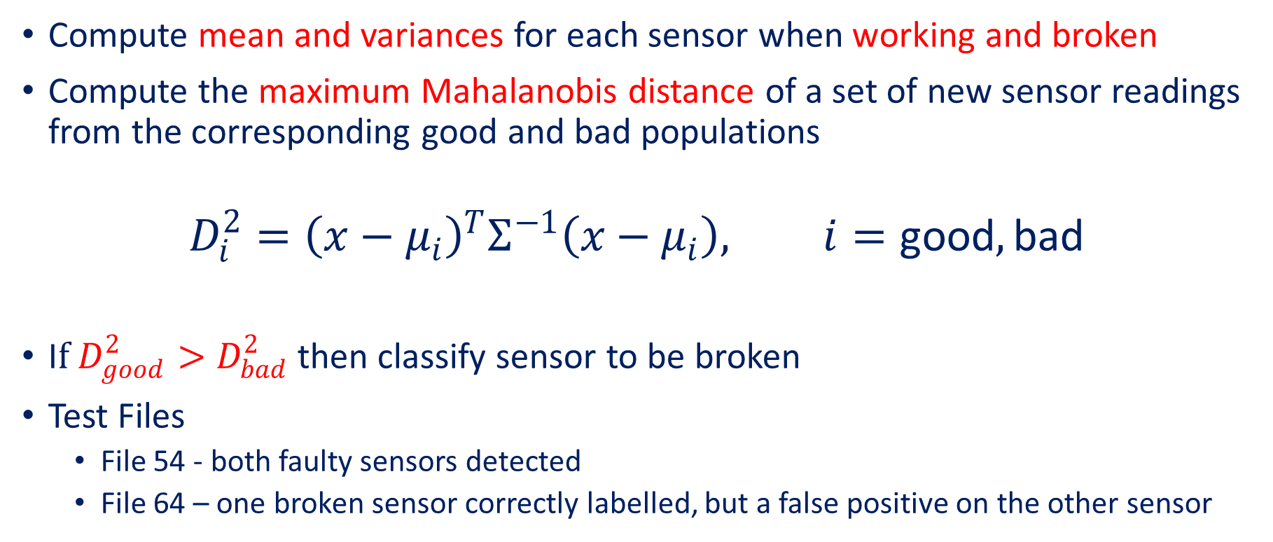
Simple approach
Compute mean and variances for each sensor when working and broken
Compute the maximum Mahalanobis distance of a set of new sensor readings from the corresponding good and bad populations
$$D_{i}^{2}={\left(x−μ_{i}\right)}^{T}Σ^{−1}\left(x−μ_{i}\right), i=\text{good}, \text{bad}$$
I$f D_{good}^{2}>D_{bad}^{2}$ then classify sensor to be broken
Test Files
File 54 - both faulty sensors detected
File 64 – one broken sensor correctly labelled, but a false positive on the other sensor
Anomaly Detection in Test Fields | ITT10 | June 2019
Notes:
Potentially, bad is not a good distribution to calculate- could go wrong in many different ways
Should use some sort of hypothesis testing
No idea how to compare, e.g. in 64 which one is more likely to have broken

Slide 8
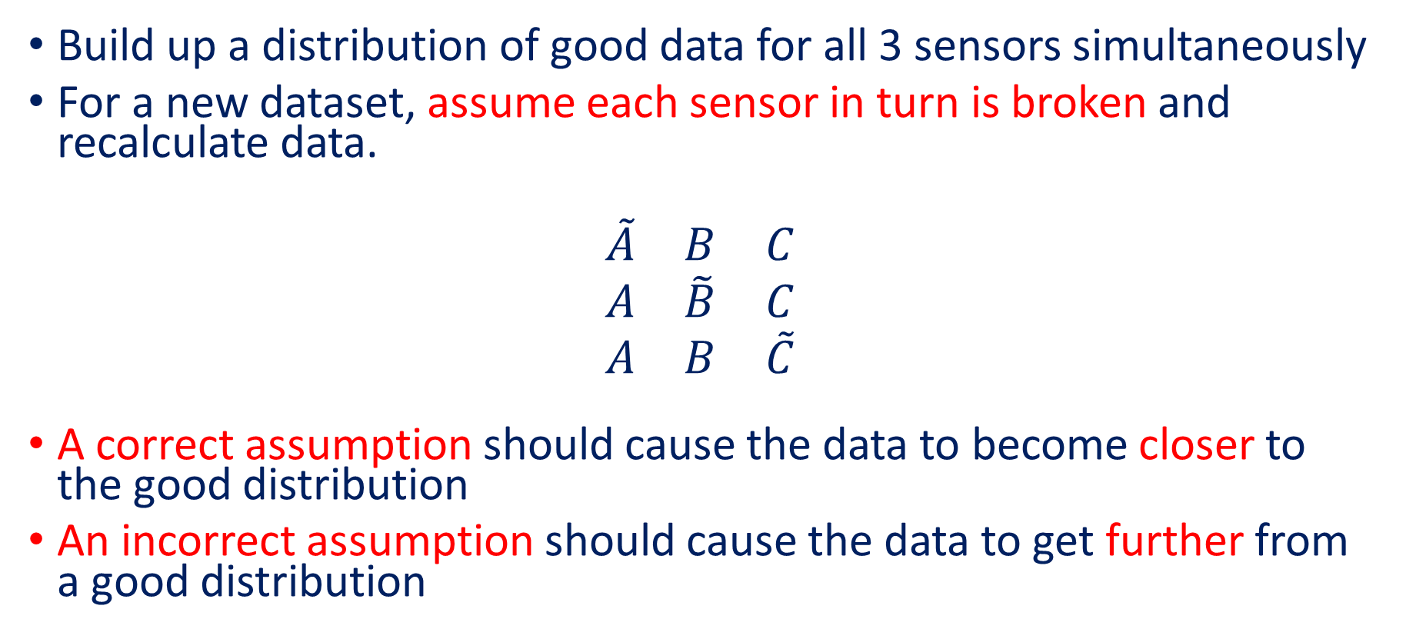
Exciting Idea
Build up a distribution of good data for all 3 sensors simultaneously
For a new dataset, assume each sensor in turn is broken and recalculate data.
$$\begin{matrix}\tilde{A} & B & C \\ A & \tilde{B} & C \\ A & B & \tilde{C}\end{matrix}$$
A correct assumption should cause the data to become closer to the good distribution
An incorrect assumption should cause the data to get further from a good distribution
Anomaly Detection in Test Fields | ITT10 | June 2019

Slide 9
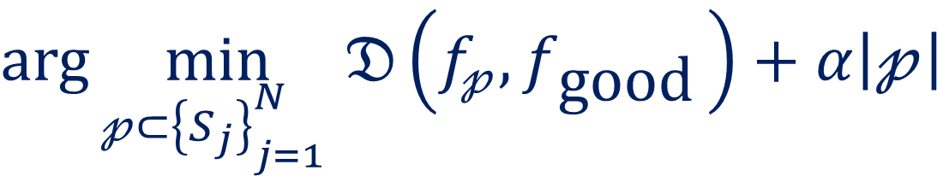
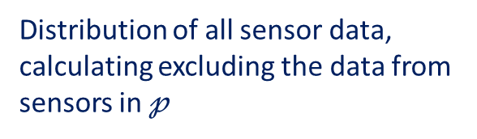
Future Direction
Large number of sensors
More than one sensor can fail at a time
Distribution of all sensor data, calculating excluding the data from sensors in $𝓅$
It is more likely that fewer sensors have failed
$$\arg{\min_{𝓅⊂{\left\{S_{j}\right\}}_{j=1 }^{N}}{𝔇\left(f_{𝓅}, f_{\text{good} }\right)+α\left|𝓅\right|}}$$
Learnt good distribution of all sensors
Distance measure between distributions
Subsets of all sensors.
Anomaly Detection in Test Fields | ITT10 | June 2019
Notes:
Greedy methods
Sequential updating algorithms – change points online setting, machine learning and calculating existing fata from the sensors, on line classification
Time series data??

