Slide 1
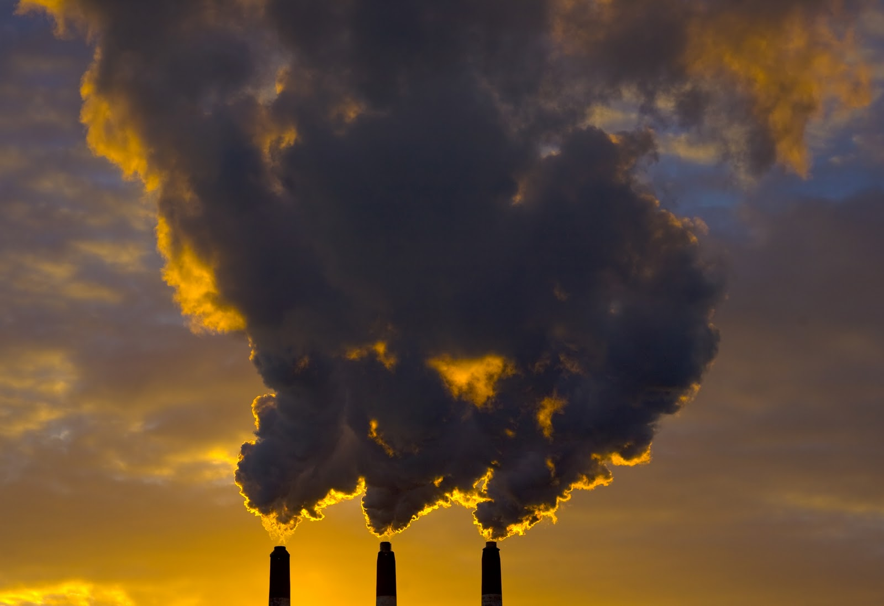
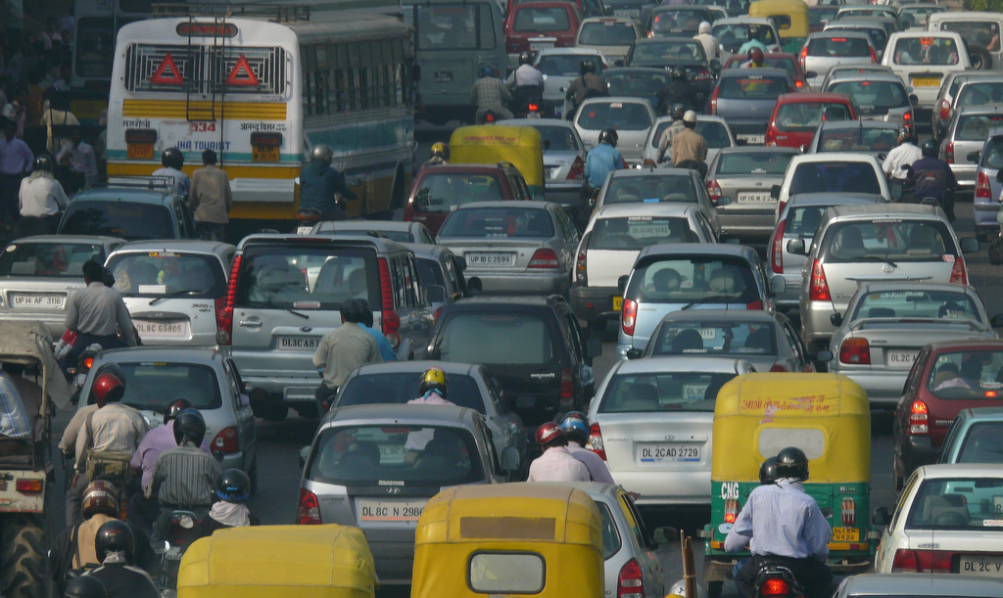

How far in advance can we reliably predict traffic conditions and associated air quality?

Slide 2

: Assemble
AVL problem presented by Gerhard Schagerl
Group:
Elizabeth Arter,
Nick McCullen,
Lizzi Pitt,
Cameron Smith,
Teresa Smith.

Slide 3
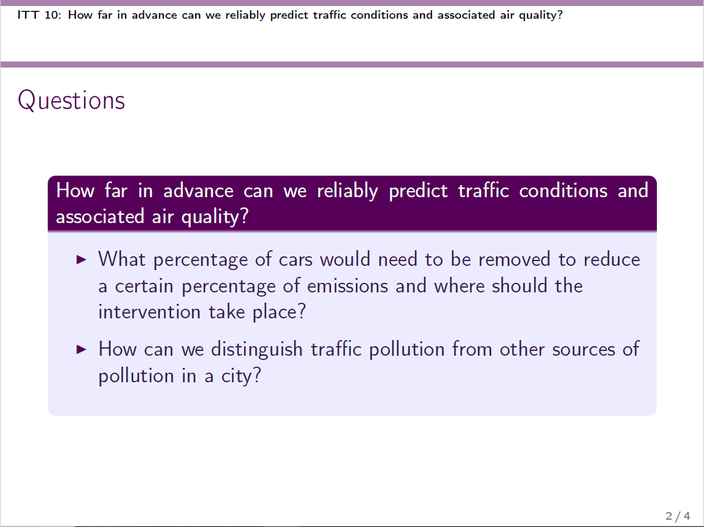
Notes:
Formulation of the problem, recall Lizzi’s slides from Wednesday.

Slide 4
Outline
A not so civil war – The data and its problems.
The guardians of Madrid – Choosing our stations.
The not-quite-infinity war – Predicting pollution.
The endgame – where do we want to end up?
Notes:
Formulation of the problem, recall Lizzi’s slides from Wednesday.

Slide 5
A not so civil war
Minor inconvenience 1:
Los datos y su documentación asociada están en español.
The data and its associated documentation are in Spanish.
Limited knowledge of Spanish.
Minor inconvenience 2:
The data didn’t fit in excel…
Notes:
Formulation of the problem, recall Lizzi’s slides from Wednesday.

Slide 6
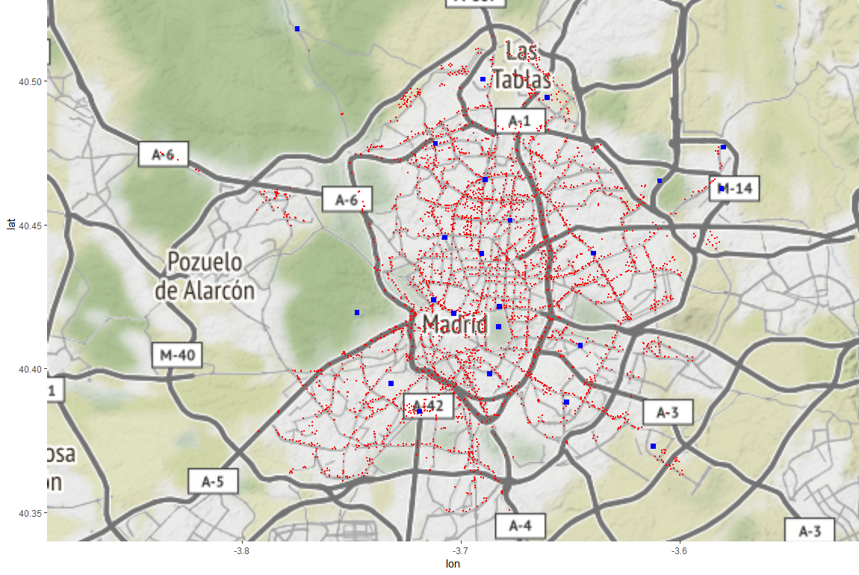
Guardians of Madrid…
Notes:
STEP 1: Clean the data

Slide 7
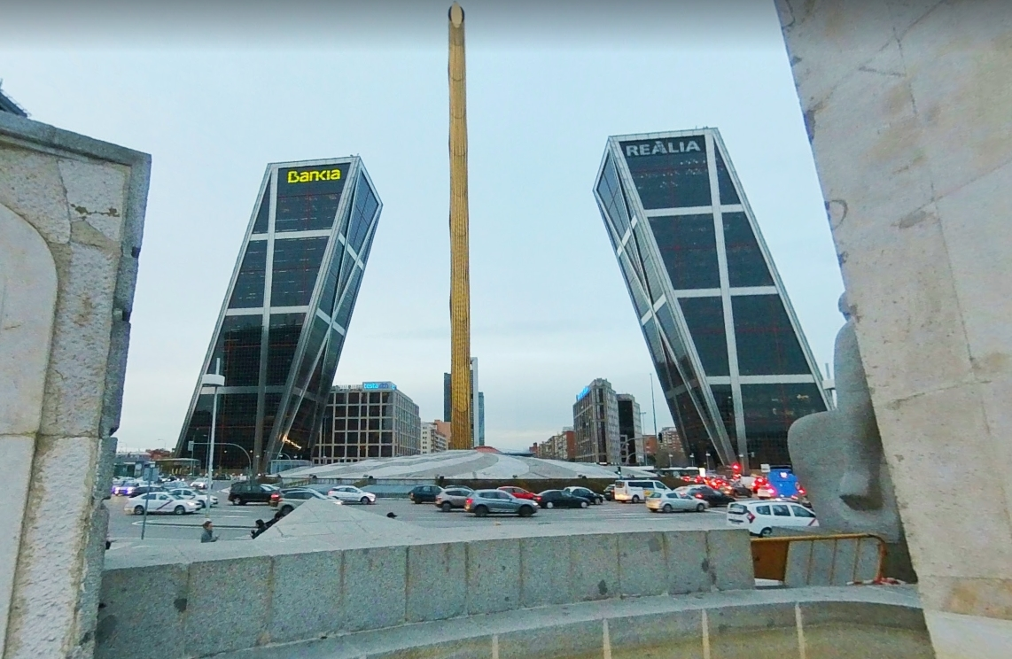
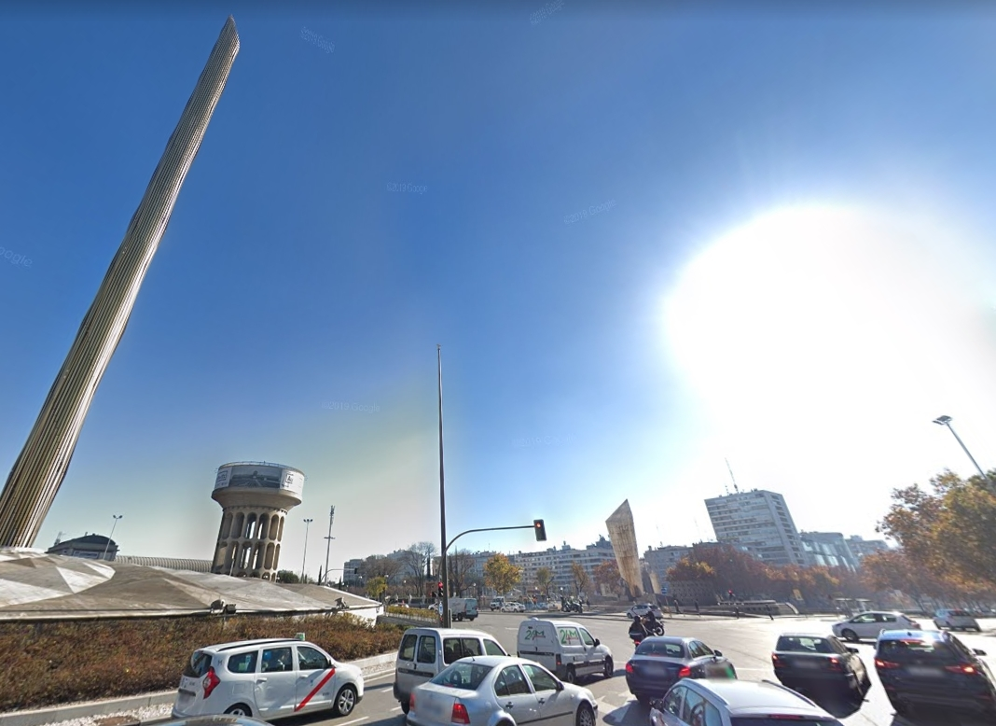
Guardians of Madrid…
La Plaza Castilla
Notes:
STEP 1: Clean the data

Slide 8
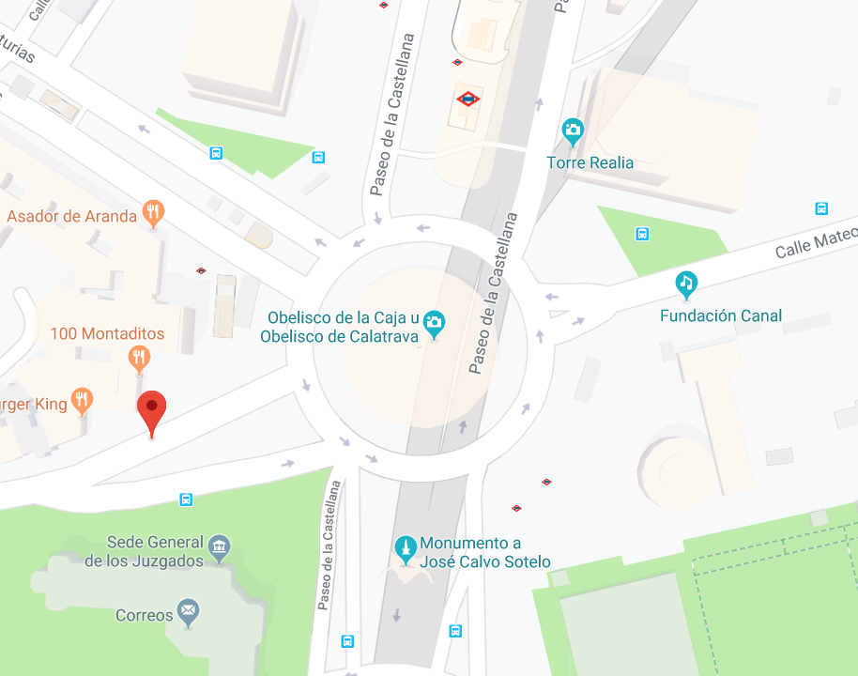
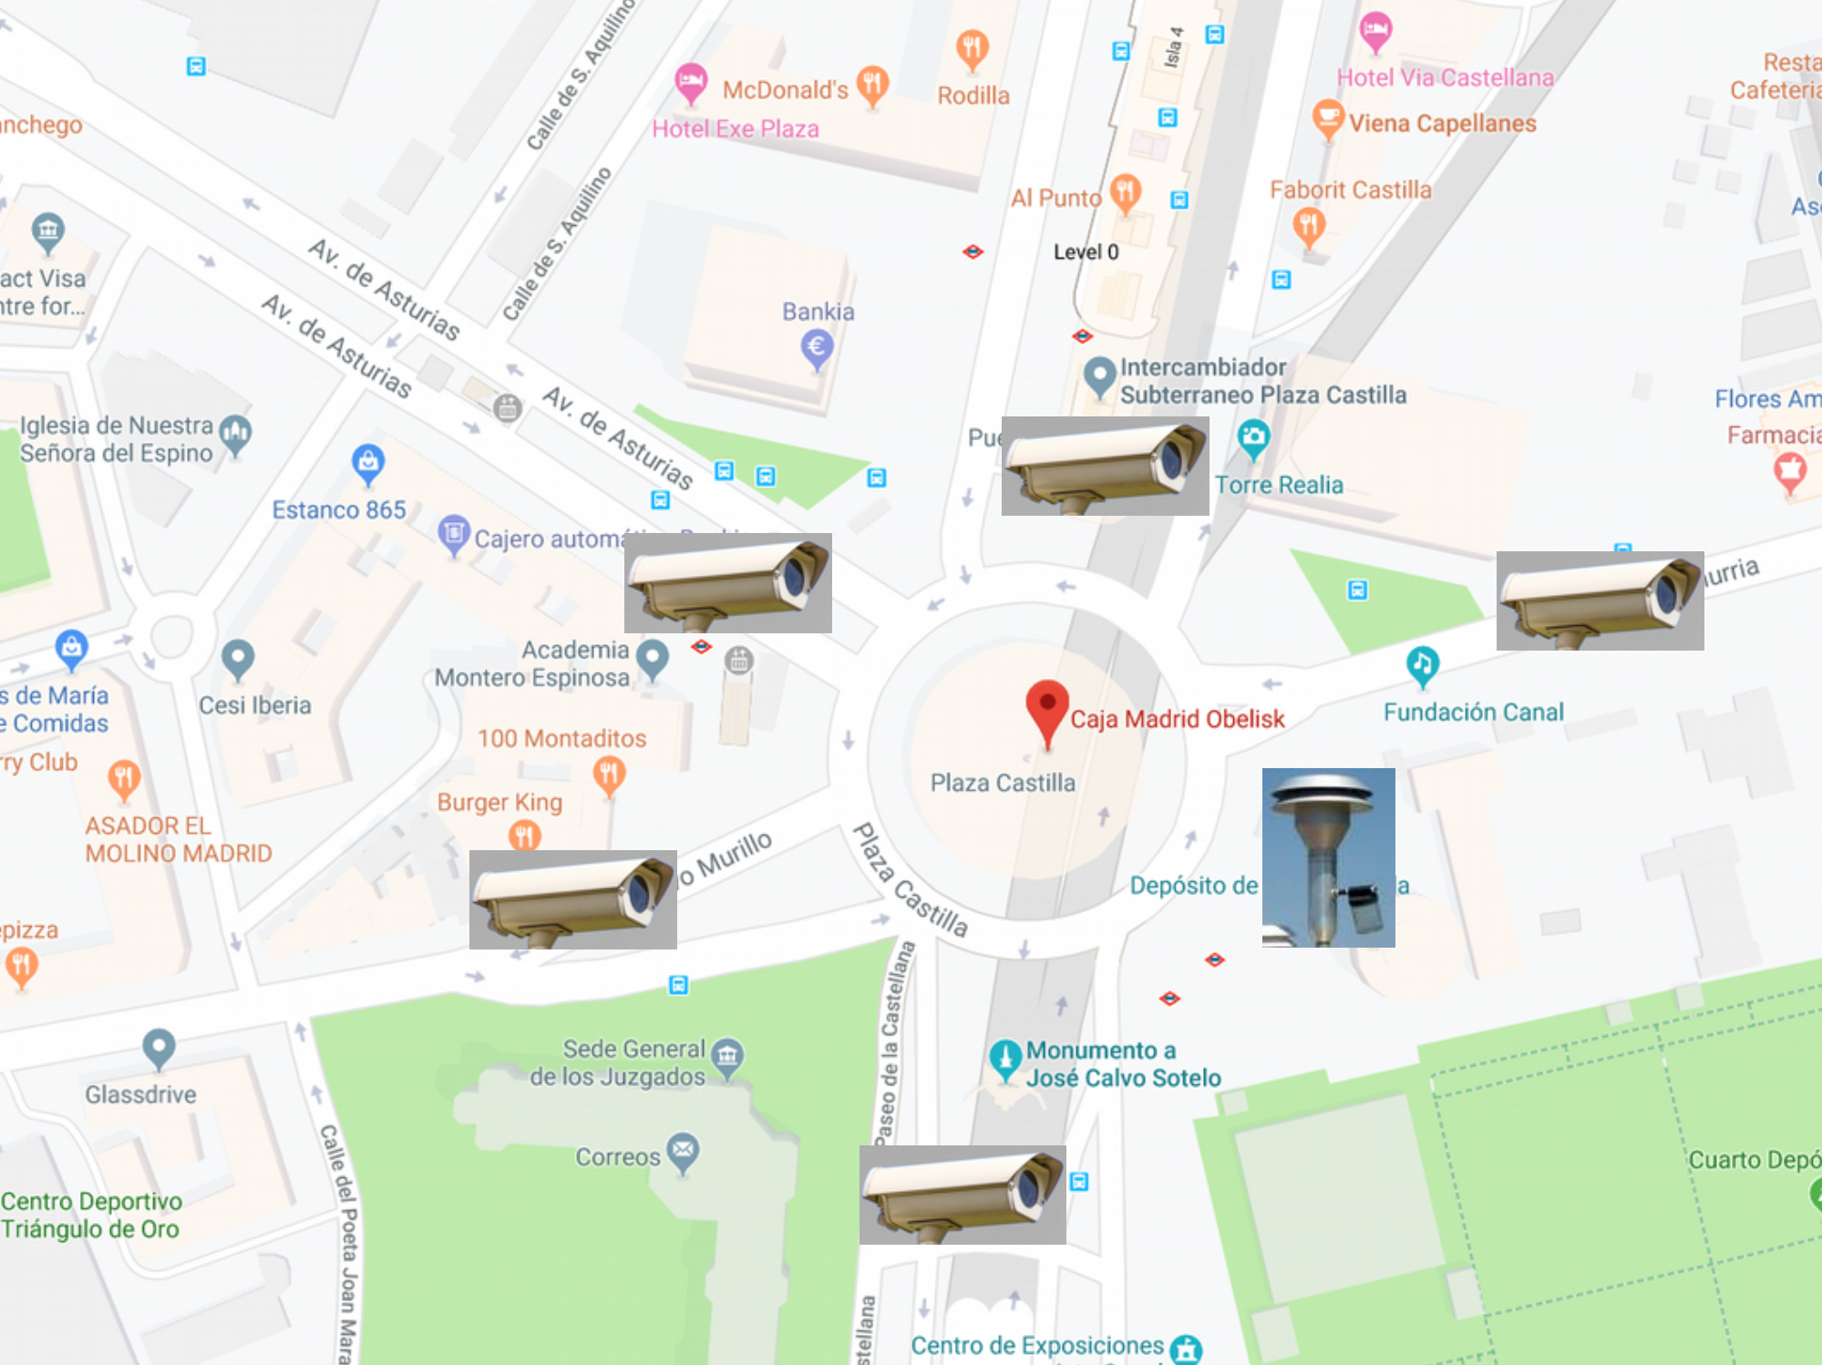
Guardians of Madrid…
La Plaza Castilla
Notes:
STEP 1: Clean the data

Slide 9
The not-quite-infinity war
Data
Single site traffic
Multi site traffic
Data
Air pollution data
Predict air pollution
Predict pollution, multiple traffic
Fleet details
City wide prediction
Weather data
Land use data
Predict traffic patterns
Traffic level data
Combine traffic sensors
Hilliness

Slide 10
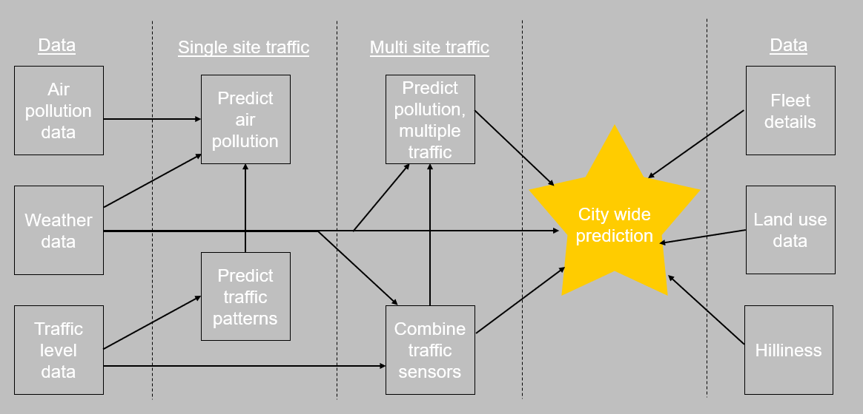
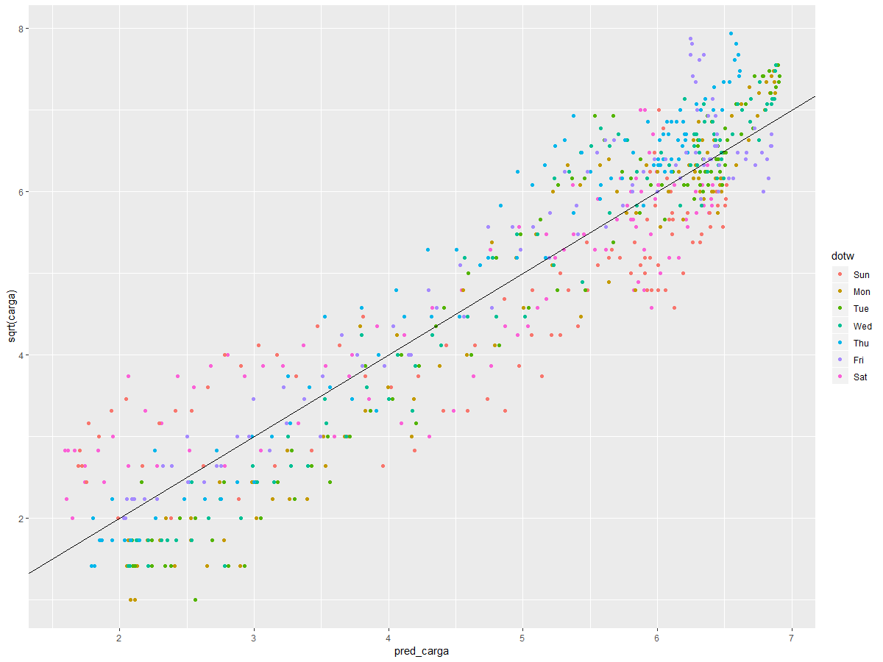
The not-quite-infinity war
Predict traffic using time

Slide 11
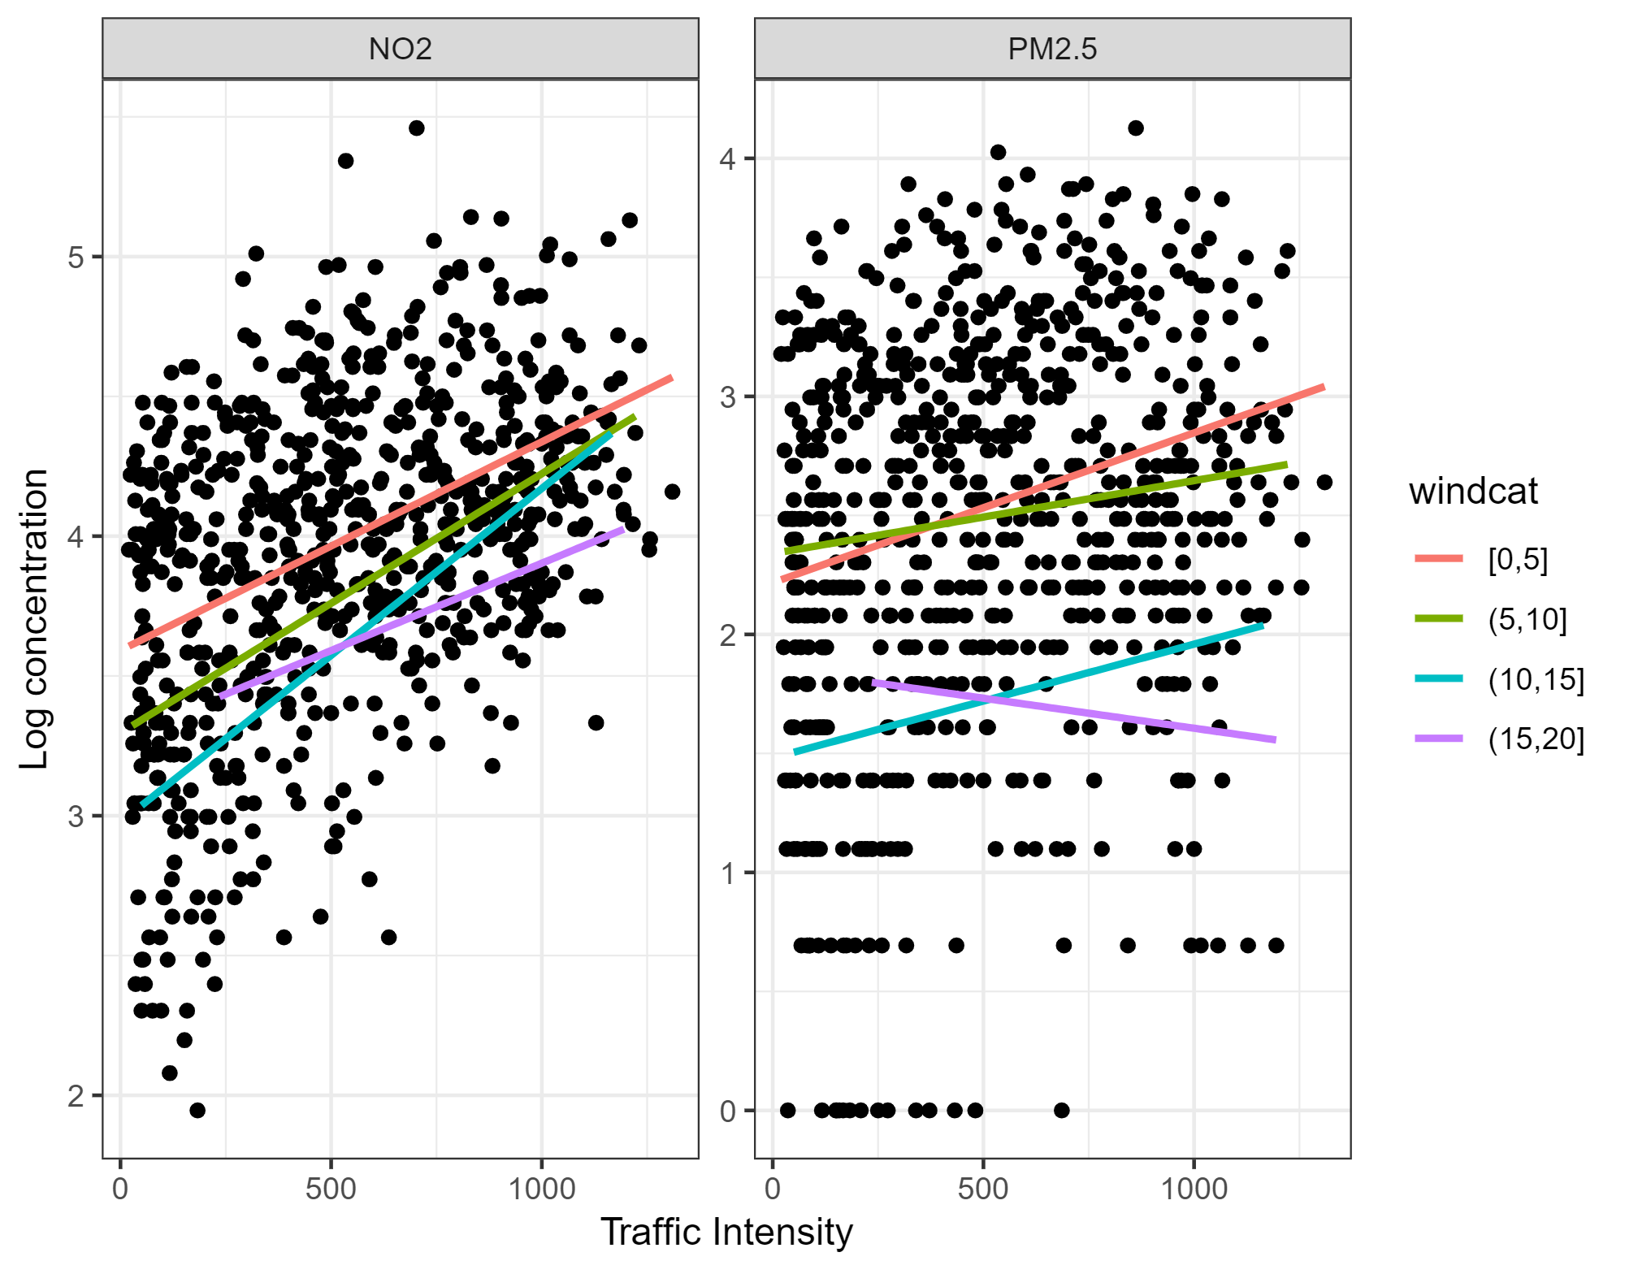
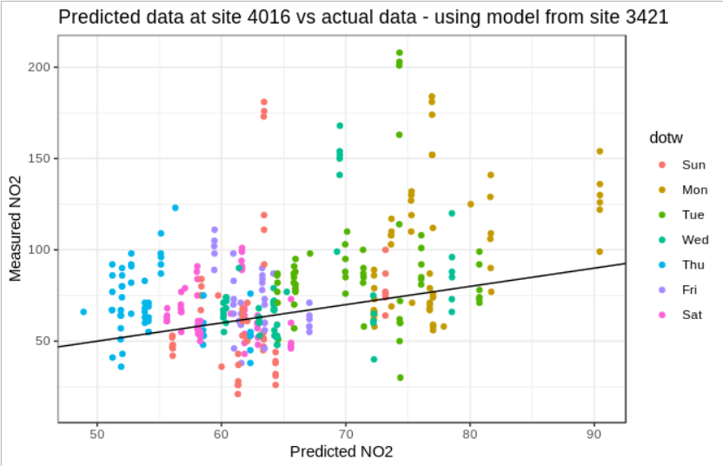
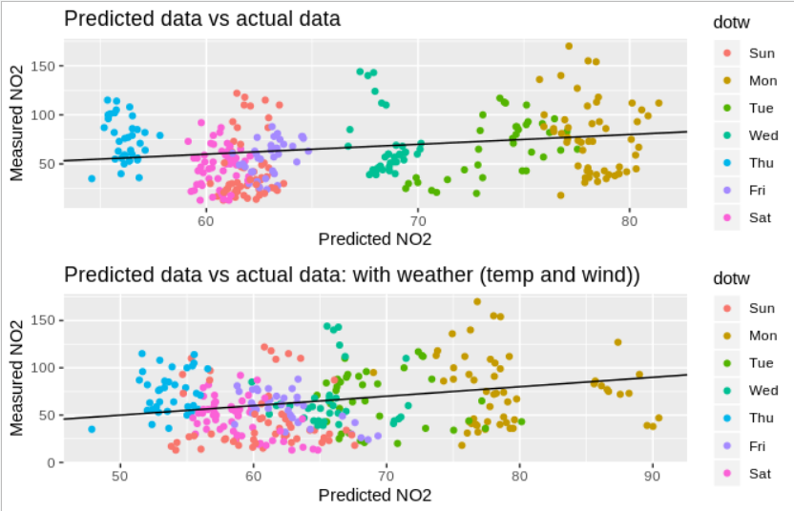
The not-quite-infinity war
Predict pollution using (residuals from) traffic, time and weather

Slide 12
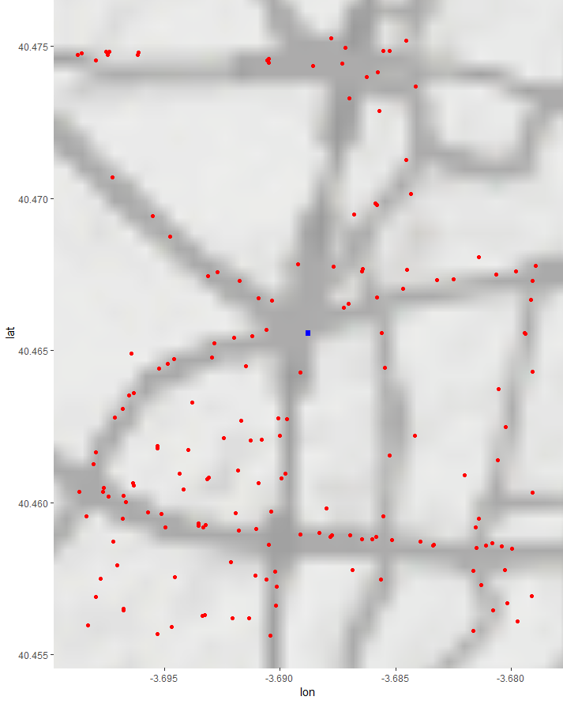

The not-quite-infinity war
How do we pool together multiple traffic sensors?

Slide 13
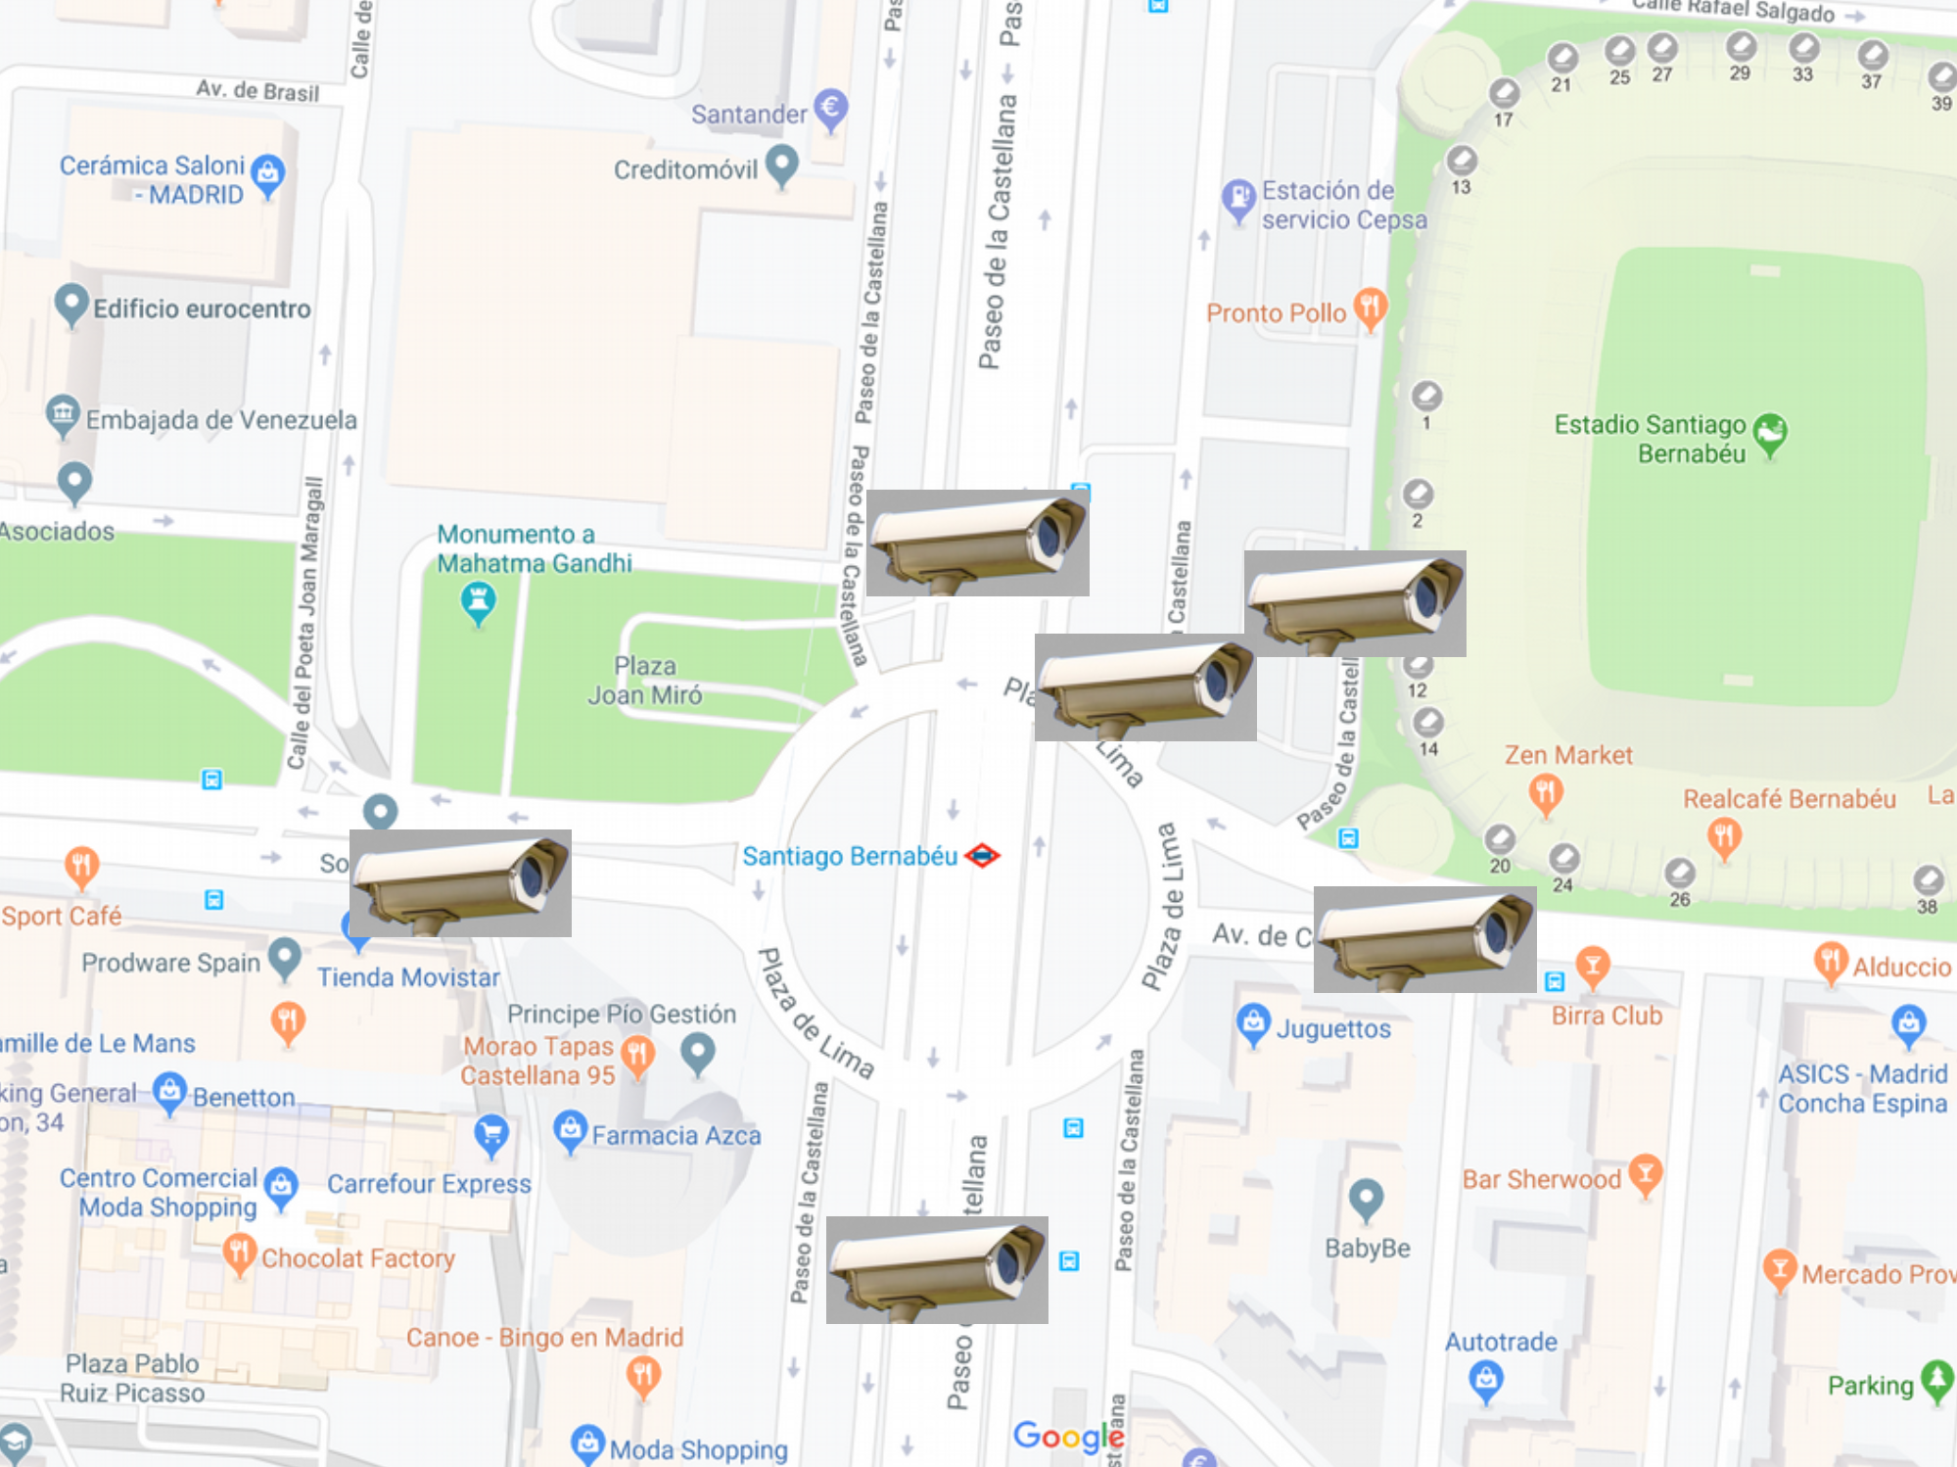
The not-quite-infinity war
How do we model pollution using multiple traffic sensors?

Slide 14
The endgame
Air pollution data
Fleet details
City wide prediction
Weather data
Land use data
Traffic level data
Hilliness

Slide 15
The endgame
Fleet details
City wide prediction
Weather data
Land use data
Air pollution data
Traffic level data
Hilliness

Slide 16
The endgame
Fleet details
City wide prediction
Land use data
Air pollution data
Weather data
Traffic level data
Hilliness

Slide 17
The endgame
City wide prediction
Fleet details
Land use data
Air pollution data
Traffic level data
Weather data
Hilliness

Slide 18
The endgame
City wide prediction
Land use data
Air pollution data
Traffic level data
Weather data
Fleet details
Hilliness

Slide 19
The endgame
City wide prediction
Air pollution data
Traffic level data
Weather data
Land use data
Fleet details
Hilliness

Slide 20
The endgame
City wide prediction
Air pollution data
Traffic level data
Weather data
Land use data
Hilliness
Fleet details

Slide 21
The endgame
City wide prediction
What percentage of cars would need to be removed to reduce a certain amount of emissions and where should the intervention take place?
Can we remove certain types of vehicle as opposed to shutting areas of a city in order to achieve similar reductions?
Can we incorporate the physical air flow in a city to the traffic and pollution models?
Air pollution data
Traffic level data
Weather data
Land use data
Hilliness
Fleet details
How can we distinguish traffic pollution from other sources of pollution in a city?

Slide 22
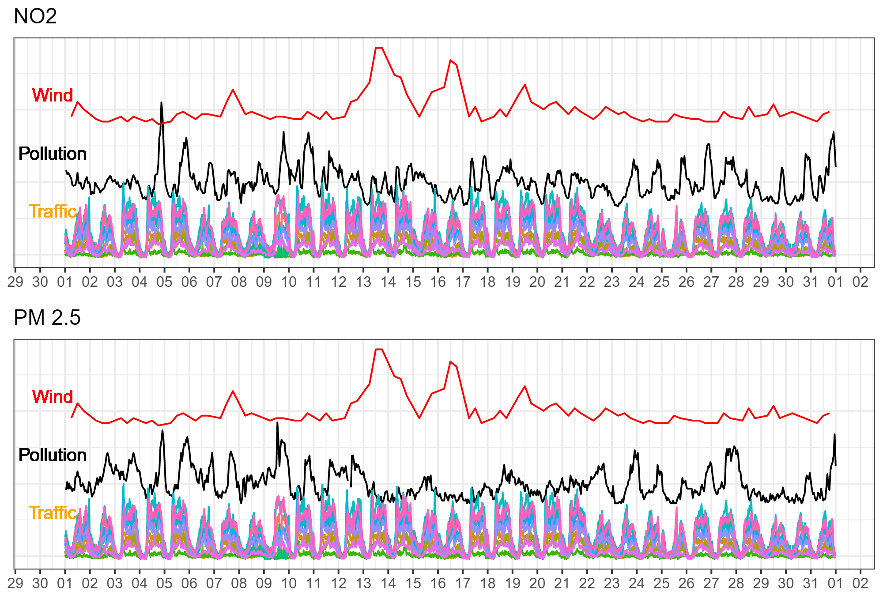
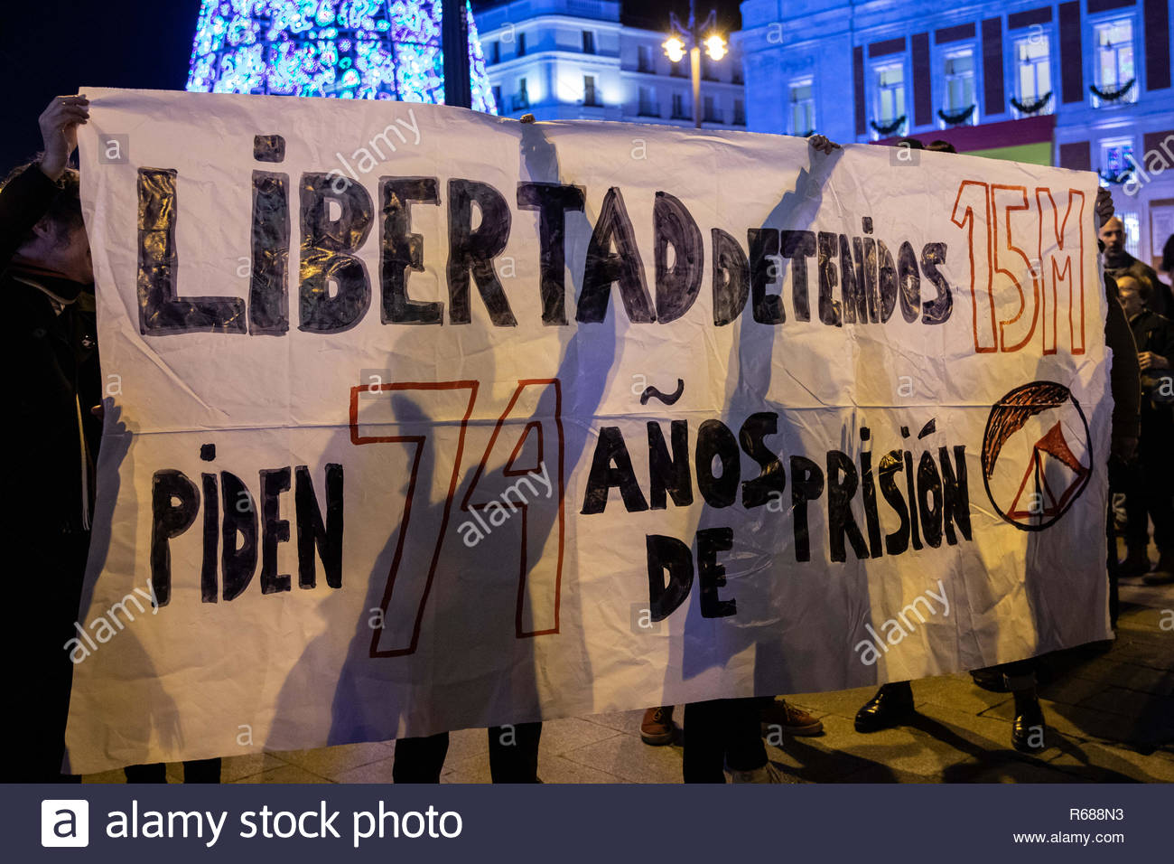
The endgame
City wide prediction
How can we distinguish traffic pollution from other sources of pollution in a city?
Air pollution data
Traffic level data
Weather data
Land use data
Hilliness
Fleet details

Slide 23
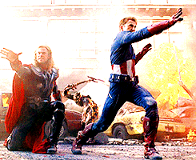
Thank you
Any questions?

