Slide 1
The MASH funding timeline
School liaison initiatives; Faculty of Science funding
Department maths drop-in; Institutional funding
1999
2002
MASH; sigma (HEFCE) funding
MASH; continued institutional funding
2007
2009
2010
2012
HESTEM funding initiatives
Enhanced staffing requests
2013
Full, permanent staffing agreed
2014

Slide 2
The MASH staffing timeline
 | 2007 | 2008 | 2009 | 2010 | 2011 | 2012 | 2013 | 2014 | 2015
Director | pilot | 0.1 | 0.1 | 0.1 | 0.1 | 0.2 | 0.2 | 0.2 | 0.2
Centre Co-ordinator | 0.6 T.T. = 0.4 fte | 0.6 T.T. | 0.6 T.T. | 0.6 T.T. | 0.6 T.T. | 0.6 T.T. | 0.6 T.T. | 0.79 | 0.79
Development officer |  |  |  |  | 0.5 Fixed term | 0.5 Fixed term | 0.6 Fixed term | 0.8 | 0.8
Stats advisory tutor |  | Hourly paid | Hourly paid | Hourly paid | Hourly paid | Hourly paid | Hourly paid | Hourly paid | 0.5
Outreach tutor |  |  |  |  |  | 0.6 | 0.6 | 0.6 | 0.6
Paid student positions
Peer tutors (funded by Dept Math Sci)
Website maintenance & development
Summer interns
Operating budget: £7K per annum
T.T. = term time only

Slide 3
Identify & develop key collaborations
Academic departments
Professional services
Students’ Union

Slide 4
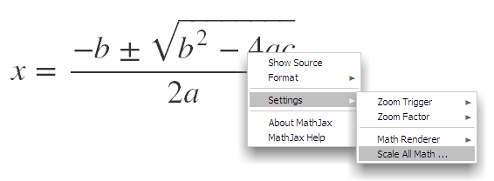
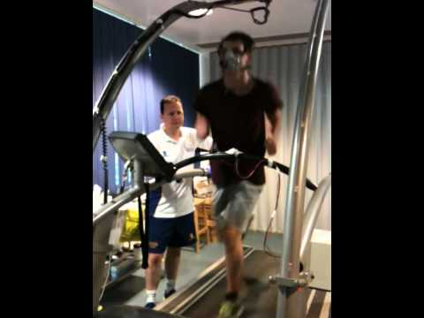
Identify & develop your USP
Mathematics
Accessibility
Pre- and post- entry
Mathematics support for
vocational qualification
entry students

Slide 5
Vision
Determination
Patience
Take opportunities
Exploit talent
Maintain coherence
Develop institution-wide engagement
Be knowledgeable

