Slide 1



  Diagnostic Testing for the Mathematical Sciences
Maths Café Team
Department of Mathematics
University of Portsmouth

Slide 2
  The Practicalities of Setting up Large Scale Testing
  (Effective) Support Following the Testing

Slide 3
Rational for Diagnostic Testing
Entry to Unit
Evidence for staff and student
Pre Entry assessment for Student

Slide 4
History
Maths Café – inaugurated in September 2002
2002/03 - Faculty of Technology L & T Committee
  addressing decline in entry level maths skills
diagnostic mathematical testing of all first year
students in the Faculty
FL&T Strategic Plan 2003/04
coordinated by the Maths Café

Slide 5
The Practicality of Setting up
Large Scale Diagnostic Testing
School of Computing & Creative Technologies
Dept. Of Electronic and Computer Engineering
Department of Mathematics
Dept. of Mechanical and Design Engineering
Third year entry and Masters International students
School of Biology
800 students approx

Slide 6
Previous Experience from early 1990’s
Computing
  Diagnostic Testing
      paper based and windows based
Mathematics
  Computer Based Learning
      Calmat, Mathletics, Mathwise, Transmaths
  Diagnostic Testing
      Mathletics for Algebra and Calculus

Slide 7
Software Considered
  Mathletics
  Calmat
  Diagnosys
  Questionmark Perception

Slide 8
Software Chosen
Perception
  Computing
  already had numerous questions since 2001
Calmat
  Rest
  Easy to set up
  70 diagostic questions available
  Results linked to Learning Plans
  No need for pre registration of students

Slide 9
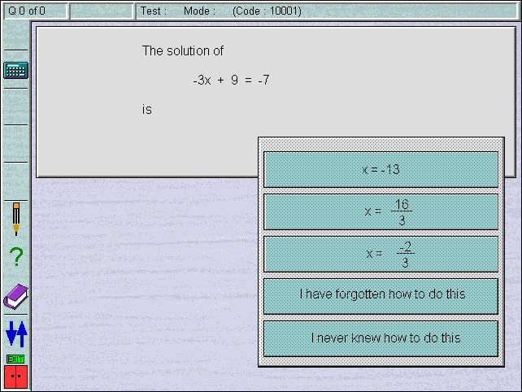
Calmat Diagnostic Test Question

Slide 10
Diagnostic Test Procedures
  Academic assigned to each department
  Questions from software selected
  Tests created and tested
  Sessions booked in Induction week
  Working with Induction coordinators
  Invigilator Instruction Sheets created
  Student Instruction sheets created

Slide 11
Delivery of Diagnostic Tests
  Students put at ease
  Positive reaction of students
  Result given at end of assessment
  Students review Learning Plans
  Publicity for Maths Café

Slide 12
Calmat Learning Plan
Revision Plan for DWS from Diagnostic test "bioldiag1" Date: 28/11/2003
You scored 26 out of 30 (87%)
Below is a breakdown of this mark and suggested revision material.
--------------------------------------------------------------------------------
Question 1 : Multiply two fractions in arithmetic Status : correct
Level 1 Lesson 5 Section c Tutorial 1
Q0276
--------------------------------------------------------------------------------
Question 2 : Add two fractions in arithmetic Status : wrong
Level 1 Lesson 13 Section f
Q0303
--------------------------------------------------------------------------------

Slide 13
Maths Café Activities Linked
to Diagnostic Tests
  Maths Individual Learning Plans
  Encouraging students to seek help
  Maths Café Centre Topic Workshops
  Diagnostic Learning plans at all Maths Café venues
  Seminars on key topics

Slide 14
Subject Review of Diagnostic Tests
  Results sent to lecturers
  Statistics produced
  Follow up by departments

Slide 15
Subject Review of Diagnostic Tests
School of Computing
Department of Mathematics
Dept. of Mechanical and Design Engineering
School of Creative Technologies
Dept. Of Electronic and Computer Engineering
Third year entry and Masters International students
School of Biology

Slide 16
Dept. of Mechanical and Design Engineering
Results for Tech Concepts
at the end of Semester One
Mean for students who attended (75%) maths
51.7%
Mean for students who attended maths and sat diagnostic test
51.9%
Mean diagnostic score for those attending 41.5%
An increase of 10.4% on diagnostic score

Slide 17
Dept. of Mechanical and Design Engineering
Comparison group-did not attend maths
Mean for students not-attending Maths
46.3%
Mean for students not-attending who sat a diagnostic test 58.2%
Mean diagnostic score for those not attending
66.3%
a decrease of 8.1% on diagnostic score

Slide 18
Dept. of Mechanical and Design Engineering
Graph to show Tec-Con Sem 1 score (x axis) against diagnostic score (y axis)
Attending
  Non-Attending

Slide 19
Subject Review of Diagnostic Tests
School of Creative Technologies
Dept. Of Electronic and Computer Engineering

Slide 20
Subject Review of Diagnostic Tests
Third year entry and Masters International students
School of Biology
  Same diagnostic test run at the end of the semester
  Statistics to show change

Slide 21
Biology crct wrng frgt nver nota
1 Apply multiplication law with positive indices 100 58 10 1 0
2 Multiply two fractions in arithmetic 111 32 24 1 1
3 Add two fractions in arithmetic 101 45 22 0 1
4 Round to two decimal places 159 8 0 0 2
5 Convert wavelengths to standard form 49 92 17 9 2
6 Express a difference as a percentage 63 100 3 0 3
7 Convert a number to standard form 85 61 15 5 3
8 Substitute and evaluate a simple expression 130 35 1 0 3
9 Use power rule for indices 67 89 9 1 3
10 Multiply two brackets 94 19 50 3 3
11 Simplify an algebraic expression containing brackets 64 45 53 4 3
12 Solve a linear equation 122 25 15 4 3
13 Find the equation of the straight line through (0,a)&(b,0) 25 34 79 28 3
14 Solve two simultaneous linear equations 88 15 60 3 3
15 Use functional notation 81 10 38 37 3
16 Solve a quadratic with integer roots 42 35 76 13 3
17 Solve a quadratic equation using formula 24 15 110 17 3
18 Give the value of ln(e) 38 40 19 69 3
19 Subtract two integers, at least one negative 142 21 1 2 3
20 Solve an equation with unknown in exponent 79 17 47 23 3

Slide 22
Response Profiles

Slide 23
Question Profiles

Slide 24
Biology Follow-up

Slide 25
Biology Follow-up
N Mean StDev SE Mean 95.0% CI
61 14.04 11.29 1.45 ( 11.15, 16.94)

Slide 26
Pre Entry assessment for Student
  Head’s Challenge
  PrepUP
  MapleTA Testing
  Pre-entry Quiz
  http://ictmt10.org/

Slide 27
Mathematical Growth during the Noughties

Slide 28
Diagnostic Testing
Sound Preparation
Smooth Delivery
Effective Support to Staff & Students
  Pre
  During
  Post
      most difficult & most important
Review
Future Software

Slide 29
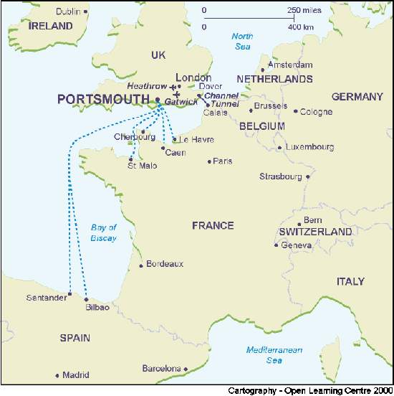
First Announcement
ICTMT-10
10th ANNIVERSARY
CONFERENCE
Come and celebrate the
10th International Conference
on Technology in Mathematics
Teaching
Tuesday July 5th to
Friday July 8th 2011
University of Portsmouth, UK
  http://ictmt10.org/

